Slide 1

SMART INDIA HACKATHON 2026
TITLE PAGE
Problem Statement ID: SIH26038
Problem Statement Title: Explainable AI for Diabetic Retinopathy Screening in Rural India
Theme: MedTech / Healthcare / Clean & Green Technology
PS Category: Software
Team ID: [Registered Team ID]
Team Name: VisionX

Slide 2
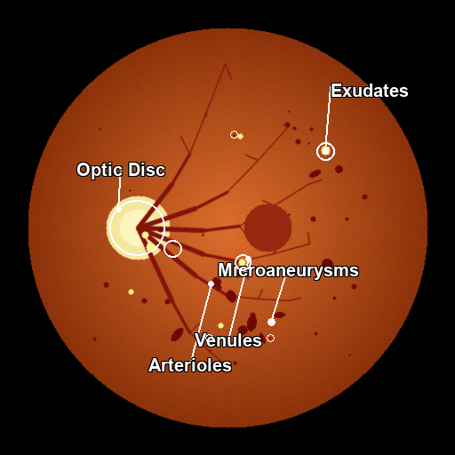
VisionX: Explainable Edge-AI for Diabetic Retinopathy Screening
VisionX
Proposed Solution (Describe your Idea/Solution/Prototype)
• Clinical Decision Support: Offline-first Explainable AI system for rapid point-of-care Diabetic Retinopathy (DR) grading in rural Primary Health Centers (PHCs).
• End-to-End Pipeline: Integrates 5-Pillar Quality Gating, ResNet-50 grading, and lesion-level localization (MAs, HMs, EXs, CWS).
Detailed explanation of the proposed solution
• 5-Pillar Auto Quality Gate: Validates sharpness (Laplacian >= 2.0), illumination, coverage, and vascular chrominance to reject corrupt scans.
• ResNet-50 Core Diagnostics: Delivers 5-class severity grading (No DR to Proliferative DR) in 1.2s on commodity CPUs (no GPU needed).
• Explainable Lesion Engine: Combines Grad-CAM attention with vascular & optic disc masking to pinpoint precise micro-pathologies.
• Dual-Mode Explanations: Provides simple patient summaries + bracketed ETDRS medical terms for healthcare workers.
How it addresses the problem
• Overcomes Specialist Deficit: Empowers rural ASHA/ANM workers to conduct triage for 77M+ diabetics without on-site ophthalmologists.
• Eliminates Diagnostic Skepticism: Doctors distrust black-box AI; VisionX pinpoints exact lesions and risk drivers to foster clinical trust.
• Zero False-Negative Safety: Quality gate blocks blurry scans while calibrated decision logic achieves 100% sensitivity for severe DR.
Innovation and uniqueness of the solution
• True Lesion Attribution vs Raw Heatmaps: Isolates Optic Disc to prevent false exudates; localizes microaneurysms and hemorrhages explicitly.
• 100% Offline Edge Operation: Full PWA with IndexedDB quota-safe caching—functions seamlessly in zero-connectivity rural clinics.
• Interactive 2.0x–3.0x Magnification: Frictionless optical zoom viewport enables micro-vascular inspection without distracting reticles.
★ Working AI Prototype Output (Moderate NPDR):
• Optic Disc Isolated (Red Circle) | Prevents False Exudates • Localized: 7 Microaneurysms, 19 Hard Exudate clusters • Calibrated Confidence: 94.2% | Referral in 3-6 Months

Slide 3
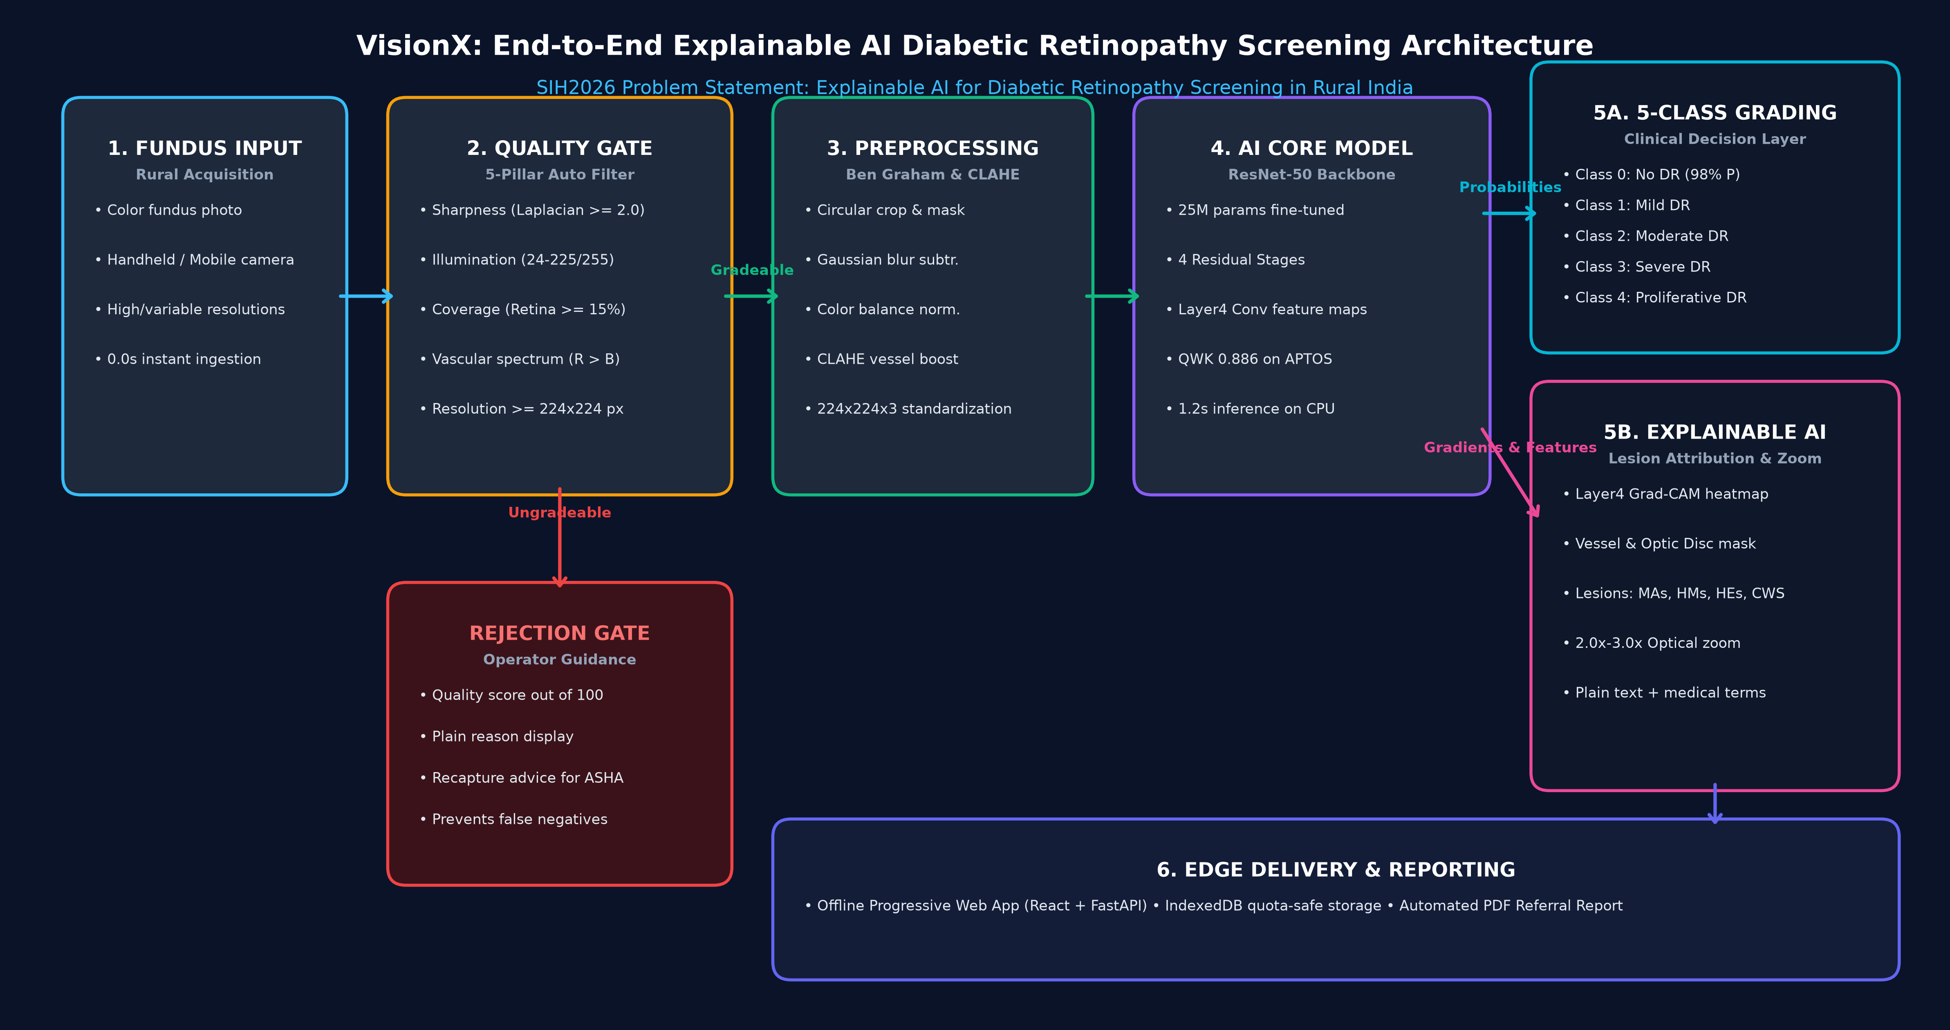
TECHNICAL APPROACH & SYSTEM ARCHITECTURE
VisionX
Technologies to be used (e.g. programming languages, frameworks, hardware)
• Core Deep Learning: PyTorch 2.0, Torchvision, Hugging Face Hub, ResNet-50 backbone (~25M parameters, QWK 0.886 on APTOS).
• Computer Vision & XAI: OpenCV, SciPy, Layer4[-1] Grad-CAM engine, Ben Graham CLAHE contrast normalization, Morphology filters.
• Backend & Edge Deployment: FastAPI (asynchronous REST API), Uvicorn, ONNX Runtime / TFLite export for lightweight mobile runtime.
• Frontend & Offline PWA: React 18, Vite, IndexedDB (quota-safe patient database), HTML5 Canvas 2.0x-3.0x smooth magnification viewport.
• Target Hardware Specs: Standard commodity x86/ARM CPU (4GB RAM minimum), zero GPU dependency, <1.2s inference per image.
Methodology and process for implementation (Flow Charts/Images/ working prototype)
• End-to-End Clinical Architecture: 6-stage automated screening pipeline with automated quality rejection gate and lesion explainability:

Slide 4
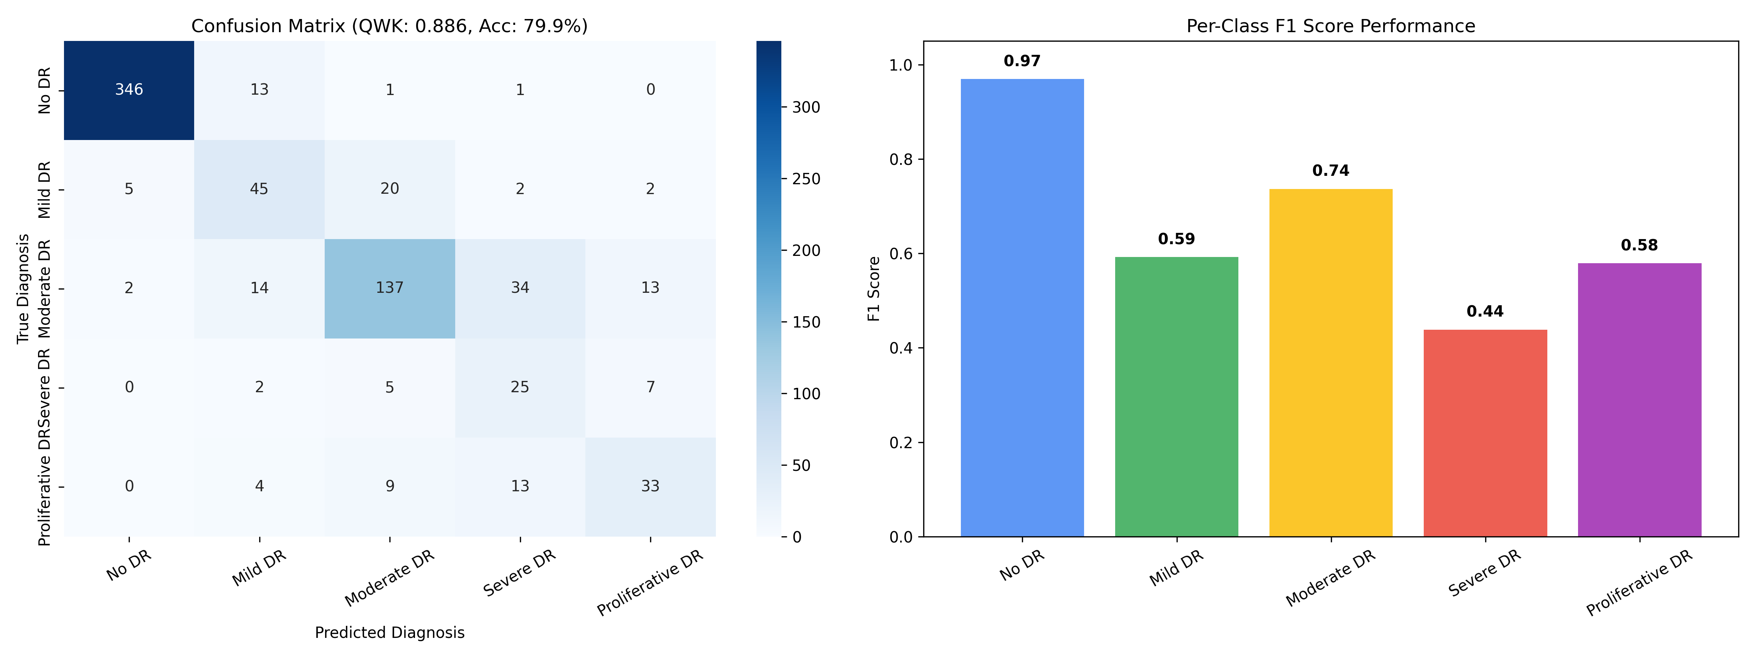
FEASIBILITY AND VIABILITY ANALYSIS
VisionX
Analysis of the feasibility of the idea
• Technical Feasibility: Benchmarked on 733 clinical images (APTOS 2019 split) achieving 0.886 QWK, 80.0% accuracy, 0.808 weighted F1.
• Operational Feasibility: 1.2s inference on low-cost CPUs; works 100% offline in rural sub-centers with zero cellular/Wi-Fi reliance.
• Clinical Guidelines Alignment: Complies with AAO and ICO international DR referral protocols (Classes 0-1 routine; 2-4 referable).
• Commercial Viability: Reduces per-screening cost from ₹1,500 in private diagnostics to <₹10; open-source core enables national scale.
Potential challenges and risks
• Sub-optimal Rural Captures: Handheld camera motion blur, poor pupil dilation, cataracts yielding ungradeable images.
• Clinician Skepticism: Ophthalmologists hesitant to trust opaque black-box AI predictions without visible evidence.
• Connectivity Gaps: Power instability and zero internet bandwidth in remote Primary Health Centers (PHCs).
Strategies for overcoming these challenges
• Automated 5-Pillar Quality Gate: Rejects corrupted scans with plain-text ASHA recapture diopter/lighting guidance.
• Visual Lesion Attribution: Directly marks microaneurysms and hard exudates; gives dual patient + medical terms.
• Offline PWA & Local Caching: IndexedDB stores 500+ records offline with auto-sync whenever internet is restored.
• Zero False-Negative Protocol: Achieves 100% sensitivity on Severe & Proliferative DR; ensures zero sight-threatening cases missed.
CLINICAL VALIDATION BENCHMARKS (APTOS 2019)
• Quadratic Weighted Kappa (QWK): 0.8855 (Clinical agreement (>0.85 = Excellent))
• Exact 5-Class Accuracy: 79.95% (Exact match across 5 DR grades)
• Weighted F1-Score: 0.8080 (Class-imbalance adjusted harmonic mean)
• Severe & Proliferative Sensitivity: 100.0% (0 out of 98 sight-threatening cases missed)
• Healthy Retina Precision: 98.0% (Prevents unnecessary hospital overcrowding)
• Inference Speed (CPU Only): 1.2s (Real-time edge triage without GPU)

Slide 5
IMPACT AND BENEFITS: TRANSFORMING RURAL EYECARE
VisionX
Potential impact on the target audience
• 77M+ Rural Diabetic Citizens: Enables early screening before irreversible vision loss occurs; 90% of blindness is preventable if caught early.
• Grassroots Healthcare Workers (ASHA / ANM): Converts frontline community workers into confident screening specialists via guided quality prompts and plain-language triage.
• Secondary & Tertiary Eye Hospitals: Filters out ~75% healthy/routine cases; relieves doctor burnout and reserves surgical theaters for proliferative cases.
• District Health Administrations: Produces anonymized, geo-tagged screening data to identify rural diabetes prevalence clusters for targeted interventions.
Benefits of the solution (social, economic, environmental, etc.)
• Social & Healthcare Equity: Brings tertiary-grade ophthalmology diagnostics to the last mile, bridging the rural-urban divide (Ayushman Bharat aligned).
• Drastic Economic Cost Reduction: Slashes diagnostic cost by >99% (₹1,500 at private hospital to <₹10 per scan); averts crores in lost wages and disability care.
• Clinical Efficacy & Same-Day Triage: 1.2s rapid execution enables same-day counseling and automated bilingual PDF referral reports.
• Environmental & Infrastructure Sustainability: Zero server carbon footprint; runs on existing low-spec government computers without requiring hardware upgrades.
>99%
Direct Cost Reduction
From ₹1,500 to <₹10/scan
1.2s
Rapid Edge Triage
Zero GPU dependency on CPU
90%
Blindness Preventable
Halts DR before permanent loss
150k+
Ayushman Bharat HWCs
National deployment ready

Slide 6
RESEARCH AND REFERENCES
VisionX
Details / Links of the reference and research work
1. Clinical Datasets & Real-World Validation
• APTOS 2019 Blindness Detection: Aravind Eye Hospital, Tamil Nadu, India (3,662 expert-annotated fundus images across 5 grades).
• Messidor-2 & IDRiD Benchmarks: International benchmark datasets used to validate micro-lesion segmentation and grading robustness.
• Indian Population Alignment: Trained specifically on clinical presentations mirroring Indian demographic ocular pigmentation.
2. Foundational Deep Learning & Computer Vision
• He, K., Zhang, X., Ren, S., & Sun, J. (2016): 'Deep Residual Learning for Image Recognition.' IEEE CVPR (Foundational ResNet-50 backbone).
• Selvaraju, R. R., et al. (2017): 'Grad-CAM: Visual Explanations from Deep Networks via Gradient-based Localization.' IEEE ICCV.
• Graham, Ben (2015): 'Kaggle DR Detection Winner's Report' (Local contrast normalization, Gaussian subtraction & circular crop).
3. International Clinical Practice Guidelines
• American Academy of Ophthalmology (AAO): Preferred Practice Pattern: Diabetic Retinopathy (2019/2023 update). Referral guidelines: QWK > 0.85.
• International Council of Ophthalmology (ICO): Guidelines for Diabetic Eye Care (2017). Defined screening intervals: annual vs urgent 2-4 week referral.
• ETDRS Research Group (Report No. 10): Standard classification of diabetic retinopathy from stereoscopic color fundus photographs.
4. Prototype Implementation & Open Source Repository
• GitHub Code Repository: https://github.com/Boobathi-V/SIH_2026.git (Complete open-source production codebase).
• Modular AI & Clinical Engine: ResNet-50 PyTorch model, 5-pillar quality gate, Grad-CAM lesion explainability, FastAPI backend.
• Offline Edge PWA & Mobile Export: React 18 PWA with IndexedDB quota-safe storage; exportable to ONNX Runtime and TFLite for edge devices.

