Slide 1

SMART INDIA HACKATHON 2026
Problem Statement ID -SIH26038
Problem Statement Title - Explainable AI for
DiabeticRetinopathy Screening in Rural India
Theme - MedTech / Clean and green technology
PS Category- Software
Team ID - P62
Team Name - visionX

Slide 2
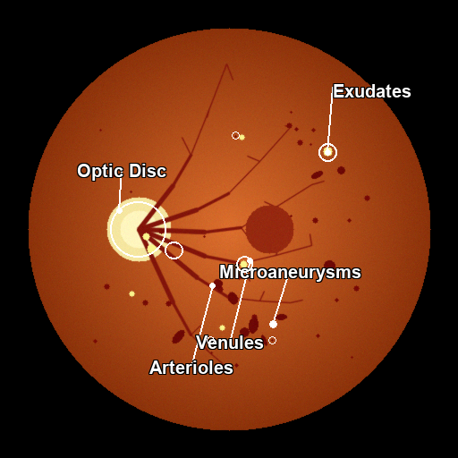
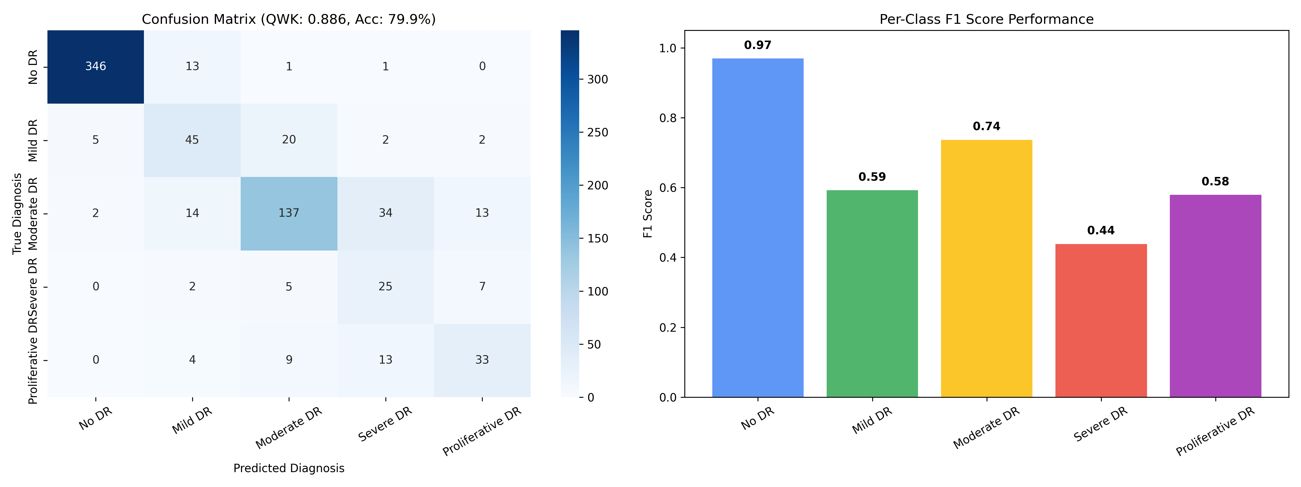
RetinaCare AI – Explainable Diabetic Retinopathy Screening for Rural India
visionX
SOLUTION
PROTOTYPE
VisionX is an offline, edge-first CDSS that brings explainable DR screening to rural PHCs — without cloud GPUs or continuous internet.
01
5-PILLAR QUALITY GATE
Rejects blur, bad exposure, low coverage and non-retinal images before AI inference.
02
1.2s EDGE INFERENCE
ResNet-50 grades 5 DR severity classes on standard CPU hardware.
03
LESION-LEVEL XAI
Grad-CAM + optic-disc isolation + lesion localization shows the visual evidence.
Grad-CAM + lesion callouts
04
CLINICAL SAFETY
Calibration preserves severe/PDR predictions to protect against critical misses.
?

Slide 3
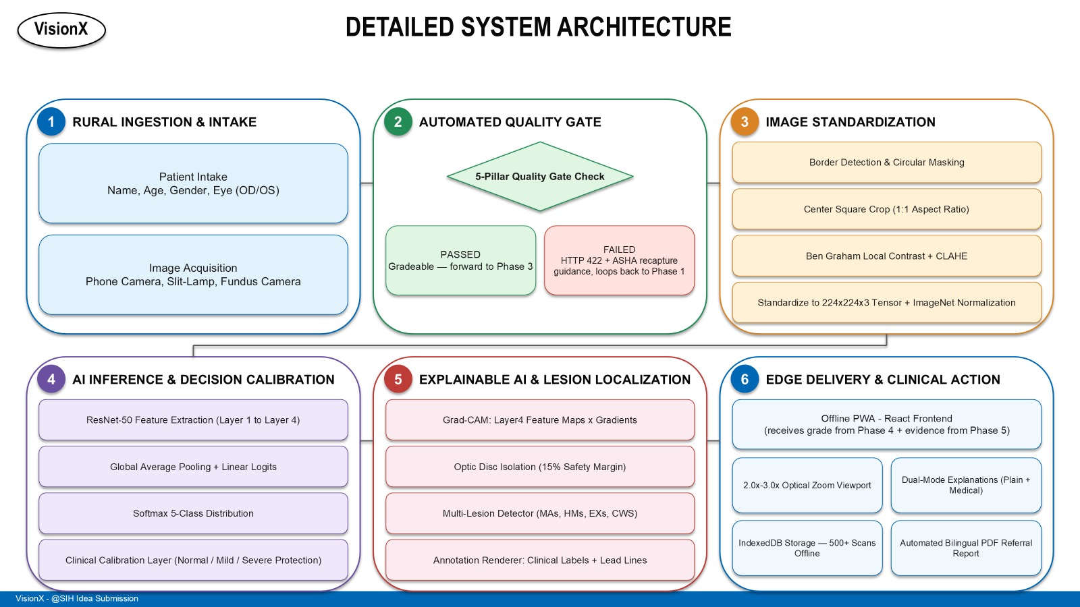
TECHNICAL APPROACH
visionX
MODEL CHOICE
ResNet-50
25.5M params • ~100 MB • 1.2 s CPU
Chosen for rural offline feasibility + native Grad-CAM interpretability.
XAI / LESION ENGINE
Grad-CAM
Layer4 attention map
Optic Disc
15% safety mask
Lesions
MAs • HMs • EXs • CWS
Report
Labels + lead lines + PDF
CORE STACK
PyTorch
OpenCV
FastAPI
React
IndexedDB
Model
Quality/XAI
Local API
PWA
Offline

Slide 4
visionX
FEASIBILITY AND VIABILITY
FEASIBILITY
CHALLENGES
⚙
Technical Feasibility
Rural deployment risks and our fixes
QWK 0.8855 • 79.95% exact 5-class accuracy
100% sensitivity on severe + PDR cases.
Bad input data
Problem: Blurred / poorly-lit / non-retinal photos
Operational Feasibility
1
⌁
Fix: 5-Pillar Quality Gate intercepts bad scans before inference.
100% offline PWA + IndexedDB
500+ patient screening records locally.
₹
Economic Feasibility
Problem: Doctors cannot verify why a grade was made
>99% lower screening triage cost
₹1,500 specialist fee → <₹10 per scan.
2
AI black box
Fix: Grad-CAM + lesion-level heatmaps + dual-mode explanations.
▣
Regulatory Feasibility
ICDR severity scale + ETDRS terminology
Designed around clinical grading conventions.
No internet / GPU
Problem: Rural sub-centers lack bandwidth and cloud hardware
3
Fix: CPU-optimized PyTorch + browser-cached offline PWA.
MARKET VIABILITY
77M+ diagnosed diabetics • <25,000 ophthalmologists
Current
Need
MODEL SELECTION
ResNet-50
EfficientNet-B7
ViT-L/16
77M+
150k+ PHCs
1.2–2.5s • <1.5GB
10–16s • >4GB
25–45s • >8GB

Slide 5
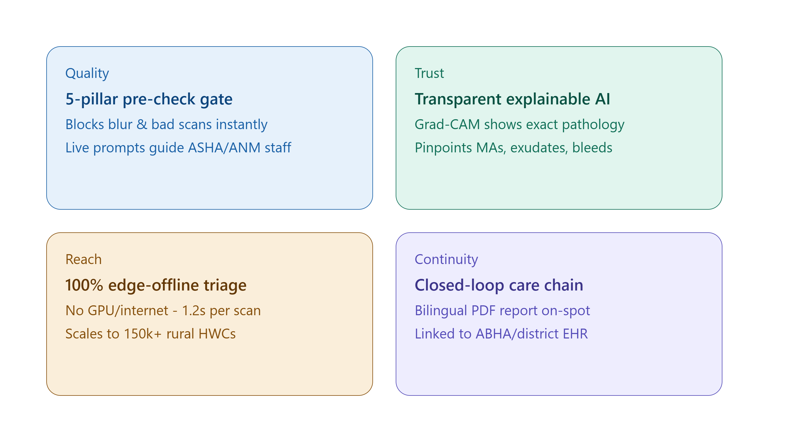
visionX
IMPACTS AND BENEFITS
Economic Benefits
₹
Social Benefits
♥
Environmental Benefits
♻
Drastically cuts travel and consultation expenses for rural patients.
Empowers low-cost, scalable nationwide screening.
Democratizes expert ophthalmology access for 77M+ diabetics.
Empowers local ASHA/ANM workers with actionable UI guidance.
Eliminates millions of unnecessary rural-to-urban commutes for
healthy patients, significantly reducing the healthcare carbon footprint.
STAKEHOLDERS & IMPACTS
RURAL PATIENT
ASHA / ANM
PRIMARY HEALTH CENTER
OPHTHALMOLOGIST
1
Receives immediate,
understandable triage results locally.
2
Empowered with step-by-step camera
adjustment guidance if a scan fails.
3
Screens hundreds of patients offline with
zero recurring software/cloud costs.
4
Receives highly accurate, visually annotated
referrals, saving time for critical surgeries.
OUR PROMISE
100% sensitivity on sight-threatening cases
(severe and PDR cases).
98% precision on healthy retinas
SDG 3
Good Health & Well-being
SDG 10
Reduced Inequalities

Slide 6
RESEARCH AND REFERENCES
visionX
Evidence trail behind the VisionX system
CLINICAL RESEARCH
OUR WORKS
APTOS 2019
3,662 expert-annotated color fundus images
ICDR Grades 0–4
GitHub
Project Proof
Project source + implementation
Validation outputs + generated reports
VALIDATION
QWK 0.8855 • 79.95% exact accuracy
100% severe/PDR sensitivity
DATASET / BENCHMARKS
DEEP LEARNING
• APTOS 2019 Blindness Detection
• Messidor-2 & IDRiD benchmarks
• He, Zhang, Ren & Sun — Deep Residual Learning
• Selvaraju et al. — Grad-CAM
INDIA NEED SIGNAL
77M+ diagnosed diabetics
<25,000 ophthalmologists
PREPROCESSING
CLINICAL GUIDELINES
• Ben Graham — DR competition winner's report
• OpenCV CLAHE / normalization pipeline
• American Academy of Ophthalmology (AAO)
• International Council of Ophthalmology (ICO)
• ETDRS Research Group
CLINICAL CONVENTIONS
AAO • ICO • ETDRS
Severity grading terminology
AI / XAI
PROJECT PROOF
Validation split: 733 images • QWK: 0.8855 • Accuracy: 79.95%
github.com/Boobathi-V/SIH_2026.git
ResNet-50 — He et al. (2016)
Grad-CAM — Selvaraju et al. (2017)
Need → Quality → AI → Evidence → Offline Action

