Slide 1

STIRS-2026 · RESEARCH PROJECT
Closed-Loop Control and Dynamic Phase Shedding
for a Two-Stage Multiphase DC-DC Converter
in EV Auxiliary Power Applications
Presented By:
Deepalakshmi M, 3rd Year, EEE
Boobesh IR, 3rd Year, EEE
Faculty Mentor:
Dr. R. Seyezhai, Professor, EEE
SSN
Notes:
This is a STIRS 2026 research project. The exact proposal title is Closed-Loop Control and Dynamic Phase Shedding for a Two-Stage Multiphase DC-DC Converter in EV Auxiliary Power Applications. Deepalakshmi M and Boobesh I R, third-year EEE, guided by Doctor R. Seyezhai. Duration and budget are on the plan slide.

Slide 2
STIRS-2026 · RESEARCH PROJECT
INTRODUCTION
DC–DC in the EV
Published light-load comparison
The auxiliary power module (APM) is the
DC–DC converter from the HV traction
battery (320–800 V class) to the 12 V /
24 V / 48 V rails.
Alharbi et al., IECON 2019, six-phase
interleaved buck for EV charging:
30 A → 2 phases
almost 98% efficiency
12 / 24 V lighting and ECU rails:
200 W – 3 kW
100 A → 5 phases
48 V compressors and power steering:
Iout ≥ 160 A → all 6 phases
> 3 kW
Extra phases at light load keep
switching and gate-drive loss after
conduction has already fallen.
Industrial APM peak efficiency in that
survey is 96% with WBG devices and
soft switching. Auxiliaries sit at partial
load, so that peak is not the duty.
This project takes that light-load
problem onto a two-stage EV-auxiliary
plant, not a traction inverter.
Kotb et al., Energies 2023, Table 3 and Fig. 2.
Alharbi et al., IECON 2019, Fig. 5 and §VI.
SSN
Notes:
Electric-vehicle auxiliaries do not run from the traction pack directly. Kotb and colleagues, in Energies 2023, treat the auxiliary power module as the DC-DC converter from a 320 to 800 volt class battery down to 12, 24 and 48 volt rails. Lighting and ECU rails sit between 200 watts and 3 kilowatts; 48 volt compressors and power steering exceed 3 kilowatts. That survey quotes an industrial peak of 96 percent with wide-band-gap devices and soft switching, but auxiliaries spend long periods at partial load, so peak is not the duty. Alharbi and colleagues, IECON 2019, show the light-load penalty on a six-phase interleaved buck: they keep almost 98 percent at 30 amperes with only two phases, use five phases at 100 amperes, and turn all six on only at 160 amperes and above. Extra phases at light load keep switching and gate-drive loss after conduction has already fallen. That is the published comparison. This project takes that problem onto a two-stage EV-auxiliary plant, not a traction inverter.

Slide 3
STIRS-2026 · RESEARCH PROJECT
LITERATURE GAP
Two-stage plants, fixed phases
Shedding on single-stage bucks
Alajmi et al., IEEE Access 2022:
cascaded non-inverting interleaved
converter. No adaptive shedding.
Su and Liu, IEEE TPEL 2013; Mao
et al., IEEE TCAS-II 2023; Alharbi
2019: shedding with current control
on multiphase bucks, not a shared-
stage two-stage aux plant.
Leal et al., IEEE TIE 2024: cascaded
interleaved, closed-loop, still a
fixed phase count.
What we already did
Our earlier study placed load-based phase shedding on Topology 2 — a two-phase
interleaved buck plus a shared boost — at 48 V to 24 V. That closed the topology-
plus-shedding gap in open-loop simulation.
Remaining gap — why STIRS
That controller is still open-loop duty maps. No outer voltage loop, no inter-phase
current sharing, no controlled add/drop, and no hardware. Closed-loop regulation
and shedding on this two-stage plant is the year.
SSN
Notes:
The papers split. Alajmi, IEEE Access 2022, and Leal, IEEE TIE 2024, give two-stage interleaved converters with a fixed phase count. Su and Liu, Mao, and Alharbi put phase shedding on single-stage multiphase bucks. Our earlier study closed the topology-plus-shedding gap by placing load-based shedding on Topology 2, a two-phase interleaved buck plus a shared boost, at 48 to 24 volts, in open-loop simulation. What remains, and what STIRS funds, is that the controller is still open-loop duty maps: no outer voltage loop, no current sharing, no controlled add and drop, and no hardware.

Slide 4
STIRS-2026 · RESEARCH PROJECT
PROBLEM AND OBJECTIVES
No voltage regulation
Year-closing objectives
1
Fixed duty cannot hold Vout. At 10%
load: 29.25 V without shedding versus
24.02 V with shedding.
1 Simulate voltage regulation and
inter-phase current sharing on the
same two-stage plant.
2 Integrate hysteresis shedding;
No current sharing
quantify regulation, share error and
Mismatch dumps heat onto the phase
that remains after a drop.
η against the open-loop baseline.
2
3 STM32: multiphase PWM, ADC
and a real-time shed/add state
machine.
Uncontrolled transients
4 Fabricate and test about 200 to
Add and drop are not coordinated.
Overshoot and imbalance are open.
300 W.
3
5 Stretch. Multiphase boost-side
extension. The year can close
without this item.
Shared boost cannot shed
The single-leg companion stage has
no phase degree of freedom in boost
mode.
4
SSN
Notes:
Four open-loop failures. Fixed duty cannot hold Vout; at 10 percent load the plant reads 29.25 volts without shedding versus 24.02 volts with shedding. There is no inter-phase current sharing, so mismatch dumps heat on the remaining phase. Add and drop transients are uncontrolled. The shared boost is a single leg, so boost mode has no shedding authority. Four year-closing objectives: simulate dual-loop sharing on this plant; integrate hysteresis shedding and quantify it against the open-loop baseline; implement PWM, ADC and the shed machine on an STM32; fabricate about 200 to 300 watts. Item five is stretch, a multiphase boost-side extension. The year can close without it.

Slide 5
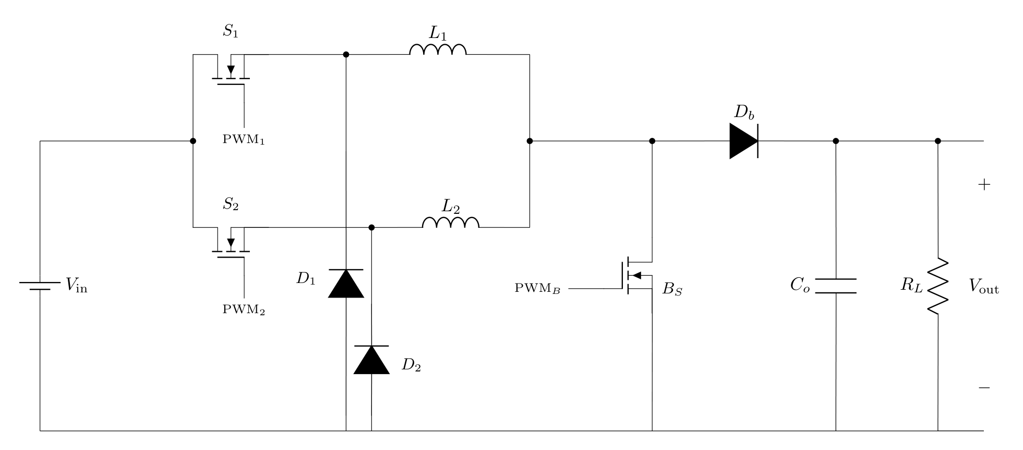
STIRS-2026 · RESEARCH PROJECT
PROPOSED TOPOLOGY
PHASE 1
PHASE 2
SHARED BOOST
SHEDDING
S1 · L1
S2 · L2
Bs · Db
drop < 100 W
PWM1 buck leg
PWM2 buck leg
PWM held off
restore > 110 W
D1 freewheels
D2 freewheels
48 V to 24 V study
200 W · 50 kHz
SSN
Notes:
Topology 2 is a two-phase interleaved buck plus a shared boost. S1-L1 and S2-L2 are the buck legs, 180 degrees apart. The shared boost stays off in the 48 to 24 volt study. Shedding sits on the two buck phases: drop one PWM below 100 watts, restore both above 110 watts. Rated 200 watts at 50 kilohertz.

Slide 6
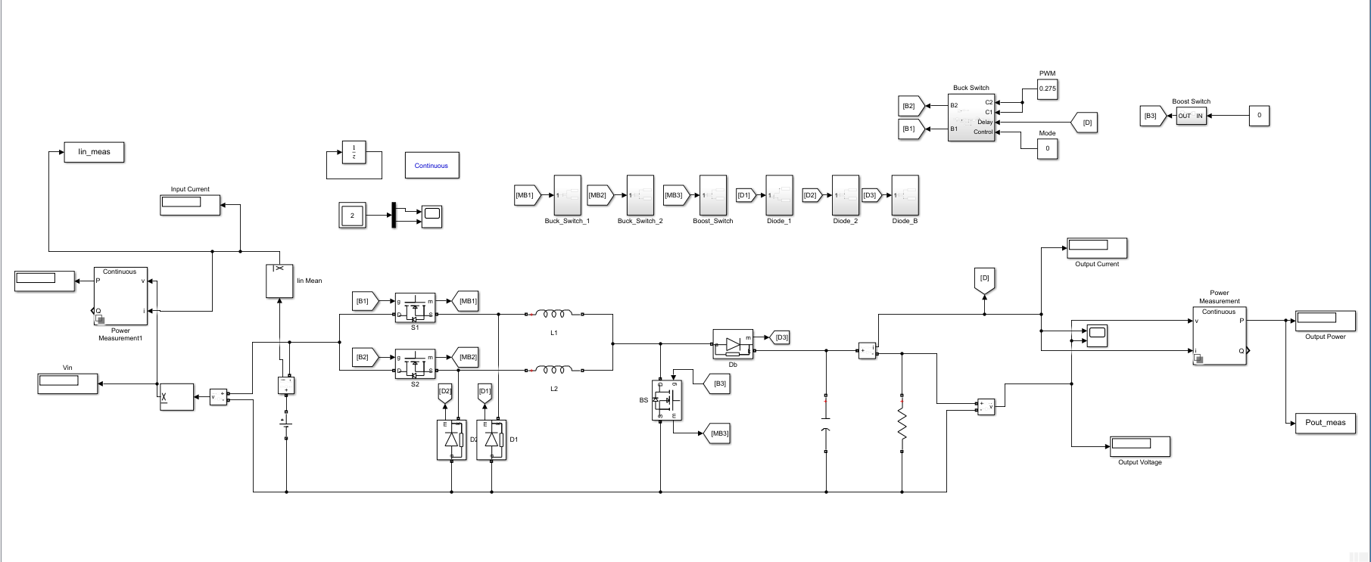
STIRS-2026 · RESEARCH PROJECT
SIMULINK MODEL
DUTY
OPEN LOOP
LOAD SWEEP
0.275
Not closed-loop
20 W – 200 W
Boost command 0
Duty maps only
48 V to 24 V plant
SSN
Notes:
This screenshot is the open-loop plant, not a closed-loop result. Duty 0.275, boost command zero, load swept from 20 watts to 200 watts on the same 48 to 24 volt circuit.

Slide 7
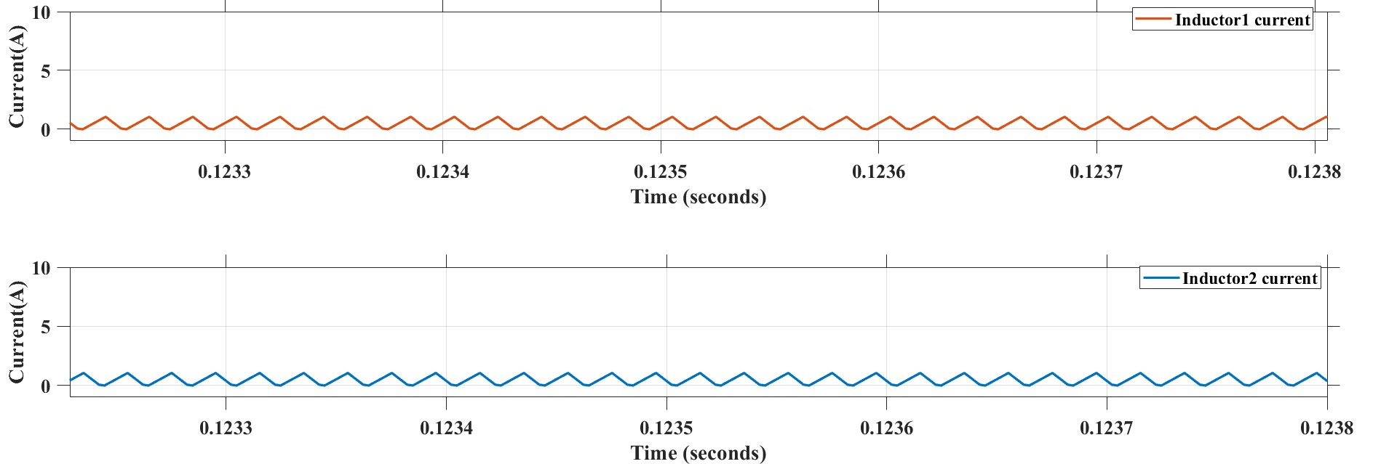
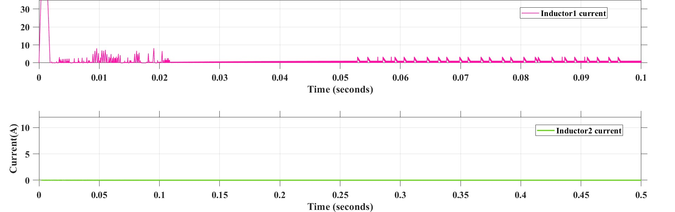
STIRS-2026 · RESEARCH PROJECT
OPEN-LOOP RESULTS
AT 20% LOAD
AT 10% LOAD
+2.30 pp · 92.33% vs 90.03%
24.02 V vs 29.25 V without shedding
WITHOUT SHEDDING
WITH SHEDDING
Both phases stay interleaved.
One phase off. Same open-loop plant.
Open-loop Simulink, 48 V to 24 V. Not a closed-loop or hardware result.
Inductor-current waveforms from the same plant as the efficiency sweep.
SSN
Notes:
These are baseline waveforms from that open-loop model. Without shedding both phases stay interleaved. With shedding one phase PWM is off. At 20 percent load, efficiency is 92.33 percent versus 90.03 percent, a gain of 2.30 percentage points. At 10 percent load, Vout is 24.02 volts with shedding versus 29.25 volts without. None of this is closed-loop or hardware.

Slide 8
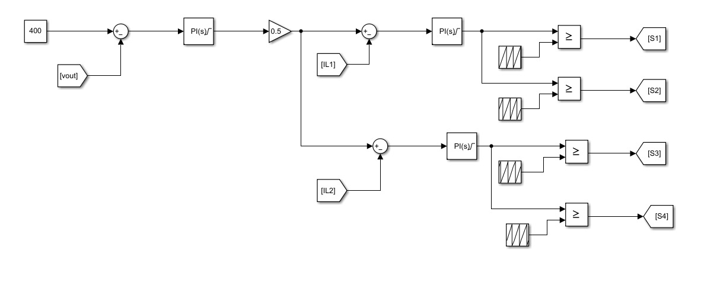
STIRS-2026 · RESEARCH PROJECT
CLOSED-LOOP SYSTEM
OUTER PI
INNER PI
STM32
Vout to 24 V
IL1 and IL2 · split 0.5
PWM, ADC, shed FSM
Proposed on the same plant — not a bench measurement.
The block labelled 400 is a loop reference, not a 400 V rail.
SSN
Notes:
The STIRS year puts dual-loop control on the same plant. Outer PI to 24 volts, inner PI on IL1 and IL2 with split gain 0.5, and an STM32 for PWM, ADC and the shed state machine. The diagram is proposed, not measured. The block labelled 400 is a loop reference, not a 400 volt rail.

Slide 9
STIRS-2026 · RESEARCH PROJECT
WORK PLAN AND BUDGET
1–2
3–4
5–6
7–8
9–10
11–12
Simulink model
Closed-loop
STM32
Hardware
Test
Report
No.
Item
Rating / notes
Qty
Rs
1
Power MOSFET (heatsink tab)
IRFP4568 / 150 V, 34 A
8
1,200
2
Gate driver IC
IR2110 / IRS2110
4
860
3
Buck-stage phase inductors
100 µH / 10 A
4
1,400
4
Boost-stage phase inductors
220 µH / 6 A
2
600
5
Schottky / fast diodes
MBR20100CT / MUR460
6
300
6
Output filter capacitors
100 µF / 100 V
6
300
7
Input filter capacitors
470 µF / 63 V
4
240
8
Current-sense modules
ACS712 / shunt + amp
6
900
9
STM32 development board
Multiphase PWM + ADC
1
3,200
10
Custom power-stage PCB
2-layer prototype
1
2,500
11
Heatsinks, wires, snubbers
Connectors, patch cords
20
2,000
12
Miscellaneous
Fuses, fasteners
—
500
13
Fibre enclosure, spacers
A4 sheet, standoffs
2
1,000
Total estimated budget
15,000
SSN
Notes:
Twelve months: model, closed-loop, STM32, hardware, test, report. Fifteen thousand rupees in full: MOSFETs 1200, drivers 860, buck inductors 1400, boost inductors 600, diodes 300, output capacitors 300, input capacitors 240, current sense 900, STM32 3200, PCB 2500, build hardware 2000, miscellaneous 500, enclosure 1000.

Slide 10
STIRS-2026 · RESEARCH PROJECT
EXPECTED OUTCOMES
1
Measured efficiency versus load, with and without shedding.
2
Inter-phase current-share error under closed-loop sharing.
3
Load-step and phase add/drop transient waveforms.
4
Open-loop versus closed-loop comparison on the same plant.
5
STM32-controlled prototype of about 200 W.
6
Final report and a conference-paper draft.
None of these items is a closed-loop measurement today.
SSN
Notes:
Month 12 hands over six items, none of them measured today: efficiency versus load with and without shedding; current-share error; load-step and add-drop transients; an open versus closed comparison on the same plant; a 200 watt STM32 prototype; a report and paper draft.

Slide 11
STIRS-2026 · RESEARCH PROJECT
REFERENCES
[1] B. N. Alajmi et al., “Multiphase interleaved
converter based on cascaded non-inverting
buck-boost converter,” IEEE Access, 2022.
[7] S. Ramya, S. Divya and C. Das,
“Multiphase bidirectional DC-DC converter
with phase shedding for BLDC driven EV,”
IEEE IPRECON, 2021.
[2] B. N. Alajmi et al., “Two stage single-phase
EV on-board charger based on interleaved
cascaded NIBB,” IEEE CPERE, 2023.
[8] A. V. Rao and G. K. P., “Analysis, design
and simulation of non-inverting buck-boost
DC-DC converter for battery charging,”
IEEE CENTCON, 2021.
[3] H. Chen et al., “Electrified automotive
powertrain architecture using composite
DC–DC converters,” IEEE TPEL, 2017.
[9] G. J. Sagar et al., “A high-efficiency EV
charging system with interleaved buck-boost
converter and adaptive control,” IEEE
NE-IECCE, 2025.
[4] W. C. Leal et al., “Cascaded interleaved
DC–DC converter for a bidirectional EV
charging station,” IEEE TIE, 2024.
[10] P. Pilati et al., “Phase shedding of a
ripple-free stacked interleaved boost
converter for fuel-cell powertrains,” IEEE
TTE, 2025.
[5] G. Mao et al., “Digital average current
predictive control for multiphase interleaved
DC–DC converters,” IEEE TCAS-II, 2023.
[6] M. A. Alharbi et al., “Current ripple
minimisation based on phase-shedding of
DC–DC interleaved converters for EV
charging,” IECON, 2019.
Also on slide 2: R. Kotb et al., Energies,
2023; J.-T. Su and C.-W. Liu, IEEE TPEL,
2013.
SSN
Notes:
The comparison and the gap sit on these papers. Alajmi two-stage interleaved; Chen composite automotive DC-DC; Leal cascaded interleaved closed-loop; Mao digital current plus rotating shedding; Alharbi light-load phase count; Ramya IPRECON; Pilati boost-mode shedding. Kotb and Su and Liu are cited on the introduction slide.

Slide 12
STIRS-2026 · RESEARCH PROJECT
Thank you
Questions
Deepalakshmi M · Boobesh IR
3rd Year, Electrical and Electronics Engineering
Guided by
Dr. R. Seyezhai, Professor, EEE
SSN College of Engineering
SSN
Notes:
Thank you. Questions for Deepalakshmi M and Boobesh I R, guided by Doctor R. Seyezhai.

