Slide 1
REAL-TIME HUMAN DETECTION & COUNTING
TEAM MEMBERS BATCH 15 MENTOR
Boobesh K Ms. D Suganthi
Deepak Kumar P
Bernard Alan Raj P

Slide 2
ABSTRACT
This project investigates and reports benchmarks for detecting and enumerating humans through real time images, videos and camera.
This is very useful in various image processing and performing computer vision tasks.
his schemes have been implemented in Python programming language, and using various tech-stacks like OpenCV[2], TensorFlow[3], etc.
Keywords : Computer Vision, Human Detection, Enumeration

Slide 3
INTRODUCTION
The objective of this project is to detect and count the number of humans present in a given video stream or real-time video feed. The project utilizes OpenCV, an open-source computer vision library, which provides powerful tools and algorithms for image and video processing.
One of the key algorithms used in this project is the Haar Cascade algorithm. The Haar Cascade algorithm is an efficient object detection technique that uses a series of trained classifiers to detect specific objects in images or video frames.
To implement the real-time human detection and counting system, we will use Python programming language along with OpenCV's Python bindings. Python provides a simple and intuitive syntax, making it ideal for rapid prototyping and development of computer vision applications.
Throughout this mini project, we will explore the steps involved in developing the system, including preprocessing the video feed, applying the Haar Cascade algorithm for human detection, tracking the detected human objects, and incrementing the count based on the detected humans.

Slide 4
LITERATURE SURVEY
Crowd counting is treated as an object/person detection problem in detection-based techniques, which assumes that a crowd is made up of individual items.
Handcrafted features were used in early works to detect people, but they were not resistant to extreme large-scale variance or occlusion in crowded scenes or clustered settings.
Despite the success of deep network-based object detectors in recent years, impressive object detection results, they still outperform regression-based methods when it comes to crowd counting.
A video-based face recognition which works on human face detection. The work done here works efficiently on challenging scenarios like multiple shot videos and surveillance videos with low quality frames.

Slide 5
ARCHITECTURE
The bounding box is a rectangle drawn on the image which tightly is the object in the image. A bounding box exists for every instance of every object in the image. For the box, 4 numbers (center x, center y, width, height) are predicted
BOUNDING BOX
In this case, the proposals are extracted using some other computer vision technique and then resized to the input for the classification network, which acts as a feature extractor. Then an SVM is trained to classify between object and background (one SVM for each class). Also a bounding box regressor is trained that outputs some correction (o sets) for proposal boxes
TWO-STAGE METHOD

Slide 6
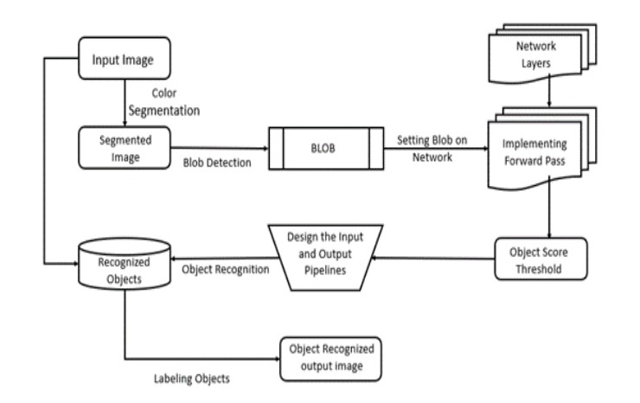
ARCHITECTURE DIAGRAM

Slide 7
HAAR CASCADE ALGORITHM
The Haar Cascade algorithm is a machine learning-based object detection algorithm used to identify objects or patterns in digital images or video streams.
The first step in the Haar Cascade algorithm is the creation of an integral image. The integral image is a representation of the original image where each pixel stores the cumulative sum of the pixel values above and to the left of it. The integral image enables fast computation of pixel sums within rectangular regions of the image.
Haar-like features are simple rectangular patterns that are used to describe various visual patterns within an image. These features capture local contrast differences and can be categorized as edge features, line features, or center-surround features. Haar-like features are defined by their position, size, and the values of the pixels within the rectangular region.
To detect objects in an image or video stream, the Haar Cascade algorithm employs a sliding window approach. A fixed-size window is moved across the image at different scales and positions

Slide 8

SOURCE CODE

Slide 9
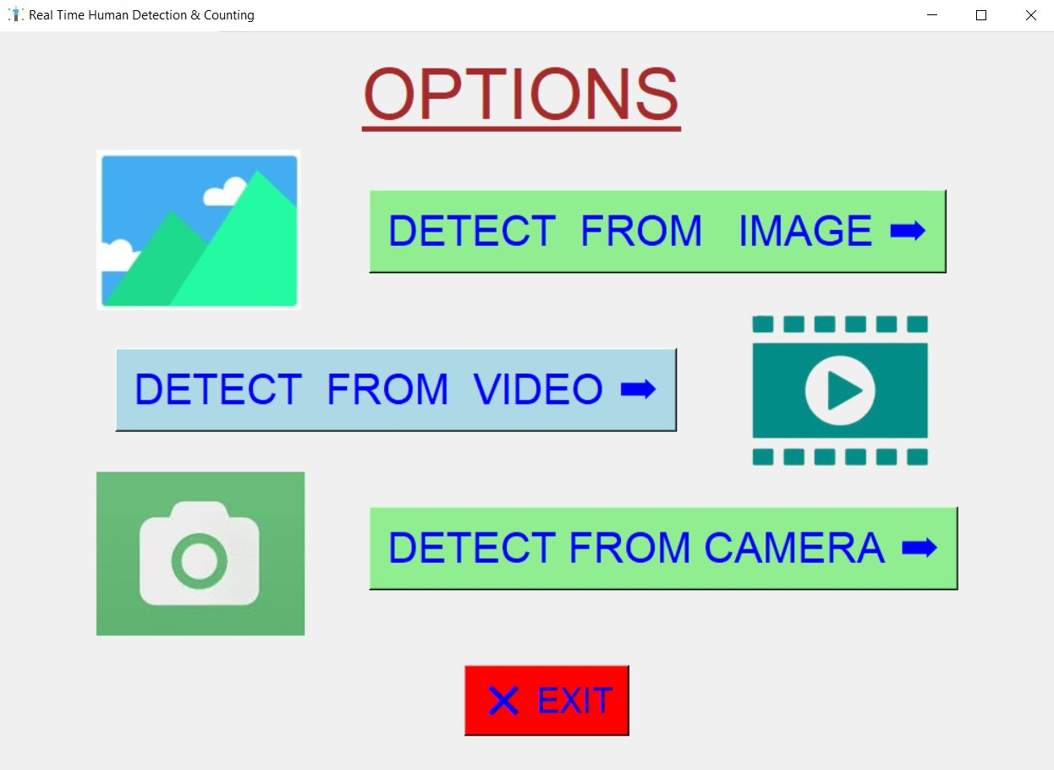
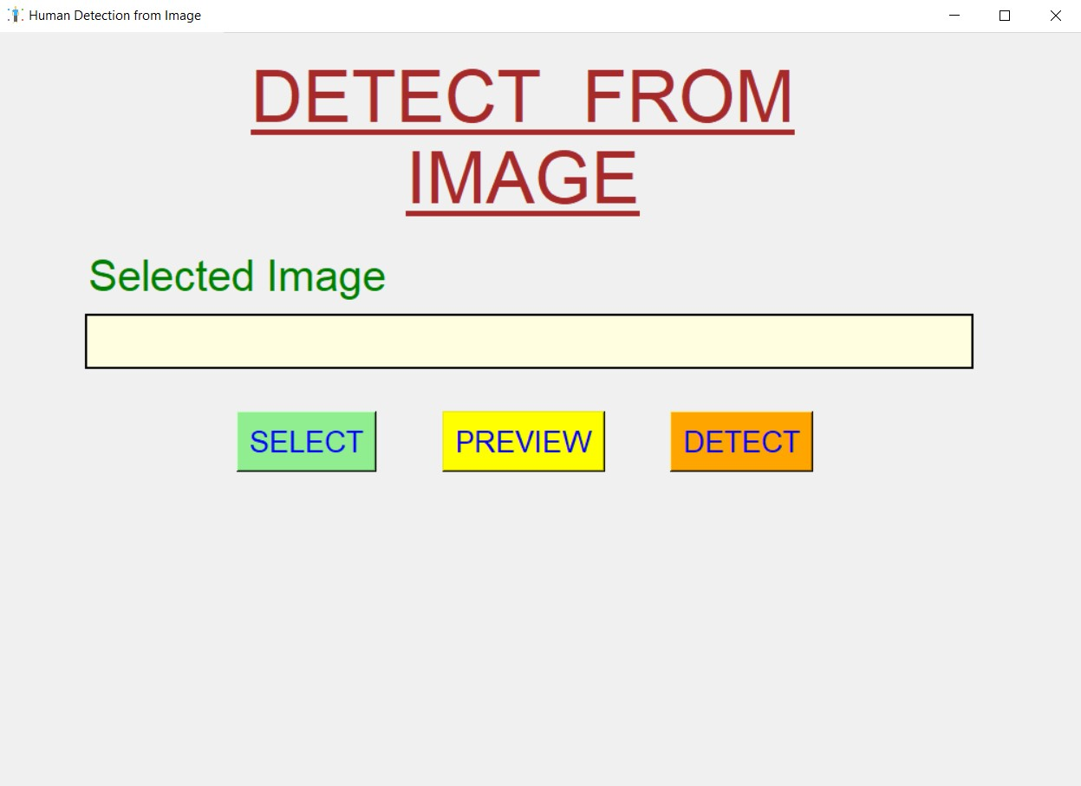
GRAPHICAL USER INTERFACE(GUI)

Slide 10
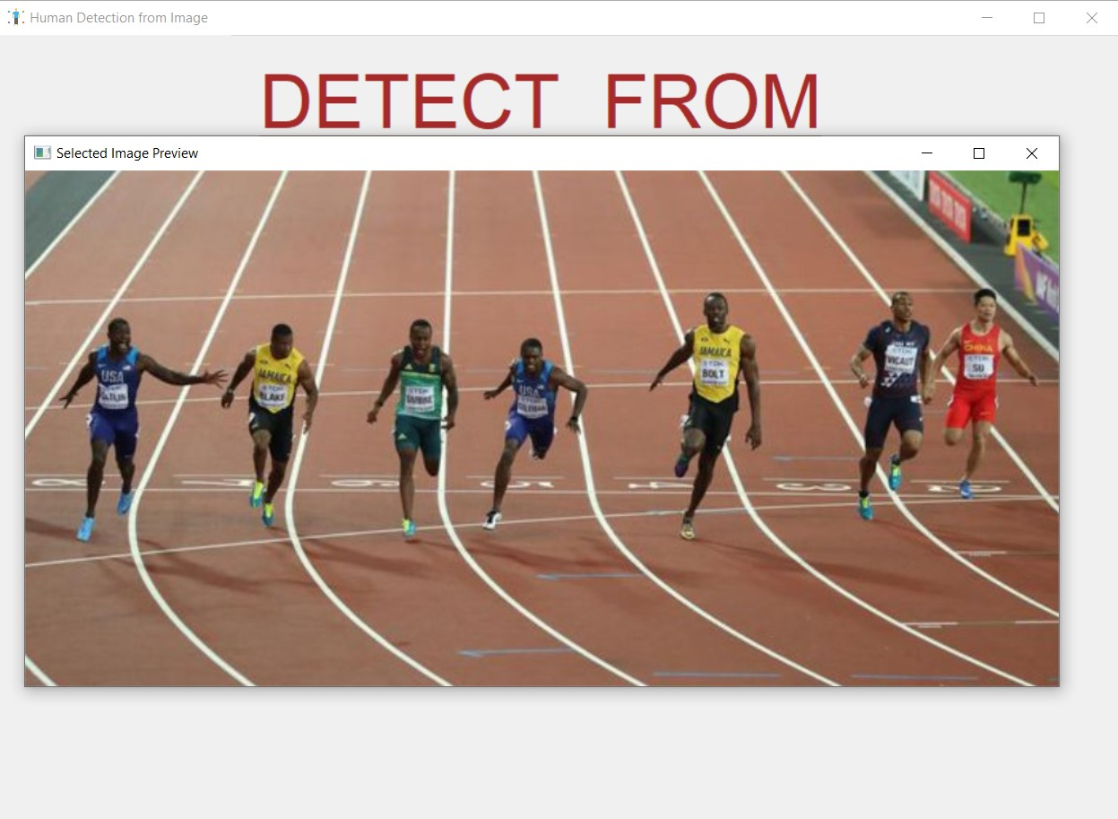
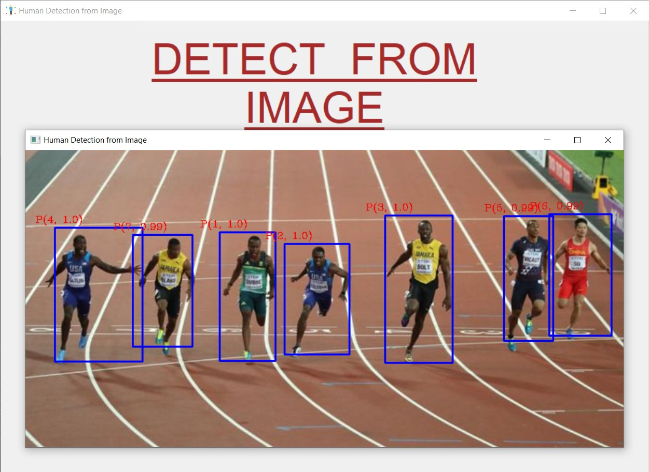
IMPLEMENTATION & SAMPLE OUTPUT

Slide 11
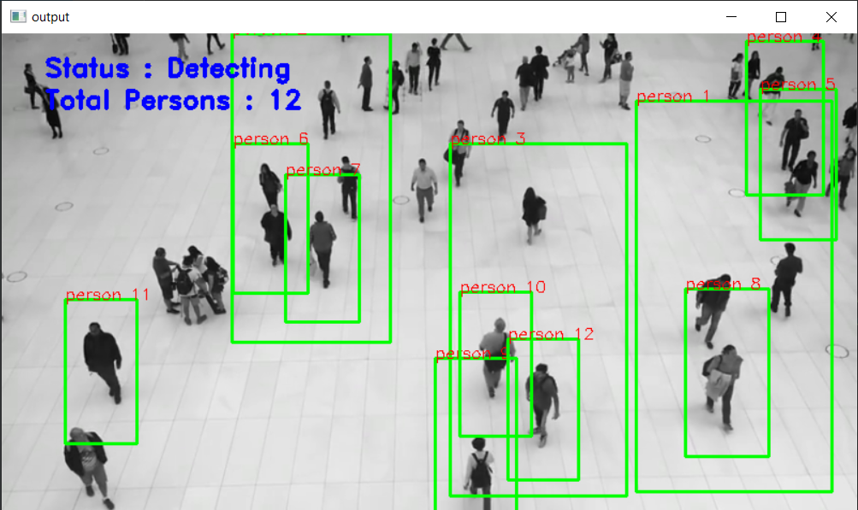
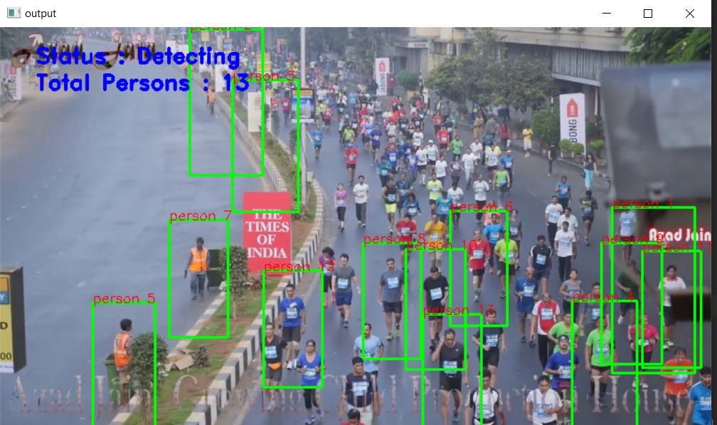
FURTHER IMPROVEMENT

Slide 12
ADVANTAGES
Real-Time Performance: The use of OpenCV Python and the Haar Cascade algorithm allows for real-time human detection and counting, enabling instant monitoring and analysis of human presence in video streams. This real-time capability is crucial for applications that require immediate response and decision-making based on human activity.
Accuracy: The Haar Cascade algorithm, when properly trained and tuned, can achieve high accuracy in detecting human presence.
Versatility: The real-time human detection and counting system can be applied in various domains and scenarios.
Implementing real-time human detection and counting using OpenCV Python and the Haar Cascade algorithm can be a cost-effective solution compared to more complex and specialized methods such as Footprint-based counting.

Slide 13
CHALLENGES
The first major complication of object detection is its added goal: not only do we want to classify image objects but also to determine the objects’ positions, generally referred to as the object localization task.
Object detection algorithms need to not only accurately classify and localize important objects, they also need to be incredibly fast at prediction time to meet the real-time demands of video processing.
For many applications of object detection, items of interest may appear in a wide range of sizes and aspect ratios. Practitioners leverage several techniques to ensure detection algorithms are able to capture objects at multiple scales and views.
The limited amount of annotated data currently available for object detection proves to be another substantial hurdle. Object detection datasets typically contain ground truth examples for about a dozen to a hundred classes of objects, while image classification datasets can include upwards of 100,000 classes

Slide 14
CONCLUSION
Using OpenCV and Python, we built a people counter. It is possible to incorporate a model that calculates the distance between the bounding boxes and thus improves the precision of the violation.
The performance of object detection in image processing is required for a growing number of Realtime applications, and we can detect any type of object with this application.
We will use various types of extraction process techniques in the future for various purposes, and this technique can be used in airports, shopping malls, businesses, parks.

Slide 15
REFERENCES
W. Liu, M. Salzmann, and P. Fua, ‘‘Context-aware crowd counting,’’ in Proc. IEEE/CVF Conf. Comput. Vis. Pattern Recognit. (CVPR), Jun. 2019, pp. 5099–5108.
Object Detection with Deep Learning” Zhao, Z.-Q.; Zheng, P.; Xu, S.-T.; Wu, X(2019)
V. A. Sindagi and V. M. Patel, ‘‘HA-CCN: Hierarchical attention based crowd counting network,’’ IEEE Trans. Image Process., vol. 29, pp. 323–335, 2020.
M. Li, Z. Zhang, K. Huang, and T. Tan, ‘‘Estimating the number of people in crowded scenes by MID based foreground segmentation and head shoulder detection,’’ in Proc. 19th Int. Conf. Pattern Recognit., Dec. 2008.

Slide 16
THANK YOU

