Slide 1
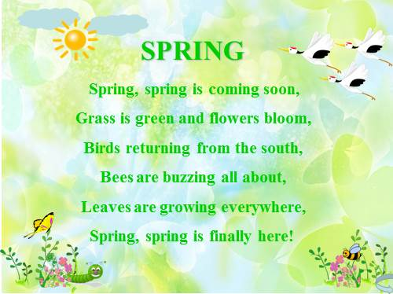

Slide 2
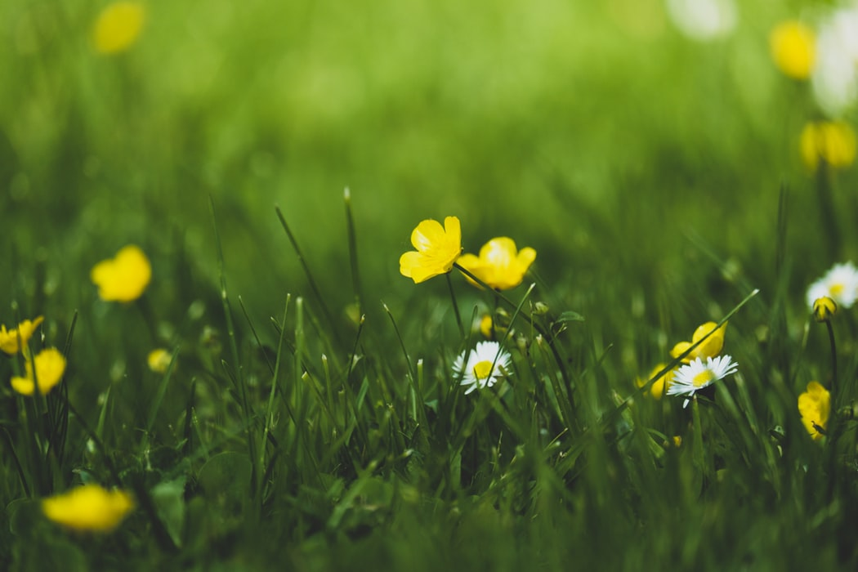
Spring, Spring is coming soon

Slide 3
Grass is grean and flowers bloom

Slide 4
Birds returning from the South

Slide 5
Bees are buzzing all about

Slide 6
Leaves are growing everywhere

Slide 7
Spring, Spring is finally here

Slide 9



