Slide 1
Chapter 2
Systems Analysis and Design in a Changing World, 7th Edition - Chapter 2 ©2016. Cengage Learning. All rights reserved.

Slide 2
Investigating System Requirements
Chapter 2
Systems Analysis and Design in a Changing World 7th Ed
Satzinger, Jackson & Burd

Slide 3
Chapter 2: Outline
Systems Analysis Activities
What Are Requirements?
Stakeholders
Information-Gathering Techniques
Models and Modeling
Documenting Workflows with Activity Diagrams

Slide 4
Learning Objectives
Describe the activities of systems analysis
Explain the difference between functional and nonfunctional requirements
Identify and understand different kinds of stakeholders and their contributions to requirements definition
Describe information-gathering techniques and determine when each is best applied
Describe the role of models in systems analysis
Develop U M L activity diagrams to model workflows

Slide 5
Overview
Chapter 1 introduced the system development lifecycle (S D L C) and demonstrated its use for a small project
This chapter expands the S D L C processes to cover a wider range of concepts, tools and techniques
Core process 3: Discover and understand the details of the problem or need—is the main focus of systems analysis
Systems analysis activities are detailed in this chapter

Slide 6
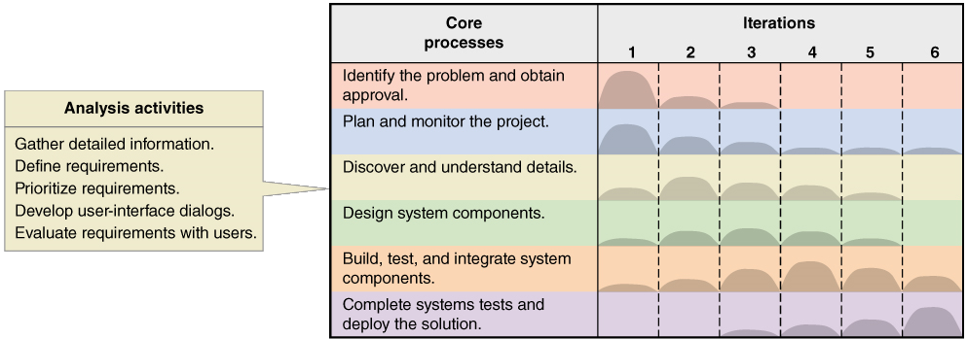
Systems Analysis Activities: Involve discovery and understanding

Slide 7
Systems Analysis Activities (2 of 2)
Gather Detailed Information
Interviews, questionnaires, documents, observing business processes, researching vendors, comments and suggestions
Define Requirements
Modeling functional requirements and non-functional requirements
Prioritize Requirements
Essential, important, vs. nice to have
Develop User-Interface Dialogs
Flow of interaction between user and system
Evaluate Requirements with Users
User involvement, feedback, adapt to changes

Slide 8
What Are Requirements?
System Requirements =
Functional requirements
Non-functional requirements
Functional Requirements– the activities the system must perform
Business uses, functions the users carry out
Non-Functional Requirements– other system characteristics
Constraints and performance goals

Slide 9
F U R P S+ Requirements Acronym (1 of 2)
Functional requirements
Usability requirements
Reliability requirements
Performance requirements
Security requirements
+ even more categories…

Slide 10
F U R P S+ Requirements Acronym (2 of 2)
Requirement categories | F U R P S categories | Example requirements
Functional | Functions | Business rules and processes
Nonfunctional | Usability Reliability Performance Security | User interface, ease of use Failure rate, recovery methods Response time, throughput Access controls, encryption

Slide 11
Additional Requirements Categories
Design constraints –
Specific restrictions for hardware and software
Implementation requirements
Specific languages, tools, protocols, etc.
Interface requirements
Interface links to other systems
Physical requirements
Physical facilities and equipment constraints
Supportability requirements
Automatic updates and enhancement methods

Slide 12
Stakeholders: Who do you involve and talk to?
Stakeholders– persons who have an interest in the successful implementation of the system
Internal Stakeholders– persons within the organization
External stakeholders – persons outside the organization
Operational stakeholders – persons who regularly interact with the system
Executive stakeholders– persons who don’t directly interact, but use the information or have financial interest

Slide 13
Stakeholders of a comprehensive accounting system for public company

Slide 14
Information Gathering Techniques
Interviewing users and other stakeholders
Distributing and collecting questionnaires
Reviewing inputs, outputs, and documentation
Observing and documenting business procedures
Researching vendor solutions
Collecting active user comments and suggestions

Slide 15
Interviewing Users and Other Stakeholders
Prepare detailed questions
Meet with individuals or groups of users
Obtain and discuss answers to the questions
Document the answers
Follow up as needed in future meetings or interviews

Slide 16
Themes for Information Gathering Questions
Theme | Questions to users
What are the business operations and processes? | What do you do?
How should those operations be performed? | How do you do it? What steps do you follow? How could they be done differently?
What information is needed to perform those operations? | What information do you use? What inputs do you use? What outputs do you produce?

Slide 17
Preparing for the Interview (1 of 2)
Before
Establish the objective for the interview.
Determine correct user(s) to be involved.
Determine project team members to participate.
Build a list of questions and issues to be discussed.
Review related documents and materials.
Set the time and location.
Inform all participants of objective, time, and locations.
During
Arrive on time.
Look for exception and error conditions.
Probe for details.
Take thorough notes.
Identify and document unanswered items or open questions.

Slide 18
Preparing for the Interview (2 of 2)
After
Review notes for accuracy, completeness, and understanding.
Transfer information to appropriate models and documents.
Identify areas needing further clarification.
Thank the participants.
Follow up on open and unanswered questions.

Slide 19
Interview Session Agenda (1 of 2)
Discussion and Interview Agenda
Setting
Objective of Interview
Determine processing rules for sales commission rates
Date, Time, and Location
April 21, 2016, at 9:00 a.m. in William McDougal’s office
User Participants (names and titles/positions)
William McDougal, vice president of marketing and sales, and several of his staff
Project Team Participants
Mary Ellen Green and Jim Williams

Slide 20
Interview Session Agenda (2 of 2)
Interview/Discussion
Who is eligible for sales commissions?
What is the basis for commissions? What rates are paid?
How is commission for returns handled?
Are there special incentives? Contests? Programs based on time?
Is there a variable scale for commissions? Are there quotas?
What are the exceptions?
Follow-Up
Important decisions or answers to questions
See attached write-up on commission policies
Open items not resolved with assignments for solution
See Item numbers 2 and 3 on open items list
Date and time of next meeting or follow-up session
April 28, 2016, at 9:00 a.m.

Slide 21
Keeping an Open Items List
I D | Issue title | Date identified | Target end date | Responsible project person | User contact | Comments
1 | Partial shipments | 6-12-2016 | 7-15-2016 | Jim Williams | Jason Nadold | Ship partials or wait for full shipment?
2 | Returns and commissions | 7-01-2016 | 9-01-2016 | Jim Williams | William McDougal | Are commissions recouped on returns?
3 | Extra commissions | 7-01-2016 | 8-01-2016 | Mary Ellen Green | William McDougal | How to handle commissions on special promotions?

Slide 22
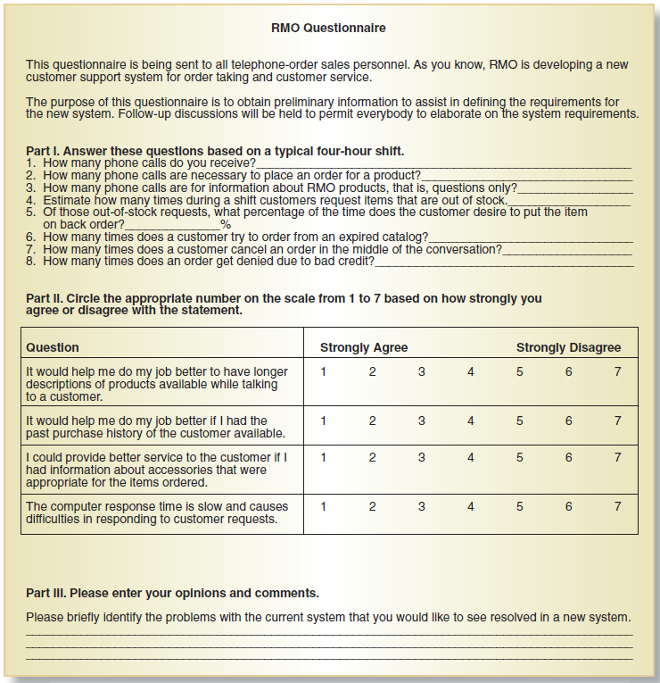
Distribute and Collect Questionnaires

Slide 23
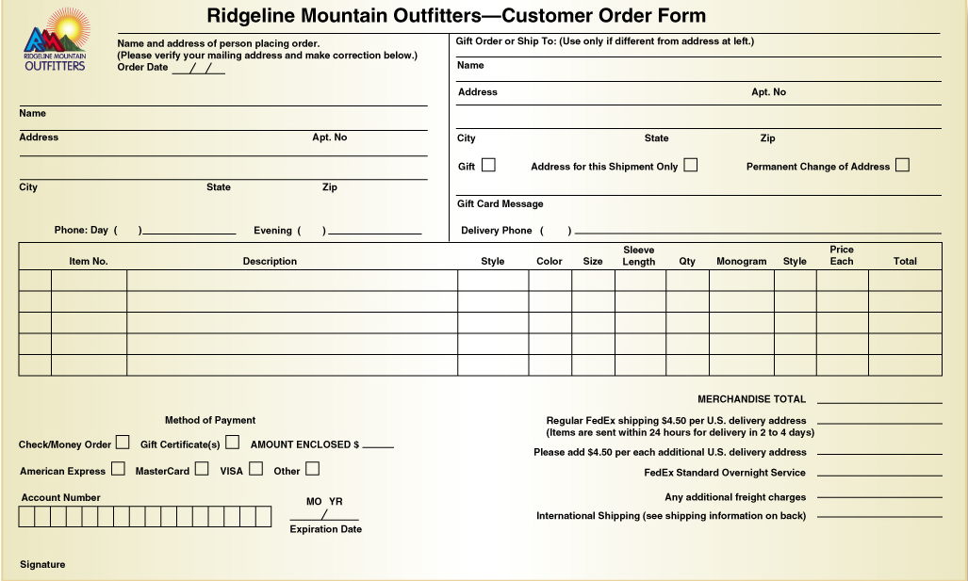
Review Inputs, Outputs, and Procedures

Slide 24
Additional Techniques
Observe and Document Business Processes
Watch and learn
Document with Activity diagram (next section)
Research Vendor Solutions
See what others have done for similar situations
White papers, vendor literature, competitors
Collect Active User Comments and Suggestions
Feedback on models and tests
Users know it when they see it

Slide 25
Models and Modeling
How do we define requirements? After collecting information, create models
Model– a representation of some aspect of the system being built
Types of Models
Textual model– something written down, described
Graphical models– diagram, schematic
Mathematical models– formulas, statistics, algorithms
Unified Modeling Language (U M L)
Standard graphical modeling symbols/terminology used for information systems

Slide 26
Reasons for Modeling
Learning from the modeling process
Reducing complexity by abstraction
Remembering all the details
Communicating with other development team members
Communicating with a variety of users and stakeholders
Documenting what was done for future maintenance/enhancement

Slide 27
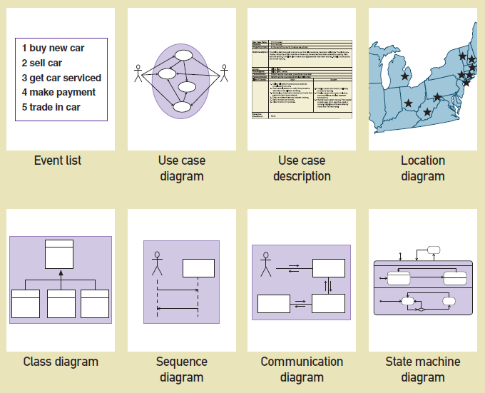
Some Analysis and Design Models

Slide 28
Documenting Workflows with Activity Diagrams
Workflow– sequence of processing steps that completely handles one business transaction or customer request
Activity Diagram– describes user (or system) activities, the person who does each activity, and the sequential flow of these activities
Useful for showing a graphical model of a workflow
A U M L diagram

Slide 29
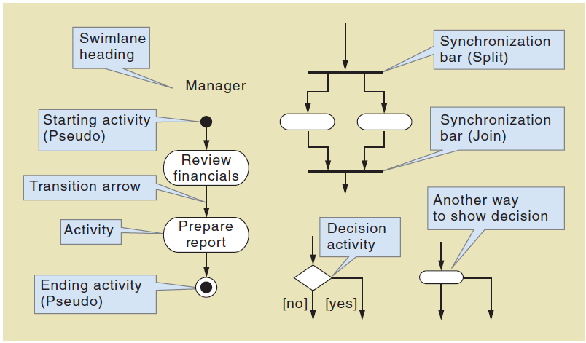
Activity Diagrams Symbols

Slide 30
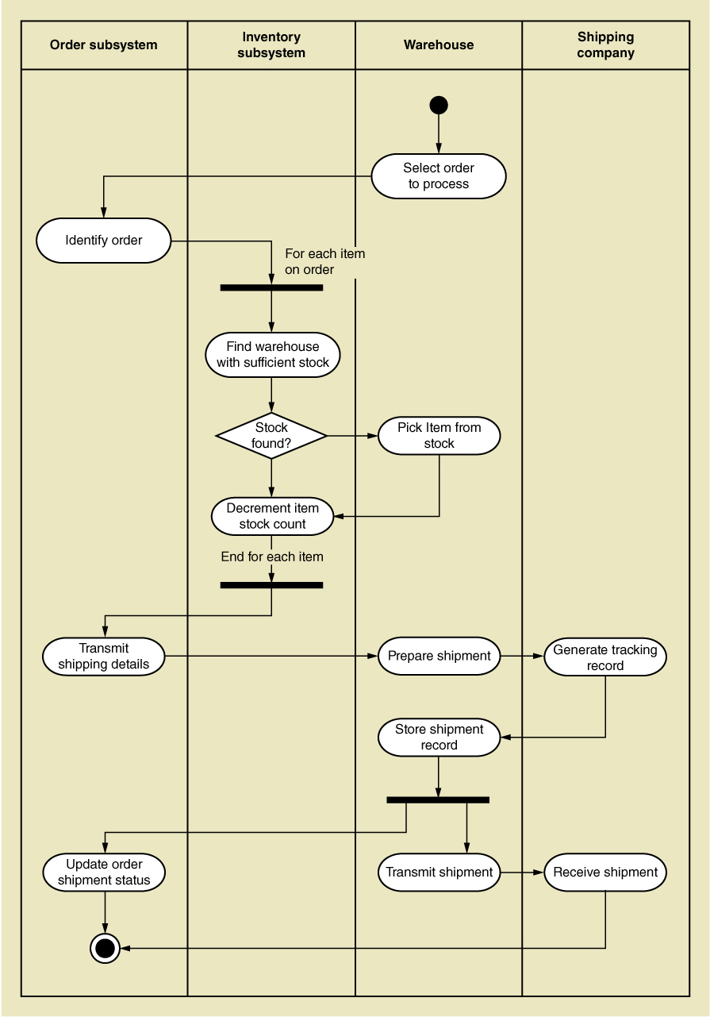
Activity Diagram for R M O Order Fulfillment

Slide 31
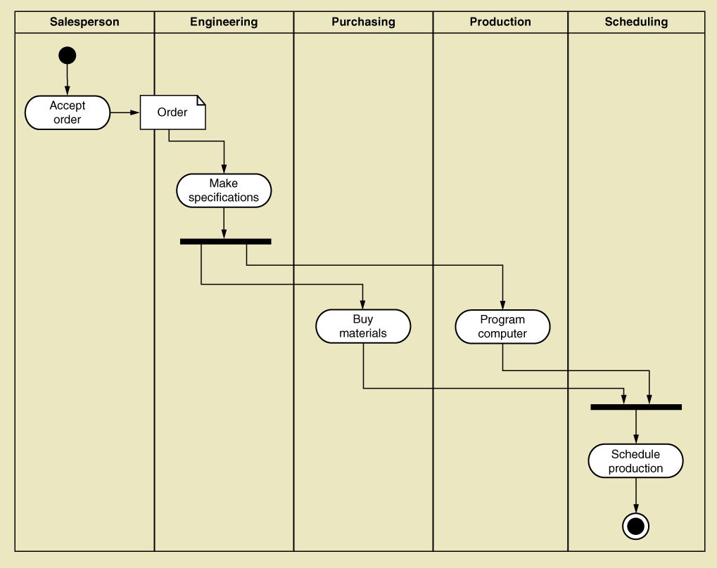
Activity Diagram with Concurrent Paths

Slide 32
Summary (1 of 3)
Systems analysis activates correspond to the core S D L C process Discover and understand details
Systems analysis involves defining system requirements– functional and non-functional
Analysis activities include
Gather detailed information
Define requirements
Prioritize requirements
Develop user-interface dialogs
Evaluate requirements with users
F U R P S+ is the acronym for functional, usability, reliability, performance, and security requirements

Slide 33
Summary (2 of 3)
Stakeholders are the people who have an interest in the success of the project
There are internal vs. external stakeholders and operational vs. executive stakeholders

Slide 34
Summary (3 of 3)
Information gathering techniques are used to collect information about the project
Interviews, questionnaires, reviewing documents, observing business processes, researching vendors, comments and suggestions
The U M L Activity Diagram is used to document (model) workflows after collecting information
Models and modeling are used to explore and document requirements
Unified Modeling Language (U M L) is the standard set of notations and terminology for information systems models

