Slide 1
Chapter 3
Systems Analysis and Design in a Changing World, 7th Edition - Chapter 3 ©2016. Cengage Learning. All rights reserved.

Slide 2
Identifying User Stories and Use Cases
Chapter 3
Systems Analysis and Design in a Changing World 7th Ed
Satzinger, Jackson & Burd

Slide 3
Chapter 3: Outline
User Stories and Use Cases
Use Cases and the User Goal Technique
Use Cases and Event Decomposition

Slide 4
Learning Objectives
Explain why identifying use cases is the key to defining functional requirements
Write user stories with acceptance criteria
Describe the two techniques for identifying use cases
Apply the user goal technique to identify use cases
Apply the event decomposition technique to identify use cases
Describe the notation and purpose for the use case diagram

Slide 5
Overview
Chapter 2 provided an overview of systems analysis activities, functional and non-functional requirements, modeling, and information gathering techniques
This chapter focuses on identifying and modeling the key aspect of functional requirements– use cases
In this chapter’s opening case Waiters on Call, examples of use cases are Record an order, Record delivery, Update an order, Sign in driver, Reconcile driver receipts, Produce end of day deposit slip, and Produce weekly sales reports

Slide 6
User Stories
A User Story is a one-sentence description of a work-related task done by a user to achieve some goal or result
Acceptance Criteria identify the features that must be present at the completion of the task
The template for a user story description is:
“As a <role> I want to <goal> so that <benefit>

Slide 7
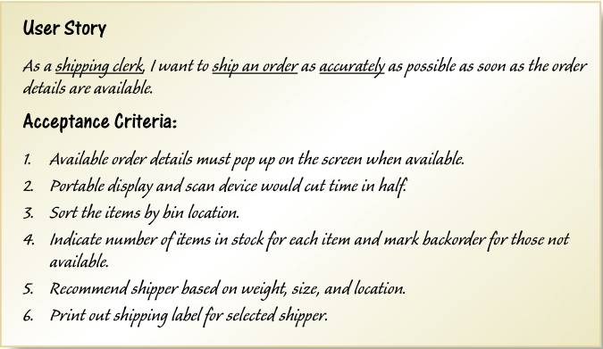
Sample User Story

Slide 8
Use Cases
Use case— an activity that the system performs, usually in response to a request by a user
Use cases define functional requirements
Analysts decompose the system into a set of use cases (functional decomposition)
Two techniques for Identifying use cases
User goal technique
Event decomposition technique
Name each use case using Verb-Noun

Slide 9
User Goal Technique
This technique is the most common in industry
Simple and effective
Identify all of the potential categories of users of the system
Interview and ask them to describe the tasks the computer can help them with
Probe further to refine the tasks into specific user goals, “I need to Ship items, Track a shipment, Create a return”

Slide 10
User Goal Technique: Some R M O C S M S Users and Goals
User | User goal and resulting use case
Potential customer | Search for item Fill shopping cart View product rating and comments
Marketing manager | Add/update product information Add/update promotion Produce sales history report
Shipping personnel | Ship items Track shipment Create item return

Slide 11
User Goal Technique: Specific Steps (1 of 2)
Identify all the potential users for the new system
Classify the potential users in terms of their functional role (e.g., shipping, marketing, sales)
Further classify potential users by organizational level (e.g., operational, management, executive)
For each type of user, interview them to find a list of specific goals they will have when using the new system (current goals and innovative functions to add value)

Slide 12
User Goal Technique: Specific Steps (2 of 2)
Create a list of preliminary use cases organized by type of user
Look for duplicates with similar use case names and resolve inconsistencies
Identify where different types of users need the same use cases
Review the completed list with each type of user and then with interested stakeholders

Slide 13
Event Decomposition Technique
More Comprehensive and Complete Technique
Identify the events that occur to which the system must respond.
For each event, name a use case (verb-noun) that describes what the system does when the event occurs
Event– something that occurs at a specific time and place, can be described, and should be remembered by the system

Slide 14
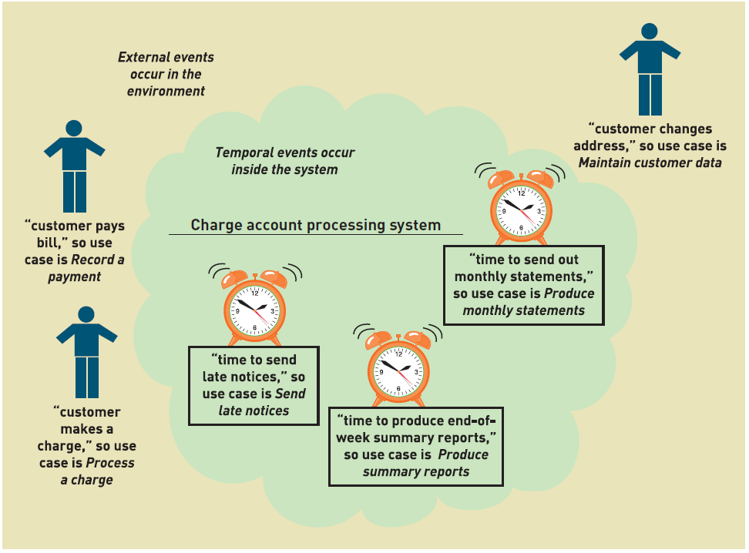
Events and Use Cases

Slide 15
Types of Events
External Event
an event that occurs outside the system, usually initiated by an external agent or actor
Temporal Event
an event that occurs as a result of reaching a point in time
State Event
an event that occurs when something happens inside the system that triggers some process
reorder point is reached for inventory item

Slide 16
External Event Checklist
External agent or actor wants something resulting in a transaction
Customer buys a product
External agent or actor wants some information
Customer wants to know product details
External data changed and needs to be updated
Customer has new address and phone
Management wants some information
Sales manager wants update on production plans

Slide 17
Temporal Event Checklist
Internal outputs needed at points in time
Management reports (summary or exception)
Operational reports (detailed transactions)
Internal statements and documents (including payroll)
External outputs needed at points of time
Statements, status reports, bills, reminders

Slide 18
Finding the actual event that affects the system

Slide 19
Tracing a sequence of transactions resulting in many events

Slide 20
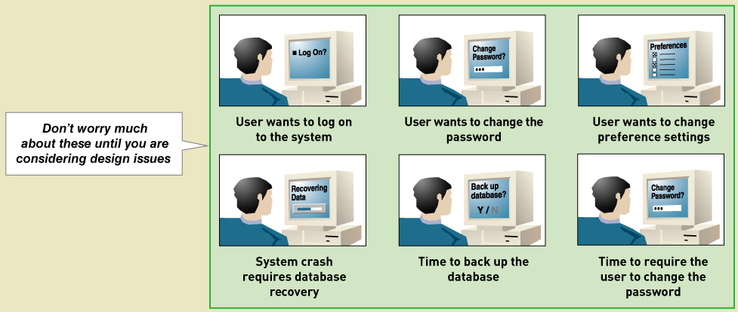
Perfect Technology Assumption
Don’t worry about functions built into system because of limits in technology and people. Wait until design.

Slide 21
Event Decomposition Technique: Specific Steps (1 of 2)
Consider the external events in the system environment that require a response from the system by using the checklist shown in Figure 3-3
For each external event, identify and name the use case that the system requires
Consider the temporal events that require a response from the system by using the checklist shown in Figure 3-4
For each temporal event, identify and name the use case that the system requires and then establish the point of time that will trigger the use case

Slide 22
Event Decomposition Technique: Specific Steps (2 of 2)
Consider the state events that the system might respond to, particularly if it is a real-time system in which devices or internal state changes trigger use cases.
For each state event, identify and name the use case that the system requires and then define the state change.
When events and use cases are defined, check to see if they are required by using the perfect technology assumption. Do not include events that involve such system controls as login, logout, change password, and backup or restore the database, as these are put in later.

Slide 23
Event Decomposition Technique: Benefits
Events are broader than user goal: Capture temporal and state events
Help decompose at the right level of analysis: an elementary business process (E B P)
E B P is a fundamental business process performed by one person, in one place, in response to a business event
Uses perfect technology assumption to make sure functions that support the users work are identified and not additional functions for security and system controls

Slide 24
Use Cases and Brief Use Case Descriptions
Brief use case description is often a one sentence description showing the main steps in a use case
Use case | Brief use case description
Create customer account | User/actor enters new customer account data, and the system assigns account number, creates a customer record, and creates an account record.
Look up customer | User/actor enters customer account number, and the system retrieves and displays customer and account data.
Process account adjustment | User/actor enters order number, and the system retrieves customer and order data; actor enters adjustment amount, and the system creates a transaction record for the adjustment.

Slide 25
R M O C S M S Project Use Cases (1 of 4)
C S M S Sales Subsystem
Use cases | Users/actors
Search for item | Customer, customer service representative, store sales representative
View product comments and ratings | Customer, customer service representative, store sales representative
View accessory combinations | Customer, customer service representative, store sales representative
Fill shopping cart | Customer
Empty shopping cart | Customer
Check out shopping cart | Customer
Fill reserve cart | Customer
Empty reserve cart | Customer
Convert reserve cart | Customer
Create phone sale | Customer service representative
Create store sale | Stores sales representative

Slide 26
R M O C S M S Project Use Cases (2 of 4)
C S M S Order Fulfillment Subsystem
Use cases | Users/actors
Ship items | Shipping
Manage shippers | Shipping
Create backborder | Shipping
Create item return | Shipping, customer
Look up order status | Shipping, customer, management
Track shipment | Shipping, customer, marketing
Rate and comment on product | Customer
Provide suggestion | Customer
Review suggestions | Management

Slide 27
R M O C S M S Project Use Cases (3 of 4)
C S M S Customer Account Subsystem
Use cases | Users/actors
Create/update customer account | Customer, customer service representative, store sales representative
Process account adjustment | Management
Send message | Customer
Browse messages | Customer
Request friend linkup | Customer
Reply to linkup request | Customer
Send/receive partner credits | Customer
View “mountain bucks” | Customer
Transfer “mountain bucks” | Customer

Slide 28
R M O C S M S Project Use Cases (4 of 4)
C S M S Marketing Subsystem
Use cases | Users/actors
Add/update product information | Merchandising, marketing
Add/update promotion | marketing
Add/update accessory package | Merchandising
Add/update business partner link | Marketing
C S M S Reporting Subsystem
Use cases | Users/actors
Produce daily transaction summary report | Management
Produce sales history report | Management, marketing
Produce sales trends report | Marketing
Produce customer usage report | Marketing
Produce shipment history report | Management, shipping
Produce promotion impact report | Marketing
Produce promotional partner activity report | Management, marketing

Slide 29
Use Case Diagrams
Use case diagram— a U M L model used to graphically show uses cases and their relationships to actors
Recall U M L is Unified Modeling Language, the standard for diagrams and terminology for developing information systems
Actor is the U M L name for a end user
Automation boundary— the boundary between the computerized portion of the application and the users who operate the application

Slide 30
Use Case Diagrams Symbols

Slide 31
Use Case Diagrams: Draw for each subsystem

Slide 32
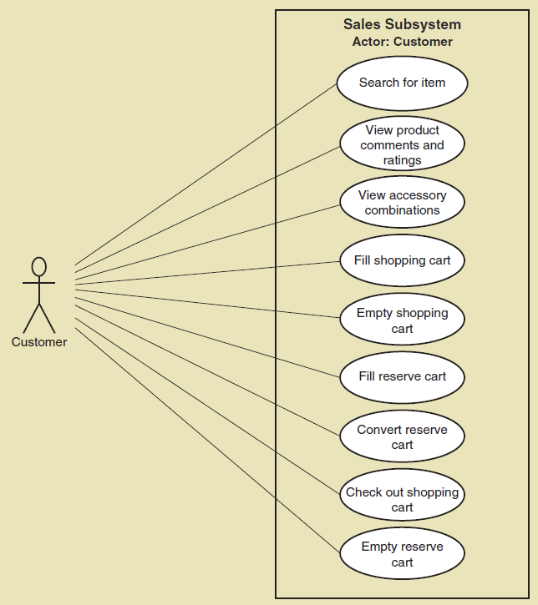
Use Case Diagrams: Draw for a single actor, such as customer

Slide 33
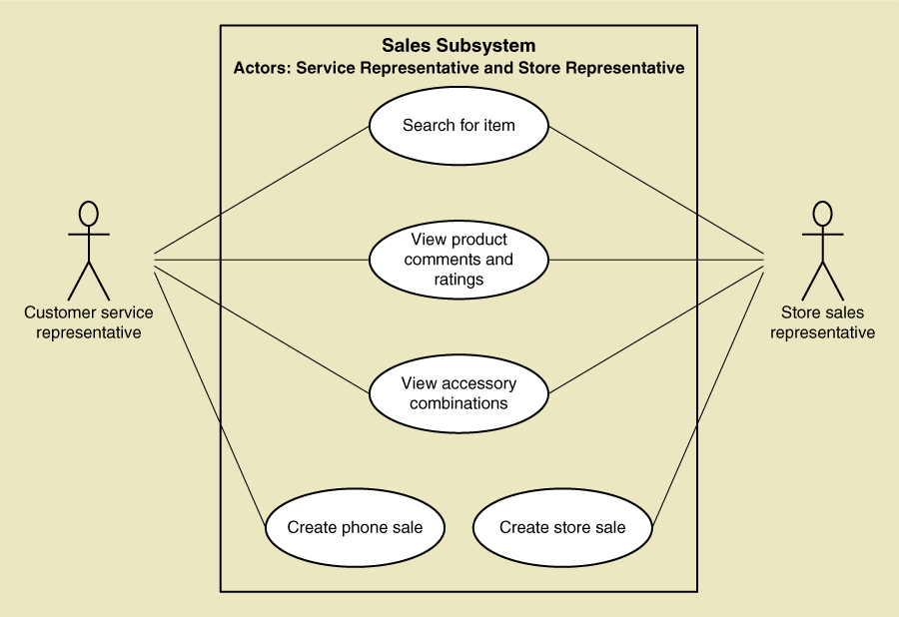
Use Case Diagrams: Draw for internal R M O actors

Slide 34
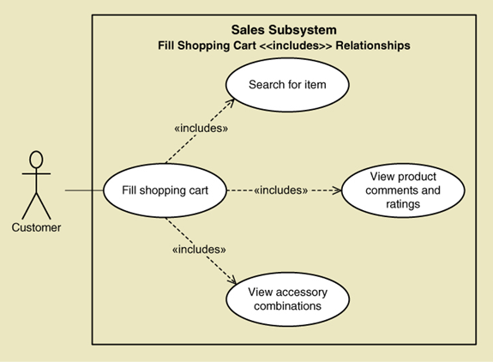
Use Case Diagrams— The <<Includes>> relationship
A relationship between use cases where one use case is stereotypically included within the other use case— like a called subroutine. Arrow points to subroutine

Slide 35
Use Case Diagrams: Steps
Identify all the stakeholders and users who would benefit by seeing a use case diagram
Determine what each stakeholder or user needs to review in a use case diagram: each subsystem, for each type of user, for use cases that are of interest
For each potential communication need, select the use cases and actors to show and draw the use case diagram. There are many software packages that can be used to draw use case diagrams
Carefully name each use case diagram and then note how and when the diagram should be used to review use cases with stakeholders and users

Slide 36
Summary (1 of 2)
This chapter is the first of three that focuses on modeling functional requirements as a part of systems analysis
Use cases are the functions identified, the activities the system carries out usually in response to a user request
Two techniques for identifying use cases are the user goal technique and the event decomposition technique
The user goal technique begins by identifying end users called actors and asking what specific goals they have when interacting with the system
The event decomposition technique begins by identifying events that occur that require the system to respond.

Slide 37
Summary (2 of 2)
Three types of events include external, temporal, and state events
Brief use case descriptions are written for use cases
The use case diagram is the U M L diagram used to show the use cases and the actors
The use case diagram shows the actors, the automation boundary, the uses cases that involve each actor, and the <<includes>> relationship.
A variety of use case diagrams are draw depending on the presentation needs of the analysis

