Slide 1
Chapter 5
Systems Analysis and Design in a Changing World, 7th Edition - Chapter 5 ©2016. Cengage Learning. All rights reserved.

Slide 2
Use Case Modeling
Chapter 5
Systems Analysis and Design in a Changing World 7th Ed
Satzinger, Jackson & Burd

Slide 3
Chapter 5: Outline
Use Case Descriptions
Activity Diagrams for Use Cases
The System Sequence Diagram—Identifying Inputs and Outputs
S S D Notation
Use Cases and C R U D
Integrating Requirements Models

Slide 4
Learning Objectives
Write fully developed use case descriptions
Develop activity diagrams to model flow of activities
Develop system sequence diagrams
Use the C R U D technique to validate use cases
Explain how use case descriptions and U M L diagrams work together to define functional requirements

Slide 5
Overview (1 of 2)
Chapters 3 and 4 identified and modeled the two primary aspects of functional requirements: use cases and domain classes
This chapter focuses on detail modelling for use cases to document the internal steps within a use case
Fully developed use case descriptions provide information about each use case, including actors, stakeholders, preconditions, post conditions, the flow of activities and exceptions conditions
Activity diagrams (first shown in Chapter 2) can also be used to show the flow of activities for a use case

Slide 6
Overview (2 of 2)
System sequence diagrams (S S D s) show the inputs and outputs for each use case as messages
C R U D analysis, which correlates problem domain classes and use cases, is an effective technique to double check that all required use cases have been identified
Not all use cases are modelled at this level of detail. Only model when there is complexity and a need to communicate details

Slide 7
Use Case Descriptions (1 of 2)
Write a brief description as shown in Chapter 3 for most use cases.
Use case | Brief use case description
Create customer account | User/actor enters new customer account data, and the system assigns account number, creates a customer record, and creates an account record.
Look up customer | User/actor enters customer number, and the system retrieves and displays customer and account data.
Process account adjustment | User/actor enters order number, and the system retrieves customer and order data; actor enters adjustment amount, and the system creates a transaction record for the adjustment.

Slide 8
Use Case Descriptions (2 of 2)
Write a fully developed use case description for more complex use cases
Typical use case description templates include:
Use case name
Scenario (if needed)
Triggering event
Brief description
Actors
Related use cases (<<includes>>)
Stakeholders
Preconditions
Postconditions
Flow of activities
Exception conditions

Slide 9
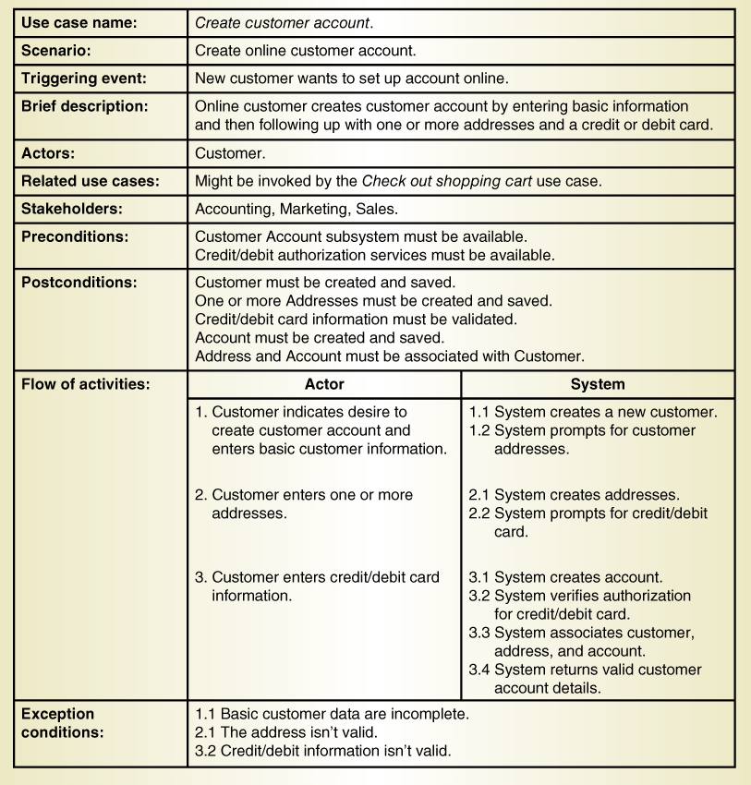
Fully Developed Use Case Description: Use case: Create customer account

Slide 10
Fully Developed Use Case Description Create customer account (part 1)
Use case name: | Create customer account.
Scenario: | Create online customer account.
Triggering event: | New customer wants to set up account online.
Brief description: | Online customer creates customer account by entering basic information and then following up with one or more addresses and a credit or debit card.
Actors: | Customer.
Related use cases: | Might be invoked by the Check out shopping cart use case.
Stakeholders: | Accounting, Marketing, Sales.
Preconditions: | Customer account subsystem must be available. Credit/debit authorization services must be available.
Postconditions: | Customer must be created and saved. One or more Addresses must be created and saved. Credit/debit card information must be validated. Account must be created and saved. Address and Account must be associated with Customer.

Slide 11
Fully Developed Use Case Description Create customer account (part 2)
Flow of activities: | Actor | System
blank | Customer indicates desire to create customer account and enters basic customer information. Customer enters one or more addresses. Customer enters credit/debit card information. | 1.1 System creates a new customer. 1.2 System prompts for customer addresses. 2.1 System creates addresses. 2.2 System prompts for credit/debit card. 3.1 System creates account. 3.2 System verifies authorization for credit/debit card. 3.3 System associates customer, address, and account. 3.4 System returns valid customer account details.
Exception conditions: | 1.1 Basic customer data are incomplete. 2.1 The address isn’t valid. 3.2 Credit/debit information isn’t valid. | Blank

Slide 12
Use Case Description Details (1 of 2)
Use case name
Verb-noun
Scenario (if needed)
A use case can have more than one scenario (special case or more specific path)
Triggering event
Based on event decomposition technique
Brief description
Written previously when use case was identified
Actors
One or more users from use case diagrams

Slide 13
Use Case Description Details (2 of 2)
Related use cases <<includes>>
If one use case invokes or includes another
Stakeholders
Anyone with an interest in the use case
Preconditions
What must be true before the use case begins
Post conditions
What must be true when the use case is completed
Use for planning test case expected results
Flow of activities
The activities that go on between actor and the system
Exception conditions
Where and what can go wrong

Slide 14
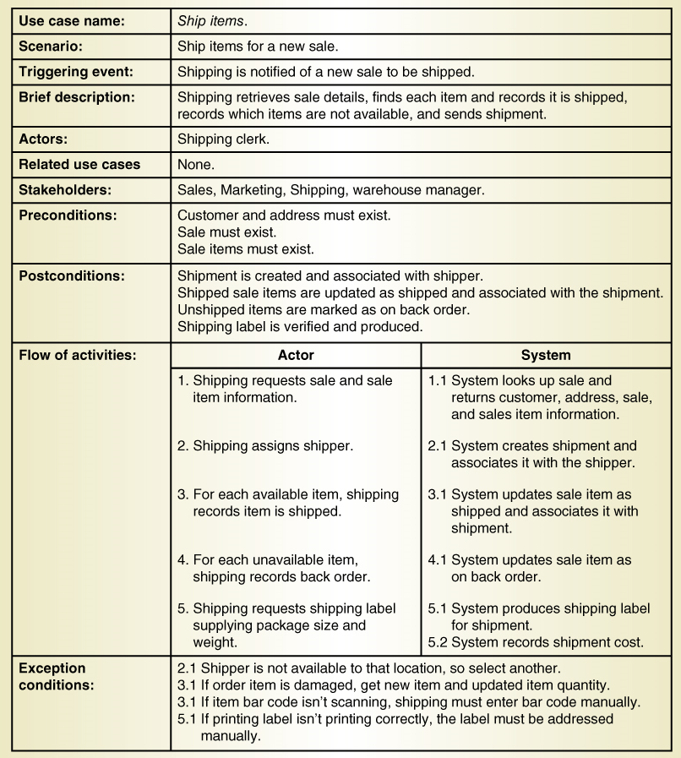
Another Fully Developed Use Case Description Example: Use case Ship items

Slide 15
Fully Developed Use Case Description Ship items (part 1)
Use case name: | Ship items.
Scenario: | Ship items for a new sale.
Triggering event: | Shipping is notified of a new sale to be shipped.
Brief description: | Shipping retrieves sale details, finds each item and records it is shipped, records which items are not available, and sends shipment.
Actors: | Shipping clerk.
Related use cases | None.
Stakeholders: | Sales, Marketing, Shipping, warehouse manager.
Preconditions: | Customer and address must exist. Sale must exist. Sale items must exist.
Postconditions: | Shipment is created and associated with shipper. Shipped sale items are updated as shipped and associated with the shipment. Unshipped items are marked as on back order. Shipping label is verified and produced.

Slide 16
Fully Developed Use Case Description Ship items (part 2)
Flow of activities: | Actor | System
blank | Shipping requests sale and sale item information. Shipping assigns shipper. For each available item, shipping records item is shipped. For each unavailable item, shipping records back order. Shipping requests shipping lablel supplying package size and weight. | 1.1 System looks up sale and returns customer, address, sale, and sales item information. 2.1 System creates shipment and associates it with the shipper. 3.1 System updates sale item as shipped and associates it with shipment. 4.1 System updates sale item as on back order. 5.1 System produces shipping label for shipment. 5.2 System records shipment cost.
Exception conditions: | 2.1 Shipper is not available to that location, so select another. 3.1 If order item is damaged, get new item and updated item quantity. 3.1 If item bar code isn’t scanning, shipping must enter bar code manually. 5.1 If printing label isn’t printing correctly, the label must be addressed manually. | blank

Slide 17
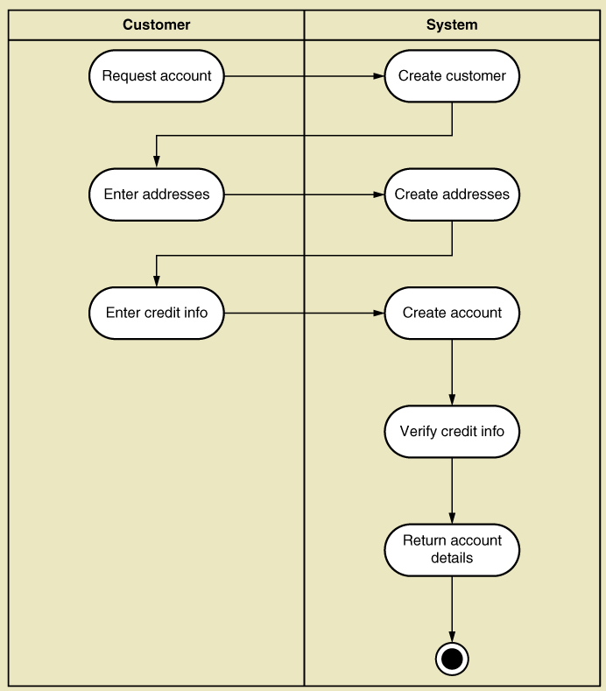
U M L Activity Diagram for Use Case: Create Customer Account
Note: this shows flow of activities only

Slide 18
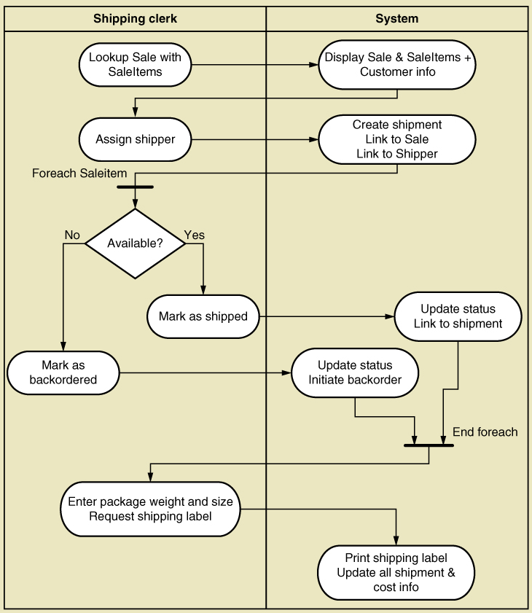
Activity Diagram for Ship Items Use Case
Note:
Synchronization bar for loop
Decision diamond

Slide 19
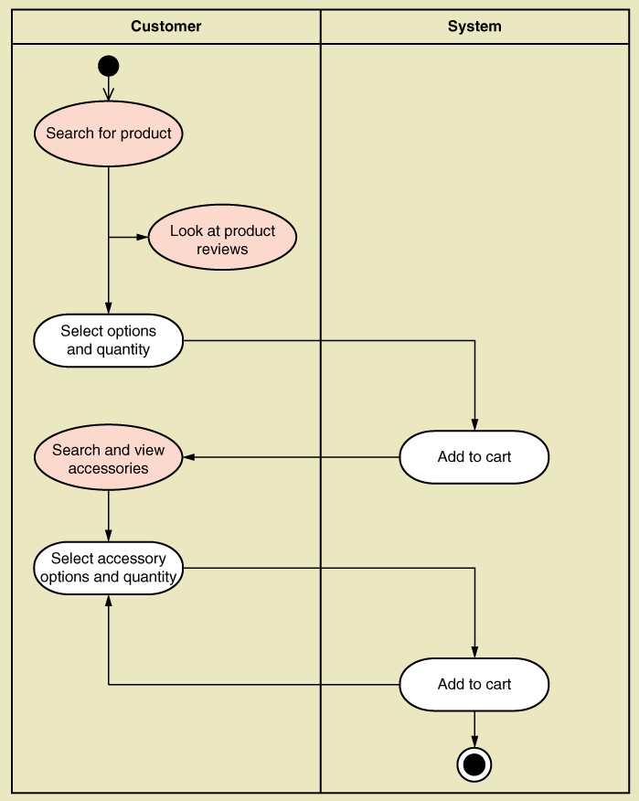
U M L Activity Diagram for Use Case: Fill shopping cart
Note: this shows use case with <<includes>> relationship

Slide 20
System Sequence Diagram (S S D)
A U M L sequence diagram
Special case for a sequence diagram
Only shows actor and one object
The one object represents the complete system
Shows input & output messaging requirements for a use case
Actor, :begin underline System end underline, object lifeline
Messages

Slide 21
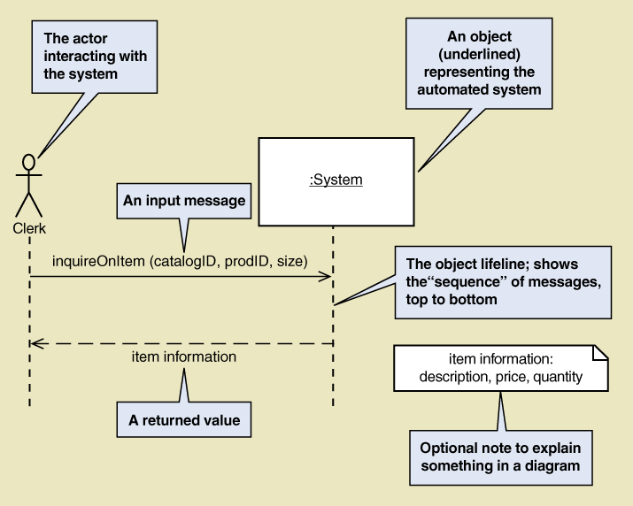
System Sequence Diagram (S S D) Notation

Slide 22
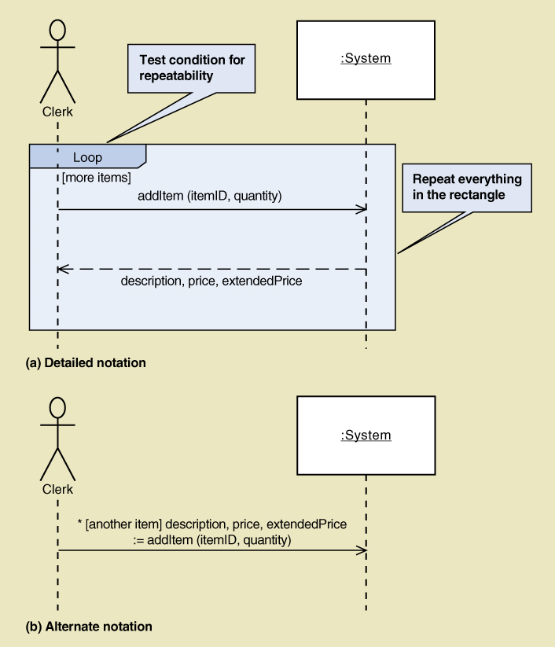
S S D Message Examples with Loop Frame

Slide 23
Message Notation for S S D
[true/false condition] return-value := message-name (parameter-list)
An asterisk (*) indicates repeating or looping of the message
Brackets [ ] indicate a true/false condition. This is a test for that message only. If it evaluates to true, the message is sent. If it evaluates to false, the message isn’t sent.
Message-name is the description of the requested service written as a verb-noun.
Parameter-list (with parentheses on initiating messages and without parentheses on return messages) shows the data that are passed with the message.
Return-value on the same line as the message (requires :=) is used to describe data being returned from the destination object to the source object in response to the message.

Slide 24
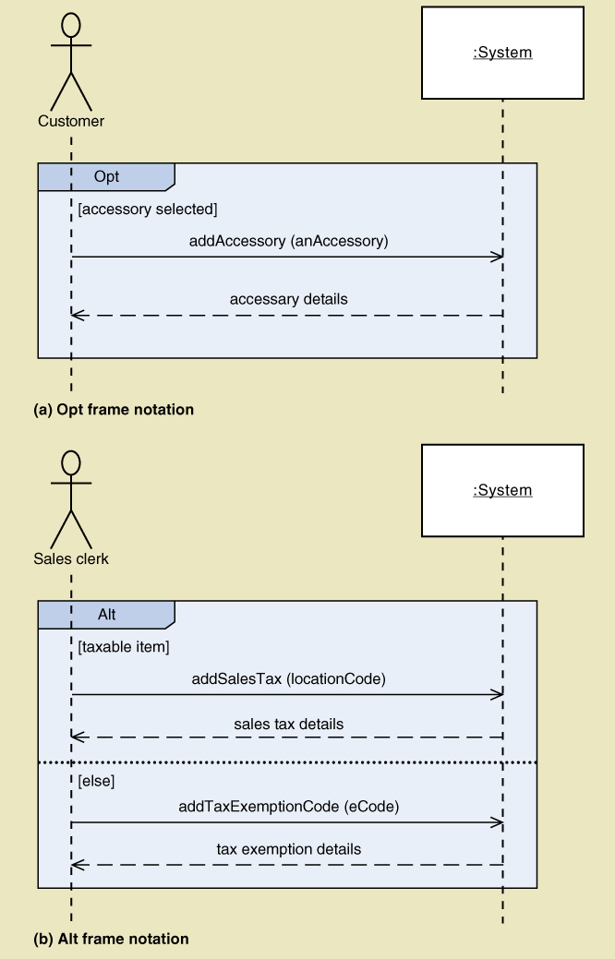
S S D Message Examples
Opt Frame (optional)
Alt Frame (if-else)

Slide 25
Steps for Developing S S D
Identify input message
See use case flow of activities or activity diagram
Describe the message from the external actor to the system using the message notation
Name it verb-noun: what the system is asked to do
Consider parameters the system will need
Identify any special conditions on input messages
Iteration/loop frame
Opt or Alt frame
Identify and add output return values
On message itself: aValue:= getValue(value I D)
As explicit return on separate dashed line

Slide 26
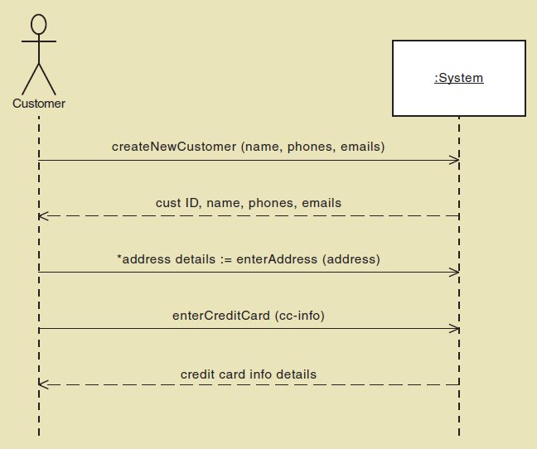
S S D for Create customer account Use case

Slide 27
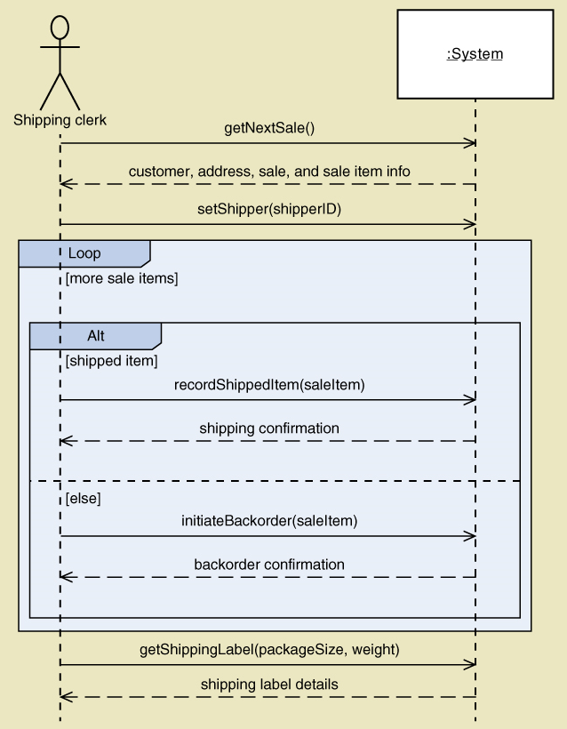
S S D for Ship items Use Case

Slide 28
Use Cases and C R U D
C R U D technique –
Create
Read/Report
Update
Delete
A good cross-check against the existing set of use cases. Used in database context
Ensure that all classes have a complete “cover” of use cases
Not for primary identification of use cases

Slide 29
Verifying use cases for Customer
Data entity/domain class | C R U D | Verified use case
Customer | Create | Create customer account
BLANK | Read/report | Look up customer Produce customer usage report
BLANK | Update | Process account adjustment Update customer account
BLANK | Delete | Update customer account (to archive)

Slide 30
C R U D Analysis: Steps
Identify all domain classes
For each class verify that use cases exist to
Create a new instance
Update existing instances
Reads or reports on information in the class
Deletes or archives inactive instances
Add new use cases as required. Identify responsible stakeholders
Identify which application has responsibility for each action: which to create, which to update, which to use

Slide 31
Sample C R U D Matrix
Use case vs. entity/domain class | Customer | Account | Sale | Adjustment
Create customer account | C | C
Look up customer | R | R | BLANK | BLANK
Produce customer usage report | R | R | R | BLANK
Process account adjustment | R | U | R | C
Update customer account | U D (archive) | U D (archive) | BLANK | BLANK

Slide 32
Extending and Integrating Requirements Models
Use cases
Use case diagram
Use case description
Activity diagram
System sequence diagram (S S D)
Domain Classes
Domain model class diagram
State machine diagram

Slide 33
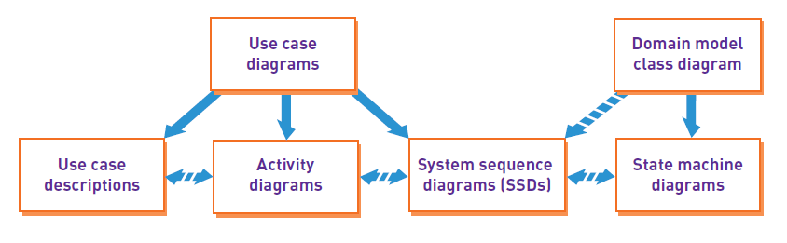
Integrating Requirements Models

Slide 34
Summary (1 of 2)
Chapters 3 and 4 identified and modeled the two primary aspects of functional requirements: use cases and domain classes
This chapter focuses on models to provide details of use cases
Fully developed use case descriptions provide information about each use case, including actors, stakeholders, preconditions, post conditions, the flow of activities and exceptions conditions
Activity diagrams (first shown in Chapter 2) can also be used to show the flow of activities for a use case

Slide 35
Summary (2 of 2)
System sequence diagrams (S S D s) show the inputs and outputs for each use case as messages
C R U D analysis serves to verify that all domain classes are fully supported by the new system, i.e. have use cases to fully process all required actions
Not all use cases and domain classes are modelled at a detailed level. Only model when there is complexity and a need to communicate details.
All of the models must be consistent and integrate together to provide a complete picture of the requirements and specification.

Slide 36
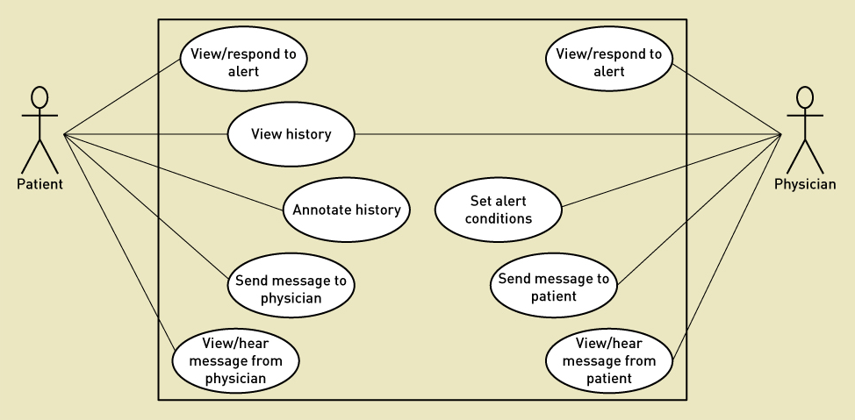
R T G M System Use Cases

