Slide 1
Contract Monthly Claim System
Streamlining Monthly Claim Submission and Approval
By Lilitha Booi

Slide 2
System Overview
The Contract Monthly Claim System is designed to automate the process of submitting and approving monthly claims for contract lecturers.
Roles:
  HR: Manages user accounts and sets hourly rates.
  Lecturer: Submits monthly claims with hours worked and supporting documents.
  Coordinator: Reviews and approves claims submitted by lecturers.
  Manager: Provides final approval for claims.

Slide 3
Database Design
Entities:
  User: Stores user details and role.
  Claim: Main claim header with total amount and status.
  ClaimItem: Breakdown of hours and rate for each claim.
  Document: Supporting documents for claims.
Relationships:
  User to Claim (One-to-Many)
  Claim to ClaimItem (One-to-Many)
  Claim to Document (One-to-Many)

Slide 4
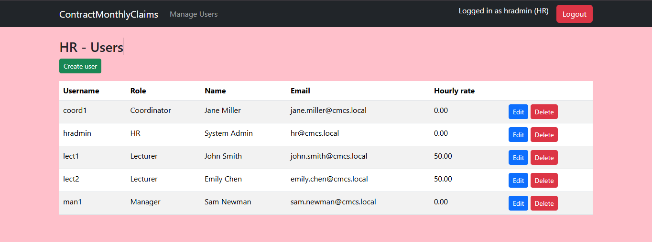
HR Portal
Features:
  Create new users (Lecturers, Coordinators, Managers, HR)
  Edit existing user details, including hourly rate for lecturers
  Delete users

Slide 5
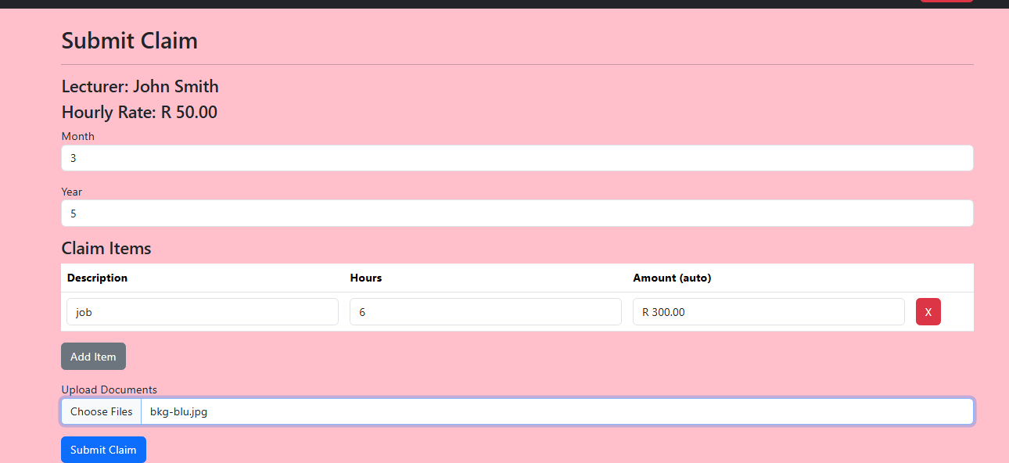
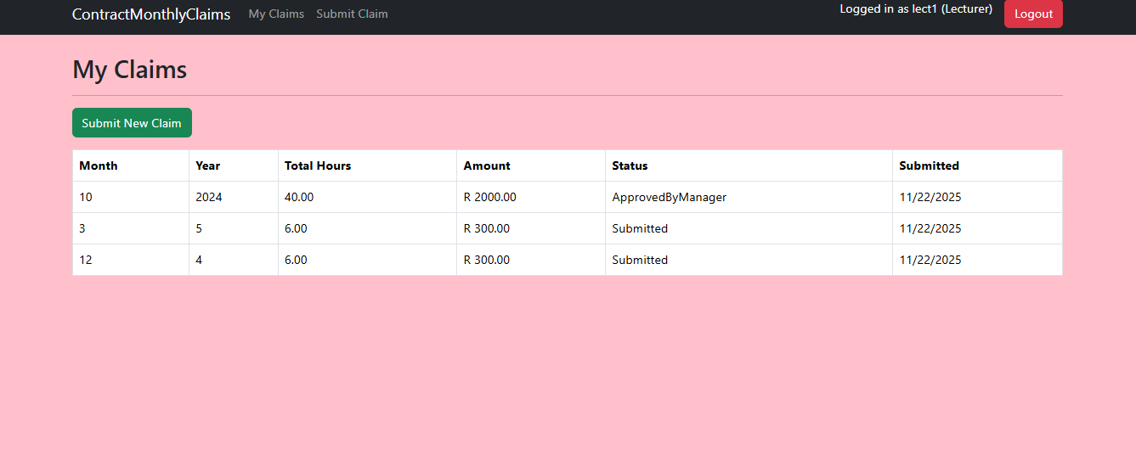
Lecturer Portal
Features:
  Auto-calculation of claim amount based on hours and HR-set rate
  Validation: Total hours cannot exceed 180 per month
  Document upload (multiple files)

Slide 6
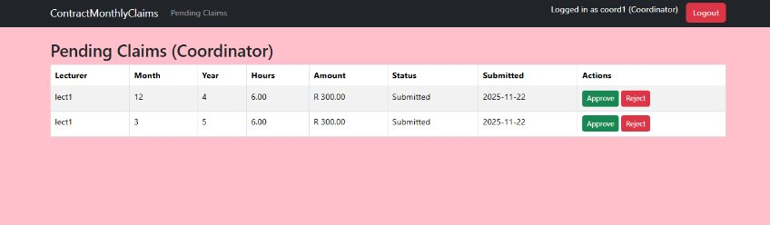
Coordinator Portal
Features:
  View claim details, items, and documents
  Approve or reject claims

Slide 7
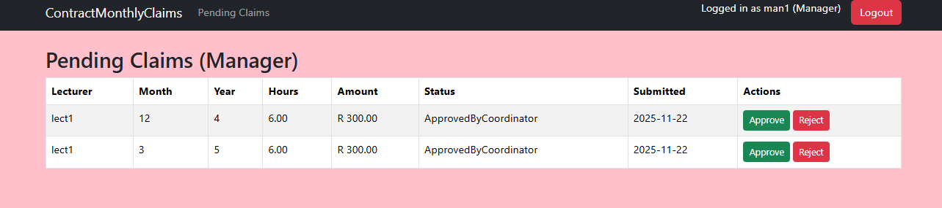
Manager Portal
Features:
  Final approval of claims
  View claim details, items, and documents

Slide 8
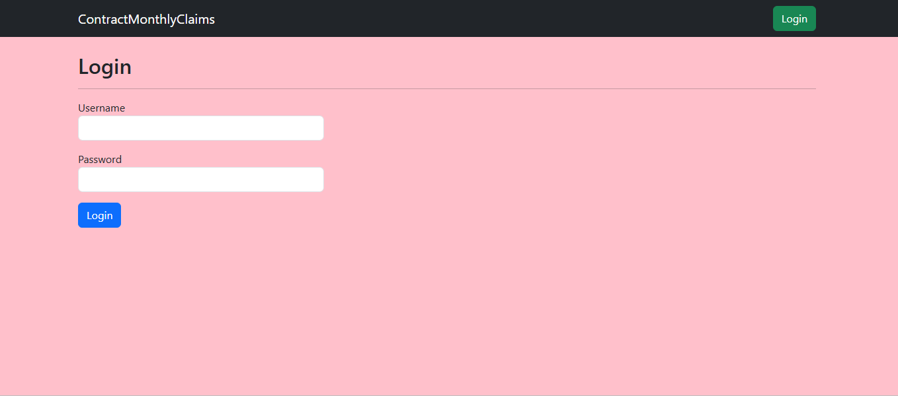
Login and Session Management
How it works:
  Users log in with credentials provided by HR.
  Session variables store username and role.
  Redirects to appropriate portal based on role.

Slide 9
Technical Stack
Backend: ASP.NET Core MVC
Database: SQL Server with Entity Framework Core
Frontend: Bootstrap, JavaScript
Authentication: Session-based

Slide 10
Conclusion
Benefits:
  Streamlined claim process
  Reduced paperwork
  Faster approvals
Future Enhancements:
  Password hashing
  Email notifications
  PDF report generation

