Slide 1
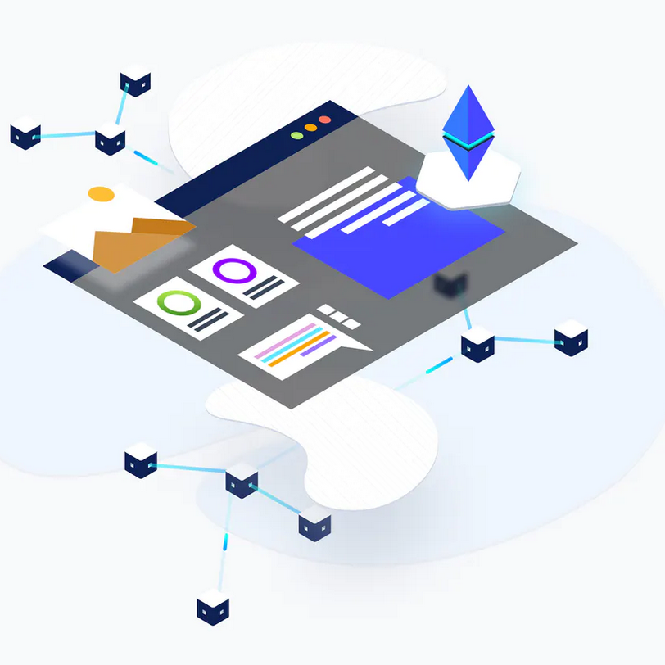
Team 2
KYC Smart Contract
KYC SMART CONTRACT
(Know Your Customer)
Blockchain & Smart Contract
Team Member: Booker Sessoms
Leon Zubkov
Richard Bertrand
Song Zhao
Faculty Advisors: Aaron, Adam, Jeff, Julia, Yichao

Slide 2
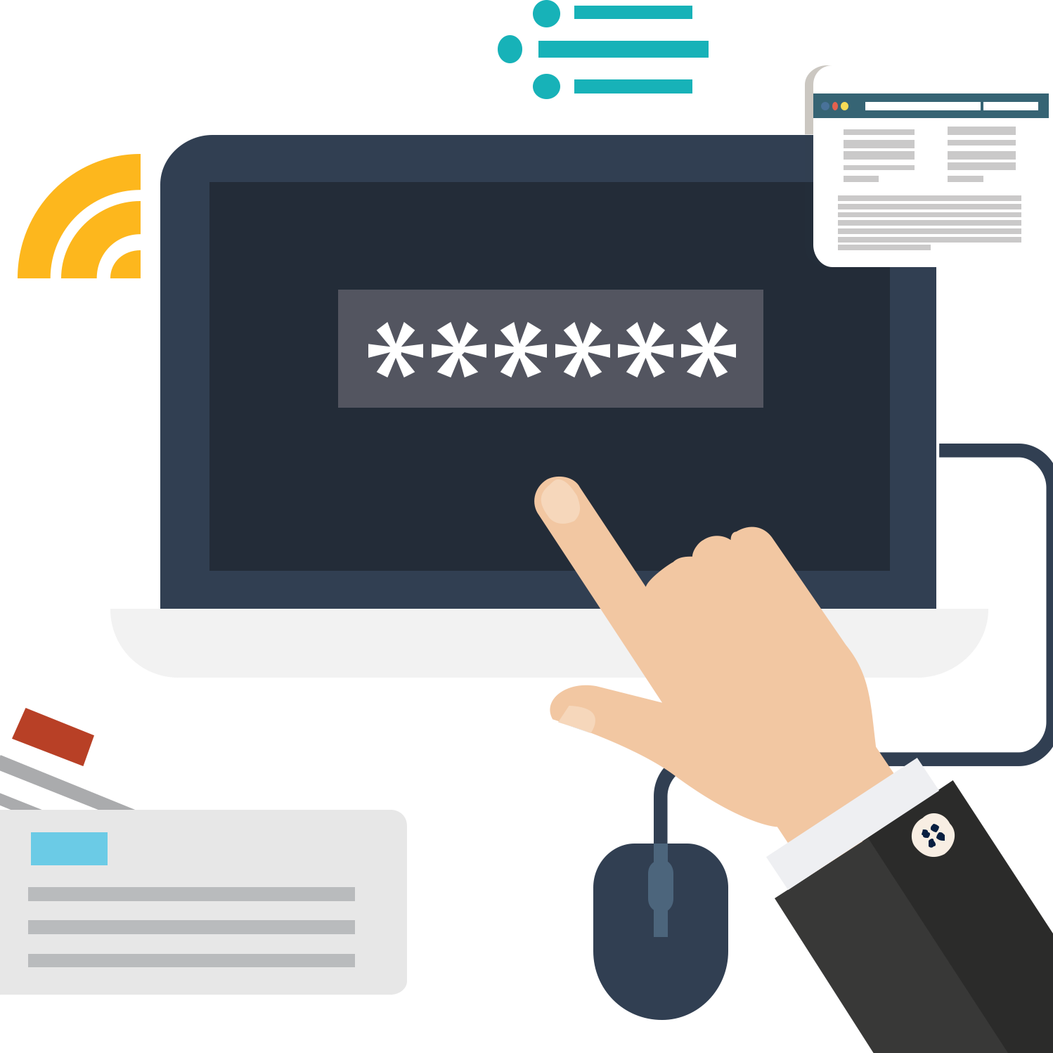
Team 2
KYC Smart Contract
Project Overview
WHAT IS KYC?
A process by which banks obtain information about the identity of the customers
1
Customers
Account/Business Owner
Authorized Professionals
Beneficial Owners
2
Elements
Customer Identification
Customer Due Diligence
Ongoing Monitoring
Risk Management
3
Application
Account Opening
Due Diligence

Slide 3


Team 2
KYC Smart Contract
CURRENT PROBLEMS
Institutions do their own KYC
Both new information and ongoing changes
Repetitiveness
- Repetitive procedures if customers want to approach to different banks
High Cost
Low efficiency

Slide 4
Team 2
KYC Smart Contract .
01
PLATFORM DEVELOPMENT
Build up a platform utilizing smart contract to best serve the anti-money laundry purpose.
A permission based blockchain to share KYC records amongst institutions.
PROJECT OVERVIEW
02
SOLUTION
PRIVACY & TRANSPARENCY
Ensure data security and privacy.
Multi-stakeholder access
03
EFFICIENCY & COST
Automate the processes
Lower the cost
Reduce receptiveness

Slide 5
Team 2
KYC Smart Contract
ABOUT KYC
Why Blockchain?
1
2
3
4
ACCESS
SPEED
COST
SECURITY
Decentralized database provides universal accessibility
Reduce the process by eliminating the repetitiveness
Lower the time spent for information acquisition
Lower the cost for user information acquisition
Stronger security to protect from hack and attack

Slide 6
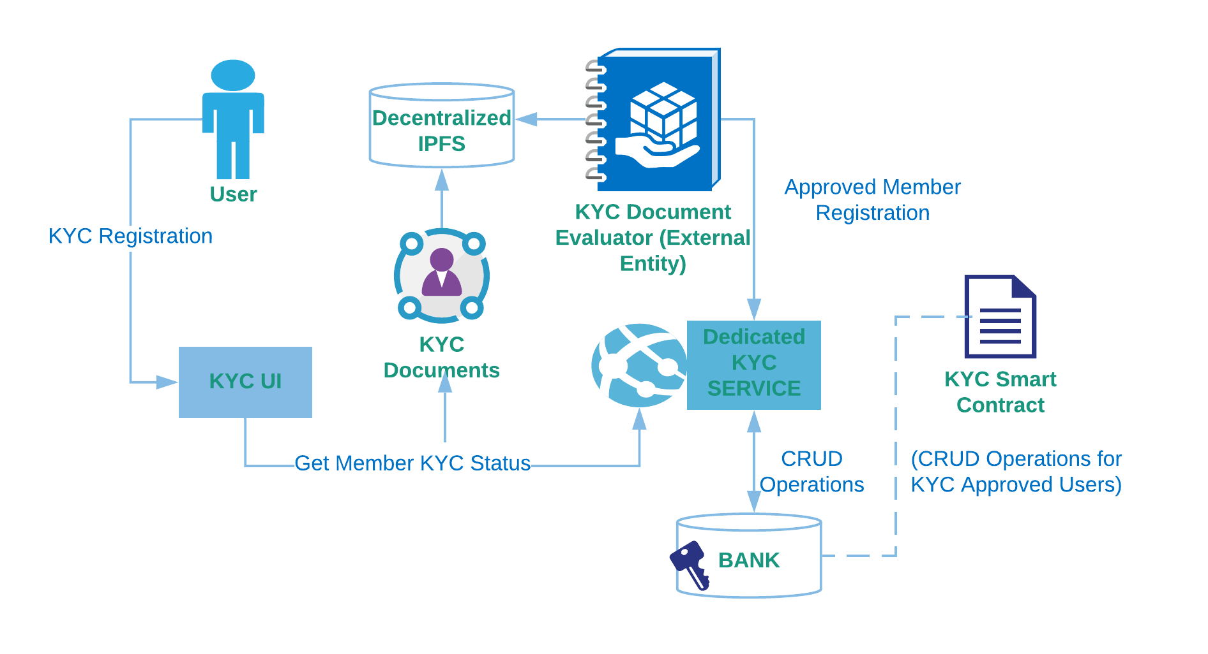
Team 2
KYC Smart Contract
STRUCTURE

Slide 7
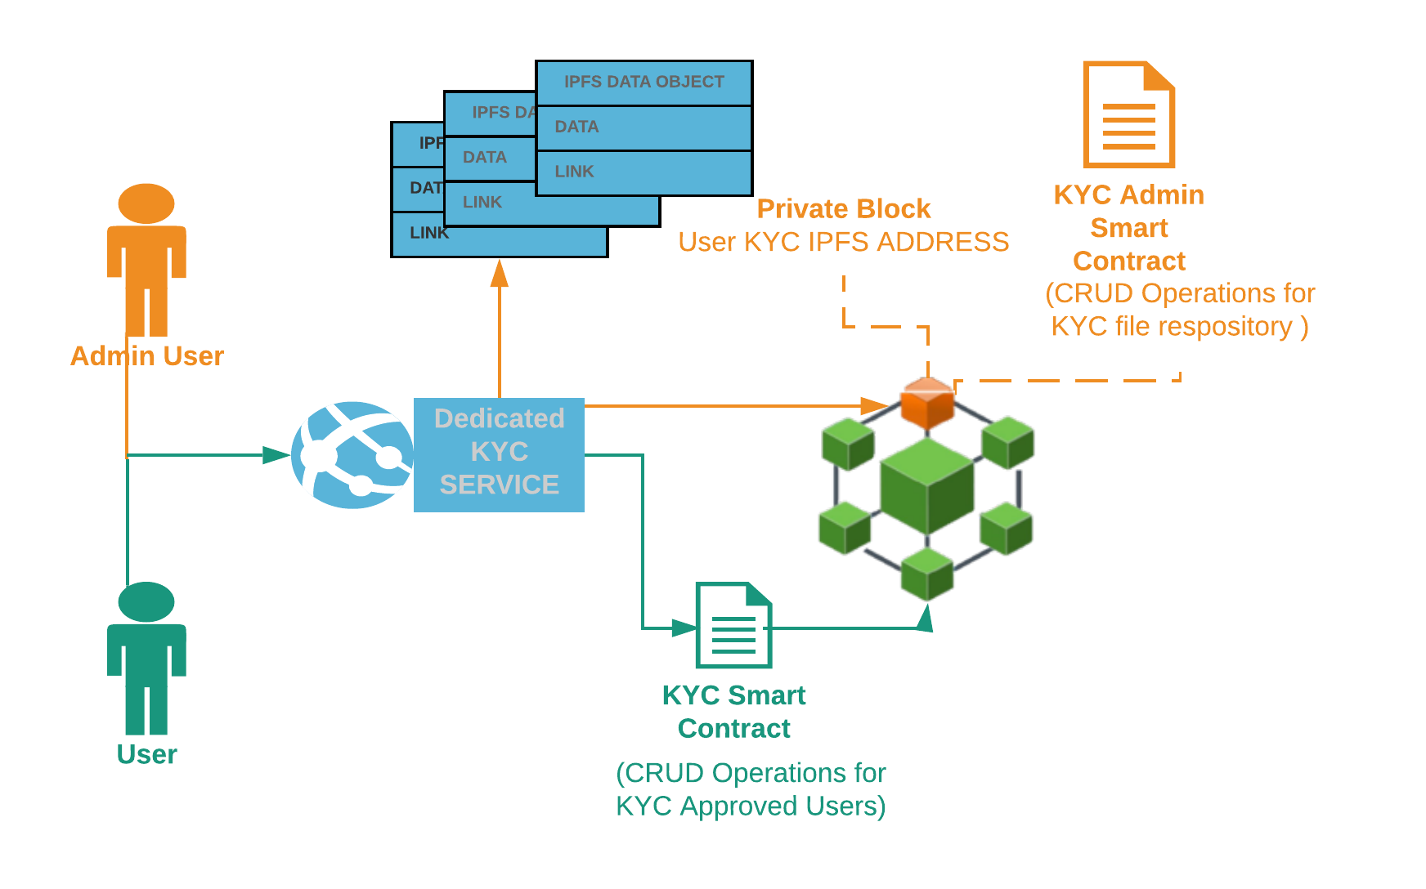
Team 2
KYC Smart Contract
Private & Public Smart Contract

Slide 8
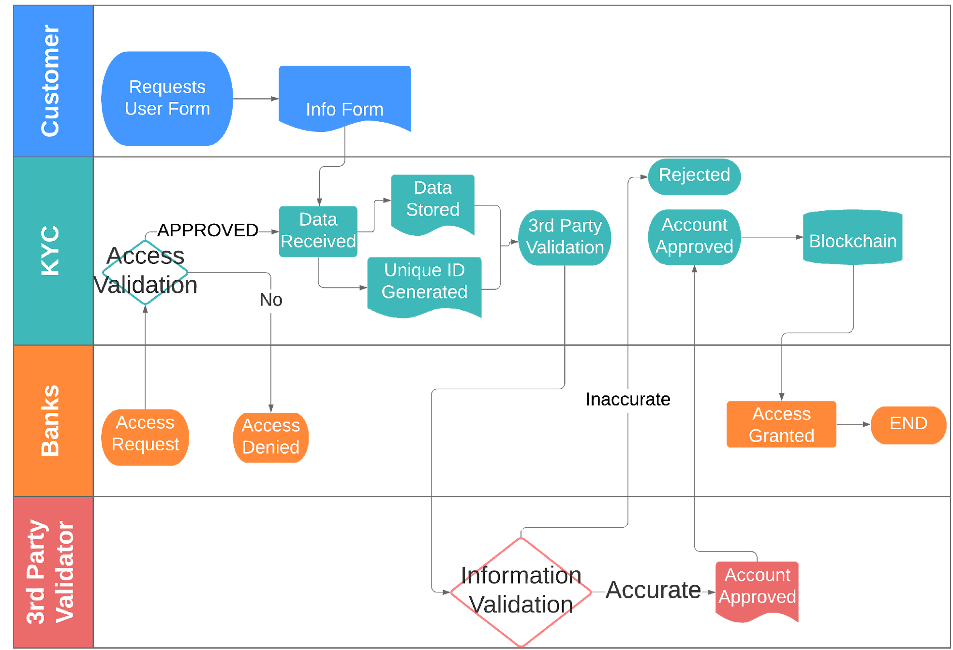
Team 2
KYC Smart Contract
OPERATION PROCESS

Slide 9

Team 2
KYC Smart Contract
Interface Mockup
LOW OPERATIONAL COSTS
SPEED INSTANT, ON DEMAND ACCESS

Slide 10
Team 2
KYC Smart Contract
Refined Security
Add more layers of security through smart contract coding and Quorum, a private blockchain
PROJECT REVIEW
IMPROVEMENT
Document Integrity
Put structures in place that weed out duplicate submissions while also accounting for customers entire profile
Contract Functionality
Current product is limited in scope and is mostly a proof of concept, but have kept expansions in mind

Slide 11
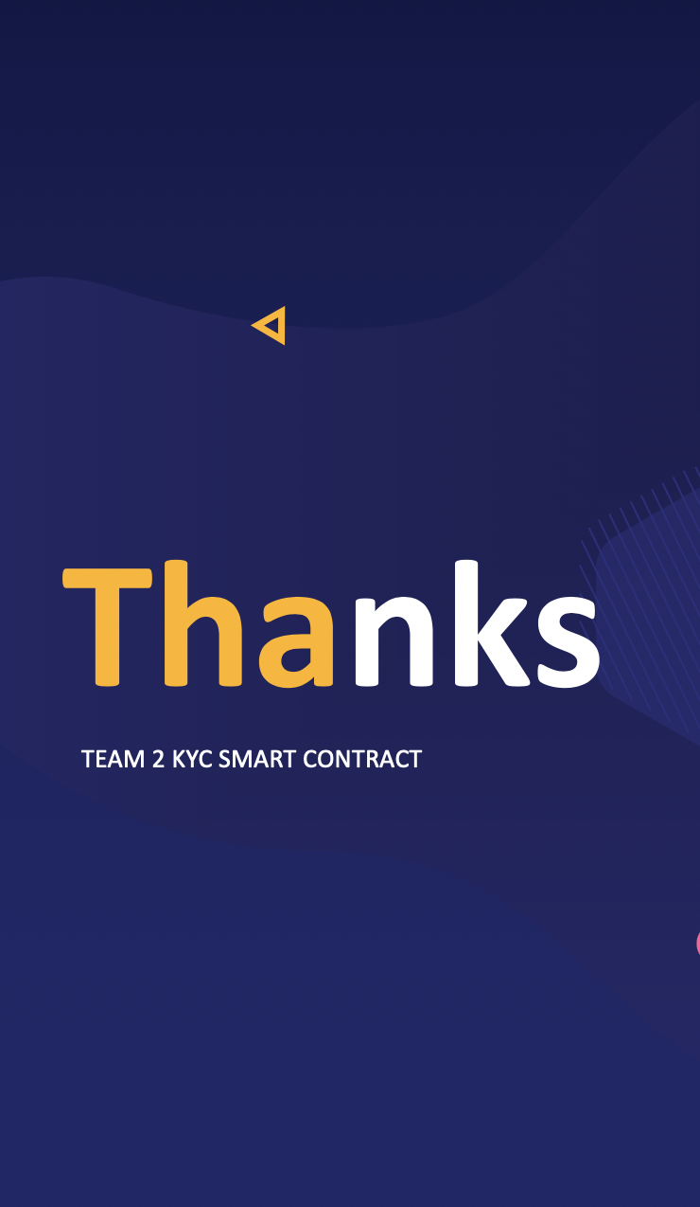
Team 2
KYC Smart Contract
Q & A

