Slide 1
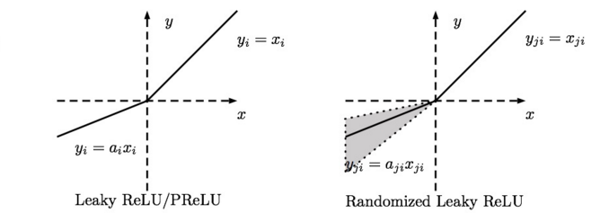
Leaky-ReLU
α = 0.25
P-ReLU
α is adaptive learned

Slide 2
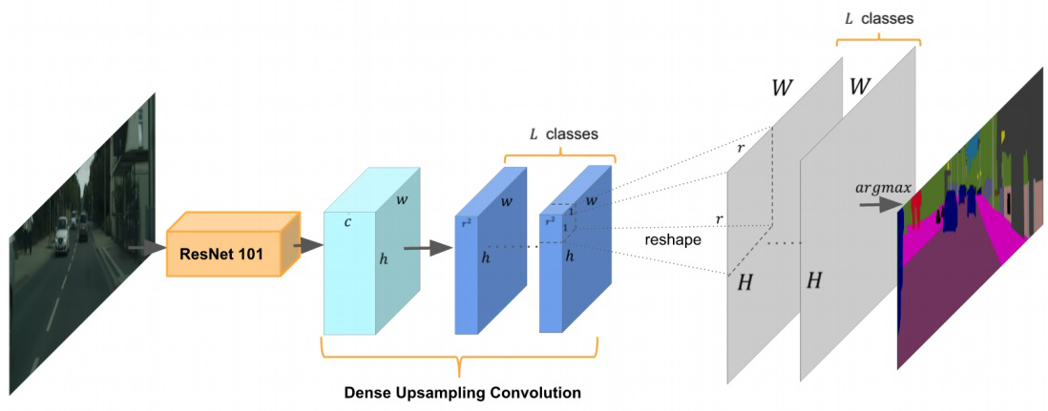
Reshape Layer

Slide 3
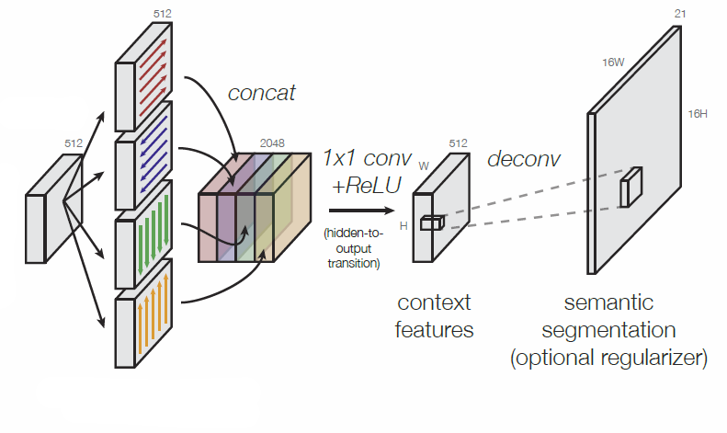
Concat Layer

Slide 4
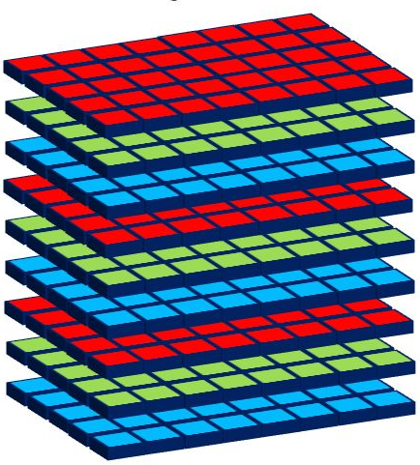
Width W
Height H
Channel C
Batch_Size N
Size: (3, 3, 5, 8)

