Slide 1
Data
Three Components of
Machine Learning
Alex Jung
Hypothesis Space
Loss Function

Slide 2
Background Material
course book: F. Chollet, “Deep Learning with Python”
https://aalto.finna.fi/Record/alli.833878
A. Jung, “Machine Learning: Basic Principles” https://arxiv.org/abs/1805.05052
I. Goodfellow, Y. Bengio and A. Courville, “Deep Learning”
https://www.deeplearningbook.org/

Slide 3

Corona ?

Slide 4
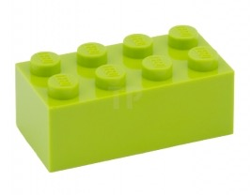
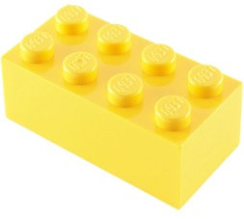
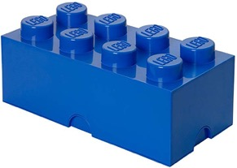
Three Main Components
data (video, audio, text)
model (network architecture)
loss function (performance measure)

Slide 5
Data

Slide 6
Dataset = (Large) Set of “Data Points”
data points are different objects but of similar “type”

Slide 7
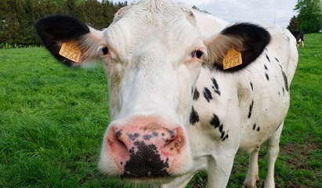
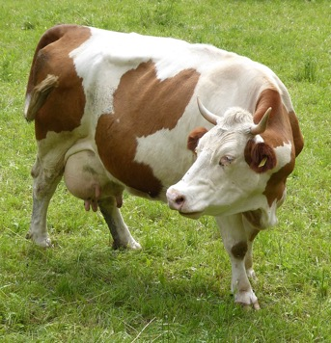
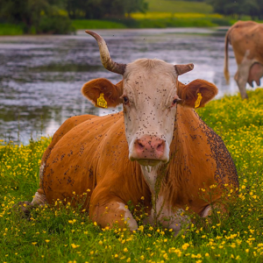
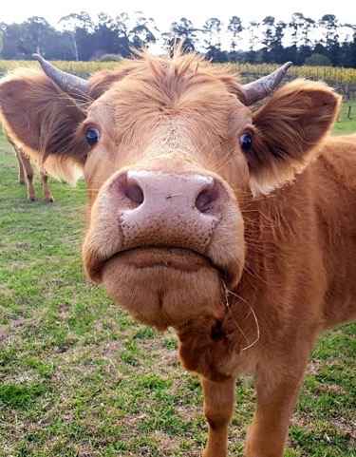
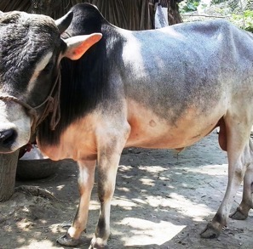
Dataset – “Cows”
Syrio / CC BY-SA (https://creativecommons.org/licenses/by-sa/4.0)

Slide 8
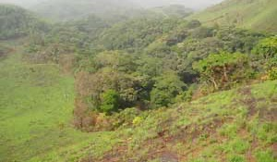
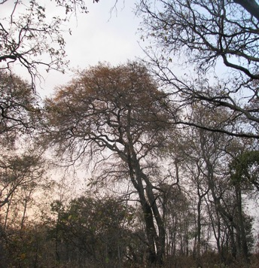
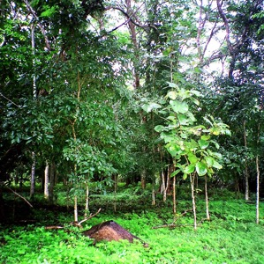

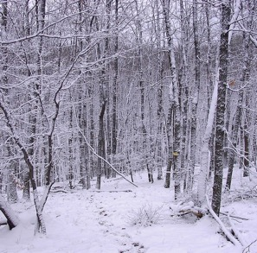
Dataset – “Forests”
CC BY-SA (https://creativecommons.org/licenses/by-sa/2.5)

Slide 9
Dataset = “Days During Pandemic”
13/Mar/2020
1/Mar/2020
2/Mar/2020
22/Apr/2020
1/Apr/2020

Slide 10
Data Point = Atomic Unit of Information
highly abstract concept
data points can represent persons
data points can represent random variables
data points can represent machine learning problems

Slide 11
Features and Labels
data points often have many different properties
“features”: properties that can be measured/computed easily
“labels”: properties that are “difficult” to compute
labels are higher-level facts or quantities of interest
labels can often be determined only in hindsight
determining labels might require human (domain) experts

Slide 12
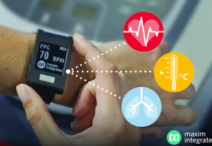
Corona ?
data point = “some human”
features = body temp., heart rate,…
label = 1 if Covid-19 infection,
0 otherwise

Slide 13
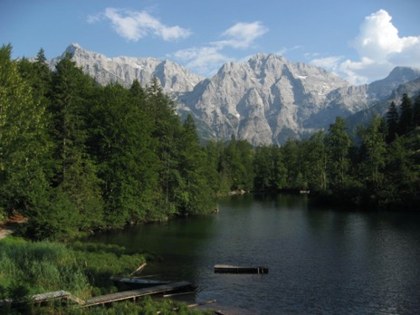
Data Point = “Some Photo”
features could include:
red, green, blue intensities of pixels
timestamp of photo
location of photo shot
identity of photographer
label:
hiking duration for the photographer
to reach mountain peak

Slide 14
Data Point = “Some Person”
features:
name
healthcare records
credit card transactions
social media posts
genetic fingerprint
fingerprint
travel history
label:
how likely will person need intensive care next week?

Slide 15
Data Point = “Some Dataset”
features:
number of data points
what type of features are used for data points
what label is used for data points
label:
can label value be predicted well from features?

Slide 16
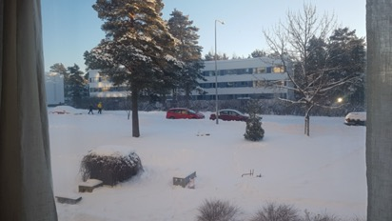
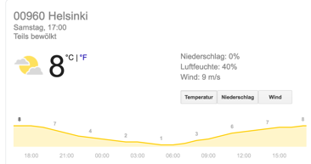
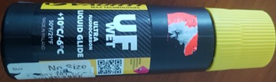
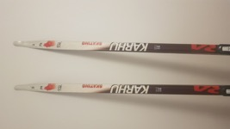
Data Point = “Some Ski-Day Ahead”
features:
snapshot in the morning
morning temperature
weather forecast
label:
maximum daytime temperature (important for ski waxing)

Slide 17
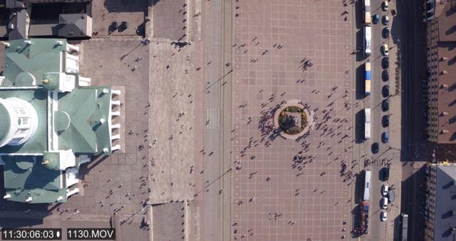
Data Point = “Place in Helsinki”
features:
coordinates of place
city building maps
current traffic statistics
CET time
drone video
label:
are people keeping average distance of >= 1 m ?

Slide 18
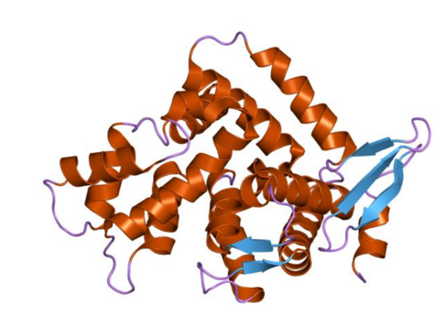
Data Point = “Some Protein”
features:
protein structure
physical measurements
scientific papers about this protein
label:
should this protein be considered for a Covid-19 vaccine?

Slide 19

Data Point = “Some Plant”
features:
plant species
RGB image
multi-spectral image
ambient temperature
label:
does the plant need more water?

Slide 20
Features and Labels Are Design Choices!
there is often a design freedom for defining/choosing features and labels
in some application the labels are higher-level facts that are defined by human experts who provide some labeled training examples
in other applications, labels are just subsets of features and we can get labeled data without any human labeling workers
consider weather forecasts (data points = some day, features are short time history of temperature and label is 2 day ahead temperature
we get labeled data from historic recordings

Slide 21

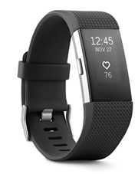
Influenza or Covid-19?
data point = “some person”
features = measurements by wearables
label could be “Covid-19 Infection?”
another label could b “Influenza?”
different choice for label results in different ML problems
related since both are contagious respiratory illnesses

Slide 22
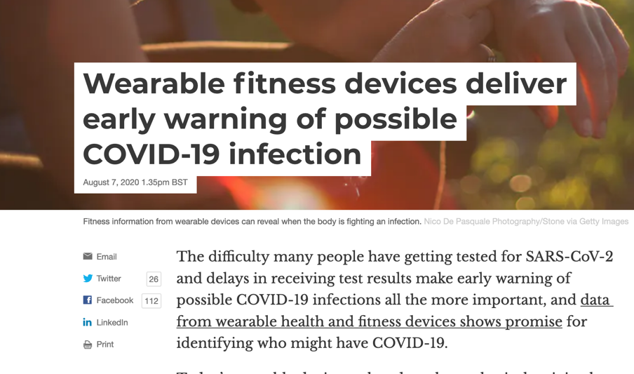
https://theconversation.com/wearable-fitness-devices-deliver-early-warning-of-possible-covid-19-infection-143388

Slide 23



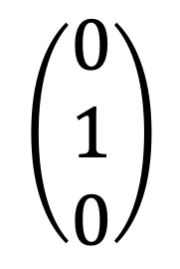
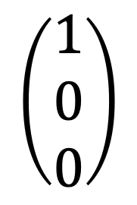
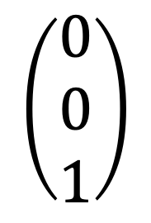
Label Encodings
consider detection of animals from a webcam
label values “wolf” vs. “bear”, vs. “lion”
we can represent label values as y=0, y=1 or y=2
another representation is “one-hot-encoding”
$$\left(\begin{aligned}1 \\ 0 \\ 0\end{aligned}\right)$$
$$\left(\begin{aligned}0 \\ 1 \\ 0\end{aligned}\right)$$
$$\left(\begin{aligned}0 \\ 0 \\ 1\end{aligned}\right)$$

Slide 24
Supervised vs. Unsupervised
methods using labels which can only be defined with the help of humans are “supervised methods”
methods using labels that can be determined automatically are “unsupervised methods”
distinction between supervised and unsupervised methods is blurry

Slide 25
Scatterplot
data point
label value y
feature value x

Slide 26
Hypothesis Space

Slide 27

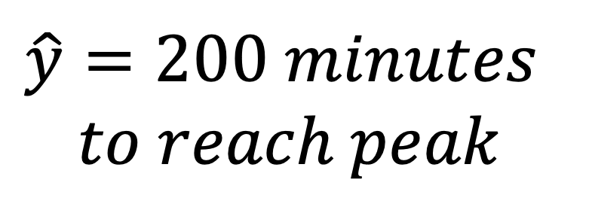
Predictor Map/Function
h(x)
$$\hat{y}=200 minutes$$
$$to reach peak$$
features x
of some data point

Slide 28
Predictor Map
some predictor
map h(x)
label value y
data point
another predictor
map h’(x)
yet another map h’’(x)
feature value x

Slide 29
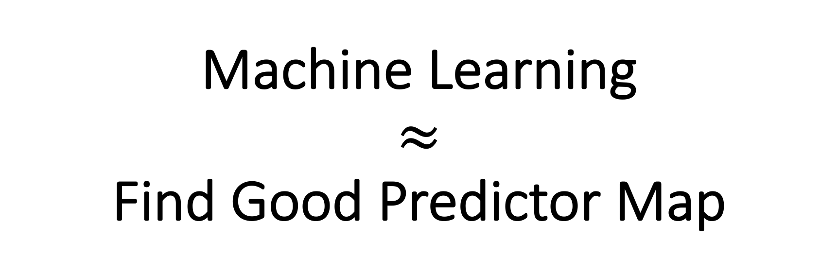
Machine Learning $≈$ Find Good Predictor Map

Slide 30
consider data points with
single numeric feature x and label y
how many predictor maps h(x) are there ?

Slide 31
Have only finite resources! a hypothesis space is a computationally tractable subset of predictor maps

Slide 32
h(x)
h(x)
h(x)
x
x
x
machine and deep learning Python libraries provide “fit()”
function to search over (huge) hypothesis spaces

Slide 33
Machine Learning
ML aim at finding/learning a good predictor h(x)
predictor inputs features x and outputs predicted label
predictor maps reading in millions of features
must choose between many different maps
deep learning uses special representation for maps

Slide 34
Artificial Neural Networks
represent predictor map h(x) using network of neurons
single neuron
feature x1
weight w1
w2
h(x) = g(z)
z = w1*x1+w2*x2+w3*x3
x2
g(.)
w3
non-linear activation function g(z)
x3

Slide 35
Activation Function
few popular choices have emerged
”ReLu”
g(z)
“Sigmoid”
z

Slide 36
(Deep) Neural Network=(Very) Non-Linear Function
w1
feature
x
w2
prediction
h(x)
adjustable weights
w1, w2, …
layer 1
layer 2

Slide 37
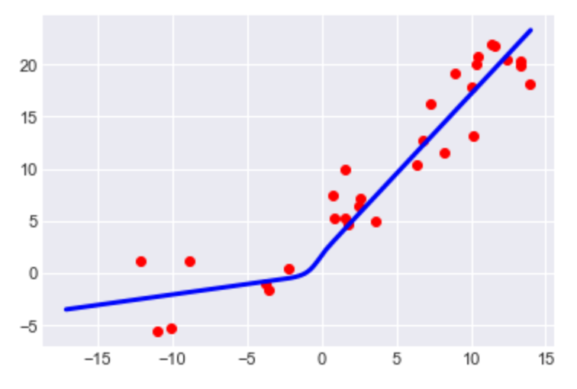
What is Deep Learning ?
label y
feature x
deep learning methods fit non-linear maps to large data sets

Slide 38
Hypothesis Space of ANN
x1
w1=1
x1
w1=1
x2
w2=0
g(.)
x2
w2=0
g(.)
x3
w3=-1
x3
w3=-3
x1
w1=1
x1
w1=10
x2
w2=-3
x2
w2=0
g(.)
g(.)
w3=-1
x3
w3=-1
x3

Slide 39
Loss Function

Slide 40

Evaluating Predictor (“Forward Pass”)
h(x)=“Cat”
features x
By Alvesgaspar - Own work, CC BY-SA 3.0, https://commons.wikimedia.org/w/index.php?curid=12127693

Slide 41
Deep Learning = Tune Weights
w1
w2
“Cat”
correct prediction!
-> keep current weights

Slide 42
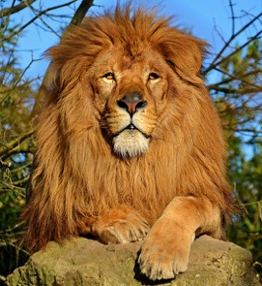
Backward Pass (”Backpropagation”)
w1
w2
h(x)=“Dog”
wrong prediction!
-> change/adjust weights
https://commons.wikimedia.org/wiki/File:Lion_d%27Afrique.jpg

Slide 43
learning is driven by making errors !

Slide 44
Loss Function
maps a pair of predictor map h (e.g. ANN) and data point (x,y) with features x and label y to some number
(h,(x,y)) -> “Loss” (denoted L(h,(x,y)))
loss function is design choice!

Slide 45
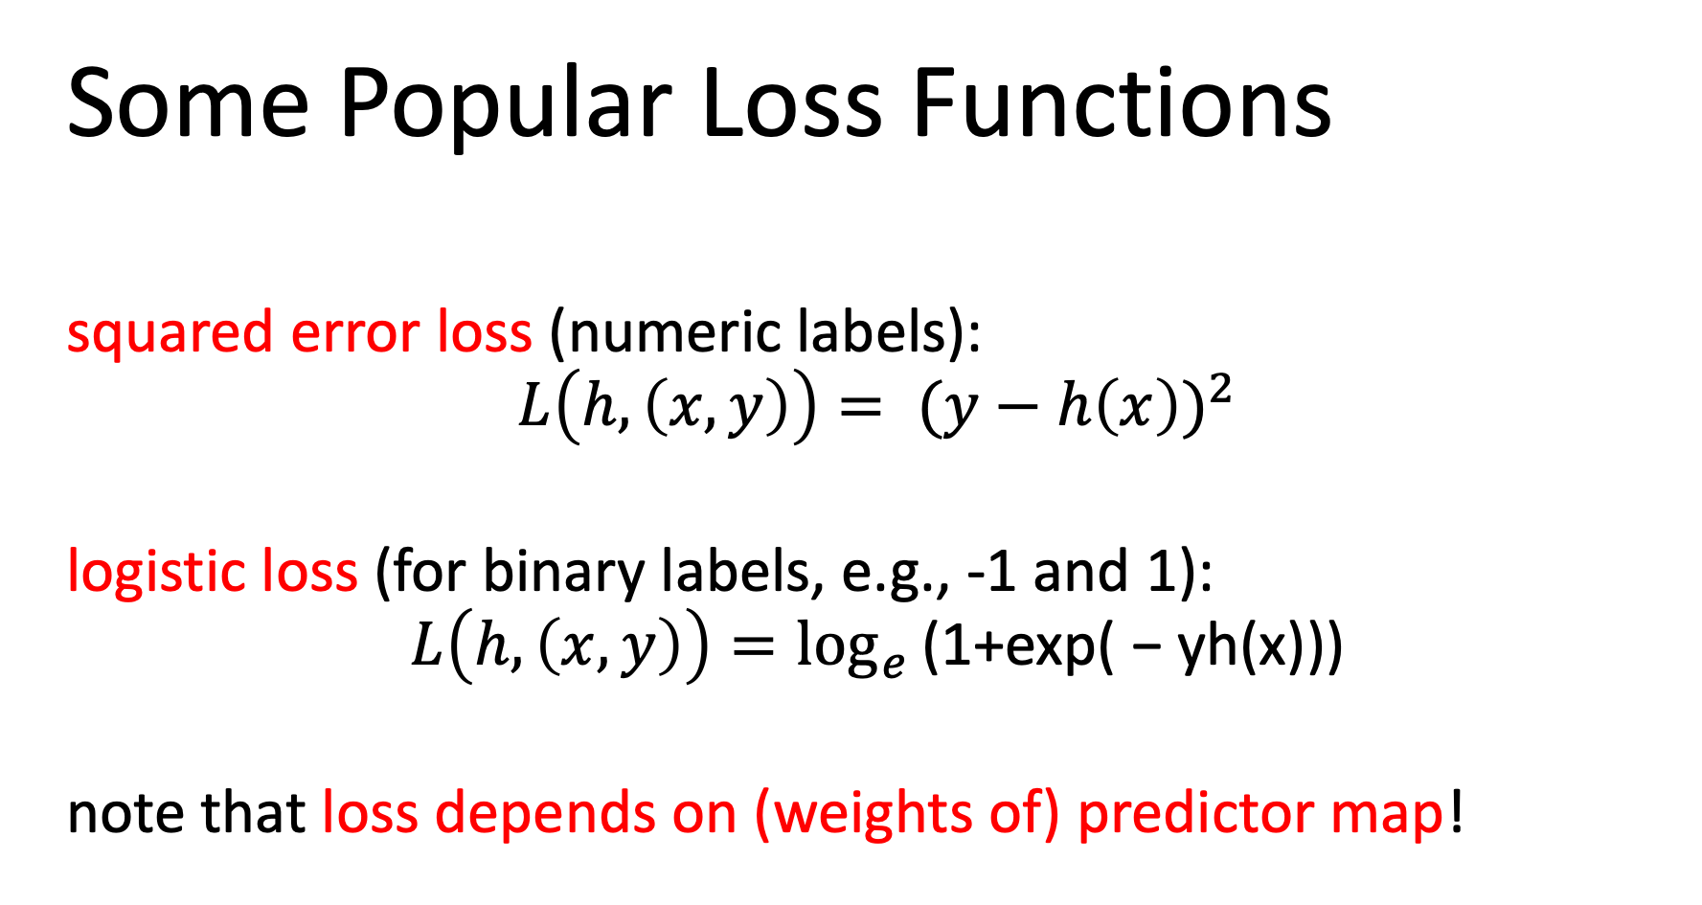
Some Popular Loss Functions
squared error loss (numeric labels):
$${L\left(h,\left(x,y\right)\right)= (y−h\left(x\right))}^{2}$$
logistic loss (for binary labels, e.g., -1 and 1):
$$L\left(h,\left(x,y\right)\right)=\log_{e}{\text{(1+}\text{exp}\text{( − }\text{yh}\text{(}\text{x}\text{)))}}$$
note that loss depends on (weights of) predictor map!

Slide 46
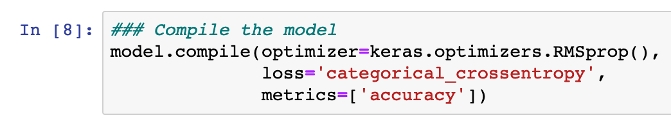
Chose Your Favorite Loss Function!
loss function used for adjusting weights
loss function used for final performance evaluation

Slide 47
Putting Together
the Pieces!

Slide 48
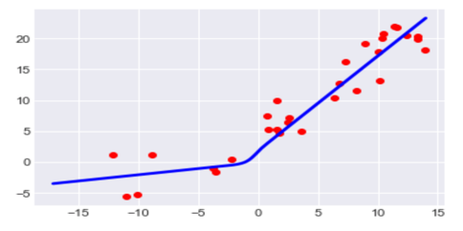
Three Views on Artificial Neural Nets
“Data View”
“Model View”
label
w1
w1
feature
“Loss View”
MSE
w1

Slide 49
learn predictor y’=h(x) by tuning
weights w to minimize loss
historic data
linear predictor y’ = w*x
max temp y
min temp x

Slide 50
Machine Learning = Optimization
average loss on labeled (training) data incurred by predictor h(x)
weights/parameters of predictor map h

Slide 51
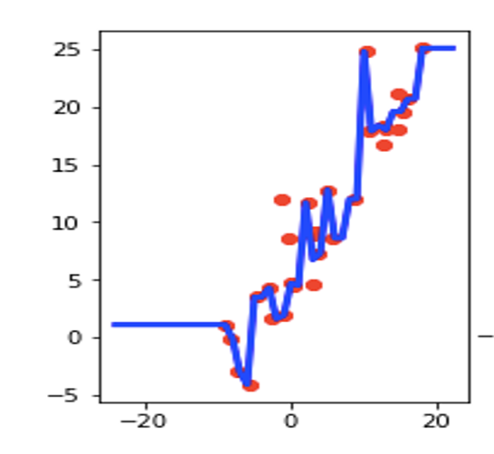
Key Challenge in Machine Learning - Overfitting
small training error but
poor predictor map!
max daytime temp y
min daytime temp x

Slide 52
Detecting Overfitting by Validation
label value
training data points
validation data points
feature value

Slide 53
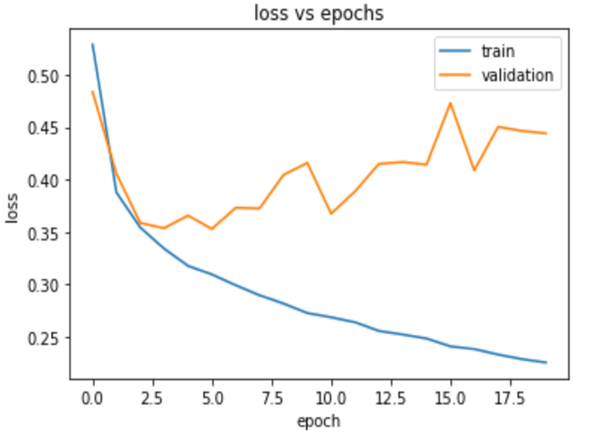
Look at the Validation Set !!!

Slide 54
Training, Validation and Test Set
training set: used to adjust weights
validation set: used to adjust hyperparameters (number of layers..)
test set: final performance evaluation

Slide 55
Test Set
used for final performance evaluation
results on test set MUST NOT BE used for model adjustment!

Slide 56
Diagnosing ML Methods
validation
error
training
error
target
performance

Slide 57
Case 1: Overfitting
validation
error
target
performance
training
error
possible remedies:
reduce hypothesis space or use more training data

Slide 58
Reducing Hypothesis Space
use fewer neurons in hidden layers
use fewer features (manually choose relevant features)
use fewer layers
use fewer iterations of gradient method (such that we
search only a smaller subset of the nominal space)

Slide 59
Reducing Hypothesis Space
use fewer neurons in hidden layers
use fewer features (manually choose relevant features)
use fewer layers
use fewer iterations of gradient descent (search only
a smaller subset of the nominal space)
“early stopping”

Slide 60
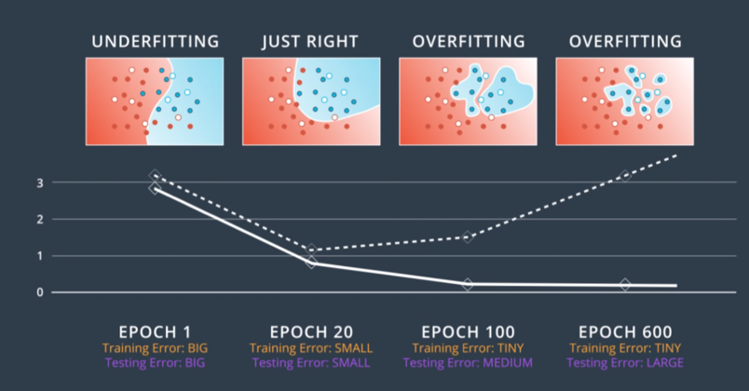
Reducing Effective Hypothesis Space

Slide 61
Case 2: Underfitting
validation
error
training
error
target
performance
possible remedy:
enlarge hypothesis space

Slide 62
Enlarging Hypothesis Space
use more neurons in hidden layers (wider layers)
use more features (manually choose relevant features)
use more layers (make network deeper)
use more iterations of gradient descent (search
a larger portion of the entire hypothesis space)

Slide 63
That’s All ! Do not hesitate to ask ! Use slack discussion forum!

Slide 64
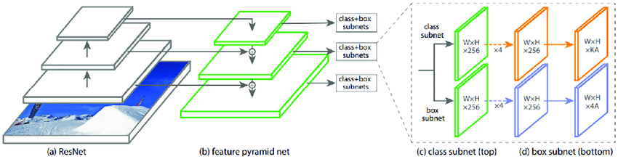
The Model (Network Architecture)
“RetinaNet” – storing one single configuration of all
weights for this model results in 500 MB file !

Slide 65
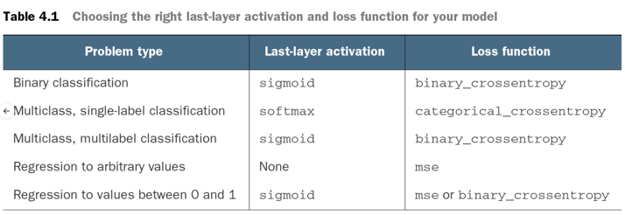
Encoding of Label Values
one hot
softmax vs. sigmoid
different encoding of label values in multiclass problems
https://gombru.github.io/2018/05/23/cross_entropy_loss/

