Slide 1
Landing, Login, Register, ForgotPassword

Slide 2
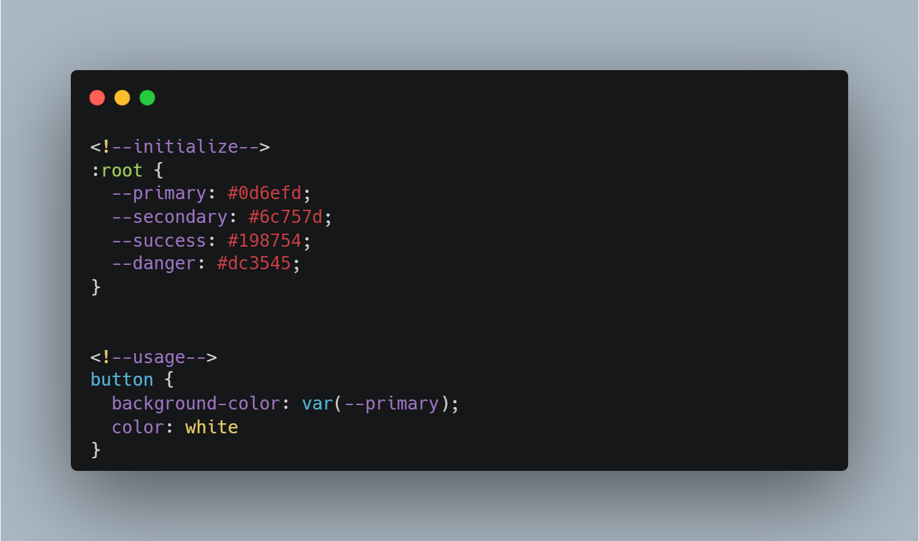
All the color palettes are stored in CSS variables to toggle dark/light mode

Slide 3
Reusable Modal message in JS. Using document.createElement

Slide 4
All lists or other elements that display data should have default CSS Class to toggle the display when there is no content.

Slide 5
landingPage.html
body{
Business Seasonal Editable Text (Title, Content, bgImage),
Editable Featured Properties (6 properties),
Offers,
Total of bookings (“324 days of booked dates”)
}
nav-bar{
logoBtn : (refreshPage());
registerBtn : (register.html);
loginBtn : (login.html);
Dark/light mode toggle
}
links{
aboutUs.html
termsPolicy.html
eula.html
contacts (email, number)
Social media links
}
Footer{
short summarization (w/ pics if possible)
links {}
}

Slide 6
register.html
Inputs{
Input = Email
Input = PhoneNumber
Input = Password
Input = Confirm Password
Input = Fname (Auto capslock first letter)
Input = M-initial (Auto capslock first letter)
Input = LastName (Auto capslock first letter)
Input = Sex
Input = Bday
}
nav-bar{
logoBtn : (refreshPage());
loginBtn : (login.html);
Dark/light mode toggle
}
body{
Inputs{}
registerBtn : emailOTPModal{}
alreadyHaveAccountBtn : (login.html);
}
emailOTPModal{
Input = otpInput
verifyBtn : messageModal{}
Timer (2mins before resend)
resendBtn
}
messageModal{
ifVerified{Success message > Continuebtn(API-redirection) or verifyForLaterBtn(GoToLogin)}
else{Error message > closeMessageModal}
}

Slide 7
login.html
nav-bar{
logoBtn : (refreshPage());
registerBtn : (register.html);
Dark/light mode toggle
}
emailOTPModal{
Input(email)
sendOTPBtn : verifyOTPModal{}
}
body{
Inputs{email, password},
loginBtn (auth) or messageModal (err)
dontHaveAnAccYet : (register.html)
forgotBtn : emailOTPModal
}
verifyOTPModal{
OTP sent message
Input(code)
verifyOTPBtn : false = modalMessage(err) ? true = forgotPassword.html
}

Slide 8
forgotPassword.html
nav-bar{
logoBtn : (refreshPage());
registerBtn : (register.html);
loginBtn : (login.html);
}
Inputs{
Password
Confirm Password
}
body{
backBtn : (login.html)
text : “change pass for john doe”
Inputs{},
changePassword (auth) or messageModal (err)
}
If (true){
messageModal (Password Updated Successfully)
continueBtn : (login.html)
}

Slide 9
ADMIN

Slide 10
nav-bar{
logoBtn : (adminDashboard.html);
Notification : (modalNotif)
ProfilePic{
Profile : (adminProfile.html)
Darkmode toggle
logout
}
}
sidebar{
Maintenance{
adminProperty.html
adminEmpoyee.html
adminFAQs.html
adminLandingPage.html
}
AuditTrails.html
}
modalNotif(
Notif-Category (Cancellation Req, Message)
senderName
Date and time
Message
If (Cancel Request ? toggle btnApproval)
)
btnApproval(
Approve
Reject
)
This is reusable for every page in Admin User Level

Slide 11
adminDashboard.html
Dashboard{
Summary{
Total Earnings This Month,
This Year
This Week
}
TopPropertyByEaningsGraph{
Input (SelectMonth, SelectYear)
Graph (any)
Total
}
auditTrailsSummary{
List at least 5
Toggle(Admin, Employees or Guest)
Table(Ref No., Date & Time, Name, Activity)
}
}

Slide 12
adminProfile.html
Profile{
EditBtn : (adminEditProfile.html)
Profile Picture (onclick (ZoomModal))
Full Name
Email
}

Slide 13
adminEditProfile.html
EditProfileDetails{
Auto-fill inputs{
ProfilePictureBtn (Upload)
Full Name Input
Email input
}
editPasswordBtn{
modalEditPassword(
CurrentPasword
Enter New Password
Confirm Password
forgotPasswordBtn : forgotPassword.html
Btnconfirm(API update password)
)
}
Btn (Cancel, Update) : message if successful, then go back to Profile
}

Slide 14

adminProperty.html
{
AddProperty (adminAddProperty.html)
Search
PropertyLists in Table or cards (Name, Address, MaxCapacity, Price, Price per Pax, Status, ViewDetailsBtn(adminViewProperty.html), # of reports badge)
}
Small red circle—that appears in the corner of an icon to indicate a count of unsolved reports

Slide 15
adminViewProperty.html
{
Property Details {
Photos
Name
Address
Display Map Link
City
Description
Package Capacity
Maximum Capacity
Time of CheckIn&Out
Category
Package Price
Reservation Fee
Additional Pax Price
Status
Amenities{cards or maybe just texts}
Other Amenities {cards or maybe texts}
Discount
Reports: could be modal if clicked. w/ badge # of reports
// buttons
DeactivateBtn (are you sure you want to deactivate this property? y/n) or EditBtn (adminEditProperty.html)
}
}
Reports{
toggle(Unsolved | Solved)
Report List(
Name of sender
Date
Transaction No.
Report Category
viewBtn(ReportView)
)
}
ReportView{
Name of sender
Date
Transaction No.
Report Category
Message
Buttons: backBtn, solvedBtn
}

Slide 16
adminEditProperty.html
{
Property Inputs Auto Fill {
Photos (one by one display with delete icon)
Name : text
Address : text
MapLink : text
City : text
Description : text
Package Capacity : number
Maximum Capacity : number
Time of CheckIn&Out : Time
Category : select (Barkada, Couple, Family, Other)
Package Price : Currency/Number w/ peso sign
Reservation Fee : Currency/Number w/ peso sign
Additional Pax Price: Currency/Number w/ peso sign
Status : select {available, deactivate}
Amenities : checkbox
Other Amenities : text
Discount : float
Calendar
}
Buttons : (cancel, save (y/n) message success/err)
}
calendar{
Text : Set maintenance Day
Calendar with bookings
Buttons: set (y/n), revert (clear selected)
}

Slide 17
adminAddProperty.html
{
Property Inputs {
Photos (one by one display with delete icon)
Name : text
Address : text
MapLink : text
City : text
Description : text
Package Capacity : number
Maximum Capacity : number
Time of CheckIn&Out : Time
Category : select (Barkada, Couple, Family, Other)
Package Price : Currency/Number w/ peso sign
Reservation Fee : Currency/Number w/ peso sign
Additional Pax Price: Currency/Number w/ peso sign
Status : select {available, deactivate}
Amenities : checkbox
Other Amenities : text
Discount : float
Calendar
}
Buttons : (cancel, save (y/n) message success/err)
}
calendar{
Text : Set maintenance Day
Calendar
Buttons: set (y/n), revert (clear selected)
}

Slide 18
adminEmpoyee.html
{
addEmployeeBtn (adminAddEmployee.html)
Search
RolesBtn (Roles.html)
Category of lists (Available List, Deactivated List)
List table or cards{
First, Last Name,
Email,
Roles
viewDetailsBtn (adminViewEmployee.html)
}
}

Slide 19
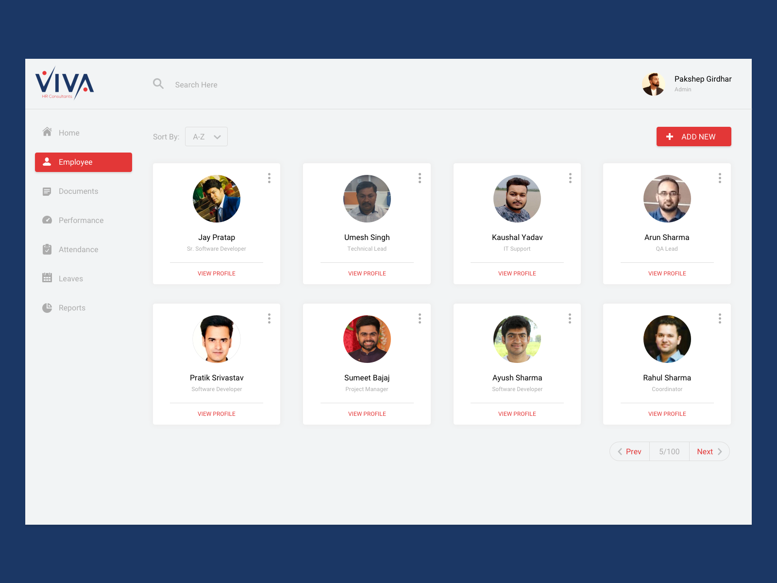
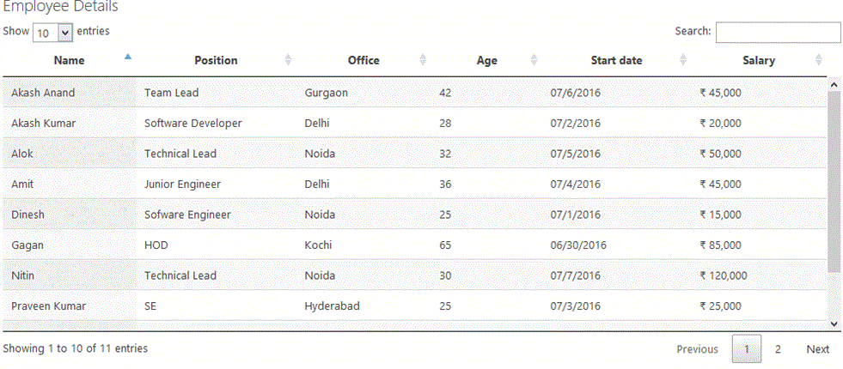
adminEmpoyee.html
Cards VS Table

Slide 20
adminViewEmpoyee.html
{
Employee Name
Picture of Employee (has default pfp if no picture)
Email
Roles
Privileges
Scope Properties List (Picture?, Name, Address)
Buttons : DeactivateBtn, EditBtn (y/n)
}

Slide 21
adminAddEmpoyee.html
Input{
F,L Name : text
Email : email text
Add Roles : text with dropdown
Roles (Name of role) : cards with button for delete role
Add Properties : text with dropdown
Properties (Name of Property, Address): cards with button for delete property
Buttons : DeactivateBtn, EditBtn (y/n)
// if role and properties is empty, don’t proceed to edit
// the privilege is ONLY PSR, No Add Properties & Properties.
}

Slide 22
adminEditEmpoyee.html
Input-Autofill{
F,L Name : text
Email : email text
Add Roles : text with dropdown
Roles (Name of role) : cards with button for delete role
Add Properties : text with dropdown
Properties (Name of Property, Address): cards with button for delete property
Buttons : DeactivateBtn, EditBtn (y/n)
// if role and properties is empty, don’t proceed to edit
// the privilege is ONLY PSR, No Add Properties.
}

Slide 23
adminRoles.html
Roles{
Add Roles
Search Roles
List of Roles (table or cards) {
Role name
viewRoleDetails(adminViewRoles.html)
}
}

Slide 24
adminViewRole.html
viewRole{
Name of role
Privileges
Buttons : edit delete (y/n)
}

Slide 25
adminAddRole.html
addRoleInput{
Name of role : text
Privileges: {
(PSR) Property Summary Report
(TS) Transactions
(TK) Ticketing
(PM) Property Monitoring
}
Buttons : Add, Cancel (y/n)
}

Slide 26
adminEditRole.html
editRoleInput Auto Fill{
Name of role : text
Privileges: {
(PSR) Property Summary Report
(TS) Transactions
(TK) Ticketing
(PM) Property Monitoring
}
Buttons : Save, Cancel (y/n)
}

Slide 27
adminFAQs.html
{
List{(Question, Answer), (Buttons : deleteBtn, editBtn (y/n))}
AddFAQs{
(
Question : text
Answer : text
Save : button (y/n)
Cancel : button (y/n)
)
}
}
editBtn => {
Modal autofill(
Question
Answer
Save
Cancel
)
}

Slide 28
adminFAQs.html
{
List{(Question, Answer), (Buttons : deleteBtn, editBtn (y/n))}
AddFAQs{
(
Question : text
Answer : text
Save : button (y/n)
Cancel : button (y/n)
)
}
}
editBtn => {
Modal autofill(
Question
Answer
Save
Cancel
)
}

Slide 29
adminLandingPage.html
modalEdit auto fill{
Seasonal Texts{
Title : text input (min char)
Content : text input (min char)
Upload: BgImage (set a mins-max size of image required)
}
Edit Featured Units {
Text Input w/ dropdown suggestion: (Name, Address)
List of selected Featured units{
Photo?, Name, Address
}
}
Landing PageView{
Seasonal Texts{
Title
Content
}
Featured Units (6) cards (photo?, Name, Address)
Button : editBtn (modalEdit)
}

Slide 30
adminAuditTrails.html
Toggle By: (Admin,Employee, Guest)
Search (By: Date & time, Query(Name, Activity, Role))
List(Ref No., Date&Time, Name, Activity, Role)

Slide 31
EMPLOYEE

Slide 32
nav-bar{
logoBtn : (employeeDashboard.html);
Notification : (modalNotif)
ProfilePic{
Profile : (employeeProfile.html)
Darkmode toggle
logout
}
}
sidebar{
// these are the dynamic modules
employeePSR.html
employeeTS.html
employeeTK.html
employeePM.html
}
modalNotif(
senderName
Date and time
Message
)
This is reusable for every page in Employee User Level

Slide 33
employeeDashboard.html
Dynamic Dashboard
If PSR Summary{
Total earnings this Week,
Month,
Year
Most Peak Booking Day this (Toggle):
Month
Year
Week
Result: `This Week: Jan 01, 2025 - 25 bookings`
}
If TS{
Display (5) transactions of a property that assigned to them
Trans#, Name of guest, Name of property, Date of booking)
Button : Go to (employeeTS.html)
}
If TK{
Display (5) Queue List of concerns.
List (# of queue, Name, Concern category, Button : handleBtn(will start the conversation)) }
If PM {
List of bookings today. cards or list
Max of 5 list
(Name of guest, Time & date of checking in/out, property name )
}

Slide 34
employeeProfile.html
Profile{
EditBtn : (employeeEditProfile.html)
Profile Picture (onclick (ZoomModal))
Full Name
Email
}

Slide 35
employeeEditProfile.html
EditProfileDetails{
Auto-fill inputs{
ProfilePictureBtn (Upload)
Fullname
}
Btn (Cancel, Update) : message if successful, then go back to Profile
}

Slide 36
employeePSR.html
1{
Total earnings this Week,
Month,
Year
}
2{
Most Peak Booking Day this: (Toggle):
Month
Year
Week
Result: `This Week/Month/Year: Jan 01, 2025 - 25 bookings`
}
3{
List of all successful Transaction
(Trans#, Property Name, Date of Booking, Amount)
}
Generate Summary report{
Select : {
Month (year), quarterly (year), semi-annual (year) , annual (year)
}
Button : Generate (download pdf or excel)
}

Slide 37
employeeTS.html
category (Pending, Completed){
List (Trans #, Name of guest, Property Name, Date (I-O), Payment mode, Total Amount, Status) Button : View (employeeTSView.html)
}

Slide 38
employeeTSView.html
{
Property Name
Transaction Number
Name of Guest
Status (Reserved, Fully Paid, Check In, Check Out, Completed or Cancel) // parang shopee xd
Breakdown of payment (Reservation + (Package Payment – discount) * Additional Pax )
Button : back (employeeTS.html)
}

Slide 39
employeeTK.html
Section 1 (left){
// category of (Pending/Completed)
List of queue in stack (Queue #, Name, Concern category, Time Date, Button : openQueue
}
Section 2 (Right){
If no queue is open “There is No Open Queue”
If true => {
First blob message : Concern, submitted by guest
Reply Input : Text
Button : Send
Button : End Ticket
}
}

Slide 40
employeePM.html
Section 1{
Calendar with booked dates and maintenance
}
Section 2{
Stack of booking list Accorfing to selected date from calendar
(Name of property, CheckIn-CheckOut (Time, date), button : (viewBookingModal))
}
Section 3 {
Category (CheckIn, CheckOut Today List)
Button : confirmation of check in and cash payment modal
Property Name
Guest Name
Check In or Check Out time
Button : completeBtn(completeModal)
}
viewBookingModal{
DisplayDetails
Name of property
Guest
CheckIn-CheckOut (Time, date)
Buttons : Back , Cancel(CancelModal)
}
CompleteModal{
Completing Transaction
Report Note: Input
Complete : Button
}
CancelModal{
Cancellation Request // add note that this will sent to admin for approval if the admin didn’t approve or did not respond, it'll not proceed.
Reason to send for user : Input (min of char depends on design)
Reason to send for Admin : input (min of char depends on design)
Button : Send
}

Slide 41
GUEST

Slide 42
navbar{
logo : button (guestDashboard.html)
searchButton(SearchModal{})
tickets
FAQs
Notification with badge
profilePicture : button {
Profile (guestProfile.html)
My Bookings (guestMyBookings.html)
AboutUs (aboutUs.html)
Darkmode toggle
logout
}
}
SearchModal{
Inputs{
Where? (all city in database) : selection
CheckIn : calendar (default any)
CheckOut : calendar (default any)
Price range start: float (default no range)
Price range end: float (default no end range)
People : number (default any)
}
SearchButton : button (checkAPI)
}
If CheckAPI (true){Go to (guestSearchResult.html)}
else { modal message “No Property found.” }
modalNotif(
senderName
Date and time
Message
)
This is reusable for every page in Guest User Level

Slide 43
guestDashboard.html
Dashboard : Featured Property auto scroll{
List 6 Property w/ button : {guestViewProperty.html}
}
Catergory of property (Top Rated, barkada, family, couple, & others){
List of property (Picture, Name, Address, Price/Day)
Onclick {guestViewProperty.html}
}

Slide 44
guestSearchResult.html
Example text on top `Searched for Quezon City`
{
List Properties w/ button : {guestViewProperty.html}
}

Slide 45
// same as before revamp the design
guestViewProperty.html {
section 3 eployeePM cash check in
delete slide 50
Photos
Name
Address
Map
Description
Package Capacity - maximum capacity
Time of CheckIn&Out
Category : select (Barkada, Couple, Family, Other)
Package Price : Currency/Number w/ peso sign
Reservation Fee : Currency/Number w/ peso sign
Additional Pax Price: Currency/Number w/ peso sign
Discount
Amenities
Other Amenities
Calendar
book button
Review scale
}
guestConfirmReservation.html{
// same as before revamp the design
}

Slide 46
guestProfile.html
Profile{
EditBtn : (guestEditProfile.html)
Profile Picture (onclick (ZoomModal))
Full Name (Verified or Unverified) ☑
Phone Number
Email
Bday
Age
Sex
}
If (unverified){
Clickable Div{
Verify your account using Valid ID
You can add picture of digital design of ID
Description of Verifying ID (`To meet KYC requirements, we use AI tools to verify the authenticity of your ID and extract only key information—your actual ID is not stored by our system.`)
Onclick (Redirection)
}
}

Slide 47
guestEditProfile.html
EditProfileDetails{
Auto-fill inputs{
ProfilePictureBtn (Upload)
Full Name Input
Phone Number
Email input
}
editPasswordBtn{
modalEditPassword(
Enter Current Password
Enter New Password
Confirm Password
forgotPasswordBtn : ForgotPassword.html
Btnconfirm(API update password)
)
}
Btn (Cancel, Update) : message if successful, then go back to Profile
}

Slide 48
guestTickets.html
generateTicketBtn : button (guesGenerateTicket.html)
Section 1 (list of tickets){
Ticket lists ( ticketQueueID,`CustomerSupport username`, Status (End, In Queue, Open))
}
Section 2 {
When user clicked one of the ticket lists, Itll show the conversation here.
{
First blob message : Concern, submitted by guest
If (status == Open){
Reply Input : Text
Button : Send
Button : End Ticket
}
}
}

Slide 49
guestGenerateTicket.html
backBtn : Button (guestTickets.html)
Generate a Ticket{
Inputs{
Select a Customer Service Agent : (`CS - FirstName`…) : selection
Select a concern : (“Location”, “Appliances”, “Amenities”, “Payment”, “Others”) : selection
Description (min of character ?) : text
}
generateBtn : Buttons (API) > go back to guestTickets.html
}

Slide 50
guestFAQs.html
{
Q & A
Same as before
Revamp the design or keep the OG
}

Slide 51
guestMyBookings.html
Pending / Completed {
List of bookings (Property Name, Address, Date of booking, Status)
Onclick (guestViewBooking.html)
}

Slide 52
guestViewBooking.html
{
Property Name
Ref id
Pictures of property
Address
Embed map
Date
Time of Check In
Time of Checking out
Details of transaction{
Payment mode
Price per day * Additional Pax : `Unpaid or Paid (PHP2,000)`
Discount
Reservation Fee: `Paid (PHP 500)`
Status
TOTAL REMAINING BALANCE or TOTAL:
}
If (!fullpayment){button: pay remaining balance (redirection)}
}
If (pending && booking date is <=10days old){
Reschedule : button (rescheduleModal)
}
Else { Reschedule is unavailable for bookings that is already 10 days or older}
rescheduleModal{
Reason : text (min of char for notif)
Start date & end date (calendar)
CancelBtn
RescheduleBtn
}

