Slide 1
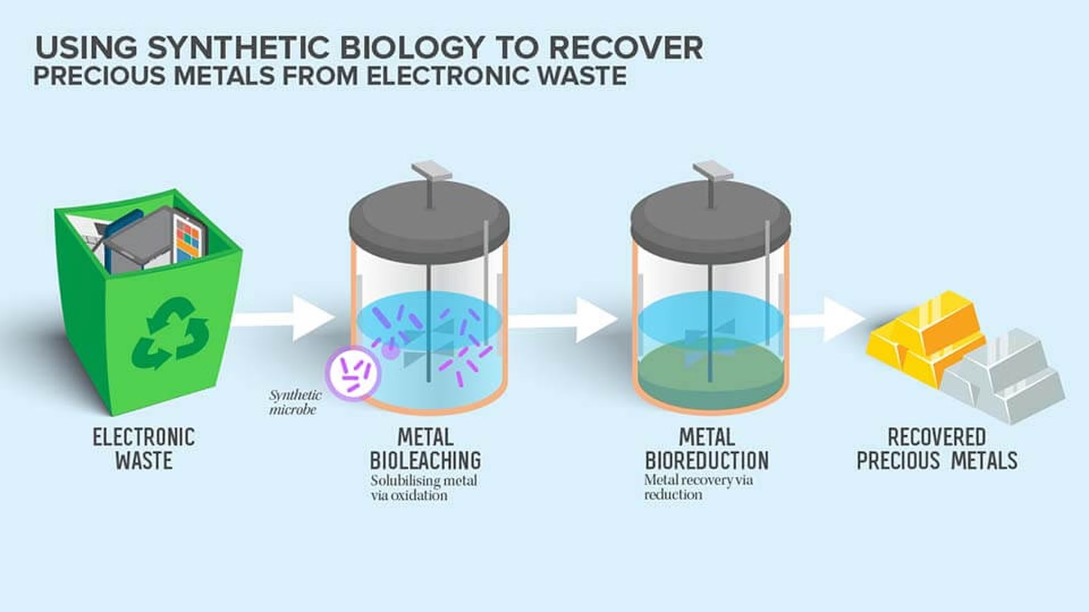
High Value Metal Extraction from E-waste using
Microorganisms
Problem Statement(according to the website): The world today faces a range of pressing environmental challenges – from inefficient waste management and excessive carbon footprints to unsustainable energy consumption and poor recycling practices. As technology continues to shape our world, it is imperative that we leverage it to build a more sustainable, eco-conscious future.

Slide 2
Problem Statement According To Our Solution:
Growing E-waste Crisis
Toxic Materials
Valuable Resources Lost
Electronic waste is one of the fastest growing waste streams globally, with millions of tons discarded annually.
E-waste contains hazardous materials that contaminate soil, water, and air when improperly disposed.
Precious metals like gold, silver, and copper in electronics are lost through conventional disposal methods.
Why This Problem Matters
53.6M
17.4%
Tons of E-waste
Recycling Rate
Generated globally in 2019
Only a fraction properly recycled
$57B
Value Lost
In recoverable materials annually

Slide 3



Existing Solutions & Limitations
Method
Advantages
Limitations
Pyrometallurgy
High recovery rates for certain metals
High energy consumption, toxic emissions
Hydrometallurgy
Selective metal recovery
Uses hazardous chemicals, generates toxic waste
Mechanical Separation
Simple process, low cost
Low efficiency for complex materials
Our Unique Solution
Microorganism-Based Extraction
Eco-Friendly Approach
Cost-Effective
Using Chromobacterium violaceum to extract precious metals from e-waste
Zero toxic emissions, minimal environmental impact
Lower energy requirements and operational costs than traditional methods

Slide 4
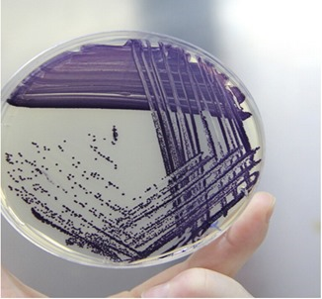



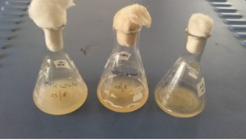


Technical Approach
Step-by-step process using Chromobacterium violaceum
Collection & Preprocessing
E-waste is collected, sorted, and shredded into small particles
Bacterial Culture Preparation
Chromobacterium violaceum cultures are grown in optimal conditions
Bioleaching Process
Bacteria produce cyanide compounds that selectively bind to metals
Metal Recovery
Precious metals are separated from the solution
Purification
Recovered metals are refined to high purity levels
Pic 1,2: Extracting the bacteria

Slide 5
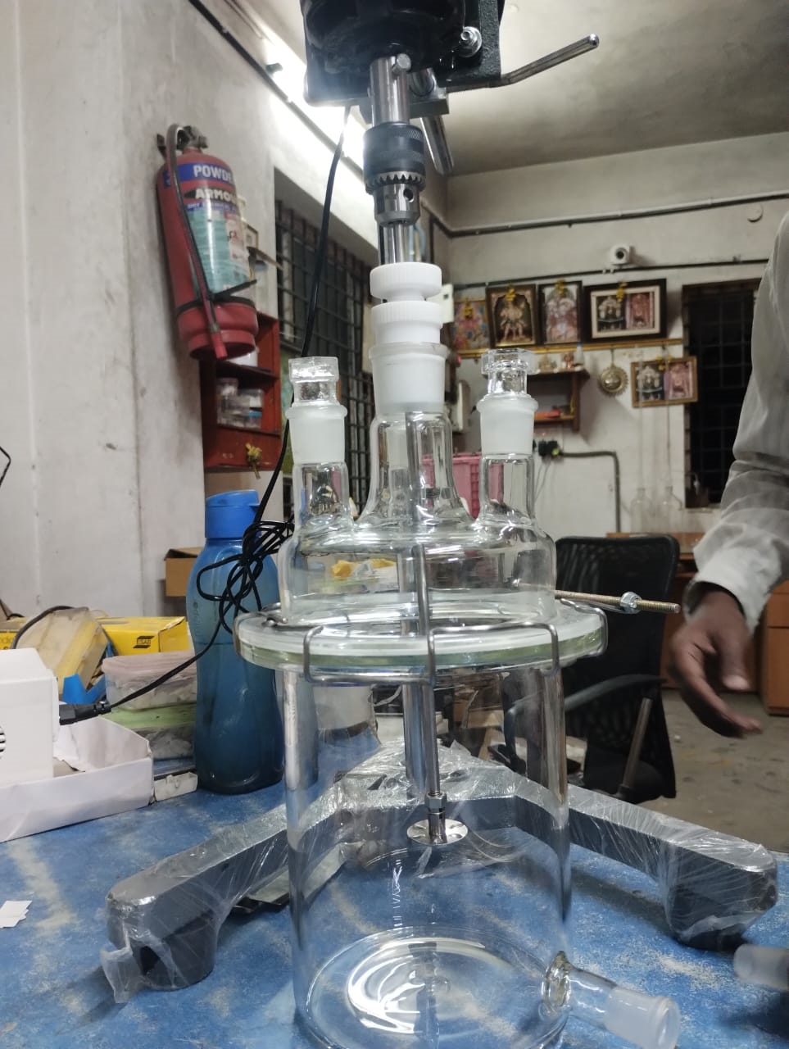
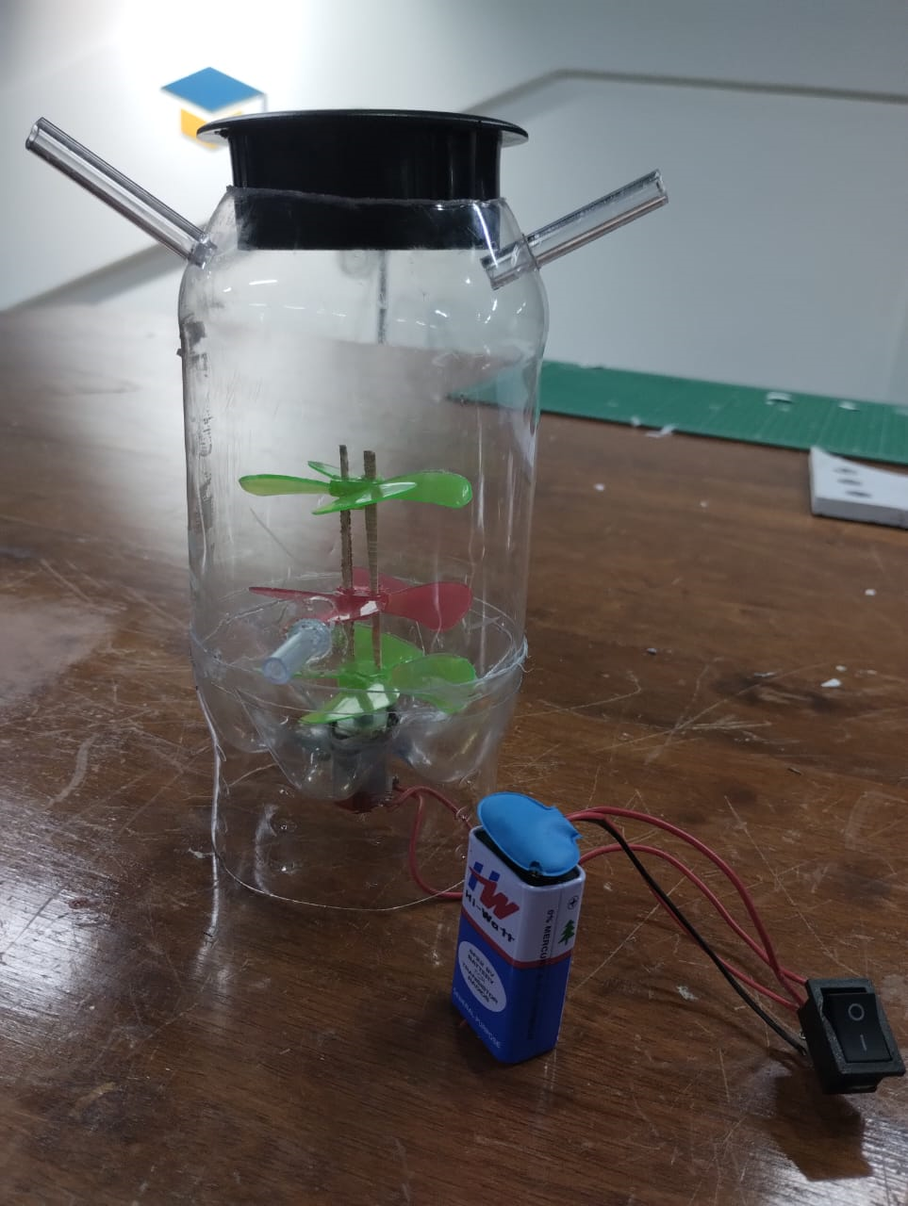




Prototype & Sample Model
Key Components:
Bioreactor vessel with temperature control
Bacterial culture maintenance system
Metal recovery unit
Process monitoring sensors
Filtration system
Technology Used:
Bioreactors
For controlled bacterial growth and metal extraction
Spectroscopy
For metal concentration analysis
Chromatography
For separation and purification of metals
Genetic Engineering
For optimizing bacterial strains
Pic-3: Prototye Image
Pic-4: Sample Model

Slide 6
Uniqueness & Innovation
Biological vs. Chemical
Selective Recovery
Uses natural biological processes instead of harsh chemicals for
metal extraction
Bacteria can be engineered to target specific high-value metals
Low Energy Requirements
Circular Economy
Operates at ambient temperature and pressure, unlike energy-intensive
traditional methods
Creates a closed-loop system where waste becomes a resource
Feasibility Study
Resources Required:
Implementation Timeline:
Laboratory space with basic equipment
3 months
1
Bacterial culture maintenance facilities
Lab-scale prototype development
E-waste preprocessing equipment
2
6 months
Metal recovery and purification systems
Process optimization
Trained personnel
12 months
3
Pilot plant setup
4
24 months
Commercial implementation

Slide 7
Impact
Environmental Benefits
Economic Benefits
Reduction in toxic leachate from landfills
Recovery of valuable metals worth billions
Lower carbon footprint compared to traditional methods
Job creation in green technology sector
Conservation of natural resources
Reduced dependency on mining
Decreased mining-related environmental damage
New revenue streams from waste
Social Benefits
Improved health outcomes in communities near e-waste sites
Technology transfer opportunities
Educational opportunities in biotechnology
Sustainable development model
Gold
Silver
Copper
Palladium
Platinum

Slide 8
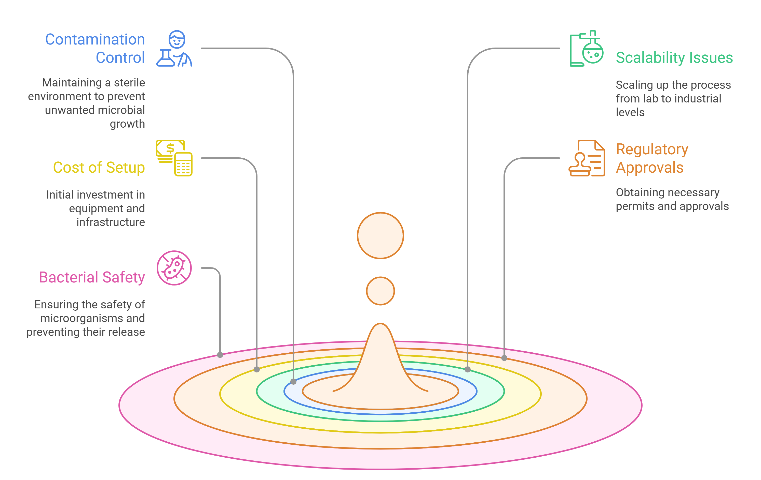
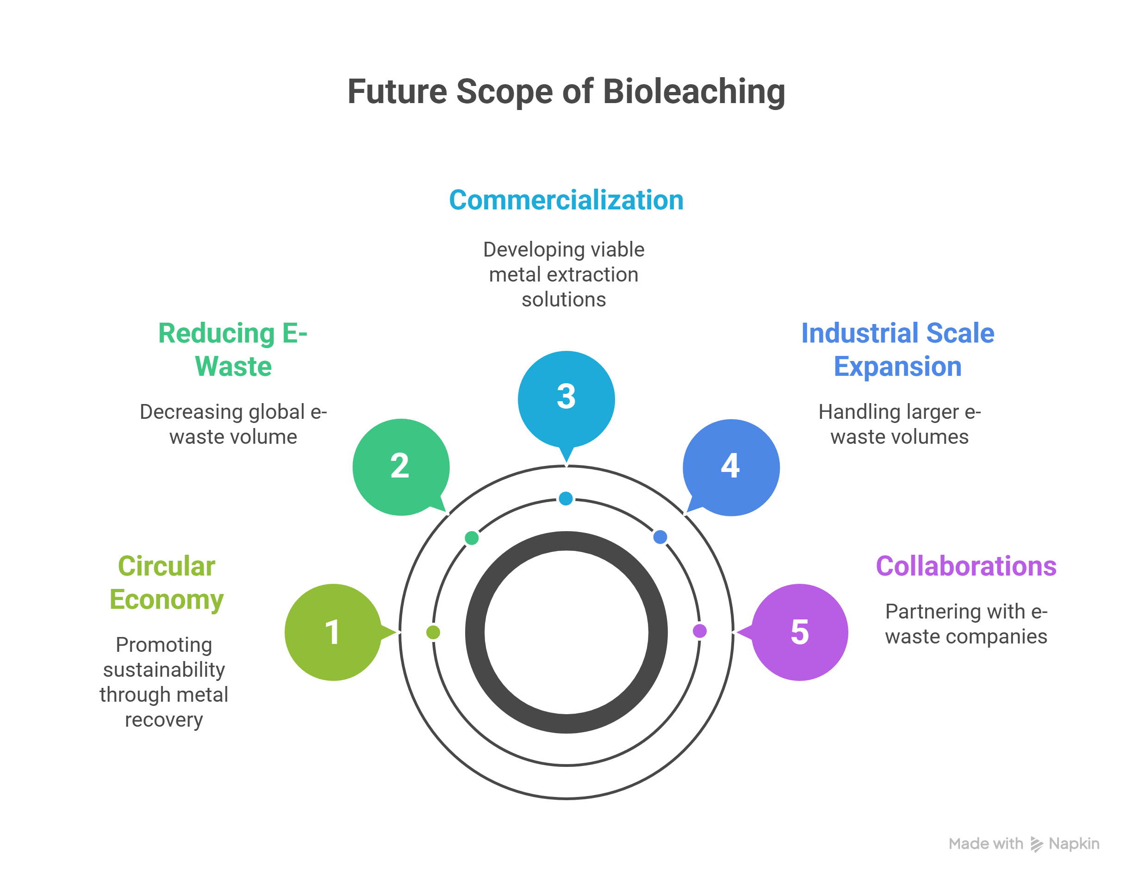
Potential Challenges & Risks
Future Scope & Scaling

Slide 9
Team Name: Ctrl Alt Elite
Team Members
Rounak Banerjee
Ronit Keshri
Sohaib Ahmed
Sriram Ramesh
“Software Engineers coding a greener future, one sustainable solution at a time.”

