Slide 1

AI-POWERED PROCUREMENT AUTOMATION
Invoice-PO Guardian
An intelligent pipeline that extracts, matches, and validates supplier invoices against Purchase Orders — with automatic discrepancy detection and tiered approval routing.
Built for AnthraSync — AI Engineer Assignment, Round 3
Python · FastAPI · React · Groq (Llama 3.3) · SQLite · Airtable
Notes:
Good [morning/afternoon], thank you for the time. I'm going to walk you through Invoice-PO Guardian, the project I built for Round 3. In one sentence: it's an AI pipeline that reads supplier invoices, checks them against approved Purchase Orders, and automatically decides whether an invoice is ready for payment, needs a human's eyes, or should be rejected outright. Everything you'll see today is actually running — this isn't a mockup. I built it in Python with FastAPI on the backend, React on the frontend, Groq's Llama 3.3 for the AI extraction, and I treated this as a real code-based alternative to a tool like n8n, since the goal was production-style engineering, not just a demo script.

Slide 2




THE BUSINESS PROBLEM
Manual invoice reconciliation doesn't scale
Procurement teams receive supplier invoices by email and manually cross-check every line against approved Purchase Orders before payment. This process is slow, error-prone, and leaves no consistent audit trail.
Slow Turnaround
Human Error
Fraud & Duplicates
No Audit Trail
Manual review delays payment cycles and strains vendor relationships.
Fatigue-driven mistakes in reading quantities, prices, and totals.
Duplicate or inflated invoices can slip through unnoticed.
Approvals happen ad hoc, with little record of who decided what, and why.
INVOICE-PO GUARDIAN
2
Notes:
Before I show the solution, let's ground this in the actual business pain. When a supplier sends an invoice, someone on the procurement team has to manually pull up the original Purchase Order and check: same vendor? same quantities? same prices? does the math add up? That's slow, and it's exactly the kind of repetitive checking where humans get fatigued and miss things. Worse, there's often no consistent record of why an invoice was approved or rejected — which becomes a real problem if a duplicate or inflated invoice slips through. Those four boxes — slow turnaround, human error, fraud risk, and no audit trail — are the four things this project is specifically designed to solve.

Slide 3





THE SOLUTION
One pipeline, from inbox to payment decision
Invoice-PO Guardian acts as a code-based equivalent to tools like n8n — a fully automated, auditable pipeline that reads unstructured invoices, understands them with an LLM, and applies consistent business rules every time.
1
2
3
4
5
6
Ingest
Email
Extract
PDF Text
AI
Extraction
Match
vs. PO
Detect
Discrepancies
Route &
Store
9
8
±2%
3
Pipeline Stages
Discrepancy Types Detected
Configurable Tolerance
Outcome Tiers
INVOICE-PO GUARDIAN
3
Notes:
This is the whole system in one picture. An email with an invoice PDF comes in, we pull the text out of the PDF, hand that text to an LLM to turn it into structured data, look up the matching Purchase Order, compare them field by field, flag any discrepancies, and route the invoice to one of three outcomes. I want to highlight the assignment explicitly allowed 'n8n or an equivalent' — I chose to build this as a code-based pipeline instead of a visual no-code tool, because it gave me full control over the matching logic and error handling, and because as an AI Engineer candidate, I wanted to show real backend engineering, not just wiring together pre-built nodes. The numbers at the bottom — 9 pipeline stages, 8 discrepancy types, configurable tolerance, 3 outcome tiers — are the concrete proof points I'll expand on in the next few slides.

Slide 4





ARCHITECTURE
Built on a modern, pragmatic stack
Python + FastAPI
React Dashboard
Groq — Llama 3.3 70B
Async REST API powering the entire pipeline and review workflow.
Live invoice queue, side-by-side PO comparison, and audit trail views.
Fast, low-cost LLM inference for structured invoice extraction.
SQLite
Airtable
JWT + bcrypt
Local relational store for invoices, POs, users, and audit logs.
Durable final storage layer, mirroring records for long-term retention.
Token-based authentication with hashed credentials and rate limiting.
INVOICE-PO GUARDIAN
4
Notes:
A quick word on why I chose each piece of this stack. FastAPI gives me async performance and automatic request validation, which matters when you're handling file uploads and calling an external AI API. React powers the dashboard so reviewers get a real-time, interactive view instead of a static report. For the AI layer, I used Groq running Llama 3.3 70B — it's extremely fast inference and free-tier friendly, which mattered given my timeline, without sacrificing extraction quality. SQLite is my local operational database — fast, zero-setup, perfect for this scope — while Airtable serves as a durable, human-browsable final storage layer, which is closer to what a real finance team might already use day to day. And JWT plus bcrypt handles authentication properly — I'll go deeper on that in the security slide, since that's explicitly part of the evaluation criteria.

Slide 5
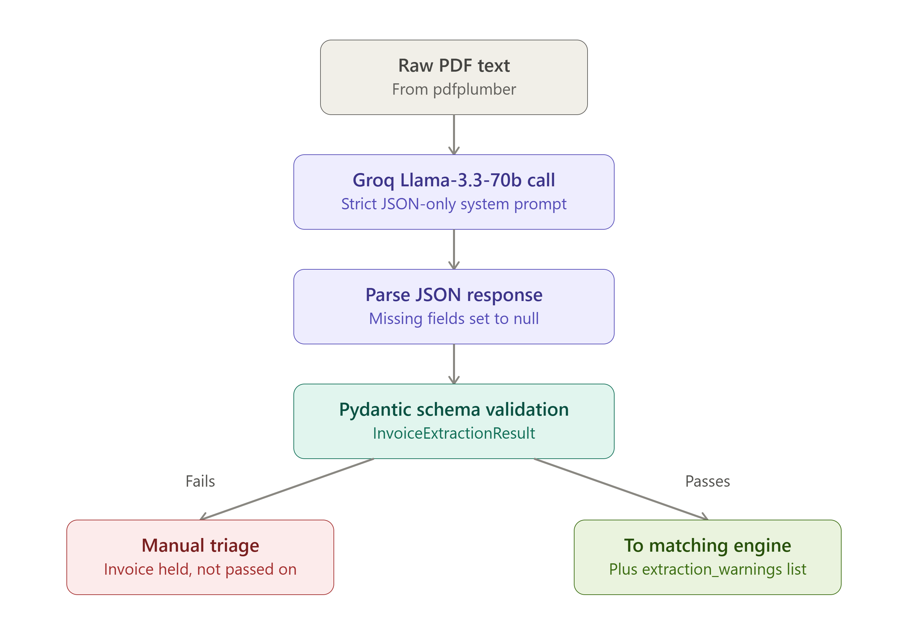
ARCHITECTURE
INVOICE-PO GUARDIAN
4
Notes:
A quick word on why I chose each piece of this stack. FastAPI gives me async performance and automatic request validation, which matters when you're handling file uploads and calling an external AI API. React powers the dashboard so reviewers get a real-time, interactive view instead of a static report. For the AI layer, I used Groq running Llama 3.3 70B — it's extremely fast inference and free-tier friendly, which mattered given my timeline, without sacrificing extraction quality. SQLite is my local operational database — fast, zero-setup, perfect for this scope — while Airtable serves as a durable, human-browsable final storage layer, which is closer to what a real finance team might already use day to day. And JWT plus bcrypt handles authentication properly — I'll go deeper on that in the security slide, since that's explicitly part of the evaluation criteria.

Slide 6
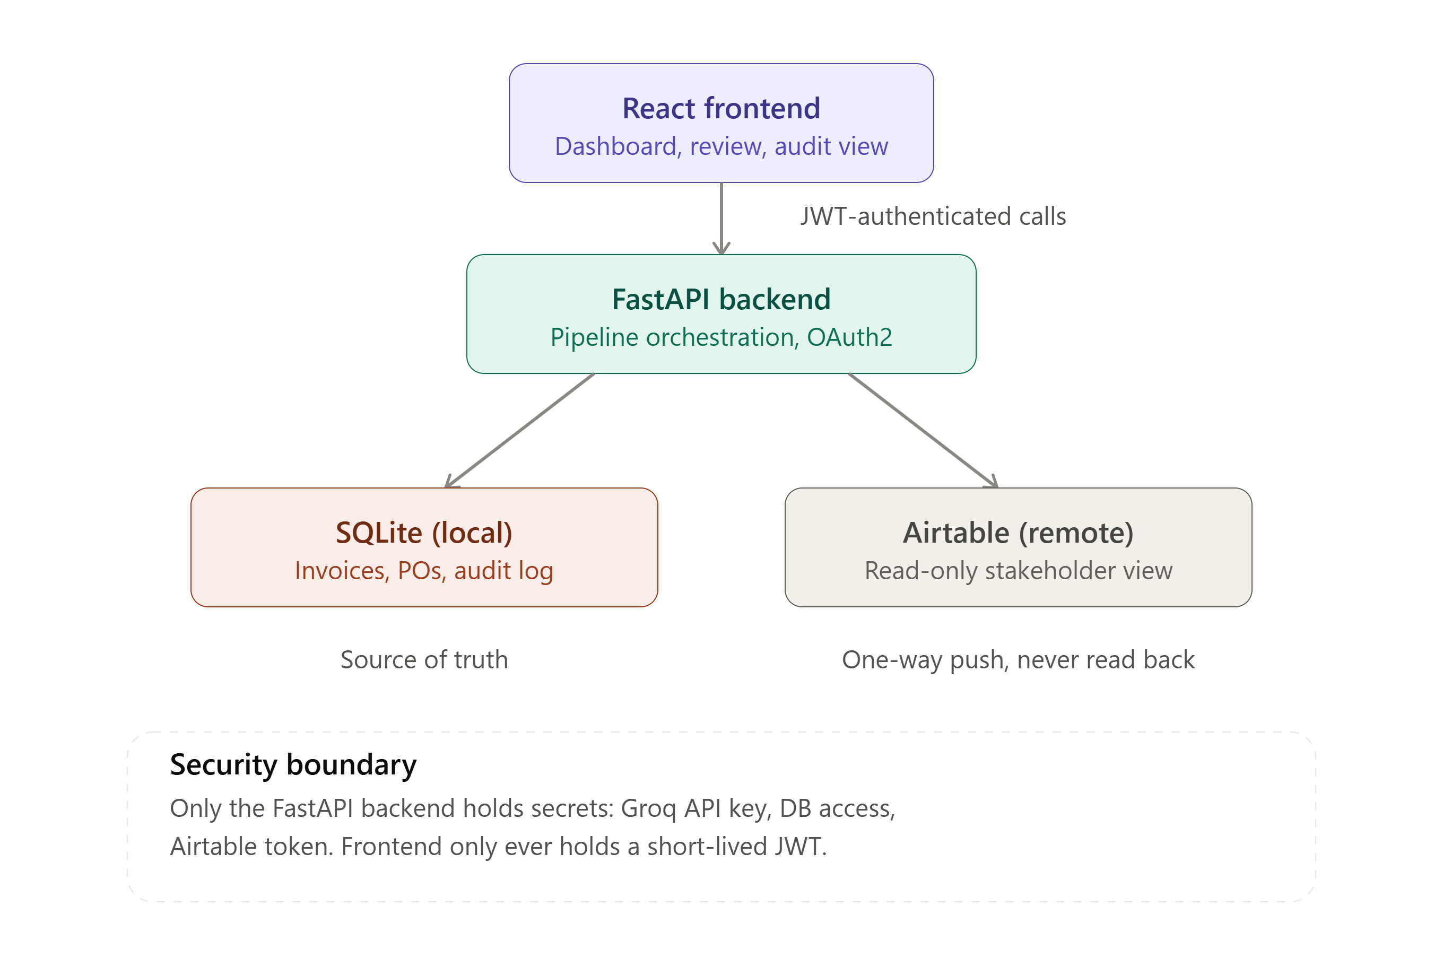
ARCHITECTURE
Built on a modern, pragmatic stack
INVOICE-PO GUARDIAN
4
Notes:
A quick word on why I chose each piece of this stack. FastAPI gives me async performance and automatic request validation, which matters when you're handling file uploads and calling an external AI API. React powers the dashboard so reviewers get a real-time, interactive view instead of a static report. For the AI layer, I used Groq running Llama 3.3 70B — it's extremely fast inference and free-tier friendly, which mattered given my timeline, without sacrificing extraction quality. SQLite is my local operational database — fast, zero-setup, perfect for this scope — while Airtable serves as a durable, human-browsable final storage layer, which is closer to what a real finance team might already use day to day. And JWT plus bcrypt handles authentication properly — I'll go deeper on that in the security slide, since that's explicitly part of the evaluation criteria.

Slide 7
DEEP DIVE
The pipeline, stage by stage
01
Email Ingestion
05
Field-by-Field Matching
Simulated folder watcher & IMAP fetcher detect new invoice emails and PDF attachments.
Vendor, currency, quantities, prices, and totals are compared with configurable tolerance.
02
PDF Text Extraction
06
Discrepancy Detection
pdfplumber pulls raw text from the attached invoice, page by page.
Eight distinct mismatch types are identified and classified by severity.
03
LLM Data Extraction
07
Validation Routing
Groq (Llama 3.3) returns structured JSON validated against strict Pydantic schemas.
Business rules decide: Ready for Payment, Procurement Review, or Rejected.
04
PO Retrieval
08
Secure Storage & Audit
The matching Purchase Order is looked up by PO number in the database.
Every decision is persisted with a full, timestamped audit trail.
INVOICE-PO GUARDIAN
5
Notes:
Let me walk through all eight stages quickly, left to right, top to bottom. First, ingestion — I built both a folder-watcher for simulated testing and a real IMAP fetcher, so this isn't limited to fake data. Second, PDF extraction using pdfplumber pulls raw text out, handling multi-page invoices. Third, that raw text goes to Llama 3.3 via Groq, which returns strict JSON validated against a Pydantic schema — if the AI's response doesn't match the schema, we catch that immediately rather than letting bad data flow downstream. Fourth, we look up the matching PO by PO number. Fifth — and this is the core engineering work — a field-by-field comparison engine checks vendor name, currency, every line item's quantity and price, and the totals, all with a configurable tolerance rather than naive exact matching. Sixth, that comparison feeds into discrepancy detection, which identifies eight distinct mismatch types. Seventh, business rules turn those discrepancies into one of three outcomes. And eighth, everything is stored with a full audit trail — every approval, rejection, and override is timestamped and attributed.

Slide 8
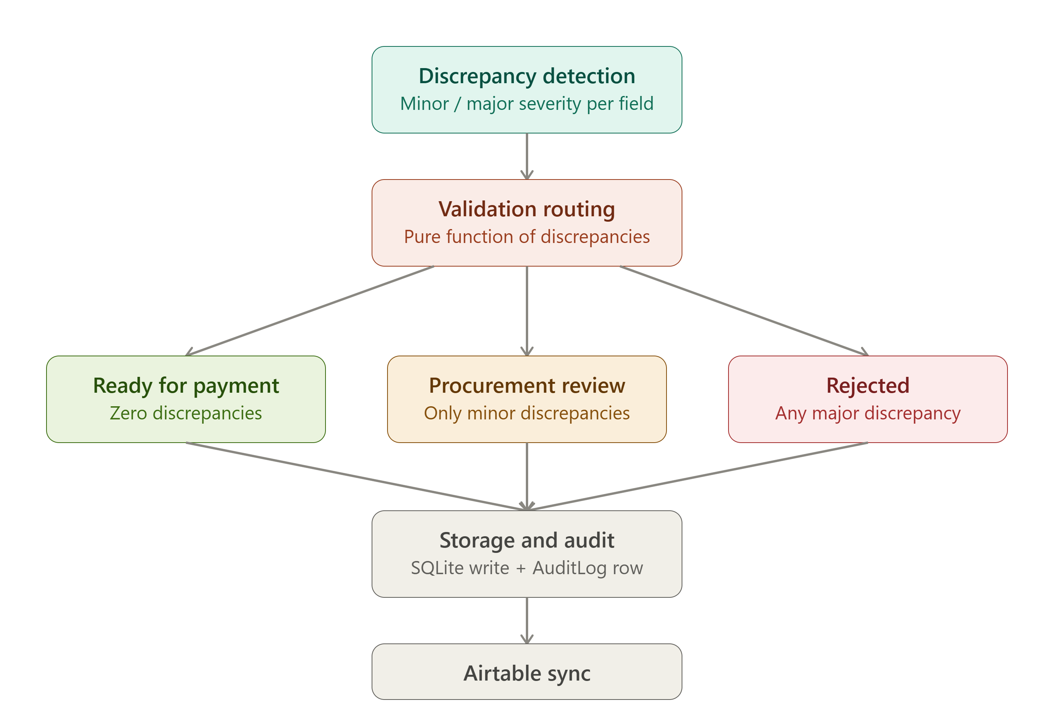
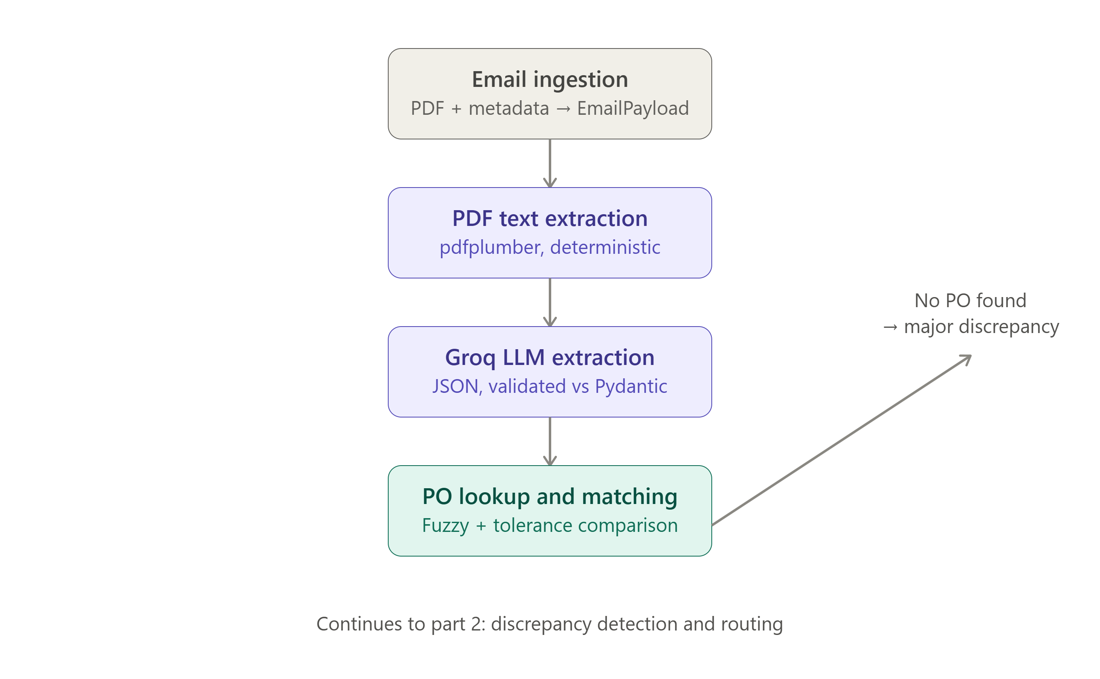
DEEP DIVE
The pipeline, stage by stage
Notes:
Let me walk through all eight stages quickly, left to right, top to bottom. First, ingestion — I built both a folder-watcher for simulated testing and a real IMAP fetcher, so this isn't limited to fake data. Second, PDF extraction using pdfplumber pulls raw text out, handling multi-page invoices. Third, that raw text goes to Llama 3.3 via Groq, which returns strict JSON validated against a Pydantic schema — if the AI's response doesn't match the schema, we catch that immediately rather than letting bad data flow downstream. Fourth, we look up the matching PO by PO number. Fifth — and this is the core engineering work — a field-by-field comparison engine checks vendor name, currency, every line item's quantity and price, and the totals, all with a configurable tolerance rather than naive exact matching. Sixth, that comparison feeds into discrepancy detection, which identifies eight distinct mismatch types. Seventh, business rules turn those discrepancies into one of three outcomes. And eighth, everything is stored with a full audit trail — every approval, rejection, and override is timestamped and attributed.

Slide 9




AI STRATEGY
Prompt engineering built for reliability
Strict JSON Schema
Few-Shot Anchoring
Every required field is explicitly named; the model is instructed to return ONLY valid JSON, no markdown or commentary.
A compact worked example anchors output formatting and reduces drift on messy invoice layouts.
Explicit Null Handling
Self-Reported Confidence
Missing fields become null with a note in extraction_warnings — the model is told never to guess.
A 0.0–1.0 confidence_score reflects extraction certainty, driving downstream review routing.
Low Temperature (0.1)
Retry on Malformed Output
Minimizes variance run-to-run — critical for a deterministic business pipeline.
A corrective follow-up prompt re-requests valid JSON before falling back to manual review.
INVOICE-PO GUARDIAN
6
Notes:
Since this is an AI Engineer role, I want to spend real time on the prompt engineering, because that's where a lot of the reliability of this system actually comes from. First, the prompt enforces a strict JSON schema and explicitly tells the model to return nothing but JSON — no markdown fences, no commentary — because I need to parse this programmatically every single time. Second, I included a compact few-shot example directly in the system prompt, which anchors the model's formatting even when the invoice text is messy or oddly structured. Third — and I think this is the detail that shows real engineering maturity — I explicitly instruct the model to never guess a missing value; instead it returns null and logs a warning. That's a deliberate choice: a wrong guess is worse than an honest 'I don't know' in a finance context. Fourth, the model self-reports a confidence score, which I actually use downstream — low-confidence extractions get routed to human review regardless of whether the numbers matched. Fifth, temperature is set low, at 0.1, because I want consistent, repeatable behavior, not creative variation. And finally, if the model ever returns malformed JSON, I don't just crash — I send one corrective retry prompt, and only fall back to manual review if that also fails.

Slide 10

DECISION LOGIC
Consistent, explainable business rules
Every invoice lands in exactly one of three outcomes, determined by discrepancy severity — never by ad hoc judgment.
Ready for Payment
Procurement Review
Rejected
Zero discrepancies, or all differences within the ±2% configurable tolerance.
Minor issues only — e.g. price/quantity off by <10%, or an extra line item.
Any major discrepancy — missing PO, vendor mismatch, or a difference ≥10%.
Example Batch Outcome Distribution
Severity thresholds are configurable via environment variables — not hardcoded — so tolerance can be tuned per deployment without touching code.
INVOICE-PO GUARDIAN
7
Notes:
This is the business logic that turns raw discrepancy data into an actual decision. I deliberately avoided a binary 'match or no match' system, because that's not how real procurement teams think about risk. Instead, I built a three-tier model. Green — Ready for Payment — means either a perfect match, or every difference falls inside a configurable tolerance band, which I set at plus-or-minus 2 percent by default. Amber — Procurement Review — covers minor issues, like a price or quantity that's off by less than 10 percent, or an extra line item that wasn't on the original PO — these need a human's judgment but aren't automatically rejected. Red — Rejected — is reserved for major issues: a vendor mismatch, a missing PO entirely, or any difference of 10 percent or more. The donut chart on the left shows what a realistic batch of invoices might look like once this logic runs — and I want to emphasize that none of these thresholds are hardcoded magic numbers; they're pulled from environment variables, so this could be tuned for a stricter or looser policy without touching a single line of code.

Slide 11



SECURITY
Access control taken seriously, not bolted on
JWT-Based Authentication
Bcrypt Password Hashing
Every data endpoint requires a signed, time-limited access token.
Credentials are never stored in plaintext, anywhere.
Login Rate Limiting
Generic Error Messages
Brute-force protection caps repeated failed login attempts per IP.
Failed logins never reveal whether the username or password was wrong.
Environment-Based Secrets
Session-Scoped Tokens
JWT keys and default credentials are sourced from .env, never hardcoded.
Tokens live in sessionStorage, cleared automatically when the tab closes.
INVOICE-PO GUARDIAN
8
Notes:
Since security is explicitly called out in the evaluation criteria, I want to be specific rather than hand-wavy about what's actually implemented here — all six of these are real, not decorative. Every endpoint that touches invoice or PO data requires a valid, signed JWT — I tested this directly by hitting a protected endpoint with no token and confirming it returns a 401, not invoice data. Passwords are hashed with bcrypt, never stored in plaintext, and I added rate limiting on the login endpoint specifically to blunt brute-force attempts. Failed logins return a generic 'invalid credentials' message — I deliberately don't reveal whether the username or the password was wrong, since that kind of detail is exactly what helps an attacker narrow down a valid account. Secrets like the JWT signing key and the default admin password are read from environment variables, never hardcoded into source code. And session tokens live in sessionStorage rather than localStorage, so they're cleared the moment the browser tab closes, reducing the exposure window. I do note in my README that a production deployment would go further — httpOnly cookies, refresh token rotation — but for this scope, this is a genuinely defensible security posture, not just a login form for show.

Slide 12
RELIABILITY
Designed to degrade gracefully, never to crash
The pipeline treats failure as an expected input, not an exception to fear. Every failure mode routes to a safe, reviewable state instead of losing data.
Corrupted or empty PDF
Extraction error caught → invoice saved with a warning → routed to Procurement Review, not dropped.
Malformed AI JSON response
One corrective retry prompt; on repeated failure, flagged with extraction_failed instead of crashing.
Groq API timeout / rate limit
Automatic retry with exponential backoff (up to 3 attempts) before surfacing an error.
Database write contention
Retry-with-backoff wrapper around commits absorbs transient SQLite lock errors.
Duplicate invoice submission
Vendor + invoice number combination checked before storage; duplicates auto-rejected.
INVOICE-PO GUARDIAN
9
Notes:
In a finance-adjacent pipeline, the worst outcome isn't an error — it's silently losing or mishandling an invoice. So I built every stage of this pipeline to fail into a safe, visible state rather than crash or drop data. If a PDF is corrupted or empty, the extraction error is caught, the invoice is still saved with a warning attached, and it's routed straight to Procurement Review instead of vanishing. If the AI returns malformed JSON, there's one corrective retry before we flag it honestly as a failed extraction. If the Groq API times out or hits a rate limit, there's automatic retry with exponential backoff before it ever surfaces as a user-facing error. Database writes are wrapped in retry logic too, to absorb the occasional SQLite lock under concurrent access. And I also built duplicate invoice detection as a bonus feature — before storing a new invoice, the system checks if that vendor and invoice number combination already exists, and if so, it's automatically rejected rather than risking a double payment. I actually triggered this live during testing by accident, which was a nice confirmation that it works exactly as designed.

Slide 13
WHY IT MATTERS
From manual bottleneck to auditable automation
100%
8
0
Full
Of invoices get a consistent, documented decision path
Discrepancy types caught automatically, every time
Plaintext passwords or hardcoded secrets in the codebase
Audit trail on every approval, rejection, and override
Human-in-the-loop by design: the AI accelerates the work, but every review, approval, and rejection remains a documented human decision — not a black box.
Thank You
Invoice-PO Guardian — Rounak · AnthraSync AI Engineer Assignment, Round 3
github.com/BookishThumb
INVOICE-PO GUARDIAN
10
Notes:
To close, I want to bring this back to business value, not just technical features. Every single invoice that flows through this system gets a consistent, explainable decision — nobody's having a bad day and missing a mismatch, because the same eight checks run identically every time. There are zero hardcoded secrets anywhere in this codebase, which matters if this were ever handed to another engineer or deployed somewhere real. And critically, this isn't trying to remove humans from the loop — it's trying to remove the tedious, error-prone parts of their job so their judgment gets used where it actually matters: reviewing genuinely ambiguous cases, not manually cross-checking numbers on a hundred invoices a day. That's the philosophy behind every design decision I made here. Thank you — happy to answer any questions, or walk through the live system and the code directly.

