Slide 1

CLACELL: Robust cell type classifier for immune cells
Julian Kraus
Biomedical Network Science Lab
Department Artificial Intelligence in Biomedical Engineering
Friedrich-Alexander-Universität Erlangen-Nürnberg
https://www.bionets.tf.fau.de

Slide 2

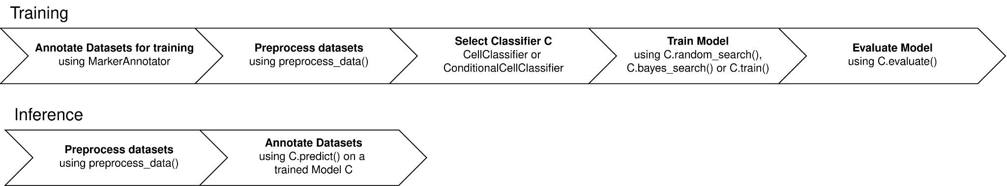
Motivation
Cell type annotation is a critical prerequisite for downstream biological insights (e.g. gene regulatory network modeling)
Existing cell type classifiers suffer from a lack of robustness, low F1-Scores, high variance and sensitivity to gene dropout
=> CLACELL: a Python package designed for the robust and deterministic classification of immune cells

Slide 3
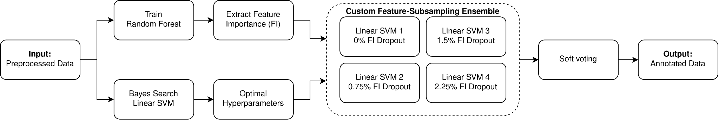
CellClassifier: Custom Ensemble

Slide 4
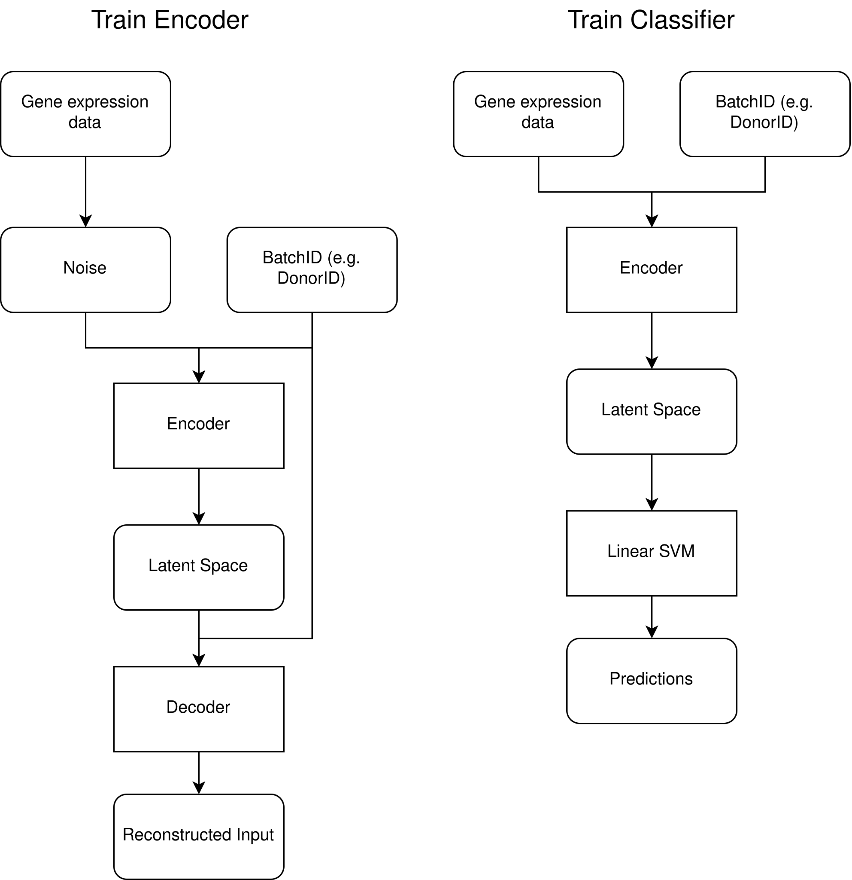
ConditionalCellClassifier: Conditional Autoencoder

Slide 5
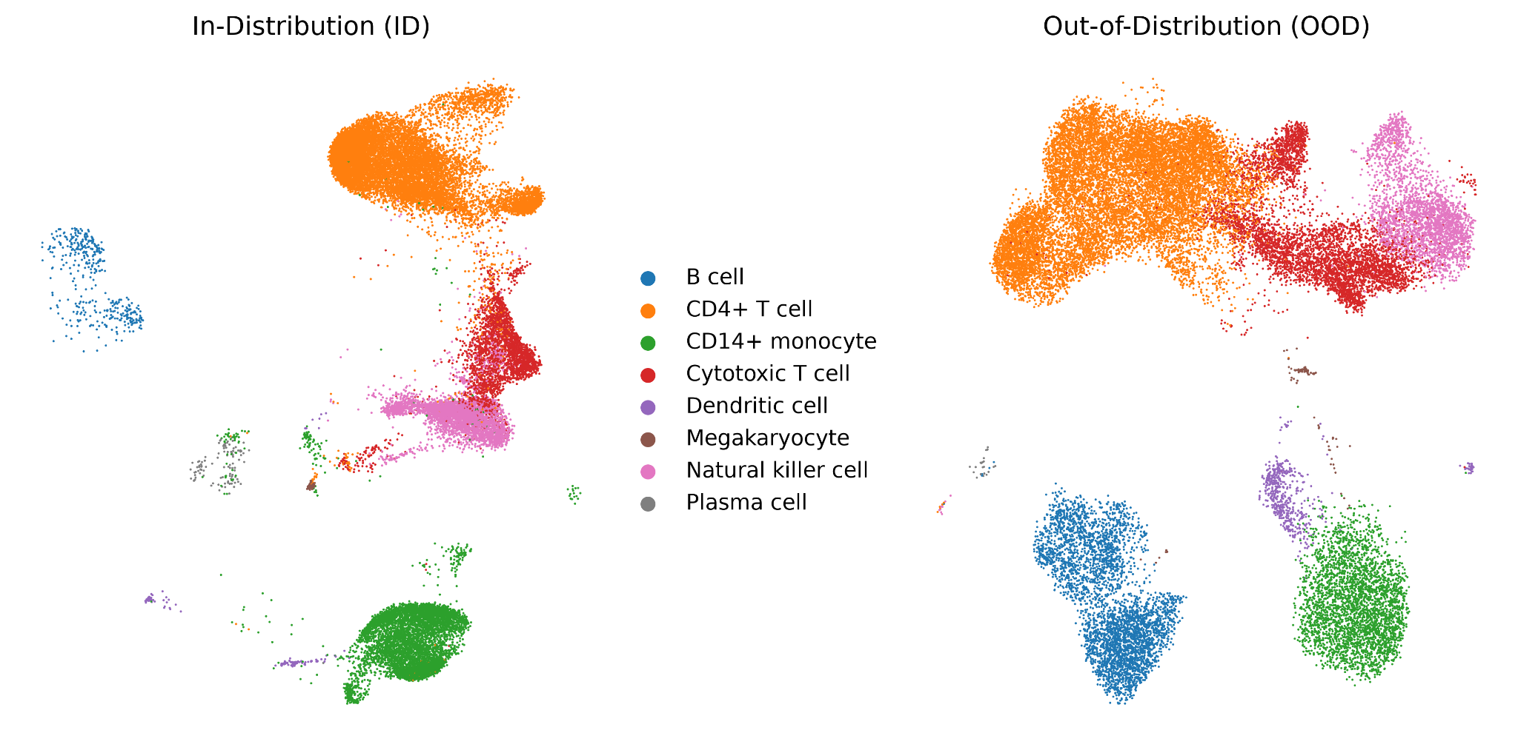
In-Distribution and Out-of-Distribution Datasets

Slide 6
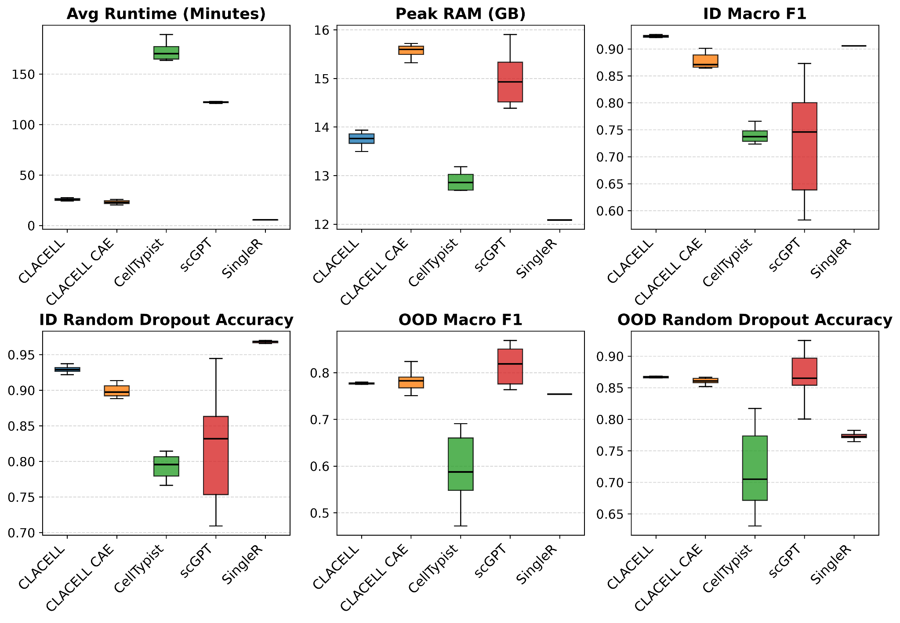
Results
Overall Comparison

Slide 7
Results
Overall Comparison

Slide 8
Results
Overall Comparison

Slide 9
Results
Overall Comparison

Slide 10
Results
Overall Comparison

Slide 11
Results
Overall Comparison

Slide 12
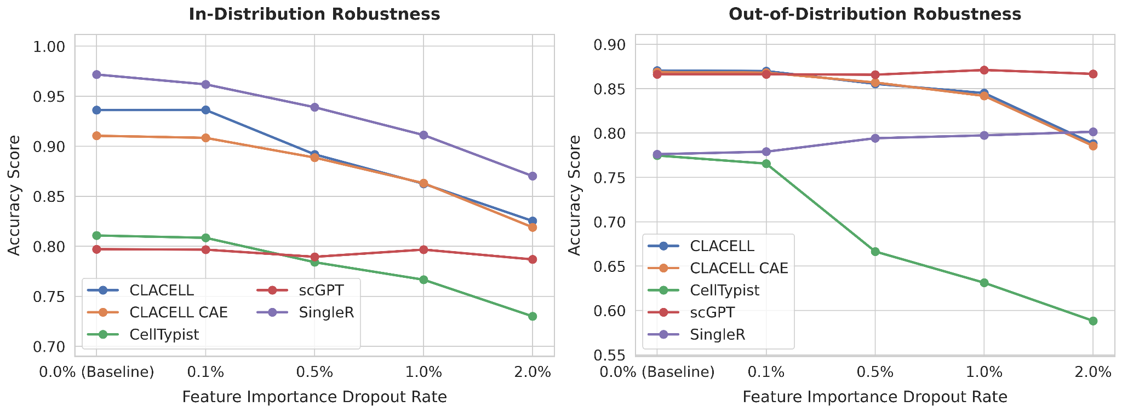
Results
Feature Importance Dropout

Slide 13
Conclusion
Python package for the robust and deterministic annotation of immune cells
CellClassifier offers a lower standard deviation, while ConditionalCellClassifier generalizes slightly better on out-of-distribution data
Future Work:
Classify more fine-grained cell types
Evaluate package on spatial data
Code: https://github.com/Boolean-true/CLACELL

