Slide 1
Lift Risk
Brennan Thomas
Advisor: Dr. Rashmi Jha

Slide 2
Goals
Repeated lifting of heavy objects has been shown to create increased risk for incidences of lower back pain. While lifting objects cannot be entirely avoided in daily life, proper technique mitigates these risks. Determining when a person is lifting in a risky way can help a worker learn to avoid dangerous lifts and help the employer determine if the workplace layout is prone to requiring them. The goal of this project is to develop a machine learning approach for detecting the risk level of an individual lift based on accelerometer and gyroscope data from various sensors placed on a worker’s body.

Slide 3
Intellectual Merits
Traditional human activity recognition systems focus on recognition of easily separable activities – walking, running, jumping, sitting, etc.
There is little research on different classes of similar activities
Provide insight into capabilities of machine learning for this use case

Slide 4
Broader Impacts
Workplace ergonomics is a very important field
Unsafe workplaces can have lasting impact on quality of life
Determining the usefulness of machine learning for monitoring workplace safety
Provides a framework for safer work environments using unintrusive IMU monitoring

Slide 5
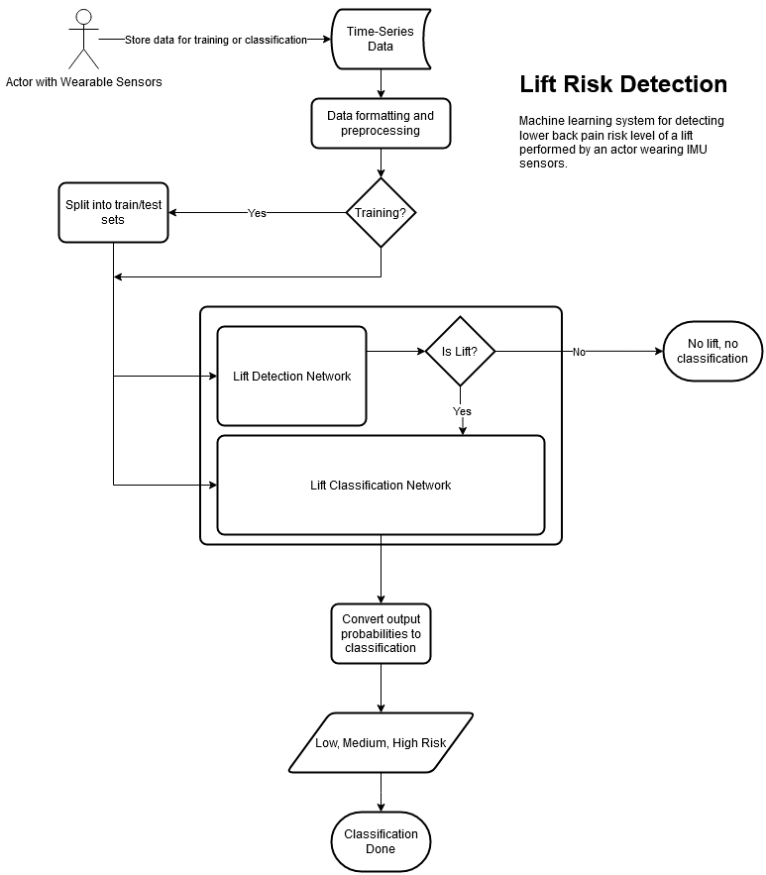
Design Specifications
Consists of three components
Preprocessing
Prepares training/testing data
Lift Detection
Detects if a lift is occurring given a segment of IMU data
Lift Risk Classification
Classifies the risk level of a lift in a segment of IMU data

Slide 6
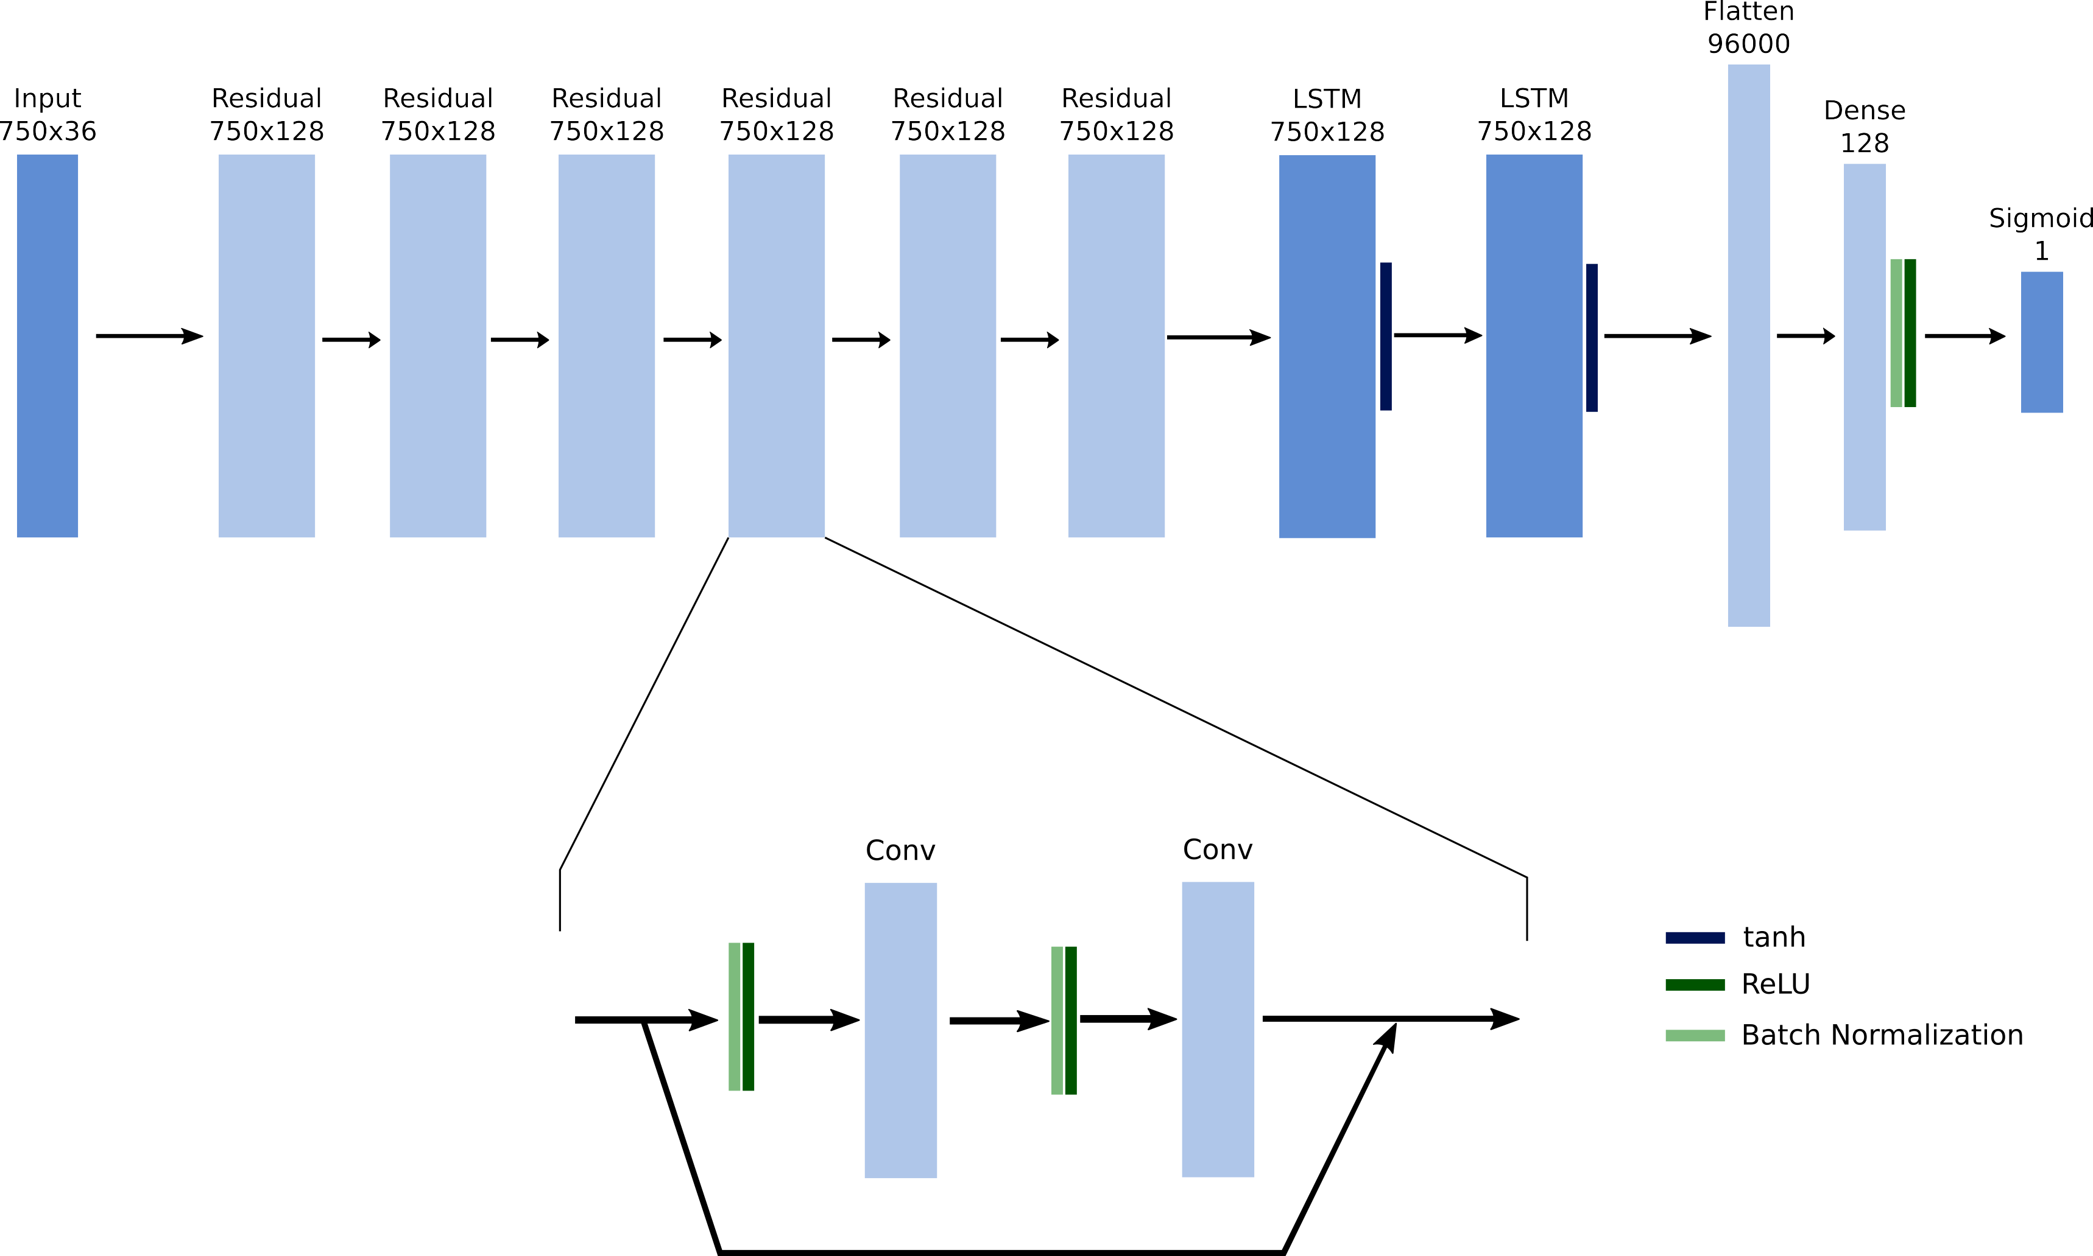
Design Specifications – Detection Model
6 Residual Blocks
2 LSTM layers
Fully-connected layer
Sigmoid output

Slide 7

Design Specifications – Classification Model
Similar to detection
Softmax output
1 unit for each class

Slide 8




Technologies
Code is written in Python
Tensorflow used for model implementations
Numpy and Pandas for data preprocessing
Scikit Learn for metrics
Machine Learning models
Both models are implementations of deep learning networks
Long Short-Term Memory Networks (LSTM) and convolutional layers form the core of the networks
IMU Sensors provide training and testing data

Slide 9
Milestones
Preprocessing – Oct 26th, 2020
Python code for preparing data for model consumption
Lift Detection – Dec 1st, 2020
Python implementation of a machine learning model capable of detecting if a lift is occurring in a segment of IMU data
Lift Classification – Jan 5th, 2021
Python implementation of a machine learning model capable of classifying a lift’s risk level from a segment of IMU data
Refinement – Feb 28th, 2021
Modifications to previous milestones based on possible improvements

Slide 10
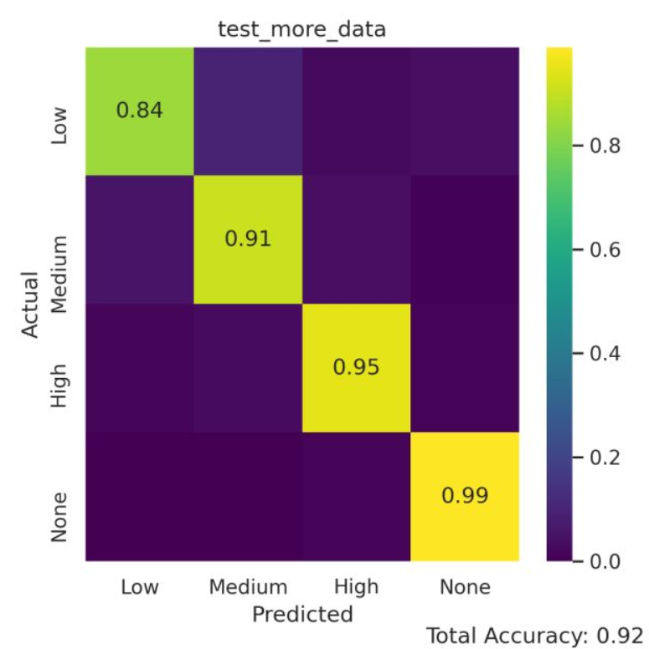
Results – Lift Classification
Balanced Accuracy (BAC): 89.5%
Slightly biased towards samples with more data
Very good at separating lift and non-lift

Slide 11
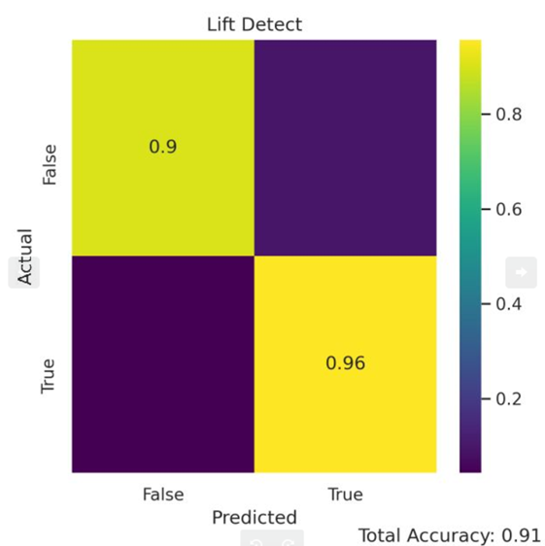
Results – Lift Detection
BAC: 92.9%
Suffers from poor precision due to unbalanced dataset
F1 Score: 0.666
Positive predictions have around 50% chance to be negative
Must be caught by classification model
 | Predicted Negative | Predicted Positive
Actual Negative | 35791 | 3858
Actual Positive | 185 | 4027

Slide 12
Results
Good performance from both models
Need to be integrated together into one pipeline
Code should be refactored for ease of use

Slide 13
Challenges
Lift detection dataset is imbalanced
Lifting action happens significantly less often than other activities
Mitigated with rebalancing and data augmentation
Limited computing power and long train times
Limit complexity of models and plan ahead for testing

