Slide 1
Lift Risk
Machine learning solution for detecting the risk of lower back pain caused by repeated action of lifting heavy objects

Slide 2

Team
Brennan Thomas
thoma2bm@mail.uc.edu
Advisor: Dr. Rashmi Jha

Slide 3
Abstract
Repeated lifting of heavy objects has been shown to create increased risk for incidences of lower back pain. While lifting objects cannot be entirely avoided in daily life, proper technique mitigates these risks. Determining when a person is lifting in a risky way can help a worker learn to avoid dangerous lifts and help the employer determine if the workplace layout is prone to requiring them. The goal of this project is to develop a machine learning approach for detecting the risk level of an individual lift based on accelerometer and gyroscope data from various sensors placed on a worker’s body.

Slide 4

User Stories
As a worker, I want a way to tell if I am lifting in an unsafe manner, so that I can learn to avoid such actions and reduce physical risk to myself.
As a manager, I want a way to tell if my workers often perform unsafe lifts, so that I can know if the workspace is set up in a way that unsafe lifts are required.
As a researcher, I want to determine if machine learning is a feasible approach for lift classification, so that I know a workable system can be built using it.
As a researcher, I want to learn about different data preprocessing techniques so that I can generate good input for machine learning systems.

Slide 5
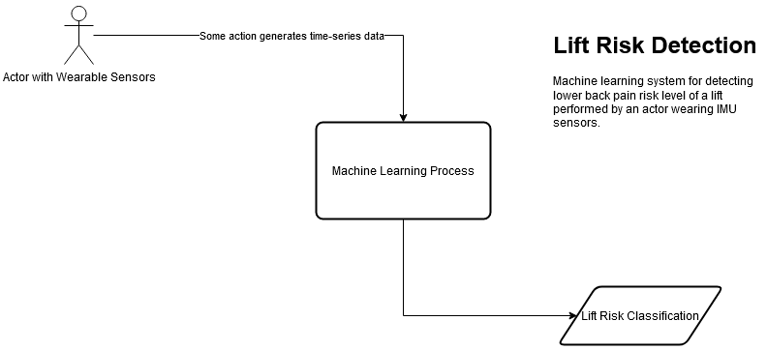
Design Diagrams – D0

Slide 6
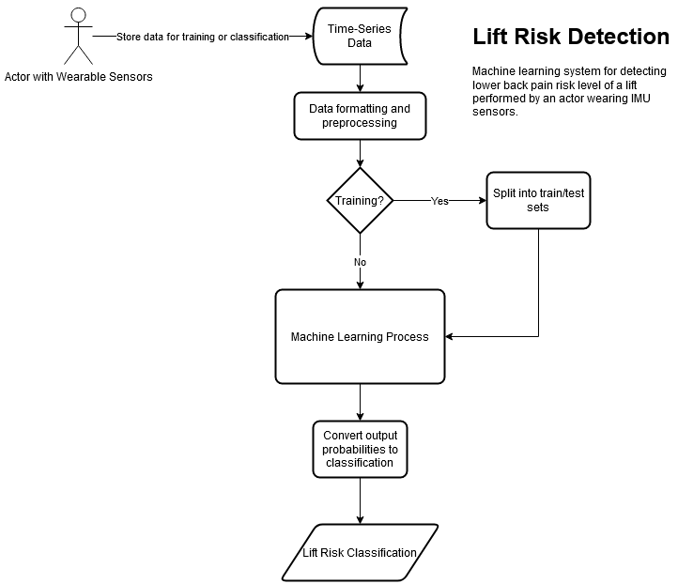
Design Diagrams – D1

Slide 7
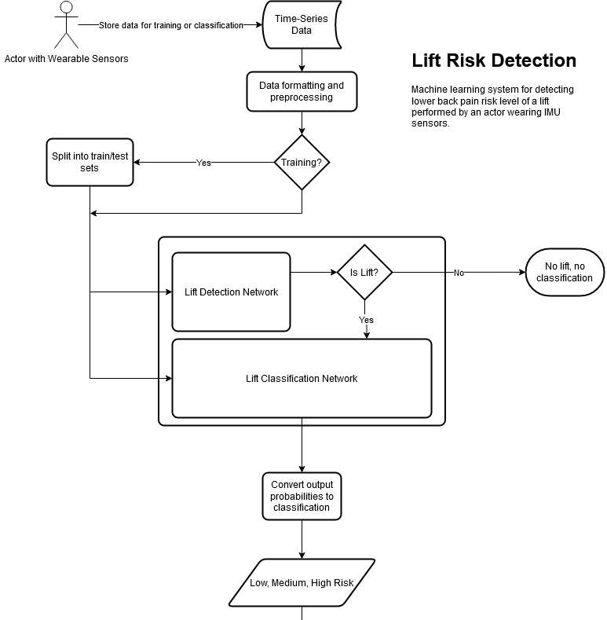
Design Diagrams – D2

Slide 8
Major Constraints
Research must be completed over the course of the academic year. The nature of research means that a fully viable solution may not be devised in this time frame; the goal is to have the best possible working model within the time frame.
The objective is to research strategies for lift classification and develop machine learning models for this goal. The models will not be implemented in an active system.
The devised solution should not require identifying information for any individuals using the system, such as age, height, weight, gender, etc.
The solution must work on as many members of the general population as possible. It must be general enough to work without being configured for each affected user.
The solution must be viable to work in an industrial setting. It cannot be so invasive as to impede the ability of a worker or produce more risk than is present without the system.
The solution should not require a significant technical understanding to use. Workers should not need to familiarize themselves with the system beyond knowledge of how to utilize the IMU sensors.

Slide 9
Current Progress
Data preparation
Little preprocessing due to preliminary models
Developed initial models for both detection and classification stages

Slide 10
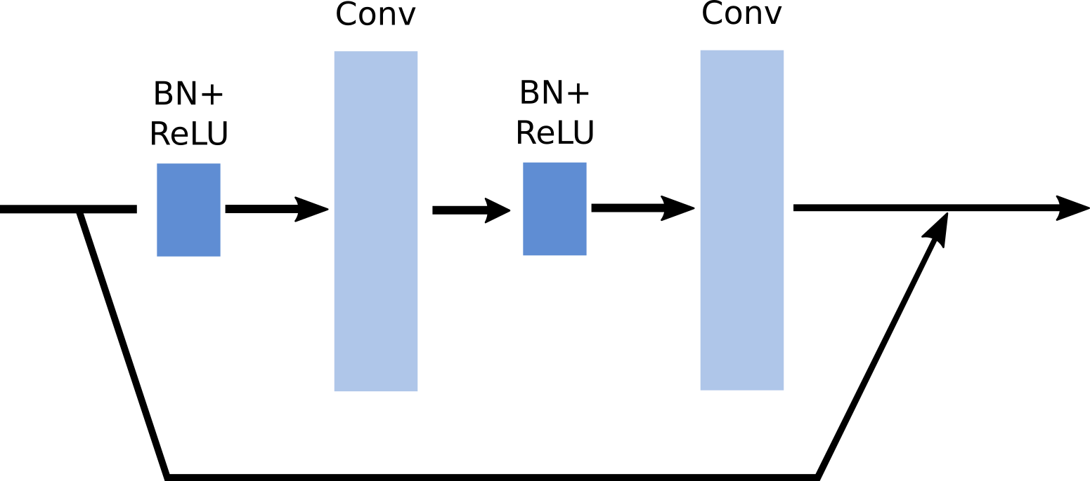
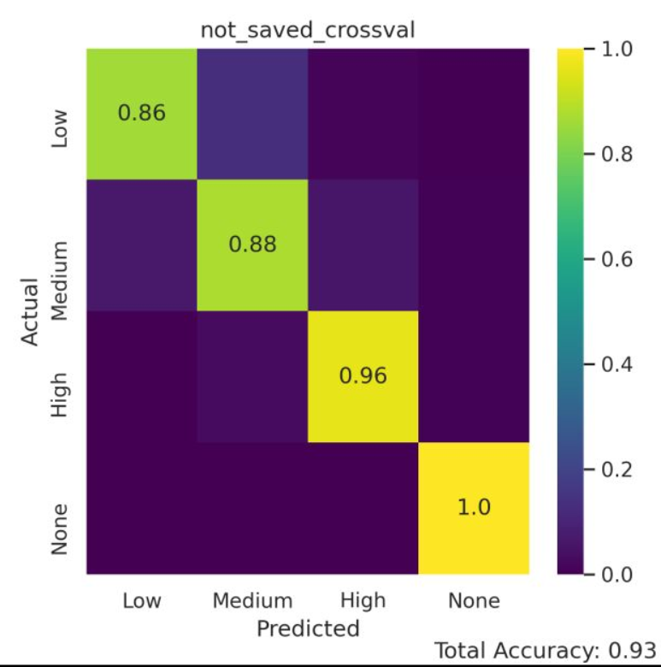
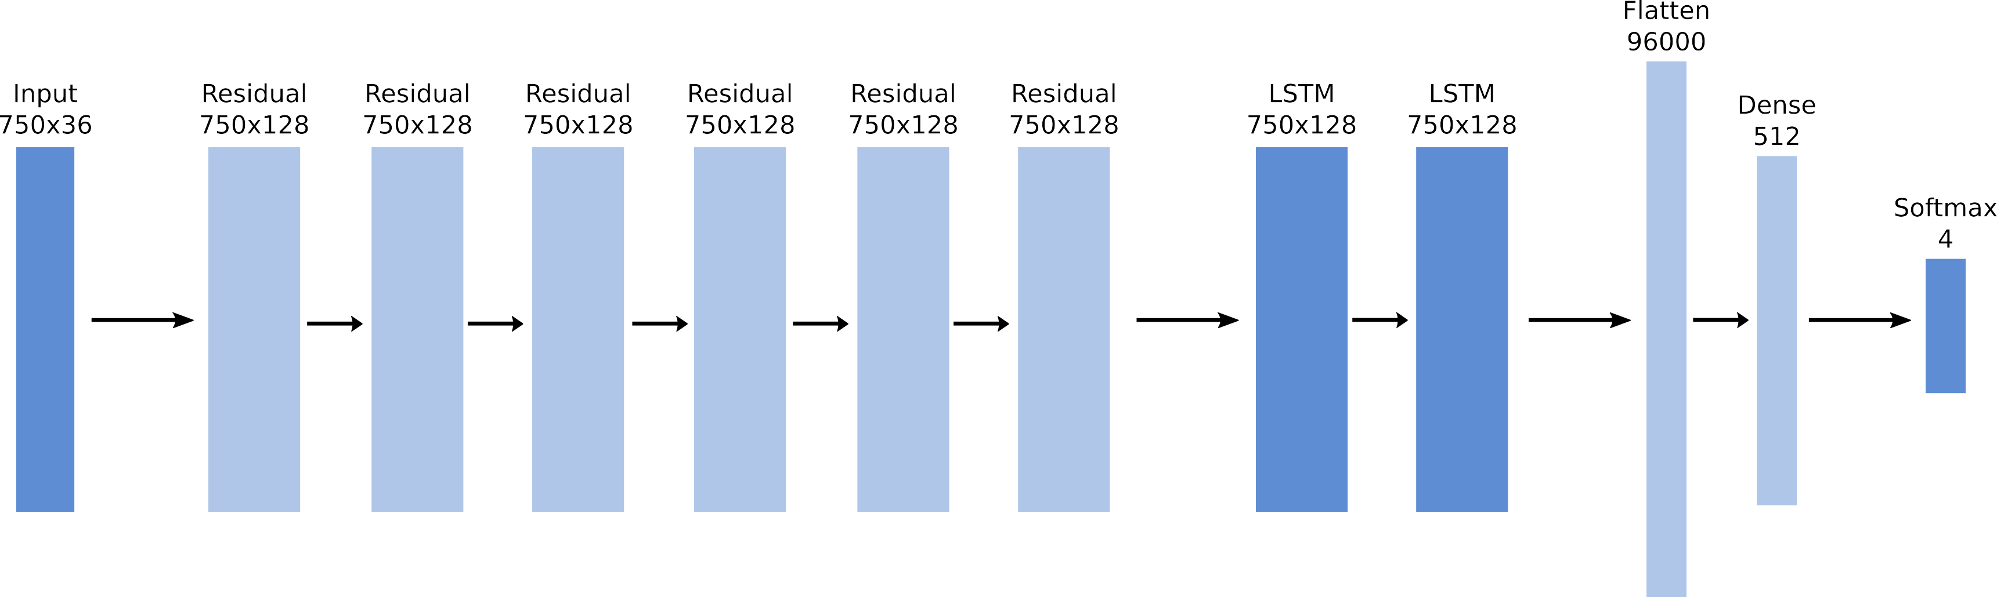
Lift Classification
Based on a modified version of the DeepConvLSTM model with residual blocks
Requires no preprocessing of data

Slide 11
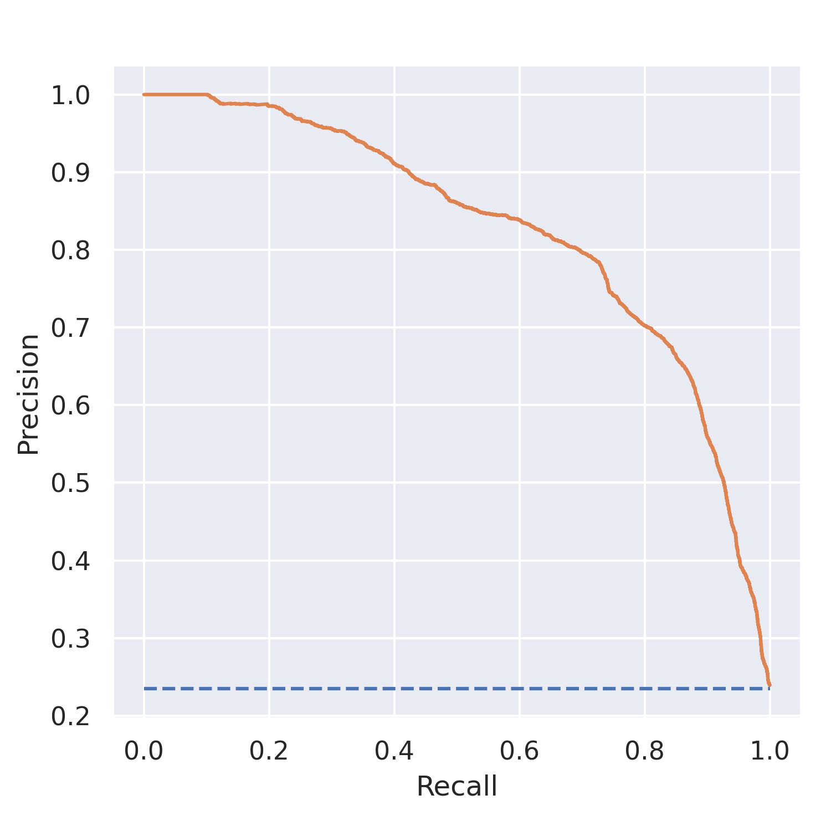
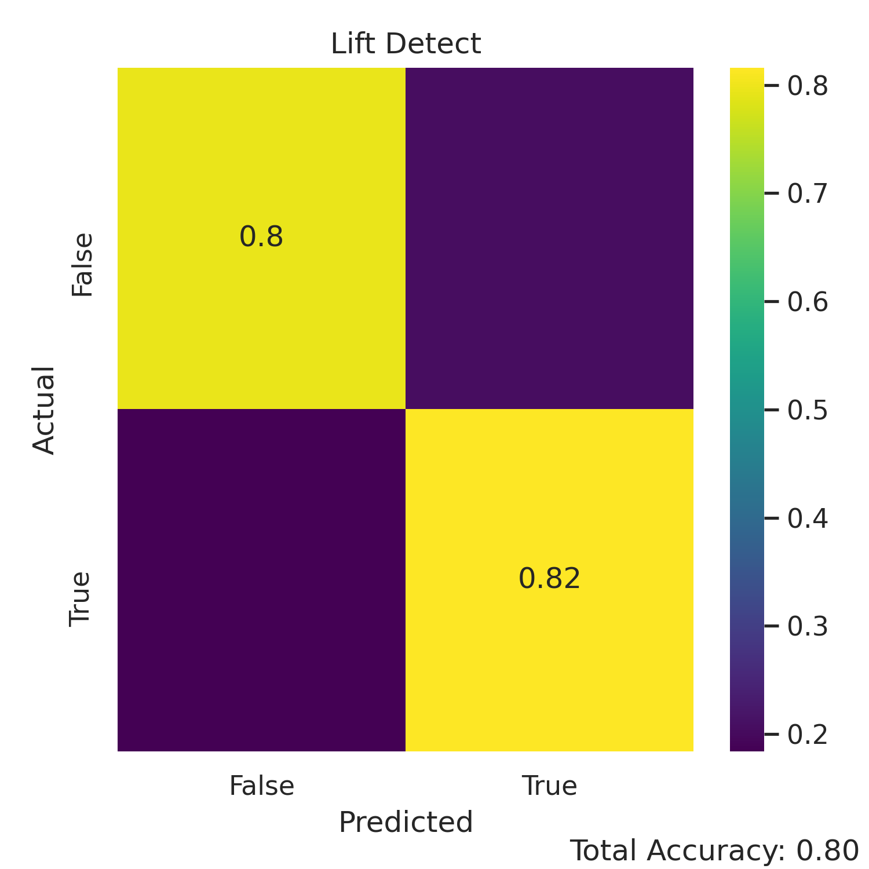
Lift Detection
Currently using same model as Classification, with modified inputs and outputs
Input is generated using a sliding window over the time-series data
Very unbalanced
Good recall, low precision

Slide 12
Expected Term Accomplishments
Completion of three main components
Preprocessing
Prepare data for model consumption
Lift Detection
Given a time-series signal, detect when lift occurs
Lift Classification
Given a time-series signal, classify risk level of lift

Slide 13
Division of Work
Me ☺

Slide 14
Expected Demo
Compiled results showing performance of the system
Detection rate
Classification rate
Demonstration of model classification on sample data

Slide 15
Thanks!

