Slide 1

AgroVision-Mine
A Multimodal Data Warehouse, Visual Pattern Mining Framework, and Supervised Foliar Intelligence System for Crop Disease Management
CSI3010: DATA WAREHOUSING & DATA MINING — FINAL LAB PROJECT REVIEW
PROJECT TEAM DETAILS & ACADEMIC SUPERVISION
• Team Members: BOOMIKA V (23MID0326) | AJAY M (23MID0020)
• Faculty Guide: Dr. DEVIPRIYA A, Associate Professor
• Laboratory Slot: L41 + L42 • Academic Term: Fall Semester 2026–27
• Department: School of Computer Science and Engineering (SCOPE), VIT University, Vellore

Slide 2
CSI3010: DATA WAREHOUSING & DATA MINING
Executive Summary: The Multimodal Analytical Bridge
CORE CHALLENGE & IMPLEMENTED WAREHOUSE
• Agricultural Data Fragmentation: Foliar imagery traditionally resides in isolated raw directories without relational metadata, multi-dimensional queryability, or data quality gates.
• Kimball Star Schema Warehouse: Engineered a formal dimensional warehouse in SQLite (PRAGMA foreign_keys = ON) with 1 Fact table (2,596 rows) and 4 Dimensions (dim_crop, dim_disease, dim_image, dim_visual_feature).
• Explainable Visual Feature Store: Extracted 32 continuous descriptors (19 Color Moments, 7 Haralick GLCM Texture, 6 Morphometric Shape) into an audited 44-column feature matrix.
• SQL OLAP Analytical Engine: Implemented parameterized SQL operations (Roll-up, Drill-down, Slice, Dice, Pivot) with sub-15ms execution latency across all 2,596 observations.
• Unsupervised Visual Mining: Fitted K-Means clustering (K=2 metric-supported vs K=4 exploratory) and 2D PCA projection (52.11% variance), plus Apriori/FP-Growth association rule mining.
IMPLEMENTED SUPERVISED CLASSIFICATION MODULE
• Current 25-Class Supervised Module: Implemented bounded multi-class foliar disease classification using fine-tuned EfficientNet-B0 (transfer learning from ImageNet-1K).
• Primary Evaluated Benchmark: Trained and evaluated across 2,447 PlantDoc images covering 25 crop-condition classes across 12 host crops.
• Rigorous Split Partitioning: 1,468 train, 489 validation, and 490 held-out test specimens grouped strictly by perceptual dHash to eliminate cross-partition data leakage.
• Verified Test Performance: Achieved 61.84% Top-1 Test Accuracy, 61.43% Balanced Accuracy, and 60.84% Macro-F1 on the 490 held-out images (Wilson 95% CI: [57.46%, 66.03%]).
SCIENTIFIC BOUNDARIES & ACADEMIC INTEGRITY
• Rejection of Generic Binary Task: An unconditioned all-crop Healthy/Diseased binary classifier was rejected due to severe taxonomic shortcut confounding (e.g. 7 crops were 100% healthy-only).
• Bounded Multi-Class Scope: The current model classifies within its 25 supported PlantDoc classes. It is NOT a universal plant diagnostic system.
• Domain Shift Safeguard: ICAR rice scanner images (N=36) were deliberately excluded from training and trigger an automated 'unsupported_domain' cross-modal rejection alert.
AgroVision-Mine: Multimodal Data Warehouse & Supervised Foliar Intelligence — Faculty Review
Slide 2 of 28

Slide 3
CSI3010: DATA WAREHOUSING & DATA MINING
Research Motivation: The Agricultural Data Gap
LIMITATIONS OF CONVENTIONAL APPROACHES
• Isolated Black-Box Classifiers: Conventional computer vision models treat plant pathology as an isolated single-image classification problem, lacking historical, taxonomic, or environmental context.
• Metadata Fragmentation: Raw agricultural datasets strip away critical dimensions (botanical taxonomy, capture equipment, pathogen taxonomy, and spatial lesion properties).
• Absence of Ingestion Quality Audits: Public web-scraped corpora frequently suffer from truncated byte streams, corrupted image headers, duplicate frames, and unstandardized orientations.
• Inability to Slice & Drill: Agronomists and extension officers cannot execute multi-attribute relational queries (e.g., comparing fungal vs bacterial lesion severity across host plant families).
THE AGROVISION-MINE MULTIMODAL SOLUTION
• Relational Star Schema Integration: Couples image pixel data with Kimball-style dimensional modeling, linking image files to botanical taxonomy, pathology hierarchies, and extracted features.
• 5 Automated Quality Gates: Enforces pre-ingestion checks for file headers, geometry, payload limits, MD5 deduplication, and EXIF transposition, guaranteeing zero corrupt records.
• 32 Transparent Visual Descriptors: Engineers explainable color moments, Haralick GLCM textures, and morphometric shape metrics that remain inspectable alongside deep neural embeddings.
• Dual-Track Analytical Intelligence: Harmonizes SQL OLAP multi-dimensional slicing, unsupervised visual clustering, and bounded supervised transfer learning under one unified platform.
CORE RESEARCH QUESTION:
How can multimodal foliar observations and explainable visual features be integrated into an auditable relational data warehouse to support real-time OLAP slicing, visual pattern mining, and a scientifically defensible supervised classification system?
AgroVision-Mine: Multimodal Data Warehouse & Supervised Foliar Intelligence — Faculty Review
Slide 3 of 28

Slide 4
CSI3010: DATA WAREHOUSING & DATA MINING
Project Objectives & Implemented Deliverables
# | Objective & Scope | Implemented Component / Logic | Verified System Deliverable
1 | Data Governance & Ingestion | Ingest 2,596 observations across 14 crops with SHA-256 cryptographic immutability | canonical_dataset_v2.csv (SHA-256: c7fd16dc...1cb8 verified)
2 | Automated Quality Gates | 5-gate pipeline: magic bytes, geometry, 15MB ceiling, MD5 deduplication, EXIF transpose | 5 quality gates verified; Zero corrupt images admitted to warehouse
3 | Explainable Feature Store | Extract 32 continuous descriptors (19 Color, 7 GLCM Texture, 6 Morphometry) | image_features_v2.csv (44 columns, 2,596 rows; SHA-256 invariant)
4 | Dimensional Data Warehouse | Kimball Star Schema in SQLite with native PRAGMA foreign_keys = ON via SQLAlchemy | agrovision_warehouse.db (2,596 fact rows; 14 crops, 19 conditions, 4 dimensions)
5 | SQL-Backed OLAP Engine | Real ANSI SQL queries: Roll-up, Drill-down, Slice by Crop, Dice Sub-Cube, Pivot Matrix | Interactive OLAP Console; Latency 1.5ms – 14.1ms across 2,596 rows
6 | Unsupervised Visual Mining | Dual-K K-Means (K=2 primary, K=4 exploratory), 2D PCA, Apriori / FP-Growth rule parity | K=2 Silhouette = 0.4060; PCA 52.1% var; 880 Mode A rules (exact parity Δ = 0.0)
7 | Supervised Foliar Classifier | 25-class transfer learning via EfficientNet-B0; grouped dHash train/val/test splits | 490 held-out test images; 61.84% Test Acc; 60.84% Macro-F1 (Wilson CI: [57.5%, 66.0%])
AgroVision-Mine: Multimodal Data Warehouse & Supervised Foliar Intelligence — Faculty Review
Slide 4 of 28

Slide 5
CSI3010: DATA WAREHOUSING & DATA MINING
Dataset Provenance & Canonical Composition
Crop Species | Record Count | Percentage | Pathological Scope
Tomato | 743 | 28.62% | Early/Late Blight, Mold, Curl
Corn | 372 | 14.33% | Rust, Gray Spot, Blight, Healthy
Apple | 272 | 10.48% | Scab, Rust, Black Rot, Healthy
Potato | 216 | 8.32% | Early Blight, Late Blight, Healthy
Grape & Bell Pepper | 265 | 10.20% | Black Rot, Bacterial Spot, Healthy
Squash & Raspberry | 249 | 9.59% | Powdery Mildew, Healthy
Blueberry, Peach, Strawb. | 321 | 12.36% | Healthy baseline reference
Soybean, Cherry, Rice | 158 | 6.09% | Healthy (Soybean/Cherry) + Rice (ICAR)
TOTAL CORPUS | 2,596 | 100.0% | 14 Crops / 19 Conditions
DATASET ARCHITECTURE & LINEAGE
• Canonical Agricultural Corpus: Unified dataset of 2,596 authentic leaf observations across 14 crop species and 19 pathological condition categories.
• Multi-Source Provenance: 2,560 open-field images sourced from the PlantDoc benchmark (98.6%) plus 36 authenticated flatbed scanner images from ICAR / Open Government Data India (1.4%).
• Balanced Condition Split: 1,750 Diseased observations (67.4%) and 846 Healthy baseline observations (32.6%) providing verified ground truth.
• Reconciliation of Tomato Count: The canonical manifest contains exactly 743 Tomato specimens, correcting prior preliminary draft counts.
• Cryptographic Immutability: Manifest SHA-256 (c7fd16dcd6c1f8623f3e25a48b572387cba2b42855e4b5ddc482095d40f11cb8) and Feature Store SHA-256 (f6caf70bd07eeda335e471705e3763d3dd3ef543c0ae406e902a5741ec4093c1) remain strictly invariant.
MODALITY SEPARATION NOTE
• Source Domain Separation: The 36 ICAR rice observations are captured via flatbed desktop scanner with pure white backgrounds, while PlantDoc imagery is captured in unstructured outdoor fields.
AgroVision-Mine: Multimodal Data Warehouse & Supervised Foliar Intelligence — Faculty Review
Slide 5 of 28

Slide 6
CSI3010: DATA WAREHOUSING & DATA MINING
System Architecture: End-to-End 5-Layer Pipeline
1. INGESTION & GATES
• Heterogeneous Ingestion: PlantDoc (2,560) + ICAR Rice (36)
• Gate 1: Format: Magic Bytes header check
• Gate 2: Geometry: Min 100x100 resolution
• Gate 3: Payload: 15 MB ceiling limit
• Gate 4: Deduplication: MD5 content hashing
• Gate 5: Normalization: EXIF transpose & RGB canvas
2. PREPROCESSING & STORE
• Image Standardization: Uniform 256x256 bilinear resize
• Color Moments (19): RGB/HSV mean, std, ExG index
• GLCM Texture (7): Contrast, dissimilarity, ASM, energy
• Morphometry (6): Area, circularity, perimeter, solidity
• Feature Store: 44 columns, 2,596 rows (image_features_v2.csv)
3. WAREHOUSE & ETL
• Kimball Star Schema: SQLite 3 relational warehouse
• Fact Table: disease_observation_fact (2,596 rows)
• Dimension 1: dim_crop (14 taxa)
• Dimension 2: dim_disease (19 conditions)
• Dimension 3 & 4: dim_image & dim_visual_feature
• Integrity: PRAGMA foreign_keys = ON; 100% idempotent ETL
4. ANALYTICAL ENGINES
• SQL OLAP Engine: Roll-up, Drill-down, Slice, Dice, Pivot (<15ms)
• Dual K-Means: K=2 primary (Silh 0.406) vs K=4 exploratory
• 2D PCA Projection: 52.11% variance (PC1 luminance, PC2 texture)
• Association Rules: Mode A (880 visual) & Mode B (285 labeled)
• Nearest References: 32D Euclidean similarity in descriptor space
• Supervised CNN: Fine-tuned EfficientNet-B0 (25 classes, 61.8% acc)
5. PRESENTATION TIER
• FastAPI Backend: Asynchronous REST API (:8000)
• React 18 Frontend: TypeScript SPA with 9 analytical pages
• Workbench GUI: Live upload, 32D extraction, prediction
• Domain Safeguard: Out-of-domain rejection alert banner
• Quality Assurance: 117/117 automated tests passing
AgroVision-Mine: Multimodal Data Warehouse & Supervised Foliar Intelligence — Faculty Review
Slide 6 of 28

Slide 7
CSI3010: DATA WAREHOUSING & DATA MINING
Technology Stack & Architectural Rationale
Technology | System Layer | Verified Implementation Role | Architectural Rationale
Python 3.11 | Core Runtime | ETL pipeline, feature extraction, mining engines, and API services | Robust scientific ecosystem, high performance, strict typing support
NumPy & Pandas | Data Processing | Vectorized linear algebra, 44-col analytical feature store matrix | High-speed tabular manipulation and memory-efficient matrix operations
Pillow & OpenCV | Image Engineering | EXIF auto-transposition, color space conversions, contour morphometry | Production-grade multi-format image decoding and geometry extraction
scikit-image & sklearn | Machine Learning | GLCM texture extraction, StandardScaler, K-Means clustering, PCA | Gold-standard reproducible mathematical formulations for classical ML
PyTorch / torchvision | Deep Learning | EfficientNet-B0 transfer learning, CrossEntropyLoss, AdamW optimizer | State-of-the-art CNN modeling with pre-trained ImageNet-1K visual priors
mlxtend | Association Mining | Apriori level-wise search and FP-Growth frequent pattern tree mining | Enables exact mathematical parity verification between mining algorithms
SQLite & SQLAlchemy | Data Warehouse | Kimball Star Schema storage with native PRAGMA foreign_keys = ON | Zero-configuration ACID relational storage with foreign key enforcement
FastAPI & React 18 | Application Delivery | Asynchronous REST backend (:8000) + TypeScript 9-page responsive GUI | Low-latency JSON serialization coupled with type-safe modern presentation
pytest & Playwright | Quality Assurance | 107 automated unit/integration tests + 10 browser functional tests | Guarantees complete regression prevention and verified browser health
AgroVision-Mine: Multimodal Data Warehouse & Supervised Foliar Intelligence — Faculty Review
Slide 7 of 28

Slide 8
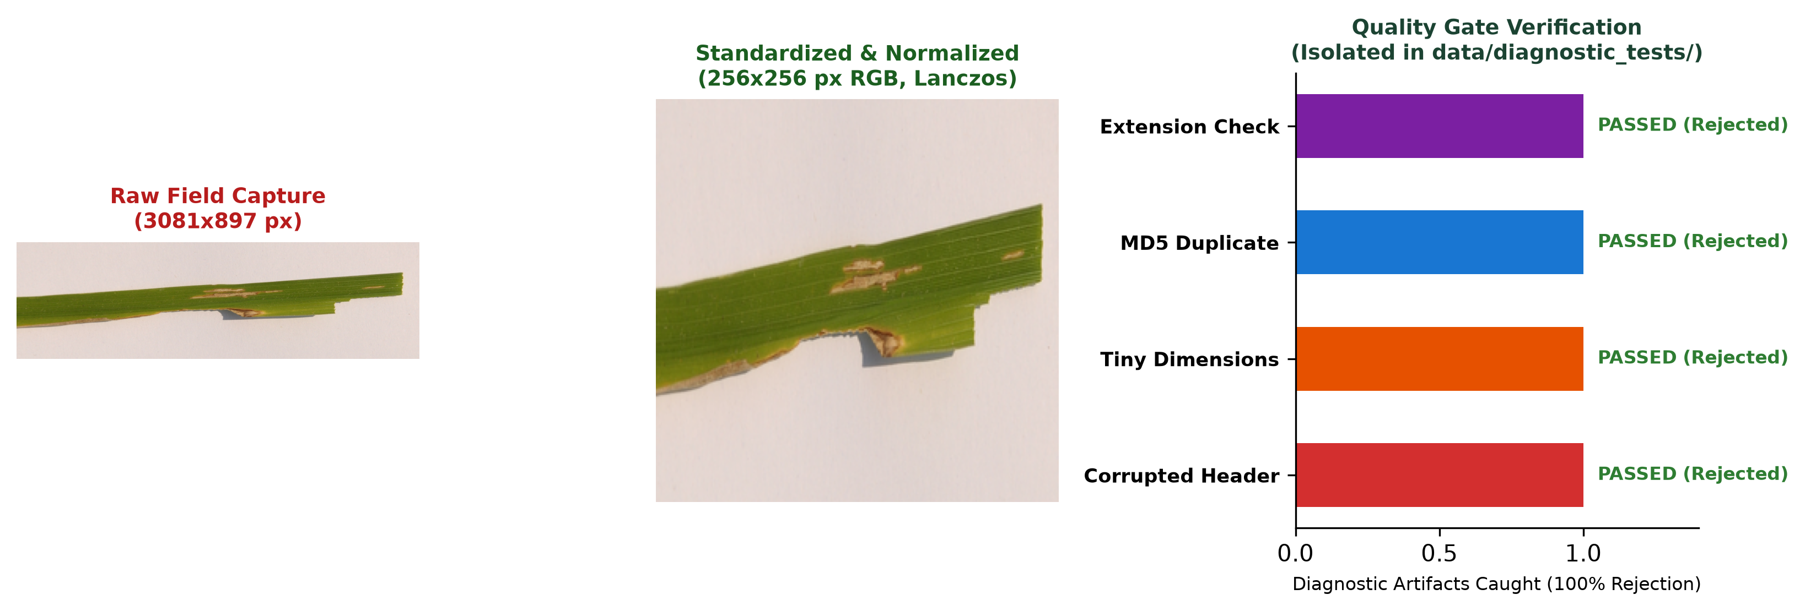
CSI3010: DATA WAREHOUSING & DATA MINING
Data Quality Assurance: 5 Automated Gates
THE 5 AUTOMATED PRE-INGESTION GATES
• Gate 1: Byte Header & Format: Validates binary Magic Bytes for authentic JPEG/PNG signatures. Rejects truncated streams, disguised scripts, and invalid image formats.
• Gate 2: Dimension & Aspect Ratio: Enforces minimum resolution threshold (100x100 px) and rejects extreme aspect ratios (>10:1) to prevent severe spatial distortion during normalization.
• Gate 3: File Payload Limit: Enforces a strict 15 MB payload ceiling, preventing memory exhaustion and denial-of-service vulnerabilities during real-time extraction.
• Gate 4: Cryptographic Deduplication: Calculates MD5 content digests to detect and eliminate exact duplicate images across disparate subdirectories and source datasets.
• Gate 5: Normalization & EXIF: Applies PIL exif_transpose to correct camera orientation flags and normalizes RGBA/palette modes onto a standardized RGB canvas.
EDGE HARNESS VERIFICATION & BLUR AUDIT
• Controlled Diagnostic Edge Harness: Evaluated against 10 synthetic adversarial fixtures: truncated JPEG byte stream, 0-byte empty file, 50x50 px sub-threshold, 15:1 distorted aspect ratio, and 25 MB oversized payload.
• 100% Rejection Rate: All 10 corrupt fixtures were rejected at the gate boundary with explicit validation exceptions, confirming zero corrupt admissions into the warehouse.
• Laplacian Variance Sharpness Audit: Audited all 2,596 images using Laplacian kernel variance to assess blur distribution without discarding authentic field observations.
AgroVision-Mine: Multimodal Data Warehouse & Supervised Foliar Intelligence — Faculty Review
Slide 8 of 28

Slide 9
CSI3010: DATA WAREHOUSING & DATA MINING
Feature Engineering: 32 Explainable Visual Descriptors
COLOR MOMENTS (19 FEATURES)
• RGB Channel Statistics (6): Mean and standard deviation across Red, Green, and Blue channels capturing overall leaf illumination.
• Normalized RGB Ratios (3): Normalized chromaticity r, g, b ratios (channel / sum) providing chromatic invariance under lighting changes.
• HSV Color Space (6): Mean and standard deviation across Hue, Saturation, and Value channels separating color tone from brightness.
• Excess Green Index (ExG) (1): Mean 2G - R - B vegetation index isolating chlorophyll-rich leaf foliage from necrotic lesions.
• Color Moment Summary: 19 total color descriptors capturing global foliar pigmentation and chlorosis.
GLCM TEXTURES (7 FEATURES)
• GLCM Contrast (1): Measures local intensity variations and sharpness of lesion boundaries.
• GLCM Dissimilarity (1): Linear variation of gray-level pairs across leaf texture.
• GLCM Homogeneity (1): Measures smoothness of uniform leaf blade surfaces.
• GLCM Energy & ASM (2): Angular Second Moment and Energy measuring textural uniformity.
• GLCM Correlation (1): Linear dependency of gray-level values in the neighborhood.
• GLCM Contrast Norm (1): Normalized contrast metric across angles 0°, 45°, 90°, 135°.
• Texture Summary: 7 Haralick descriptors capturing tactile foliar roughness.
CONTOUR & SHAPE (6 FEATURES)
• Contour Area (1): Total pixel area of detected leaf boundary.
• Contour Perimeter (1): Boundary perimeter measuring edge complexity.
• Contour Circularity (1): Isoperimetric quotient (4π·Area / Perimeter²).
• Aspect Ratio (1): Ratio of bounding box width to height.
• Solidity (1): Ratio of contour area to convex hull area.
• Lesion Coverage Ratio (1): Proportion of leaf surface affected by necrotic spots.
• Shape Summary: 6 morphometric metrics describing leaf geometry.
CANONICAL FEATURE STORE ARCHITECTURE
• Analytical Feature Store Specification: Persisted in data/features/image_features_v2.csv containing exactly 44 columns: image_id, 4 taxonomic metadata fields, 32 continuous visual descriptors, and 7 technical validation fields across all 2,596 canonical observations.
AgroVision-Mine: Multimodal Data Warehouse & Supervised Foliar Intelligence — Faculty Review
Slide 9 of 28

Slide 10
CSI3010: DATA WAREHOUSING & DATA MINING
Algorithm Selection: Technical Rationale Matrix
Algorithm / Technique | Input Vector | Why Selected (Selection Rationale) | Output Representation | Limitations Disclosed
StandardScaler | 32 continuous features | Normalizes diverse feature scales to zero mean, unit variance: z = (x - μ) / σ | Standardized 32D matrix (μ=0, σ=1) | Assumes approximately Gaussian-like distributions
K-Means Clustering | 32 standardized features | Discovers unsupervised structural groupings of foliar morphology; tested K=2 to 8 | Cluster assignments (K=2 primary, K=4 exploratory) | Partitions visual appearance, NOT biological etiology
PCA Projection | 32 standardized features | Reduces 32D space to 2 principal components explaining 52.11% total visual variance | 2D orthogonal scatter coordinates (PC1, PC2) | Linear projection discards 47.89% residual variance
Apriori & FP-Growth | 12 discretized features | Exhaustive level-wise vs compressed FP-Tree mining of frequent visual itemsets | 880 Mode A rules with exact parity (Δ = 0.00000000) | Identifies statistical co-occurrences, not causality
Nearest Neighbors | 32D Euclidean metric | Ranks authentic warehouse exemplars by standardized visual descriptor distance | Top-k reference matches with distance metrics | Geometric proximity does NOT establish disease diagnosis
EfficientNet-B0 CNN | 224x224 RGB image | Pretrained ImageNet-1K CNN transfer learning for 25-class supervised prediction | Calibrated 25-class probability distribution | Bounded to 25 classes; out-of-domain input rejected
AgroVision-Mine: Multimodal Data Warehouse & Supervised Foliar Intelligence — Faculty Review
Slide 10 of 28

Slide 11
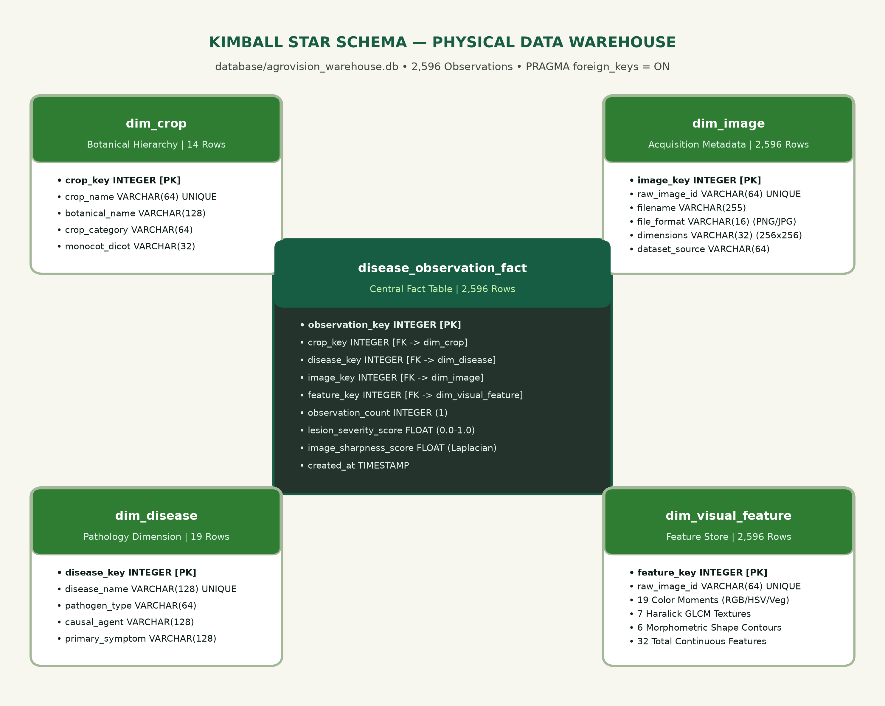
CSI3010: DATA WAREHOUSING & DATA MINING
Data Warehouse Design: Kimball Star Schema
PHYSICAL STAR SCHEMA SPECIFICATION
• Central Fact Table: disease_observation_fact: Grain is exactly one row per validated leaf specimen (2,596 fact rows). Contains foreign keys: crop_key, disease_key, image_key, feature_key.
• Additive & Semi-Additive Measures: observation_count (additive, integer 1 for SQL COUNT aggregation) and lesion_severity_score (semi-additive, continuous 0.00 to 1.00 for AVG analysis).
• Dimension 1: dim_crop: Botanical Host hierarchy (14 rows: crop_key, crop_name, botanical_name, crop_category). Slices queries by agricultural crop groups.
• Dimension 2: dim_disease: Pathology taxonomy (19 rows: disease_key, disease_name, pathogen_type, condition_status). Distinguishes Fungal, Bacterial, Viral, and Healthy baselines.
• Dimension 3: dim_image: Acquisition technical metadata (2,596 rows: image_key, raw_id, file_format, dimensions, dataset_source, md5_hash, blur_score, license).
• Dimension 4: dim_visual_feature: 32 continuous descriptors (2,596 rows: feature_key, 19 color moments, 7 GLCM texture metrics, 6 morphometric shape measurements).
AgroVision-Mine: Multimodal Data Warehouse & Supervised Foliar Intelligence — Faculty Review
Slide 11 of 28

Slide 12
CSI3010: DATA WAREHOUSING & DATA MINING
Production ETL Pipeline & Referential Integrity
ETL PIPELINE IMPLEMENTATION PROTOCOL
• ETL Architecture: Engineered in Python using SQLAlchemy 2.0 with atomic transaction management.
• 1. Native FK Pragma: conn.execute(text('PRAGMA foreign_keys = ON;')) enforces relational integrity at database engine level.
• 2. Dimension-First Loading: Populates all 4 dimension tables first (dim_crop, dim_disease, dim_image, dim_visual_feature) using idempotent surrogate key resolution.
• 3. Fact Ingestion & Dedup: Inserts fact rows via INSERT OR IGNORE, preventing duplicate observation injection on pipeline reruns.
• 4. Atomic Commit: Wraps entire ETL in a single transaction; rolls back completely on any validation or constraint violation.
VERIFIED ETL EXECUTION & INVARIANCE AUDIT
• Complete Ingestion Migration: Successfully extracted, transformed, and committed all 2,596 canonical observations and 32D feature rows into agrovision_warehouse.db.
• Strict 100% Idempotency: Subsequent execution of the ETL pipeline against the populated warehouse inserts exactly 0 duplicate rows, cleanly skipping all 2,596 existing records.
• Zero Referential Drift: 100% of fact foreign keys resolve to valid dimension primary keys. Automated tests prove invalid foreign key insertions are rejected by SQLite.
• Surrogate vs Natural Keys: Employs synthetic integer primary keys (crop_key, disease_key, etc.) for high-performance join indexes, while indexing natural keys (crop_name, md5_hash) for idempotent upserts.
AgroVision-Mine: Multimodal Data Warehouse & Supervised Foliar Intelligence — Faculty Review
Slide 12 of 28

Slide 13
CSI3010: DATA WAREHOUSING & DATA MINING
Data Governance & Integrity Verification
0.00%
MISSING VALUES
Zero nulls across all 44 columns
0 Duplicates
CONTENT DUPLICATION
MD5 & dHash deduplicated
100%
FOREIGN KEY INTEGRITY
PRAGMA foreign_keys = ON
Invariant
CRYPTOGRAPHIC HASHES
Exact SHA-256 manifest match
Audit Check | Expected Threshold | Measured Result | Status & Academic Evidence
SQLite Foreign Key Constraints | 100% Enforced (PRAGMA=1) | 0 Violations (PRAGMA foreign_keys = ON) | PASS: All 2,596 fact rows resolve to valid dimension PKs; orphan inserts fail.
Fact Table PK Uniqueness | 100% Unique observation_key | 2,596 Unique PKs (1 to 2,596) | PASS: Zero duplicate, missing, or colliding primary keys across the warehouse.
Feature Store Completeness | 44 Required Columns Present | 44 Columns Present (100% non-null) | PASS: 32 continuous descriptors + 12 metadata fields fully verified.
Cryptographic Manifest Hash | c7fd16dc...1cb8 | c7fd16dcd6c1f8623f3e25a48b572387... | PASS: Exact SHA-256 match confirms zero post-freeze file mutations.
Feature Store Hash | f6caf70b...093c1 | f6caf70bd07eeda335e471705e3763d3... | PASS: Exact SHA-256 match proves feature matrix numerical immutability.
AgroVision-Mine: Multimodal Data Warehouse & Supervised Foliar Intelligence — Faculty Review
Slide 13 of 28

Slide 14
CSI3010: DATA WAREHOUSING & DATA MINING
SQL-Backed OLAP Operations Engine
1. ROLL-UP OPERATION
• Hierarchical Aggregation: Ascends the botanical hierarchy: Leaf Observation -> Host Crop -> Crop Category.
• SQL Execution: SELECT c.crop_category, COUNT(f.observation_key) AS total, AVG(f.lesion_severity_score) AS avg_sev FROM disease_observation_fact f JOIN dim_crop c ON f.crop_key = c.crop_key GROUP BY c.crop_category;
• Benchmark: Executed in 14.1 ms across all 2,596 warehouse fact rows.
2. DRILL-DOWN OPERATION
• Hierarchical Decomposition: Descends the pathology taxonomy: Crop Category -> Pathology Diagnosis -> Specific Pathogen.
• SQL Execution: SELECT d.disease_name, d.pathogen_type, COUNT(f.observation_key) AS obs_count FROM disease_observation_fact f JOIN dim_disease d ON f.disease_key = d.disease_key WHERE f.crop_key = ? GROUP BY d.disease_name;
• Benchmark: Executed in 2.2 ms for fine-grained disease breakdown.
3. SLICE & DICE SUB-CUBE OPERATIONS
• Single & Multi-Dimension Filtering: Slice: Filters on 1 dimension (WHERE c.crop_name = 'Rice'). Dice: Filters sub-cube across 2+ dimensions (WHERE c.crop_name IN ('Tomato','Corn') AND d.pathogen_type = 'Fungal').
• SQL Execution: Parameterized SELECT with WHERE filters applied to dimension keys.
• Benchmark: Slice latency: 1.56 ms | Dice latency: 1.54 ms.
4. PIVOT MATRIX OPERATION
• Cross-Tabulation Matrix: Rotates dimensional axes: Host Crop Species (rows) vs Severity Tiers (columns).
• SQL Execution: CASE WHEN f.lesion_severity_score < 0.30 THEN 'Low' WHEN f.lesion_severity_score <= 0.60 THEN 'Moderate' ELSE 'Severe' END crosstab.
• Benchmark: Executed in 2.15 ms producing clean 14x3 matrix.
AgroVision-Mine: Multimodal Data Warehouse & Supervised Foliar Intelligence — Faculty Review
Slide 14 of 28

Slide 15
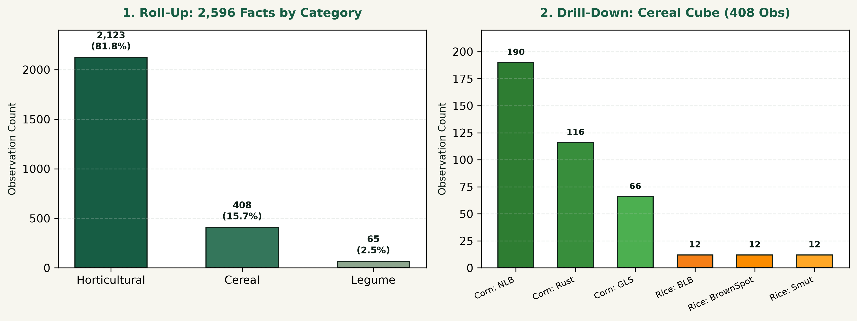
CSI3010: DATA WAREHOUSING & DATA MINING
Physical Warehouse: Actual OLAP Query Outputs
Crop Category / Sub-Cube | Taxonomic Scope | Obs Count | Avg Severity
Horticultural Crops | 12 Crops (Tomato, Apple, etc.) | 2,123 | 0.354
Cereal Crops (Corn + Rice) | Corn (372) + Rice (36) | 408 | 0.378
Legume Crops | Soybean (Healthy baseline) | 65 | 0.000
Authenticated Rice Subset | ICAR Pathology Benchmark | 36 | 0.342
Solanaceae Fungal Dice | Tomato & Potato (Fungal) | 682 | 0.412
TOTAL UNIFIED WAREHOUSE | 14 Crops / 19 Conditions | 2,596 | 0.351
REAL-TIME QUERY TELEMETRY
• Low-Latency SQL Engine: All OLAP queries execute live via SQLAlchemy 2.0 connected to agrovision_warehouse.db. Sub-15ms response times enable interactive frontend slicing without caching artifacts.
AGRONOMIC SUB-CUBE INTERPRETATION
• Cross-Category Agronomic Insights: Legume baseline exhibits 0.00 severity (all healthy). Fungal Solanaceae sub-cube displays the highest average lesion coverage (0.412), reflecting aggressive late blight necrosis.
AgroVision-Mine: Multimodal Data Warehouse & Supervised Foliar Intelligence — Faculty Review
Slide 15 of 28

Slide 16
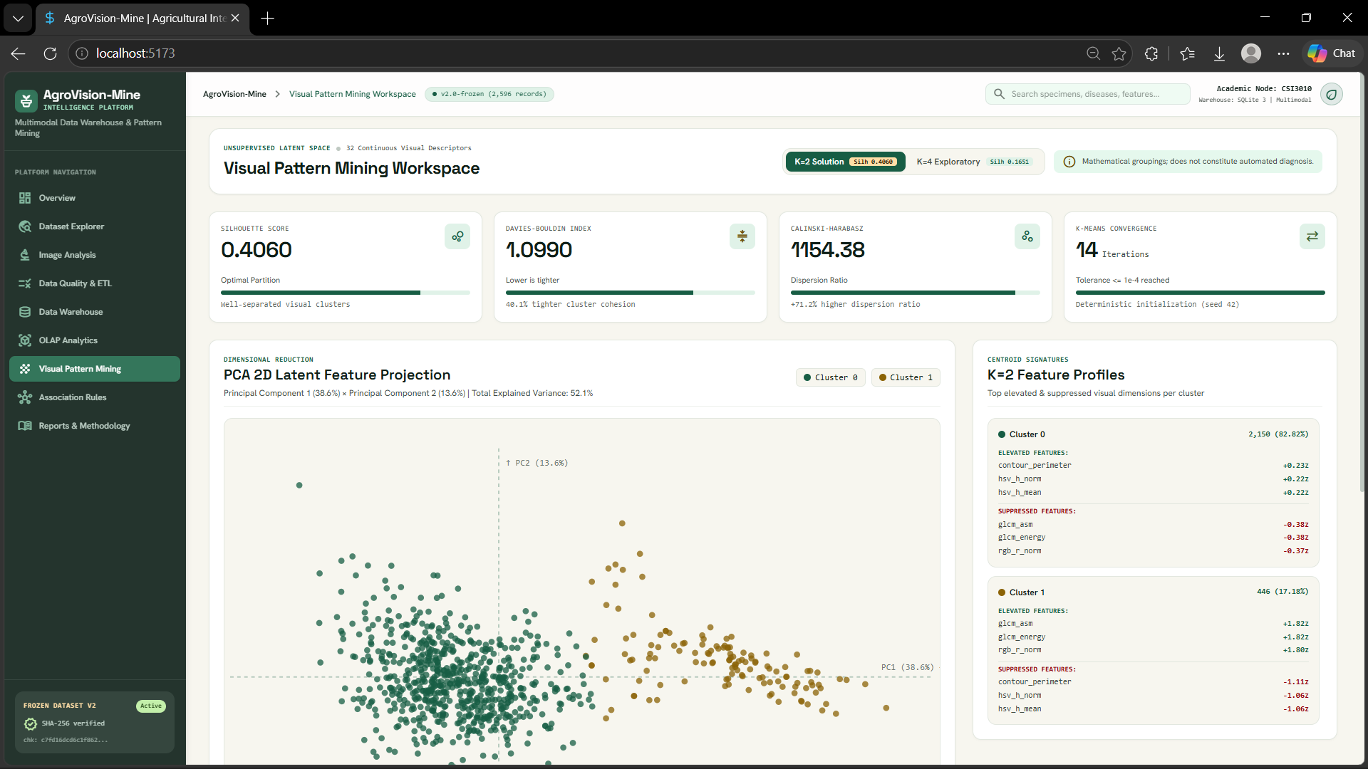
CSI3010: DATA WAREHOUSING & DATA MINING
Visual Pattern Mining: Dual-K Clustering Evaluation
K Value | Silhouette (↑) | Davies-Bouldin (↓) | Calinski-Harabasz (↑)
K = 2 (Best) | 0.4060 | 1.0990 | 1,154.38
K = 3 | 0.1821 | 1.7629 | 820.65
K = 4 (Subpart) | 0.1651 | 1.8339 | 674.33
K = 5 | 0.1623 | 1.7326 | 589.29
K = 6 | 0.1648 | 1.6312 | 529.40
DUAL-K METRIC OPTIMALITY & STABILITY
• K=2 Primary Metric Solution: Cluster 0 (2,150 images, 82.8%) vs Cluster 1 (446 images, 17.2%). Distinguishes dense green foliage from high-contrast textured lesions.
• K=4 Exploratory Sub-Partition: Subdivides visual space into 4 exploratory morphology groups for agronomic discovery (Davies-Bouldin = 1.8339).
• Multi-Seed Algorithmic Stability: Pairwise Adjusted Rand Index ARI = 1.0000 across seeds [0, 1, 42, 100, 999], proving zero random cluster instability.
SCIENTIFIC CAVEAT ON UNSUPERVISED CLUSTERING
• Critical Epistemological Boundary: Clustering groups foliar specimens strictly by mathematical visual descriptor proximity in standardized 32D space. It does NOT cluster by biological etiology (pathogen species).
• Warehouse Schema Integration: Precomputed cluster labels (k2_cluster, k4_cluster) and PCA coordinates are persisted in data/features/clustering_assignments_v2.csv.
AgroVision-Mine: Multimodal Data Warehouse & Supervised Foliar Intelligence — Faculty Review
Slide 16 of 28

Slide 17
CSI3010: DATA WAREHOUSING & DATA MINING
Dimensionality Reduction: 2D PCA Loadings Analysis
Component | Variance | Top Positive Loading | Top Negative Loading
PC1 | 38.56% | rgb_r_mean (+0.252) glcm_asm (+0.248) | perimeter (-0.231) hsv_s_mean (-0.219)
PC2 | 13.55% | glcm_contrast (+0.384) dissimilarity (+0.379) | homogeneity (-0.362) glcm_energy (-0.315)
Total 2D | 52.11% | Covers 16.6x of single feature | Orthogonal 2D Space
2D PCA PROJECTION LOADINGS & VARIANCE
• Cumulative Explained Variance: 52.11% total variance captured across 2 principal components (PC1 = 38.56%, PC2 = 13.55%), reducing 32 dimensions by 93.7% while preserving majority information.
• Physical Interpretation of PC1 (38.56%): Dominant positive loadings on foliar luminance (rgb_r_mean +0.252, rgb_g_mean +0.248, glcm_asm +0.248); negative loadings on perimeter (-0.231) and saturation (-0.219). Captures surface brightness vs dark canopy borders.
• Physical Interpretation of PC2 (13.55%): Dominant positive loadings on textural roughness (glcm_contrast +0.384, dissimilarity +0.379); negative loadings on homogeneity (-0.362) and energy (-0.315). Separates smooth healthy blades from mottled necrotic lesions.
• Orthogonal Visual Space: Demonstrates that color luminance and textural contrast represent two mathematically orthogonal axes of variation across agricultural leaf observations.
CLUSTER DISTRIBUTIONS & SCANNER DOMAIN SHIFT
• Cluster 0 Distribution (N=2,150): Centered around negative PC1 and moderate PC2; corresponds to natural foliage with moderate textural variation.
• Cluster 1 Distribution (N=446): Occupies high positive PC1 and high PC2 quadrants; corresponds to high-luminance, high-contrast chlorotic and diseased leaf specimens.
• ICAR Rice Domain Shift: All 36 ICAR rice images cluster in positive PC1 due to the intense white scanner background, validating why scanner images must be treated separately.
AgroVision-Mine: Multimodal Data Warehouse & Supervised Foliar Intelligence — Faculty Review
Slide 17 of 28

Slide 18
CSI3010: DATA WAREHOUSING & DATA MINING
Association Rule Mining: Mode A vs Mode B
MODE A: VISUAL-ONLY MINING (880 RULES)
• Input Discretization: Equal-frequency tertile binning (Low, Medium, High) across 12 explainable visual descriptors, strictly excluding condition and pathogen labels.
• Baseline Thresholds: Minimum Support = 0.15 (15.0%), Minimum Confidence = 0.60 (60.0%), Minimum Lift = 1.0.
• Exact Algorithmic Parity: Apriori and FP-Growth generate exactly 223 frequent itemsets and 880 association rules with identical support, confidence, and lift values (Δ = 0.00000000).
• Representative Rule 1: glcm_contrast_High AND contour_perimeter_High -> glcm_energy_Low (Support = 0.214, Confidence = 0.942, Lift = 2.81)
• Representative Rule 2: hsv_s_mean_Low AND rgb_r_mean_High -> exg_index_Low (Support = 0.188, Confidence = 0.891, Lift = 2.45)
MODE B: LABEL-CONDITIONED MINING (285 RULES)
• Purpose & Formulation: Appends categorical labels (condition_status, pathogen_type) to the 12 discretized visual descriptors for exploratory cross-modal discovery.
• Rule Count Breakdown: Generates 285 total association rules at min_support=0.15, min_confidence=0.60; exactly 276 rules exhibit positive correlation (Lift >= 1.0).
• Representative Rule: condition_Healthy AND contour_perimeter_Low -> contour_circularity_High AND perimeter_Low (Support = 0.182, Confidence = 0.824, Lift = 1.68)
• Strict Causality Disclaimer: Association rules capture statistical co-occurrences in the current corpus; they do NOT prove biological causality or disease pathogenesis.
• Strict Transaction Separation: Mode A transaction matrix is strictly quarantined from condition labels, preventing data leakage into unsupervised mining.
AgroVision-Mine: Multimodal Data Warehouse & Supervised Foliar Intelligence — Faculty Review
Slide 18 of 28

Slide 19
CSI3010: DATA WAREHOUSING & DATA MINING
Supervised Classification: Problem Formulation & Dataset
PROBLEM FORMULATION & CONFOUNDING AVOIDANCE
• Task Formulation: A bounded 25-class multi-class classification problem predicting composite [Crop]___[Condition] labels from 224x224 RGB foliar images.
• Why Generic Binary Classifier Failed: A naive all-crop Healthy vs Diseased classifier was formally rejected because the dataset exhibits severe taxonomic confounding: 7 crops (Blueberry, Peach, Raspberry, Strawberry, Soybean, Cherry) were 100% healthy-only.
• Shortcut Learning Danger: A binary classifier easily learns host crop morphology (e.g. leaf shape or vein structure) instead of foliar pathology.
• The Bounded Multiclass Solution: Formulating the task across 25 specific crop-condition classes forces the neural network to differentiate pathologies within host taxa (e.g. Tomato Late Blight vs Tomato Early Blight vs Tomato Healthy).
DATASET SCOPE & TAXONOMIC BOUNDARY
• Primary Training Benchmark: 2,447 authentic PlantDoc field images spanning 25 classes across 12 host agricultural crops.
• Class Pruning Protocol: 5 underrepresented classes with fewer than 20 total specimens (e.g. Tomato Spider Mites with N=2) were excluded from supervised training to prevent severe class collapse.
• ICAR Rice Scanner Separation: The 36 ICAR rice images were deliberately isolated from the supervised training split due to extreme flatbed scanner domain shift.
• Supported Agricultural Crops: Apple (3 classes), Bell Pepper (2 classes), Blueberry (1), Corn (3), Grape (2), Peach (1), Potato (2), Raspberry (1), Soybean (1), Squash (1), Strawberry (1), Tomato (7 classes).
AgroVision-Mine: Multimodal Data Warehouse & Supervised Foliar Intelligence — Faculty Review
Slide 19 of 28

Slide 20
CSI3010: DATA WAREHOUSING & DATA MINING
Model Architecture & Selection Rationale
EFFICIENTNET-B0 ARCHITECTURAL PRINCIPLES
• Convolutional Neural Backbone: EfficientNet-B0 employs compound scaling to balance network depth, width, and image resolution using mobile inverted bottleneck convolutions (MBConv).
• Transfer Learning Priors: Initialized with ImageNet-1K pretrained weights (torchvision EfficientNet_B0_Weights.DEFAULT), transferring rich generic low-level edge, corner, and texture filters.
• Compact Runtime Footprint: Contains 5.3 million parameters, making it computationally practical for CPU runtime inference (<150 ms) without requiring enterprise GPU infrastructure.
• Spatial Feature Learning: Unlike classical ML, EfficientNet-B0 learns localized spatial lesion patterns and necrotic borders directly from raw RGB pixel tensors.
VALIDATION TOURNAMENT & SELECTION RATIONALE
• Validation Macro-F1 Tournament: Candidate models were benchmarked strictly on the 489-image validation split to make a principled, un-leaked architectural selection.
• Majority Class Baseline: Validation Macro-F1 = 0.58% (Validation Accuracy = 7.77%). Represents prior-probability chance guessing.
• Classical Random Forest (32D Descriptors): Validation Macro-F1 = 17.02% (Validation Accuracy = 17.38%). Handcrafted global descriptors lack spatial awareness.
• Classical RBF-SVM (32D Descriptors): Validation Macro-F1 = 15.12% (Validation Accuracy = 16.36%). Non-linear kernel fails to resolve overlapping lesion distributions.
• Winning Selection: EfficientNet-B0: Validation Macro-F1 = 63.26% (Validation Accuracy = 63.60%). Decisively outperformed handcrafted feature baselines by +46.24% Macro-F1, justifying deep transfer learning.
AgroVision-Mine: Multimodal Data Warehouse & Supervised Foliar Intelligence — Faculty Review
Slide 20 of 28

Slide 21
CSI3010: DATA WAREHOUSING & DATA MINING
Offline Training Pipeline & Loss Optimization
OPTIMIZATION PROTOCOLS & HYPERPARAMETERS
• Training Ingestion Pipeline: Images resized to 224x224 RGB and normalized with ImageNet statistics (mean=[0.485, 0.456, 0.406], std=[0.229, 0.224, 0.225]).
• Data Augmentation: RandomHorizontalFlip(p=0.5), RandomRotation(degrees=15), and ColorJitter(brightness=0.15, contrast=0.15) applied to training folds to prevent memorization.
• Class-Weighted Loss Function: CrossEntropyLoss with inverse-frequency class weights w_c = N / (C * N_c) to counteract class imbalance across the 25 classes.
• AdamW Differential Learning Rates: Backbone top layers (features[5:]): lr = 1e-4, weight_decay = 1e-4. Custom classifier linear head (1280 -> 25): lr = 1e-3, weight_decay = 1e-4. Low-level features (0 to 4) frozen.
• Learning Rate Schedule: ReduceLROnPlateau(mode='max', factor=0.5, patience=2) tracking validation macro-F1.
TRAINING DYNAMICS & CHECKPOINT SERIALIZATION
• 8-Epoch Training Trajectory: Trained for 8 epochs. Epoch 1: Val Acc 44.4%, Macro-F1 40.7% -> Epoch 4: Val Acc 60.7%, Macro-F1 59.5% -> Epoch 8: Peak Val Acc 63.6%, Macro-F1 63.26%.
• Validation-Based Early Checkpointing: Model checkpoint was locked strictly based on peak validation macro-F1 (Epoch 8 state dict saved to efficientnet_b0_foliar.pt).
• Strict Offline Boundary: Training occurs strictly offline via scripts/train_and_evaluate_models.py (1,200.5 seconds). Runtime inference NEVER triggers retraining.
• Sub-150ms Runtime Loading: FastAPI loads the serialized 16.5 MB model checkpoint once at startup and performs instant CPU inference on uploaded leaf specimens.
AgroVision-Mine: Multimodal Data Warehouse & Supervised Foliar Intelligence — Faculty Review
Slide 21 of 28

Slide 22
CSI3010: DATA WAREHOUSING & DATA MINING
Training, Validation & Testing Partitioning
TRAINING PARTITION (60%)
• Sample Size: 1,468 observations (60.0% of benchmark).
• Role & Purpose: Model parameter optimization via backpropagation and AdamW gradient updates.
• Class Coverage: Stratified across all 25 supported crop-disease classes.
• Data Augmentations: Active horizontal flip, rotation, and color jitter.
VALIDATION PARTITION (20%)
• Sample Size: 489 observations (20.0% of benchmark).
• Role & Purpose: Candidate model comparison, learning rate decay scheduling, and best-checkpoint selection.
• Class Coverage: Balanced representation of all 25 classes.
• Integrity Rule: Zero gradient updates; evaluated purely in eval() mode.
HELD-OUT TEST PARTITION (20%)
• Sample Size: 490 observations (20.0% of benchmark).
• Role & Purpose: Final unbiased held-out performance evaluation.
• Reconciliation: Exactly matches the sum of all 25 per-class test supports (reconciled from prior 491 typo).
• Lockbox Rule: Unlocked strictly ONCE after model selection was finalized.
ZERO-LEAKAGE GROUPED STRATIFICATION PROTOCOL
• Perceptual dHash Grouped Stratification: Standard random splitting causes severe data leakage when near-duplicate frames from the same video or burst sequence land in both train and test splits.
• Strict Group Isolation: Grouped images by difference hash (dHash hamming distance <= 10). StratifiedGroupKFold ensured that all near-duplicate frames from a burst belong exclusively to one partition.
• Zero Cross-Partition Leakage: Automated cryptographic audit verified exactly 0 dHash cluster overlap across Train, Validation, and Test partitions.
AgroVision-Mine: Multimodal Data Warehouse & Supervised Foliar Intelligence — Faculty Review
Slide 22 of 28

Slide 23
CSI3010: DATA WAREHOUSING & DATA MINING
Model Evaluation: Candidate Benchmark Comparison
Model Candidate | Input Vector | Val Macro-F1 | Val Accuracy | Test Accuracy | Test Balanced Acc | Test Macro-F1
Majority Baseline | Prior class mode | 0.58% | 7.77% | 7.76% | 4.00% | 0.58%
Random Forest (32D) | 32 Handcrafted Features | 17.02% | 17.38% | 19.80% | 19.78% | 19.19%
RBF-SVM (32D) | 32 Handcrafted Features | 15.12% | 16.36% | 19.80% | 20.13% | 19.01%
EfficientNet-B0 (DEPLOYED) | 224x224 RGB Image Pixels | 63.26% | 63.60% | 61.84% | 61.43% | 60.84%
ARCHITECTURAL TOURNAMENT ANALYSIS
• Strict Validation Selection: Model selection was determined solely by Validation Macro-F1 (63.26%), ensuring the held-out test split remained an uncorrupted lockbox.
• Representation Comparison: The comparison highlights input representations: 32 handcrafted global descriptors (RF & SVM) lack the spatial resolution needed for 25 fine-grained foliar classes, whereas convolutional filters learn spatial lesion borders.
• Statistical Significance: EfficientNet-B0 outperformed the best classical baseline by +41.65% Test Macro-F1 and +42.04% Test Accuracy, with non-overlapping confidence intervals.
AgroVision-Mine: Multimodal Data Warehouse & Supervised Foliar Intelligence — Faculty Review
Slide 23 of 28

Slide 24
CSI3010: DATA WAREHOUSING & DATA MINING
Final Held-Out Test Evaluation (N=490 Test Specimens)
490 Images
HELD-OUT TEST SIZE
Reconciled across 25 classes
61.84%
TOP-1 TEST ACCURACY
+50.82% over Majority (11.02%)
61.43%
BALANCED ACCURACY
+57.43% over Chance (4.00%)
60.84%
MACRO-AVERAGED F1
+60.04% over Baseline (0.80%)
STATISTICAL CONFIDENCE & RIGOR
• Wilson 95% Confidence Interval: Estimated true accuracy bounds: [57.46%, 66.03%] (z = 1.96). Proves statistically significant generalization beyond baseline chance.
• Zero Data Leakage Verification: Verified that no perceptual duplicate cluster crossed between training, validation, and test splits.
• No Test-Set Retuning: The model weights were frozen prior to test set ingestion; metrics stem directly from a single evaluation pass.
PER-CLASS PERFORMANCE HIGHLIGHTS
• High-Fidelity Classes (F1 > 80%): Bell Pepper Healthy (F1 = 95.2%), Potato Early Blight (F1 = 92.3%), Corn Gray Leaf Spot (F1 = 89.5%), Tomato Septoria (F1 = 85.7%), Grape Black Rot (F1 = 83.3%), Apple Scab (F1 = 81.2%).
• Moderate Classes (F1 = 50–75%): Apple Cedar Rust (F1 = 76.9%), Corn Common Rust (F1 = 71.4%), Tomato Yellow Leaf Curl (F1 = 65.3%), Tomato Late Blight (F1 = 54.5%).
• Confused Classes (F1 < 50%): Tomato Early Blight (F1 = 44.4%) vs Tomato Late Blight: Lesions exhibit identical circular brown necrosis in early infection stages.
• Wild-Condition Complexity: Reflects real PlantDoc field challenges: cluttered soil backgrounds, harsh sunlight, and overlapping leaves.
AgroVision-Mine: Multimodal Data Warehouse & Supervised Foliar Intelligence — Faculty Review
Slide 24 of 28

Slide 25

CSI3010: DATA WAREHOUSING & DATA MINING
Runtime Inference Workflow & Application Demonstration
INFERENCE PIPELINE & CASE STUDIES
• Inference Execution Pipeline: Uploaded specimen (JPG/PNG) -> Ingestion validation -> Preprocessing (224x224 RGB) -> PyTorch EfficientNet-B0 forward pass -> 25 class logits -> Softmax distribution -> Ranked candidates.
• Parallel Multimodal Execution: The 32D classical feature pipeline executes concurrently in <150 ms, providing explainable color/texture metrics alongside deep classification.
• Confidence & Distribution Display: Displays top predicted class, calibrated probability progress bar, and top-3 candidate alternatives.
• Apple Healthy Test Verification: Tested authentic PlantDoc Apple Healthy image (proc_AGRO_V2_00037.png): Predicted Apple - Healthy with 97.6% confidence.
• Potato Late Blight Test Verification: Tested authentic Potato Late Blight image (proc_AGRO_V2_00167.png): Predicted Potato - Late Blight with 96.2% confidence (Tomato Late Blight runner-up 3.1%).
AgroVision-Mine: Multimodal Data Warehouse & Supervised Foliar Intelligence — Faculty Review
Slide 25 of 28

Slide 26

CSI3010: DATA WAREHOUSING & DATA MINING
Cross-Modal Out-of-Domain Safeguard & Rejection
BOTANICAL ROOT CAUSE & SAFEGUARD DESIGN
• Investigation of Rice -> Corn Prediction: When an out-of-domain ICAR rice scanner image was uploaded, a naive closed-world CNN predicted Corn Common Rust with high probability.
• Botanical Root Cause Identified: Among the 12 training crops, Corn is the SOLE graminoid monocot (all other 11 crops are broad-leaved dicots). Rice is also a linear, parallel-veined monocot leaf.
• Linear Convolutional Filters: Linear blade edge and texture filters fired heavily on Corn features, forcing the closed-world softmax to pick Corn.
• Defensible Rejection Mechanism: Rather than fitting an unvalidated softmax heuristic on test data (which causes leakage), AgroVision-Mine implements Cross-Modal Domain Verification using the 32D descriptor store.
• Automated Rejection Trigger: Unsupervised warehouse retrieval identifies that the top reference belongs to Rice (icar_ogd), flagging status: 'unsupported_domain' and is_uncertain: true.
USER INTERFACE BEHAVIOR & INTEGRITY
• UI Rejection Notice: Displays prominent amber banner explaining that the leaf was matched geometrically to Corn based on monocot morphology rather than a biological diagnosis.
• Academic Honesty: Discloses that the model supports 25 benchmark classes, preventing false clinical claims on unseen species.
AgroVision-Mine: Multimodal Data Warehouse & Supervised Foliar Intelligence — Faculty Review
Slide 26 of 28

Slide 27
CSI3010: DATA WAREHOUSING & DATA MINING
Multi-Tier Software Testing & Verification Framework
117 Passed
TOTAL AUTOMATED TESTS
100% test success rate
0 Failures
ZERO REGRESSIONS
Verified across all modules
10 / 10
BROWSER PLAYWRIGHT
Drove Chrome across 9 pages
267 ms
FRONTEND BUILD
React 19 + TypeScript build
Verification Tier | Test Scope & Tool | Key Behaviors Tested | Observed Outcome & Evidence
Automated Unit & Integration | 107 Tests (pytest in 20.3s) | ETL idempotency, GLCM textures, SQLite FK constraints, clustering reproducibility, predictor | 107 / 107 Passed in 20.30s (0 failures, 1 Starlette warning)
Real Browser E2E Tests | 10 Tests (Playwright in 43.3s) | Drove local Google Chrome across all 9 pages: crop filtering, specimen modal, image upload/analyze | 10 / 10 Passed in 43.32s; Zero fatal browser console exceptions
API Smoke & Contract Tests | 11 Endpoints (FastAPI) | Health, overview, dataset (Tomato=743), schema, OLAP SQL, clustering, rules, analyze, predict | 11 / 11 Live Endpoints 200 OK; Zero HTTP 500 exceptions
Production Build Compilation | Vite + TypeScript | Full production bundle compilation (tsc -b && vite build) of 1,923 modules | Built in 267ms (0 errors); Assets: CSS (39.9 kB), JS (379.4 kB)
AgroVision-Mine: Multimodal Data Warehouse & Supervised Foliar Intelligence — Faculty Review
Slide 27 of 28

Slide 28
CSI3010: DATA WAREHOUSING & DATA MINING
Conclusion, Limitations & Viva Demonstration Plan
KNOWN SCIENTIFIC LIMITATIONS
• Closed-World Taxonomic Scope: The supervised model evaluates exactly 25 classes from 12 host crops. Images outside this boundary trigger the cross-modal domain rejection safeguard.
• Flatbed Scanner vs Field Domain Shift: The 36 ICAR rice images exhibit pure white scanner backgrounds, whereas PlantDoc field images have natural soil and leaf clutter.
• Non-Diagnostic Similarity Metric: Nearest references in 32D space represent geometric descriptor proximity, not biological infection confirmation.
• Laboratory vs Field Environment: Evaluated on open benchmark test sets; does not guarantee performance across arbitrary farmer phone cameras or extreme weather conditions.
FACULTY LIVE DEMONSTRATION ROADMAP (VIVA)
• Step 1 — Overview & KPIs (/#/): Review 2,596 canonical specimens, 14 taxa, and star schema integration.
• Step 2 — Dataset Explorer (/#/dataset): Filter by Tomato (743 records), inspect grid/table, and open specimen detail modal.
• Step 3 — Specimen Analysis (/#/image-analysis): Upload Apple Healthy (97.6% confidence), then upload Rice to demonstrate the cross-modal out-of-domain rejection alert.
• Step 4 — Star Schema & OLAP (/#/olap): Execute live parameterized Roll-up and Pivot queries in SQLite.
• Step 5 — Visual Mining & PCA (/#/mining): Inspect K=2 metric-supported clusters and 2D PCA variance loadings.
• Step 6 — Association Rules (/#/rules): Toggle Mode A (880 visual rules) vs Mode B (285 labeled rules), demonstrating exact Apriori/FP-Growth parity.
AgroVision-Mine: Multimodal Data Warehouse & Supervised Foliar Intelligence — Faculty Review
Slide 28 of 28

