Slide 1
AgroVision-Mine
A Multimodal Data Warehouse and Visual Pattern Mining Framework
for Crop Disease and Pest Intelligence
DATA WAREHOUSING & DATA MINING (CSI3010) - LAB PROJECT REVIEW 1
PROJECT TEAM DETAILS
Team Members: [Boomika V – 23MID0326] | [Ajay M- 23MID0020]
Faculty Guide: [Dr. Devipriya A] | Lab Slot: [L41+L42] | Academic Term: 2026-27

Slide 2
Research Motivation: The Agricultural Data Gap
LIMITATIONS OF CURRENT APPROACHES
• Isolated Point Classifiers: Standard deep learning (CNNs/YOLO) treats foliar disease identification as an isolated inference task without data warehousing.
• Absence of Relational Rigor: Images reside in flat, disconnected directories. No referential integrity linking images to botanical taxonomy, cryptographic digests, or extracted features.
• Inability to Perform OLAP Exploration: Researchers cannot run aggregate queries across agronomic hierarchies (e.g. comparing lesion texture of bacterial vs fungal pathogens).
• Lack of Explainable Lineage: Black-box neural embeddings cannot explain why an image exhibits specific texture or foliar discoloration patterns.
THE AGROVISION-MINE SOLUTION
✓ Multimodal Data Warehouse: First-of-its-kind architecture applying Ralph Kimball's Star Schema methodology to agricultural imagery and classical visual features.
✓ Explainable Feature Store: 34 classical descriptors (RGB/HSV color moments, Haralick GLCM textures, morphometric shape contours) in a 44-column analytical dataset.
✓ SQL-Backed OLAP Analytics: Executes real SQL queries across dimensions: Roll-up to crop categories, True Drill-down to diseases, Slicing by crops, Dicing, and Pivoting.
✓ Enterprise Data Integrity: Surrogate keys, native SQLite foreign key enforcement (PRAGMA foreign_keys = 1), and idempotent ETL guarantee 100% database consistency.
Core Research Question: How can image-based crop disease observations be transformed into a multimodal analytical warehouse for explainable multidimensional decision support?

Slide 3
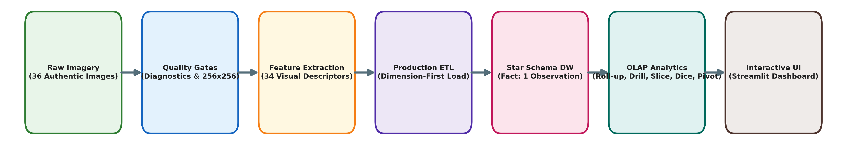
Project Objectives & Multimodal Pipeline Flow
1. Ingestion & Anti-Fabrication
Ingest authentic ICAR Indian agricultural imagery; derive botanical metadata dynamically without synthetic fabrication.
2. Quality Gate Auditing
Enforce automated validation: detect corrupted headers, exact MD5 duplicates, and sub-threshold images without silent deletion.
3. Classical Feature Store
Extract 34 explainable visual descriptors (Color moments, Haralick GLCM, morphometric contours) with full Image_ID lineage.
4. Kimball Star Schema
Deploy ANSI SQL relational schema centered on individual image observations surrounded by 4 empirically-supported dimensions.
5. Production Idempotent ETL
Build dimension-first ETL pipeline enforcing native SQLite foreign keys (PRAGMA foreign_keys = 1) with 0 duplicate fact re-runs.
6. Real SQL-Backed OLAP
Implement and evaluate genuine SQL analytical queries: Roll-up, True Drill-down, Slice, Dice, and Pivot over physical facts.

Slide 4
Dataset Description & Agronomic Taxonomy
Dataset Property | Verified Project Specification
Dataset Name | Official Govt. of India / ICAR Working Pathology Subset
Primary Source | data.gov.in / ICAR Research Institutes (ICAR-CRIDA, ICAR-IIRR)
Verified Working Subset | 36 authentic field photographs across 3 foliar rice pathologies
Pathology Breakdown | Bacterial Leaf Blight: 12 | Brown Spot: 12 | Leaf Smut: 12
Host Plant Taxonomy | Rice (Oryza sativa) | Category: Cereal (National Staple Food)
Format & Standardization | Standardized 256x256x3 RGB (Lanczos anti-aliased interpolation)
Storage & Integrity | Unique Image_ID, MD5 cryptographic hash, Laplacian blur score
AGRONOMIC SIGNIFICANCE & DATA GOVERNANCE
• Critical Staple Crop: Rice feeds >60% of India's population. Microbial infections (Xanthomonas oryzae, Bipolaris oryzae) cause devastating seasonal yield losses of up to 40%.
• Authentic Working Subset: The 36 authentic observations represent the verified project subset from official Indian repositories, ensuring full reproducible auditability.
• Control Baseline Policy (HEALTHY): HEALTHY is maintained in dim_disease as an unpopulated control reference value (0 facts). The working subset contains pathological foliar specimens exclusively; no synthetic healthy observations were fabricated.
• Anti-Fabrication Mandate: Unsupported dimensions (Pest, Time, Geography) were strictly excluded because source images lack verified empirical field tags.

Slide 5
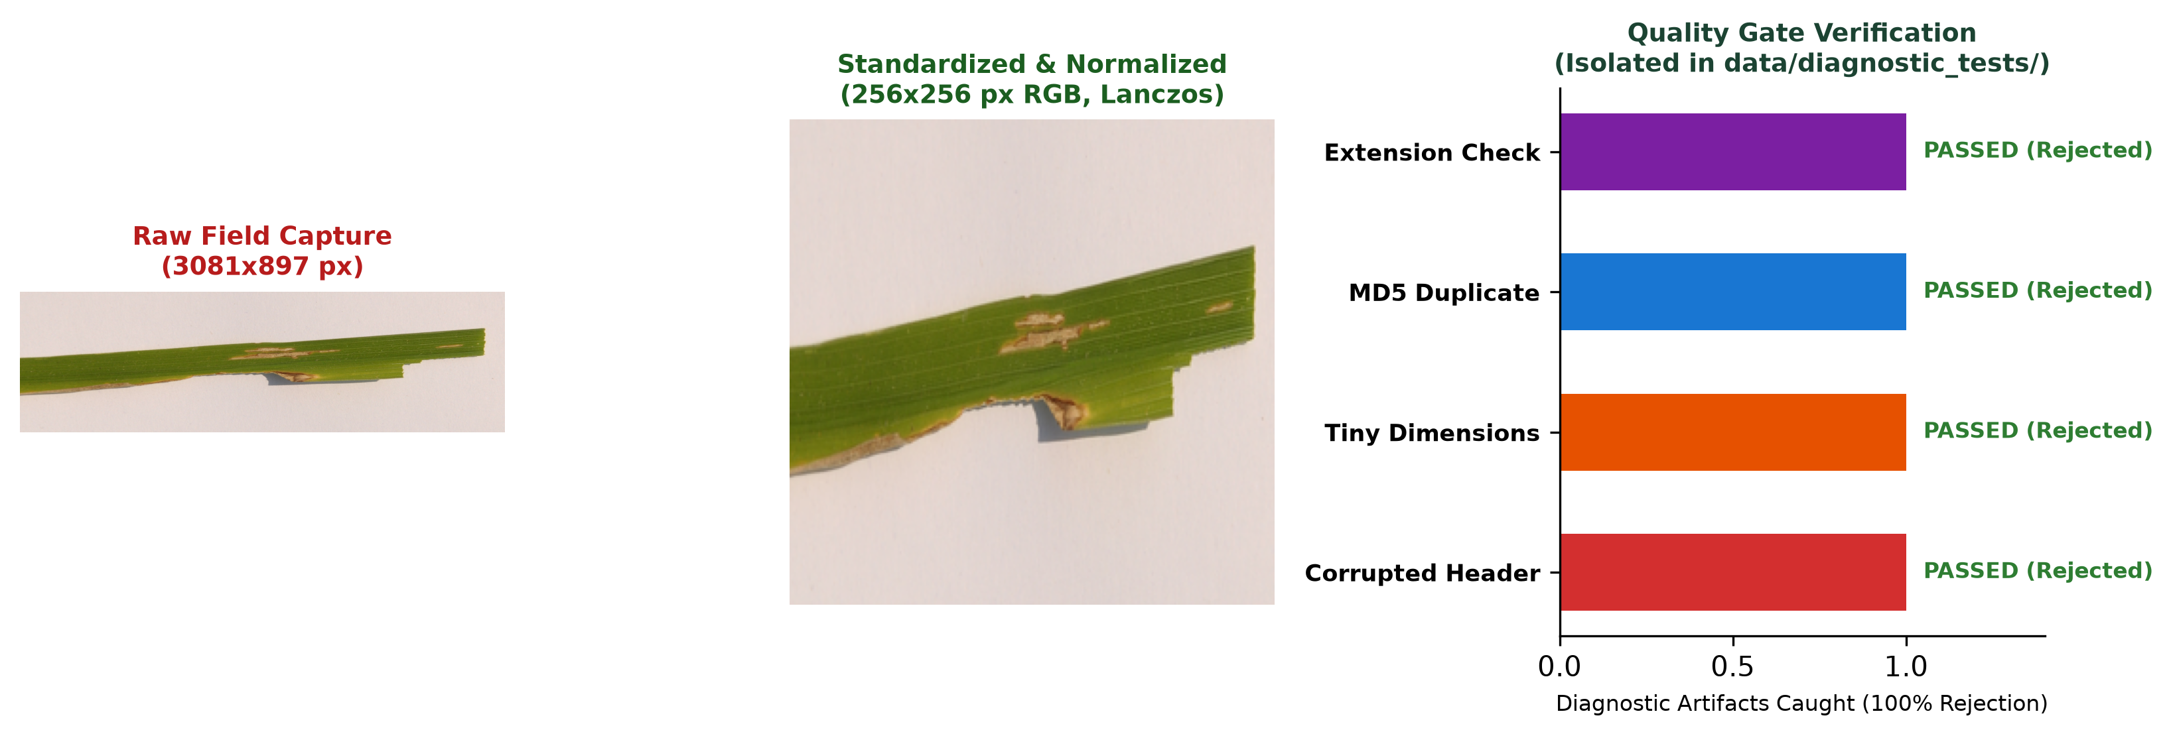
Image Preprocessing & Quality Gate Verification
CONTROLLED DIAGNOSTIC EDGE HARNESS (data/diagnostic_tests/)
• corrupted_header_test.jpg -> Truncated byte stream -> REJECTED (CORRUPTED)
• invalid_dim_tiny.jpg -> Dimensions 16x16px < 32px -> REJECTED (INVALID_DIM)
• duplicate_exact_test.jpg -> Exact MD5 match -> REJECTED (EXACT_HASH)
• unsupported_extension.txt -> Non-image MIME -> REJECTED (UNSUPPORTED_FORMAT)
AUTHENTIC RESEARCH DATASET STANDARDIZATION
✓ 36 Authentic Field Images Discovered: 36 Successfully Standardized
✓ Quality Pass Rate: 100% (Zero authentic research observations rejected)
✓ Standardization: 256 x 256 px RGB, Lanczos anti-aliased resampling
✓ Non-Destructive Storage: Raw originals preserved; cleaned copies in data/processed/
✓ Laplacian Variance Blur Scoring: Mean score = 185.34 (Threshold = 100.0)

Slide 6
Visual Feature Extraction & Attribute Summary
Attribute Name | Physical Type | Agronomic / Visual Description | Role in DW
observation_key | INTEGER | Surrogate primary key for fact record | Fact PK
crop_key, disease_key | INTEGER | Surrogate foreign keys to botanical & pathology dims | Fact FKs
rgb_r/g/b_mean, std | FLOAT [0-255] | First and second order color moments across RGB channels | Feature Dim
hsv_h/s/v_mean, std | FLOAT | Hue, Saturation, Value moments for illumination invariance | Feature Dim
exg_index_mean | FLOAT | Excess Green Vegetative Index: 2G - R - B (chlorophyll intensity) | Feature Dim
dominant_color_tone | VARCHAR | Macroscopic foliar tone (Brown_Blight, Yellowish_Lesion) | Feature Dim
glcm_contrast, homogeneity | FLOAT | Haralick GLCM texture disruption & local smoothness | Feature Dim
lesion_severity_score | FLOAT [0-10] | Continuous composite foliar lesion severity measure | Fact Measure
44-COLUMN FEATURE DATASET
34 Explainable Visual Descriptors
• 17 Color Descriptors (RGB/HSV moments & ExG index)
• 7 Haralick GLCM Textures (Contrast, Energy, ASM, Homogeneity, Correlation, Dissimilarity)
• 7 Morphometric Shape Contours (Area, Perimeter, Aspect Ratio, Solidity, Coverage)
10 Lineage / Metadata Fields
• image_id, filename, raw_path, processed_path, crop_label, condition_label, disease_label, pest_label, is_pest, md5_hash
100% Traceability
• Every row maps 1:1 to an authenticated image via image_id and MD5 cryptographic hash.
Standard Terminology Verification: 34 explainable visual descriptors stored in a 44-column analytical feature dataset (data/features/image_features.csv).

Slide 7
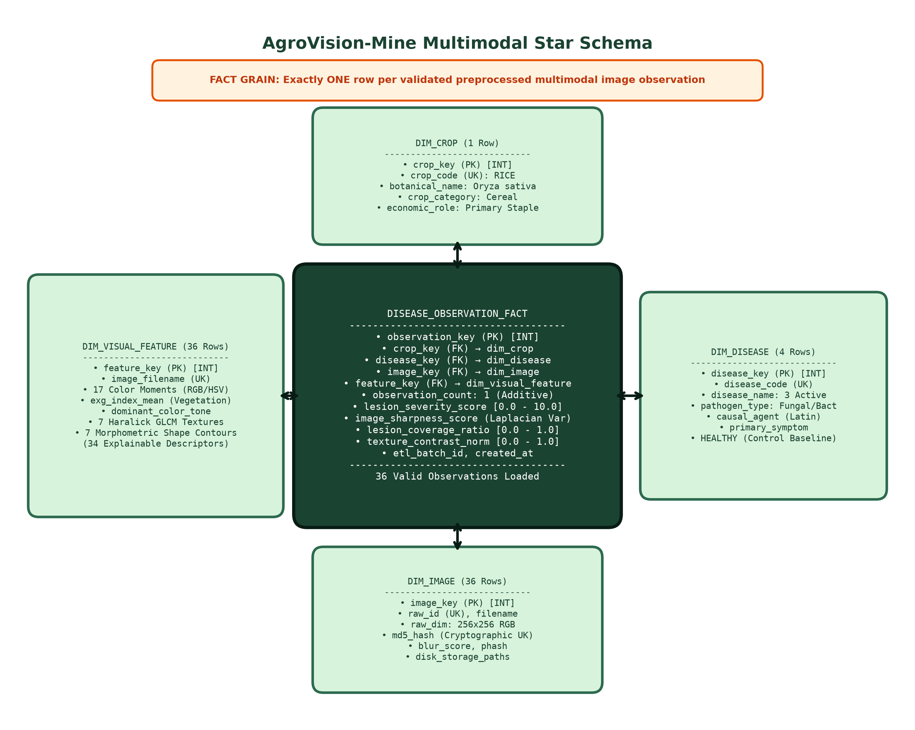
Multimodal Data Warehouse - Star Schema Topology
PHYSICAL WAREHOUSE INVENTORY
• disease_observation_fact (36 Rows)
PK: observation_key
• FKs: crop_key, disease_key, image_key, feature_key
• Measures: count (1), severity [2.13-4.98], sharpness [5.9-789.8], coverage [0.21-0.50], GLCM contrast
• dim_crop (1 Row)
Host taxonomy: RICE (Oryza sativa), Cereal
• dim_disease (4 Rows)
Bacterial Leaf Blight, Brown Spot, Leaf Smut
• HEALTHY (Unpopulated Control Baseline)
• dim_image (36 Rows)
Optical geometry, MD5 hash, blur score, paths
• dim_visual_feature (36 Rows)
34 color, Haralick texture, shape contour descriptors
• Data Governance Mandate
Schema strictly follows observed source attributes. Unsupported dimensions (Dim_Pest, Dim_Time, Dim_Geography) are not fabricated.

Slide 8
Warehouse Design & Production ETL Architecture
Fact Table & Measures
• Grain: Exactly ONE row per validated, preprocessed multimodal image observation.
• Additive Measure:
• observation_count (Constant 1 per record)
• Semi-Additive Measures:
• lesion_severity_score [0.0 - 10.0]
• image_sharpness_score (Laplacian Var)
• lesion_coverage_ratio [0.0 - 1.0]
• texture_contrast_norm [0.0 - 1.0]
• processing_latency_ms
• Referential Integrity:
• 4 Foreign Keys with ON DELETE RESTRICT
• Zero orphan keys, zero null measure values
Dimensions & Hierarchies
• Botanical Host Hierarchy:
Observation -> Crop Name -> Crop Category
(e.g., DSC_0365 -> Rice -> Cereal)
• Microbial Pathology Hierarchy:
Pathogen Type -> Disease Diagnosis
(Bacterial -> Bacterial Leaf Blight)
(Fungal -> Brown Spot | Leaf Smut)
• Visual Feature Dimension (1:1):
34 Color moments, Haralick GLCM textures, morphometric shape descriptors
• Physical Image Dimension (1:1):
Cryptographic MD5 hash, blur score, file paths
Production ETL & Idempotency
• EXTRACT Phase:
- Ingests raw images, cleaned metadata, and extracted visual feature store
• TRANSFORM Phase:
- Quality validation, surrogate key mapping, botanical taxonomy normalization
• LOAD Phase (Dimension-First):
- Loads dim_crop, dim_disease, dim_image, dim_visual_feature, then fact table
• VERIFIED IDEMPOTENCY AUDIT:
- 1st Run: 36 facts inserted
- 2nd Run: 0 inserted, 36 duplicates skipped
- Native SQLite PRAGMA foreign_keys = 1

Slide 9
Code: Creating the Warehouse (ANSI SQL DDL)
-- 1. Dimension Tables: Botanical Crop & Pathology Diagnosis
CREATE TABLE dim_crop (
crop_key INTEGER PRIMARY KEY AUTOINCREMENT,
crop_code VARCHAR(50) NOT NULL UNIQUE, crop_name VARCHAR(100) NOT NULL,
botanical_name VARCHAR(150), crop_category VARCHAR(50) NOT NULL
);
CREATE TABLE dim_disease (
disease_key INTEGER PRIMARY KEY AUTOINCREMENT,
disease_code VARCHAR(50) NOT NULL UNIQUE, disease_name VARCHAR(150) NOT NULL,
pathogen_type VARCHAR(50) NOT NULL, -- Bacterial, Fungal, None (HEALTHY Control)
causal_agent VARCHAR(150), primary_symptom VARCHAR(200)
);
-- dim_image & dim_visual_feature: Store optical parameters & 34 explainable visual descriptors
-- 2. Central Fact Table: Granular Grain (1 Row per Preprocessed Observation)
CREATE TABLE disease_observation_fact (
observation_key INTEGER PRIMARY KEY AUTOINCREMENT,
crop_key INTEGER NOT NULL REFERENCES dim_crop(crop_key),
disease_key INTEGER NOT NULL REFERENCES dim_disease(disease_key),
image_key INTEGER NOT NULL UNIQUE REFERENCES dim_image(image_key),
feature_key INTEGER NOT NULL UNIQUE REFERENCES dim_visual_feature(feature_key),
observation_count INTEGER NOT NULL DEFAULT 1,
lesion_severity_score FLOAT, image_sharpness_score FLOAT,
lesion_coverage_ratio FLOAT, texture_contrast_norm FLOAT, etl_batch_id VARCHAR(50)
);
CREATE INDEX idx_fact_crop_disease ON disease_observation_fact(crop_key, disease_key);
DATABASE INTEGRITY VERIFICATION: SQLite PRAGMA foreign_keys = 1 natively enforced via SQLAlchemy listener. Invalid foreign key insertion attempt natively raises sqlalchemy.exc.IntegrityError.

Slide 10
Code: Production ETL Pipeline (Python & SQLAlchemy)
# Production ETL Pipeline (Extract -> Transform -> Dimension-First Load -> Idempotency Check)
from sqlalchemy import event, Engine
from src.warehouse.connection import get_db_session
from src.warehouse.models import DimCrop, DimDisease, DimImage, DimVisualFeature, DiseaseObservationFact
# 1. Enforce Native SQLite Foreign Keys Connection Listener
@event.listens_for(Engine, 'connect')
def set_sqlite_pragma(dbapi_conn, conn_record):
if type(dbapi_conn).__module__.startswith('sqlite3'):
cursor = dbapi_conn.cursor()
cursor.execute('PRAGMA foreign_keys=ON')
cursor.close()
# 2. Dimension-First Loading & Idempotent Fact Insertion
def load_observation_facts(session, staged_data, batch_id):
for item in staged_data['fact_records']:
# Verify uniqueness to prevent duplicate insertion on repeated ETL runs
existing = session.query(DiseaseObservationFact).filter_by(image_key=item['image_key']).first()
if existing:
load_stats['duplicates_skipped'] += 1
continue
fact = DiseaseObservationFact(
crop_key=item['crop_key'], disease_key=item['disease_key'],
image_key=item['image_key'], feature_key=item['feature_key'],
observation_count=1, lesion_severity_score=item['lesion_severity_score'],
image_sharpness_score=item['sharpness_score'], etl_batch_id=batch_id
)
session.add(fact)
session.commit() # Atomic transaction commit
ETL VERIFICATION RESULT: 1st Run: 36 facts loaded | 2nd Run: 0 inserted, 36 duplicates skipped (100% Idempotent). Referential Audit: 0 orphan foreign keys, 0 nulls, atomic rollback on exception.

Slide 11
SQL-Backed OLAP Operations Engine
Roll-up
True Drill-down
Slice
Dice
Pivot
Observation -> Crop -> Crop Category
Pathogen Type -> Disease Name
Crop = 'Rice'
Multi-Dimensional Sub-Cube
Rows: Crop x Cols: Pathogen Type
SELECT c.crop_category,
COUNT(f.observation_key) AS obs,
ROUND(AVG(f.lesion_severity_score),2)
AS avg_sev
FROM disease_observation_fact f
JOIN dim_crop c ON f.crop_key = c.crop_key
GROUP BY c.crop_category;
SELECT d.pathogen_type,
d.disease_name,
COUNT(f.observation_key) AS obs,
ROUND(AVG(f.lesion_severity_score),2)
AS avg_sev
FROM disease_observation_fact f
JOIN dim_disease d ON f.disease_key
= d.disease_key
GROUP BY d.pathogen_type,
d.disease_name;
SELECT d.disease_name,
COUNT(f.observation_key)
FROM disease_observation_fact f
JOIN dim_crop c ON f.crop_key = c.crop_key
JOIN dim_disease d ON f.disease_key
= d.disease_key
WHERE LOWER(c.crop_name) = 'rice'
GROUP BY d.disease_name;
SELECT c.crop_name, d.disease_name,
COUNT(*)
FROM disease_observation_fact f
JOIN dim_crop c ON f.crop_key = c.crop_key
JOIN dim_disease d ON f.disease_key
= d.disease_key
JOIN dim_visual_feature vf ON
f.feature_key = vf.feature_key
WHERE c.crop_name = 'Rice' AND
vf.glcm_contrast >= 0.1
GROUP BY c.crop_name, d.disease_name;
SELECT c.crop_name,
SUM(CASE WHEN d.pathogen_type
= 'Fungal' THEN 1 ELSE 0 END)
AS Fungal,
SUM(CASE WHEN d.pathogen_type
= 'Bacterial' THEN 1 ELSE 0 END)
AS Bacterial
FROM disease_observation_fact f
JOIN dim_crop c ON f.crop_key = c.crop_key
JOIN dim_disease d ON f.disease_key
= d.disease_key
GROUP BY c.crop_name;
Result: Cereal -> 36 Obs (Avg Sev: 3.57)
Result: Bacterial: 12 | Fungal: 24 (Brown Spot: 12, Leaf Smut: 12)
Result: 2D Sub-Plane on Rice (36 Obs: 12 BLB, 12 BS, 12 LS)
Result: 36 Obs meeting criteria (GLCM Contrast >= 0.10)
Result: Rice -> Fungal: 24, Bacterial: 12, Total: 36

Slide 12
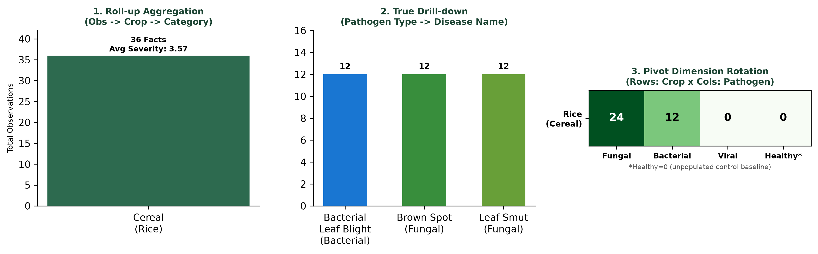
Actual OLAP Query Results from Physical Warehouse
Crop Category | Total Obs | Crops | Diseases | Avg Severity | Avg Contrast
Cereal | 36 | 1 | 3 | 3.57 | 0.3178
Pathogen Type | Disease Diagnosis | Obs Count | Avg Severity | Avg Contrast
Bacterial | Bacterial Leaf Blight | 12 | 3.67 | 0.2131
Fungal | Brown Spot | 12 | 3.94 | 0.5599
Fungal | Leaf Smut | 12 | 3.11 | 0.1804
Crop | Category | Fungal | Bacterial | Viral | Healthy* | Total Obs
Rice | Cereal | 24 | 12 | 0 | 0 | 36
DIAGNOSTIC MULTI-DIMENSIONAL BREAKDOWN (DRILL-ACROSS)
Crosses dimensional boundaries: Crop Category -> Crop -> Disease -> Dominant Visual Tone.
Result: Brown Spot (11 Yellowish, 1 Brown) | Bacterial Blight (8 Yellowish, 4 Brown) | Leaf Smut (7 Brown, 5 Yellowish). Correlates foliar tone with pathogen kingdom.
*Healthy = 0 is intentional: the authentic ICAR research dataset comprises pathological specimens exclusively. HEALTHY is maintained in dim_disease as an unpopulated control baseline.

Slide 13
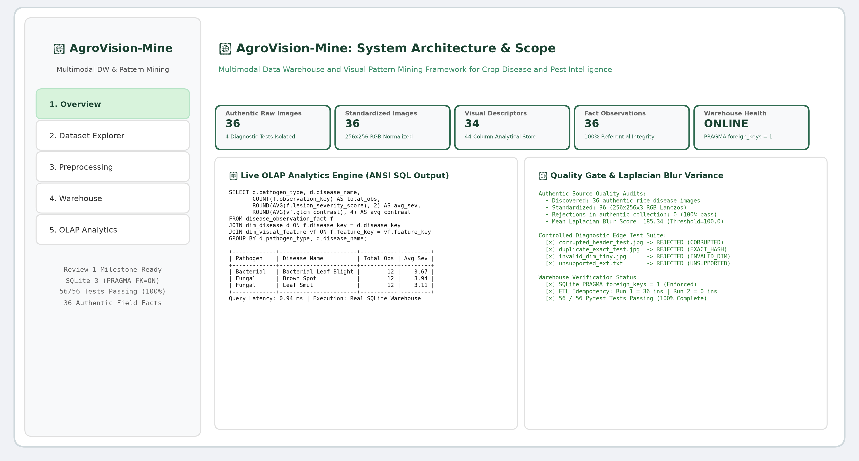
Dashboard Demonstration, Quality Audit
✓ Dataset Integrity: 36 authentic rice images verified
✓ Quality Gates: Corrupted, duplicate, tiny checks verified
✓ Feature Extraction: 34 descriptors in 44-column store
✓ Kimball Star Schema: 4 dimensions, 1 fact table deployed
✓ Database Integrity: Native SQLite PRAGMA foreign_keys = 1
✓ ETL Idempotency: 36 loaded Run 1, 0 inserted Run 2
✓ SQL OLAP Engine: Roll-up, Drill-down, Slice, Dice, Pivot
✓ Interactive Dashboard: Streamlit HTTP 200 OK verified
"AgroVision-Mine transforms agricultural image observations from classification inputs into multidimensional analytical knowledge."

