Slide 1
SINGLETON PATTERN

Slide 2
Team member:
Phạm Minh Hiếu _ 10521007
Đặng Hoàng Anh Khôi_10421031

Slide 3
TABLE OF CONTENTS
02
04
05
01
Definition
Problem of multithreading
03
Advantages Disadvantages
Application
Conclusion

Slide 4
01
DEFINITION

Slide 5
Definition
The Singleton Pattern is a design pattern that restricts the instantiation of a class to one single instance and provides a global point of access to that instance. In other words, it ensures that a class has only one instance in the entire application and that this instance is easily accessible by other objects.

Slide 6
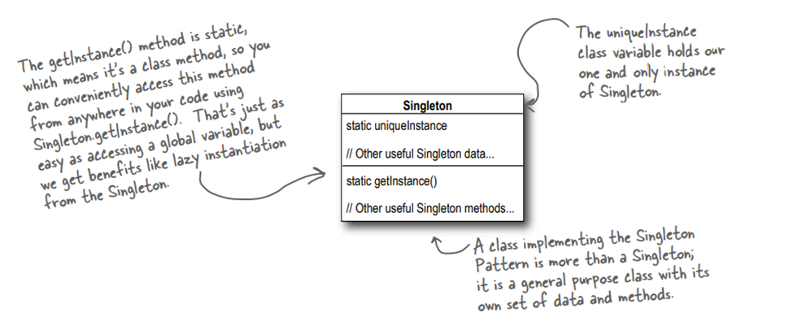
CLASS DIAGRAM

Slide 7
02
Problem of multithreading

Slide 8
Problem of multithreading
Ways to improve multithreading:\
Do nothing
Move to an eagerly created instance
Use “double-checked locking”

Slide 9
03
Advantages/Disadvantages

Slide 10
ADVANTAGES
Single instance
Global access
Lazy initialization

Slide 11
DISADVANTAGES
Overuse
Testing
Dependency injection issues

Slide 12
04
Real-world application

Slide 13

Real-world application
Configuration setting
Database access
UI components
Caching

Slide 14
05
Conclusion

Slide 15
THANKS

