Slide 1
SC1015 Project Presentation
Determining how customer profile data affect sales
Group members:
Lim Boon Hian, Lim Dong Wan, Marvell Ung Wew
Notes:
Hi everyone, we are group 9 consisting of Dong Wan, Boon Hian, and myself, Marvell. Our project is about the customer personality analysis dataset we retrieved from kaggle, from which we strive to determine how customer profile data affect sales.

Slide 2
Table Of Contents
01
02
03
Set the stage
Linear Regression
Motivation + Problem Statement
04
05
Poisson Regression
Conclusions
Data cleaning and EDA
ML Model #1
ML Model #2
Data insights
Notes:
For our presentation, we’ll mainly be going through 5 parts. The motivation and problem statement, the data cleaning and EDA, our two machine learning models : linear regression and poisson regression, and the insights we obtained from our data.

Slide 3
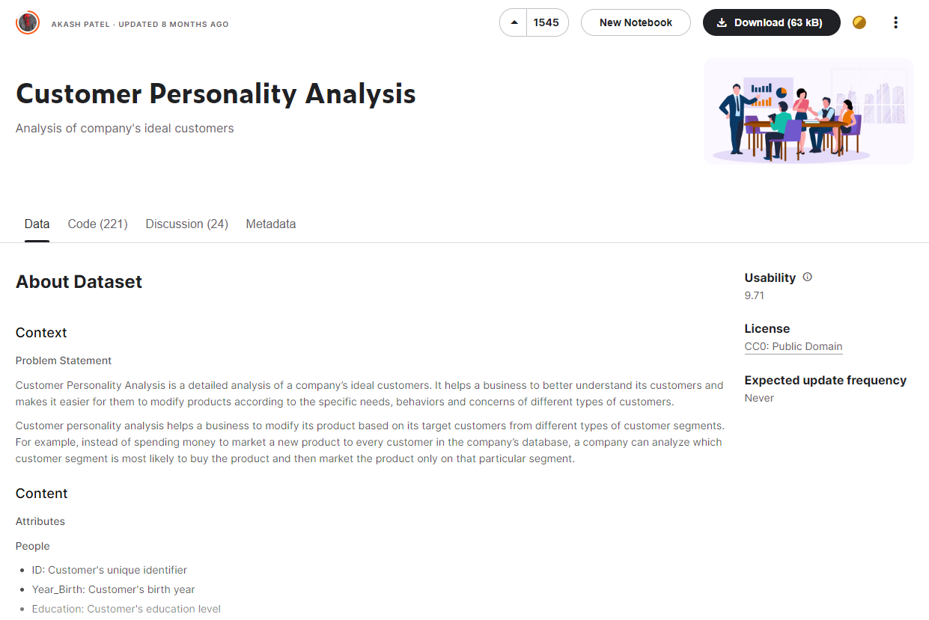
Notes:
Firstly, I will be talking about our dataset, named Customer Personality Analysis retrieved from Kaggle. It provides information about customers such as their education level and marital status as well as several sales metrics, such as number of sales.

Slide 4
Problem Statement
Determining how customer profile data affect sales
Notes:
After observing our data, we decided our problem statement would be determining how customer profile data affect sales. Why is it important you may ask?

Slide 5
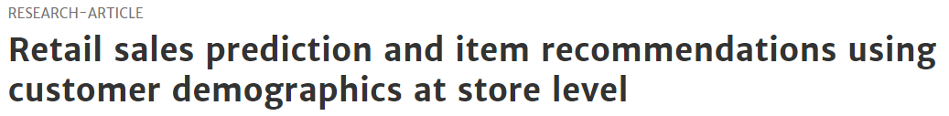
Motivation
Studies have shown that customer demographics affect sales
“modeling data at a finer level of detail by clustering across customer types and demographics yields improved performance compared to a single aggregate model built for the entire dataset”
“adopting a customer-focused sales campaign can significantly increase firm profits and return on investment”
Notes:
Well actually, studies have shown that customer demographics affect sales. From the two research papers shown here, we can see that customer demographics do affect their shopping habits. For example, a family might tend to buy more groceries than a college student. Therefore, we find it significant to use the customer’s information to predict the company’s sales. Now, I will be passing my time to Boon Hian.

Slide 6
Data Preparation
Data cleaning and EDA

Slide 7
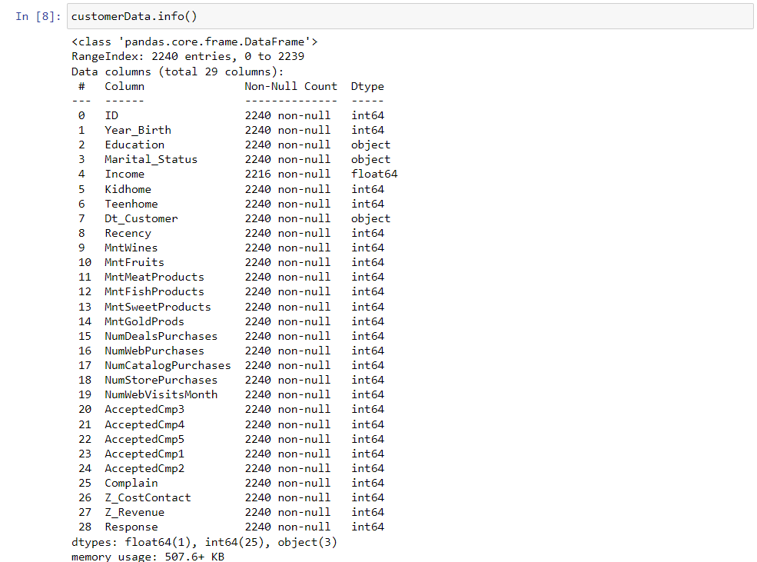

Slide 8
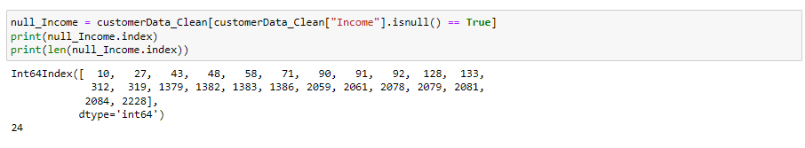
Remove null data in income
Notes:
As you can see here, there are some null data in income variable. As there are only a few columns missing data for Income, we decide to just remove them.

Slide 9
Adding columns
(1) MntGroceryProducts -
Combining MntFruits, MntMeatProducts, MntFishProducts, MntSweetProducts
Amount spent on groceries (fruits, meat, fish and sweets) in last 2 years.
(2) TotalPurchase -
Combining NumDealsPurchases, NumWebPurchases, NumCatalogPurchases, NumStorePurchases
Total number of purchases made by the customers in this store.
Notes:
To aid with the training later, we then add 5 variables based on the given variables. First, MntGroceryProducts, this variables are created based on these variables ~. which indicates the amount spent on groceries (fruits, meat, fish and sweets) in last 2 years. Second, TotalPurchase, which is the the total number of purchases made by the customers in this store.

Slide 10
Adding columns
(3) YearRange -
Based on YearBirth
Categorise customer's birth year into every 10 year.
(4) TotalChild -
Based on Kidhome, Teenhome
Customers' total number of children.
(5) HaveChild -
Based on Kidhome, Teenhome
1 if customer have children, 0 otherwise

Slide 11
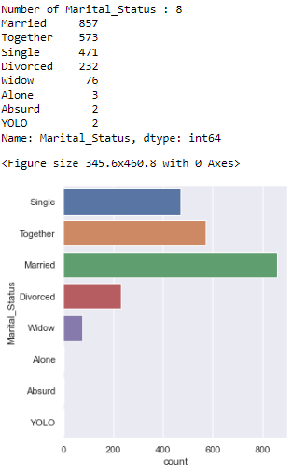
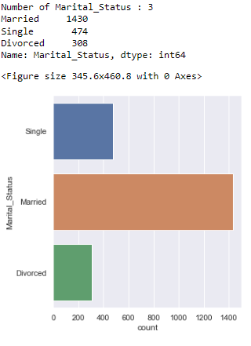
Clean Marital_Status
Notes:
Now, let us move on to the cleaning some outliers. First, as you can see in the graph, there are some strange response such as widow, alone absure and yolo. While widow can be combined with divorced and alone can be combined with single, yolo and absurd just does not make sense as marital status. Hence, we remove yolo and absurd, and combine widow with divorced and alone with single.

Slide 12
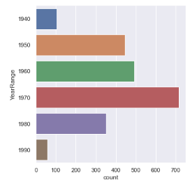
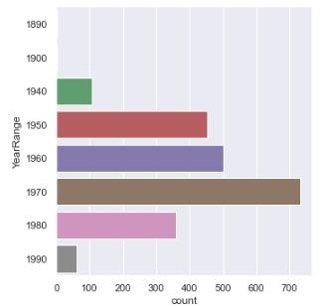
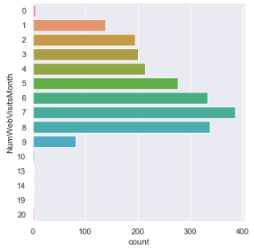
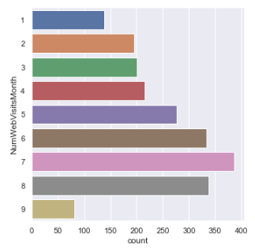
Removing outliers
YearRange
NumWebVisitsMonth

Slide 13
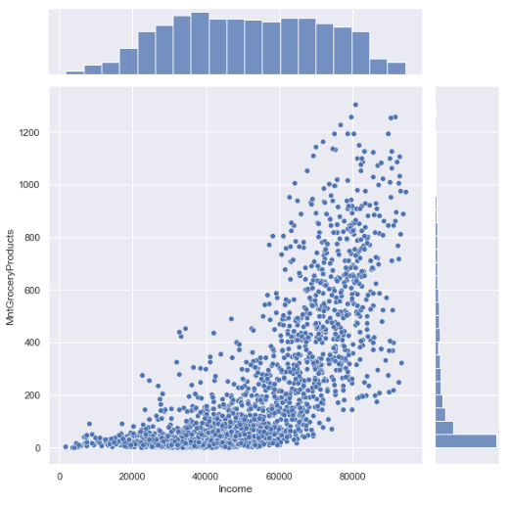
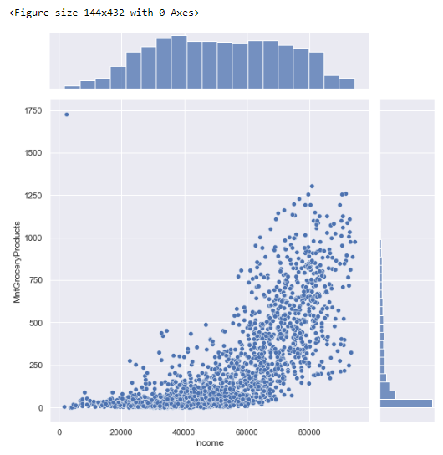
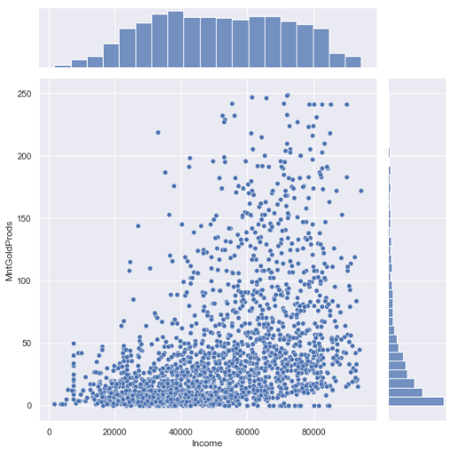
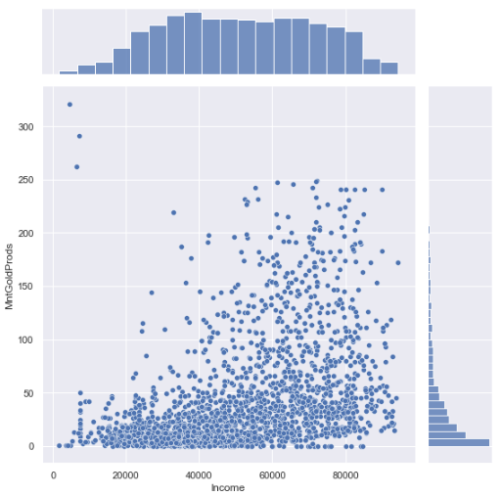
Removing outliers
MntGroceryProducts
MntGoldProds

Slide 14
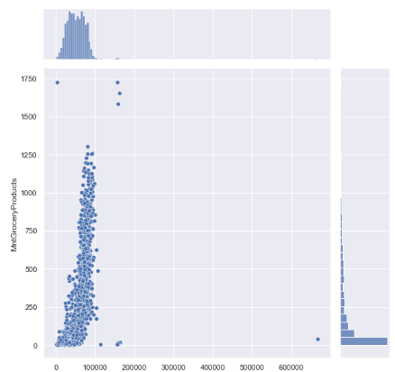
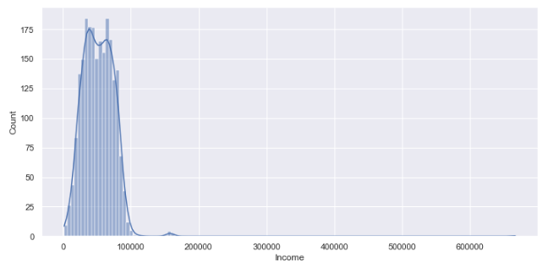
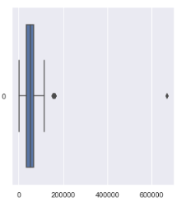
Remove outliers - Income
Notes:
As you can see here, there are some customers which earn much more money than the others. We believe that those top1% customer differs alot from the ordinary customer in the store, we decide to just remove them.

Slide 15
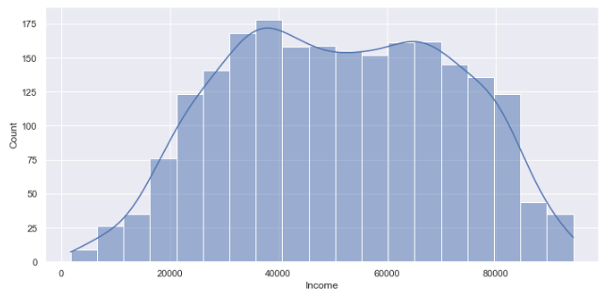
Remove outliers - Income

Slide 16
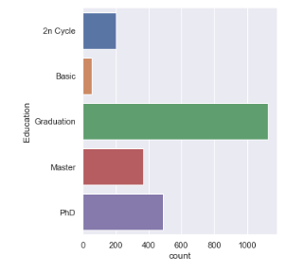
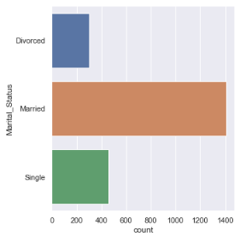
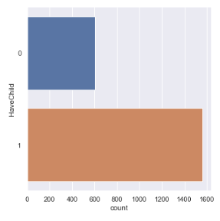
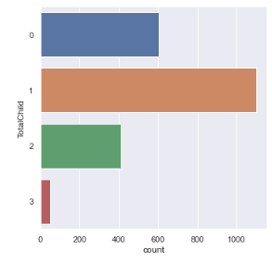
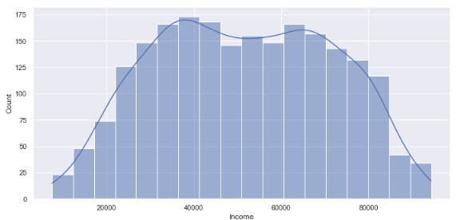
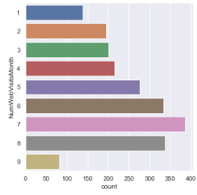
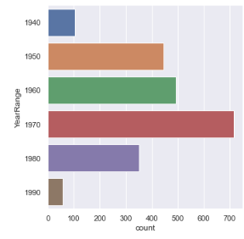
Variables of Interest - Predictors
Education
Marital_Status
HaveChild
TotalChild
Income
NumWebVisitsMonth
YearRange
Notes:
After all the cleaning and taking a look at the initial insights, we will now pick variables as our predictors. They are ~

Slide 17
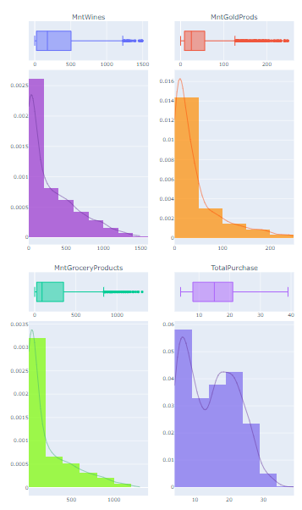
Variables of Interest - Response
Notes:
For response, we pick ~

Slide 18
Goal of Machine Learning
Predict MntWines,MntGoldProds,MntGroceryProducts,TotalPurchase
based on Education, Marital_Status, HaveChild, TotalChild, Income, NumWebVisitsMonth, YearRange
Notes:
We will use Linear Regression and Poisson(pauseson) Regression for the prediction. Now, I’ll pass my time to Dong Wan for him to explain his Linear Regression model.

Slide 19
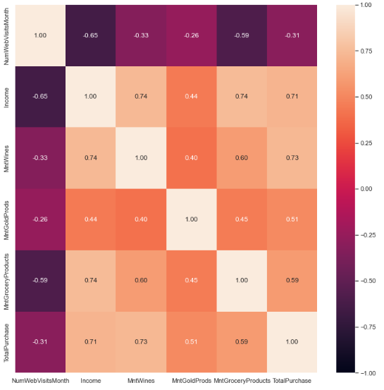
Insights
NumWebVisitsMonth has a negative correlation value with Income and all the responses
The company’s website might be poorly designed/ underutilized
Notes:
Income has a negative correlation value with NumWebVisitMonth. This means that those with higher income are less likely to visit websites, which is quite surprising. Moreover, NumWebVisitMonth have a negative correlation value to nearly every numerical response, this can mean that the website is poorly designed such that the number of visiting the websites does not related to sales. This can be further proved as the correlation value between NumWebPurchases and NumWebPurchases are low, and there is no obvious relationship between NumWebPurchases and NumWebPurchases as shown in the jointplot.

Slide 20
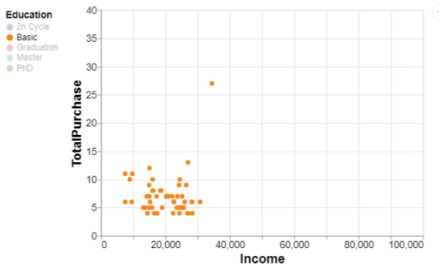
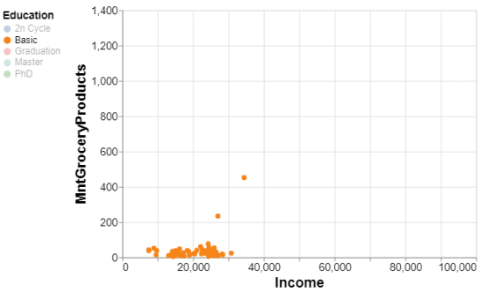
Insights
People with lower education earn lesser, and spend lesser.

Slide 21
Linear Regression
Linear Response
Assumes the response follows a linear relationship with the predictors:
Utilises multivariate linear regression
Why Linear Regression?
A starting point to investigate the relationship between predictors and response variable
Notes:
Thank you Boon Hian for the comprehensive analysis. Now I will be touching on our first Machine Learning model, which is Linear Regression. For this, we assumed that there is a linear relationship between the predictors and any of the response variables, as highlighted by Boon Hian in the previous slide.
In the context of our project, we performed multivariate linear regression, so as to observe and analyse the relationship between multiple predictors and any of the response variables.
The reason why we used Linear Regression as one of our Machine Learning models is that it serves as a good starting point to explore and analyze the relationship between the predictors and any of the response variables.

Slide 22
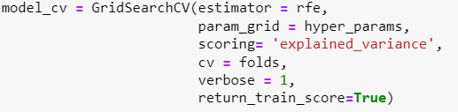
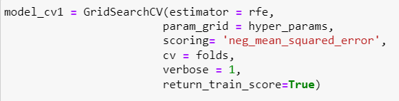
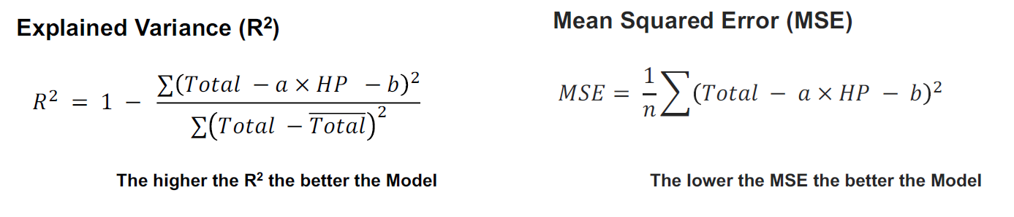
Linear Regression
Cross-Validation (CV):
GridSearch CV:
To choose the most ideal combination of parameters
Scoring metrics:
Explained Variance (R²)
Mean Squared Error (MSE)
Recursive Feature Elimination
Notes:
When it comes to splitting a particular dataset into train and test datasets, most people would probably just use the train_test_split method provided by sklearn. However, we decided to go one step further by performing Cross-Validation - to be more exact, Grid-Search Cross-Validation, on our train dataset. This would enable us to choose the best combination of response and predictor variables.
As for the scoring metrics, there are 2 kinds of scoring metrics that naturally came to our mind, namely Explained Variance (R²) and Mean Squared Error (MSE), as seen over here. As we have learnt from the lectures, in order to have a better model, we need to have a higher R² value and a lower MSE value.
The estimator we used for GridSearchCV is Recursive Feature Elimination, which is a feature selection algorithm that allows us to choose the predictor(s) that are more important in predicting each of the response variables.

Slide 23
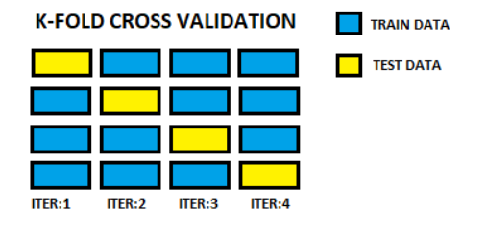
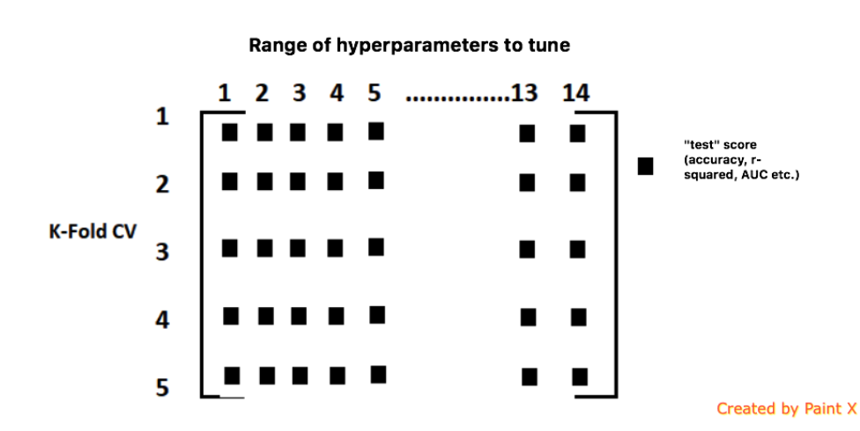
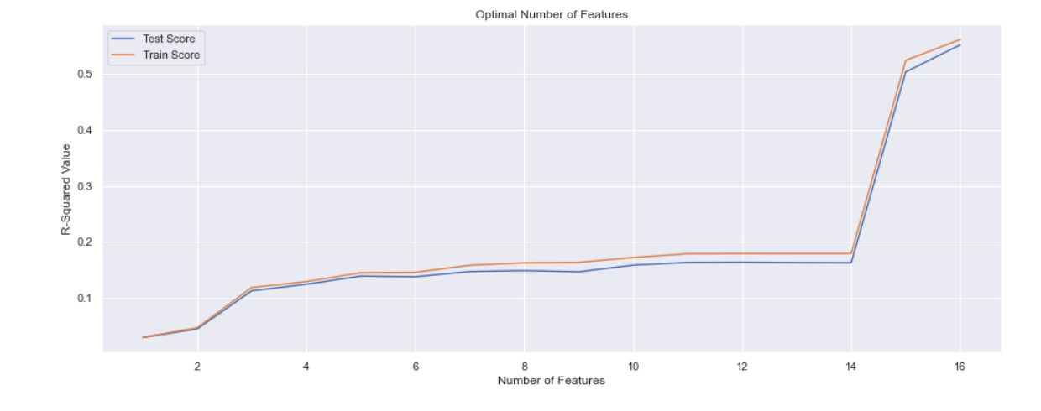
GridSearch CV
Carry out K-Fold CV
Use GridSearch CV to fine tune hyperparameters
Set number of optimal features to 15
Notes:
Here is a brief overview of how we carried out our CV. Firstly, we conducted K-Fold CV on our train dataset, by specifying the number of splits, also known as folds, to 10. Secondly, we fine tuned various hyperparameters using GridSearchCV. We then plotted the CV results to determine the number of optimal features to be used, and in this case, from the plot as shown here, it is 15.

Slide 24
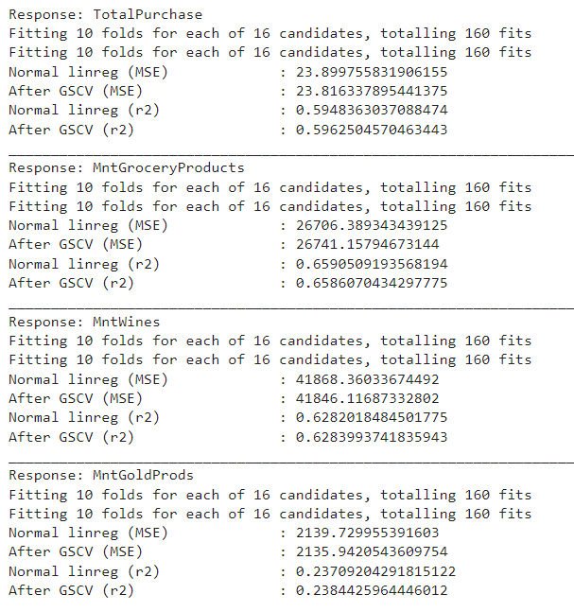
GridSearch CV Results
Only marginal improvement after carrying out GridSearch CV
Notes:
Based on the scoring results as shown here, we realized that there was only a marginal improvement after carrying out GridSearchCV as compared to if we just performed linear regression without GridSearchCV. Nevertheless, this has given us a better understanding of the impact of GridSearchCV on the R² and MSE values for each combination of response and predictor variables. Now I will let Marvell explain the 2nd Machine Learning Model we used, which is Poisson Regression, and thereafter I will be wrapping up our presentation.

Slide 25
Poisson Regression
Poisson Response
Assumes the response follows a Poisson distribution
Probability distribution for an event over a fixed time / space interval
Why Poisson Regression?
Common tool to predict count-based data, such as TotalPurchase.
Notes:
Next, I will be going in-depth to our second machine learning model, Poisson Regression. Poisson Regression is a type of regression that assumes the response follows a Poisson distribution, that is, the Probability distribution for an event over a fixed time / space interval. The reason why we chose poisson regression was because it is a common tool to predict count-based data, such as the TotalPurchase variable.

Slide 26
Poisson Regression
Works reasonably well for TotalPurchase, MntGroceryProducts and MntWines
Performs badly for MntGoldProds
R² values for:
TotalPurchase : Train - 0.53
Test - 0.56
MntGroceryProducts : Train - 0.68
Test - 0.62
MntWines : Train - 0.56
Test - 0.58
MntGoldProds : Train - 0.24
Test - 0.20
Notes:
After carrying out Poisson Regression, we find that it works reasonaly well for TotalPurchase, MntGroceryProducts and MntWines, while it performs badly for MntGoldProds. As you can see here, the R^2 values for the three aforementioned variables are relatively high while there’s a difference in MntGoldProds.

Slide 27
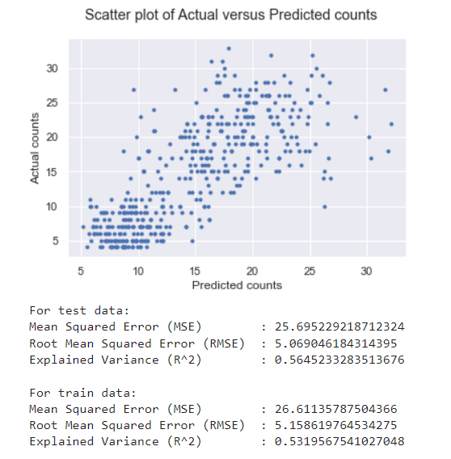
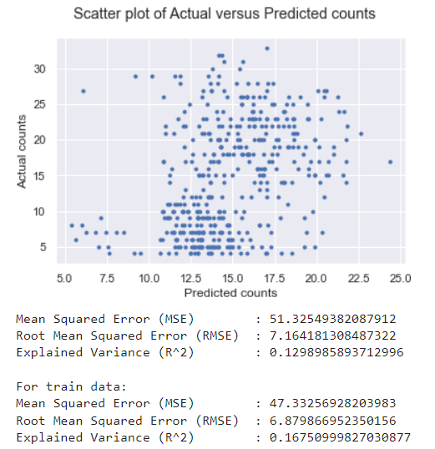
Importance of Income
Income serves as the most important predictor: R² value decreases significantly for all response variables if Income is removed.
Without Income
With Income
Notes:
Next, we tried to determine what variable is the most important in predicting the responses by removing the predictors one by one and noting the change in the model. We find that income serves as the most significant predictor. As you can see here, the model performs much worse if we remove the income variable as there seems to be little correlation between the predicted and actual data.

Slide 28
Comparison between Models
The Linear Regression Model + GridSearchCV performs better than Poisson Regression (test data)
 | R²
Response variables | Linear Regression + GridSearchCV | Poisson Regression
TotalPurchase | 0.60 | 0.56
MntGroceryProducts | 0.66 | 0.62
MntWines | 0.63 | 0.58
MntGoldProds | 0.24 | 0.20
Notes:
After carrying out the two machine learning models, we compared them both to determine which is the better model. From our results, we see that the Linear Regression Model with cross validation actually performs slightly better than the Poisson Regression model. Interestingly, we can observe that both models perform badly in predicting MntGoldProds, which might indicate that the current predictors aren’t suitable to predict the sales of gold.

Slide 29
Comparison between Models
The Linear Regression Model + GridSearchCV performs better than Poisson Regression (test data)
 | MSE
Response variables | Linear Regression + GridSearchCV | Poisson Regression
TotalPurchase | 23.81 | 25.70
MntGroceryProducts | 26741.16 | 29903.79
MntWines | 41846.12 | 47663.69
MntGoldProds | 2135.94 | 2244.14
Notes:
The same pattern can be seen for a different statistic, MSE, where the Linear Regression model performs better than the Poisson Regression model on all responses.

Slide 30
Insights & Recommendations
Utilise customer-focused sales tactics with customer’s income as a guideline
Target audience should be customers who have / are:
fewer children
higher income
higher levels of education
born in 1940 - 1950
Improve online sales:
Upgrade company website
Notes:
Thank you Marvell for your explanation of the Poisson Regression model. Now, before I conclude, let me talk about the main insight that we have derived from our dataset and provide a few recommendations. The common consensus among us is that the company actually utilizes customer’s income as a guideline for customer sales tactics.
However, we have thought of 2 recommendations. For one, we feel that the target audience should be narrowed down to customers with fewer children, higher income and higher levels of education. On top of that, they should be born in the 1940s. Another suggestion is to improve the company’s online sales. This can be done by upgrading the company’s website, so as to make it more attractive and appealing to customers.

Slide 31
Conclusions
Income is the most important predictor for customer sales.
Linear Regression outperformed Poisson Regression.
GridSearch CV only marginally improved the Linear Regression model.
Notes:
So to sum up, we have concluded that income is the most important predictor in predicting customer sales for the company, and based on the results of the 2 Machine Learning models used, Linear Regression turned out to be better than Poisson Regression, notwithstanding the fact that GridSearch CV only improved the results of the Linear Regression model slightly.

Slide 32
THANK YOU!
Notes:
With that, we have come to the end of our presentation. Thank you very much!

Slide 33
References
https://www.kaggle.com/datasets/imakash3011/customer-personality-analysis/ (Original Dataset)
https://stackoverflow.com/questions/21912634/how-can-i-sort-a-boxplot-in-pandas-by-the-median-values
https://altair-viz.github.io/gallery/index.html
https://www.kaggle.com/code/jnikhilsai/cross-validation-with-linear-regression/notebook
https://towardsdatascience.com/gridsearchcv-for-beginners-db48a90114ee
https://machinelearningmastery.com/rfe-feature-selection-in-python/
https://scikit-learn.org/stable/modules/generated/sklearn.model_selection.GridSearchCV.html
https://medium.com/lcc-unison/how-to-poisson-regression-model-python-implementation-1c672582eb96
https://timeseriesreasoning.com/contents/poisson-regression-model/
https://matplotlib.org/stable/gallery/subplots_axes_and_figures/subplots_demo.html/
https://scikit-learn.org/stable/modules/generated/sklearn.model_selection.KFold.html/
https://medium.com/analytics-vidhya/implementing-linear-regression-using-sklearn-76264a3c073c/
https://machinelearningmastery.com/rfe-feature-selection-in-python/

