Slide 1
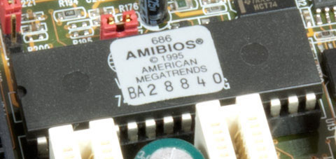
RAM / ROM
RAM (Random-Access Memory)
Temporarily stores files
Requires power
ROM (Read-Only Memory)
Can only be read, used for firmware and BIOS
Does not require power
Pros
Efficient
High Storage
Cons
Potential data loss

Slide 2
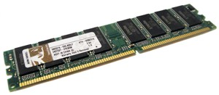
RAM / ROM
Performance and cost issues
ROM: 4-8 MB RAM: 1-256 GB
16 GB = $80
Last 5 years
DDR4 - Standard 64 GB (16 previous), double speed
Next 5 years
New type of memory - Best of both worlds
Time to hold data
Are RAM and ROM efficient and effective methods of storage?

