Slide 1
StoryboardV1

Slide 2
Silly Pivot
Average Available: 22.556
Viewing: Class Time
Viewing: Studio Room
Viewing: Class Date: Week
Viewing: Class Date: Day
Class Date: Week | Class Date: Day | 10:15:00 | 10:30:00 |  | 10:45:00
 |  | (n/a) | (n/a) | A | (n/a) | Subtotal
Week of Aug 17, 2015 | Aug 18, 2015 | 15 | 24.368 | 9.5 | 39
 |  | 15 | 24.368 | 9.5 | 39

Slide 3
Silly Pivot
Average Available: 22.556
Viewing: Class Time
Viewing: Studio Room
Viewing: Class Date: Week
Viewing: Class Date: Day
Class Date: Week | Class Date: Day | 10:15:00 | 10:30:00 |  | 10:45:00
 |  | (n/a) | (n/a) | A | (n/a) | Subtotal
Week of Aug 17, 2015 | Aug 18, 2015 | 15 | 24.368 | 9.5 | 39
 |  | 15 | 24.368 | 9.5 | 39

Slide 4
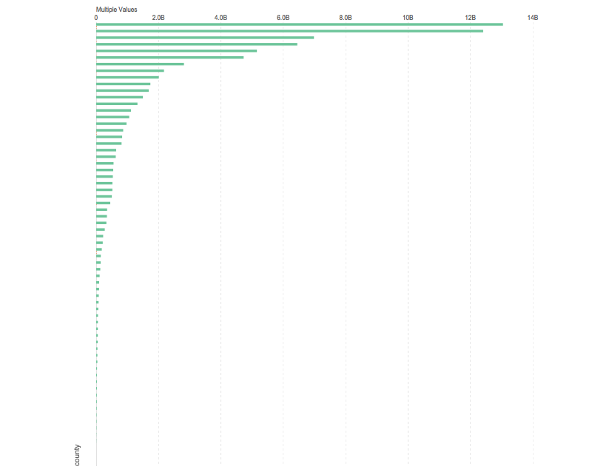
Untitled Story
◼Median Total hu_site_limit per county: 209,963,925
◼Median Total fl_site_deductible per county:
Viewing: county

Slide 5
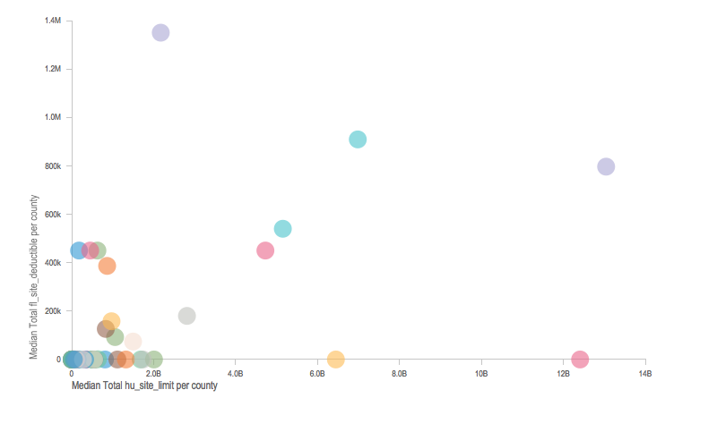
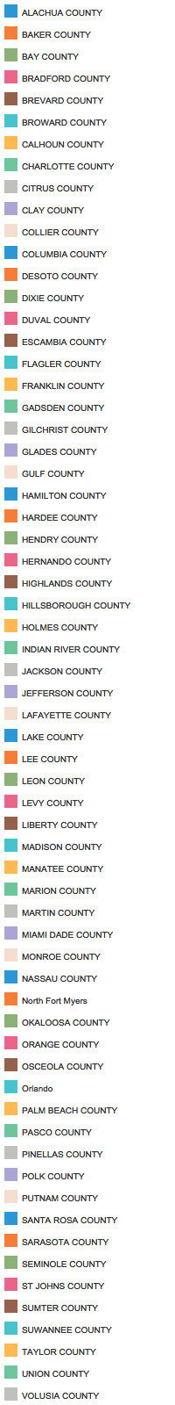
Points
Dots plotted on X and Y axis
Median Total hu_site_limit per county: 209,963,925
Median Total fl_site_deductible per county:
Viewing: statecode
By: county

Slide 6
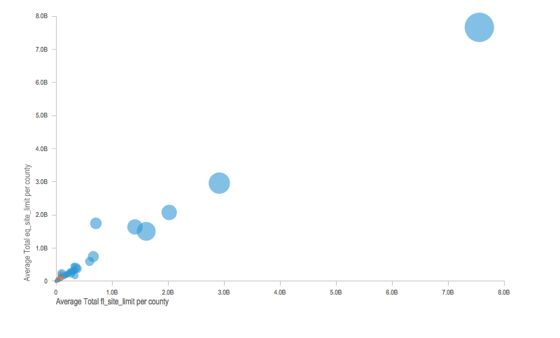


two legend
Average Total fl_site_limit per county: 363,387,921
Average Total eq_site_limit per county: 399,954,706
Viewing: Average Total fr_site_limit per county
Viewing: county
By: line

