Slide 1
RESTAURANT BILL GENERATOR
TEAM MEMBERS:
160121733170 KARTHIKEYA
160121733171 SHIVA SHANKER REDDY
160121733179 MOHAN KUMAR
160121733191 DILEEP KUMAR
MENTORED by:
T. PRASHANTHI
Assistant Professor, CSE(dept)

Slide 2
CONTENTS:
Background
Motivation
Problem Statement
Formulation
Summary
Future Scope

Slide 3
BACKGROUND:
On keeping the working of the manual system as the basis of our project
we developed an automated version of the manual system, named
as “CANTEEN BILL GENERATOR”.
It is to provide customer friendly and time saving digital bill generator .It also.
provides track of transactions,profits and loses on daily basis.

Slide 4
MOTIVATION:
The main aim of our project is to make work easy.If we do all the works like storing details of orders of the customers and to keep a track over the turn over of the restaurant , It takes a lot of time and more employees are needed .
So by using this project we can save time and it also helps in enhancing the customers and the restaurant to serve more quickly and efficiently.

Slide 5
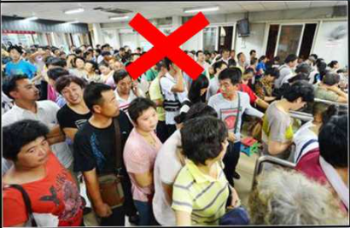
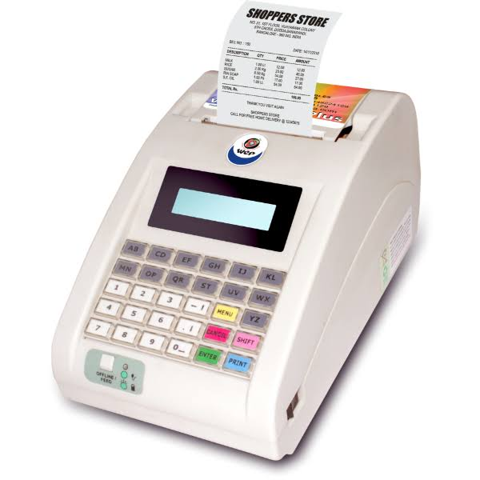


Slide 6
PROBLEM STATEMENT:
Creating a bill generator program so that canteen owner can print bills and customize bills easily.To convert analog billing system to digital billing system.To store every bill for future references and to keep track of theirs bills.

Slide 7
Formulations
We used object oriented programming language Python for creating this project. We created a class called as canteen and declared different class methods for different food categories.
Every food category(class method) contains list of lists which contains different food items and their prices respective to the particular food category
We created two python files named as billmain.py and bill maker.py in which bill main file has the main implementation of the program which calls the class and its methods by refering to the different numeric characters entered by the user and prints the bill on the screen.

Slide 8
We imported different modules such as tabulate,pandas,datetime for the customization and representation of the bill on the screen And module named as CSV for storing bills in a CSV file for the future reference. We also handled every run time error by try and accept concepts for user friendly ecosystem.
In addition to generating a bell,every bill generated will be stored in a CSV file which contains date,bill number and the items purchase for future reference and for the calculation of daily profits and losses. This CSV file can be shared to any one and the canteen owner can access it from anywhere from in this world so that he can keep track of his canteen without personally visiting it

Slide 9
implementation
Main file prompts the client to enter the code which should be in the numeric characters separated by dots.
Bill will be generated according to the code.which consists of date, Bill no, items and their quantites along with bill amount.
If the code entered is incorrect it will prompt an error to the user to enter a perfect code and continues the program.
Every bill will be stored in a CSV file including date,bill number,items purchased and total bill.

Slide 10
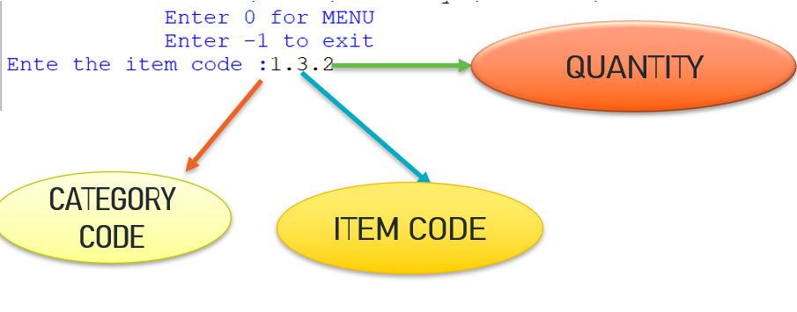
HOW TO ENTER CODE….?
We have to enter 3 digits for each item

Slide 11
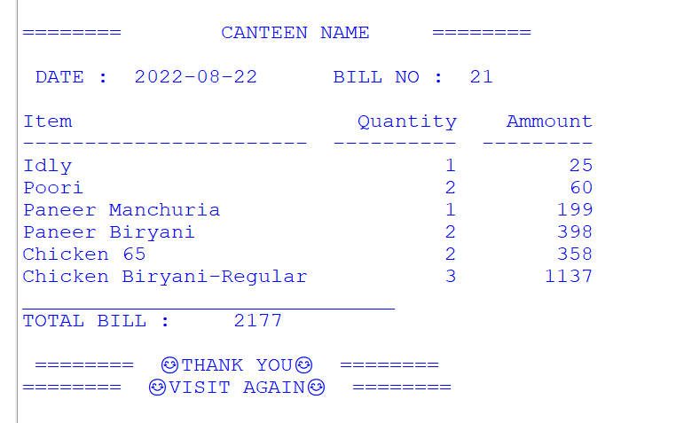
BILL OUTPUT :

Slide 12
CATEGORY CODES AND ITEMS CODES ARE ALLOTED AS…….
1 : BREAKFAST
Items Price
0 Dosa-Masala 25
1 Dosa-Onion 25
2 Dosa-Plain 25
3 Idly 25
4 Poori 30
5 Upma 30
6 Utappa 25
7 Vada 30
2 : VEG STARTERS
Items Price
0 Veg manchuria 149
1 Veg Spring Roll 149
2 Chilli Spring Roll 149
3 Mushroom 65 199
4 Paneer Manchuria 199
3 : VEG BIRYANI
Items Price
0 Veg Biryani-Mini 179
1 Veg Biryani-Regular 219
2 Veg Biryani-Large 319
3 Paneer Biryani 319
4 Paneer Lollipop Biryani 339
5 Mushroom Biryani 339
4 : NON-VEG STARTERS
Items Price
0 Chicken 65 179
1 Chicken Manchuria 149
2 Chicken Spring Roll 209
3 Chile Fish 289
4 Appolo Fish 289
5 Prawns Fry 289 ………e.t.c

Slide 13
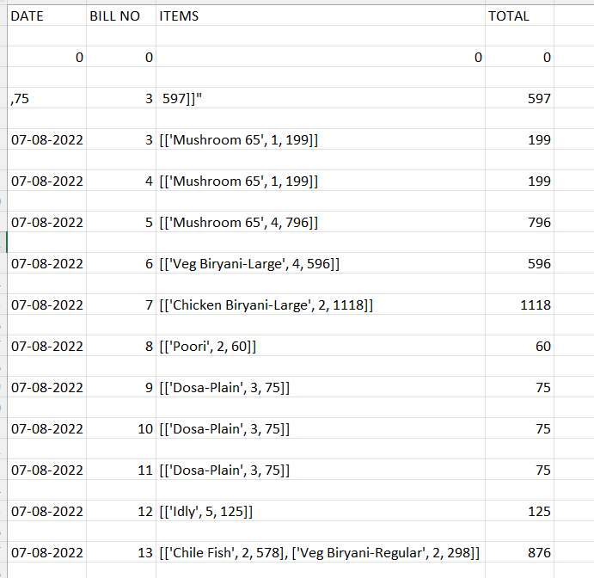
CSV File

Slide 14
summary:
Our program helps the management of the hotel to maintain a great database of all customers visited.
Enhances day-to-day operations.
This helps in tracking the financial turn-over of the hotel with simple reckoning.
Also makes the way of ordering the food much easier.

Slide 15
future scope:
This project would help various branches of a single hotel to align their data of the orders of the customers properly and safely.
Utilizing this project, the hotels can directly display the orders of the customers in their kitchen along with their table number So that, time required to prepare the food will be reduced and can be served more quickly.
Project will enable to see report regarding the item and category.

