Slide 1
처음 머릿속으로 구상한 방법과 플로우
TableView 혹은 TableViewController로 구현
Label, Switch, Indicator, Icon 등 다수 존재
User Defaults로 세부 항목을 저장하기!

Slide 2
처음 머릿속으로 구상한 방법과 플로우
TableView 혹은 TableViewController로 구현
Label, Switch, Indicator, Icon 등 다수 존재
User Defaults로 세부 항목을 저장하기!

Slide 3
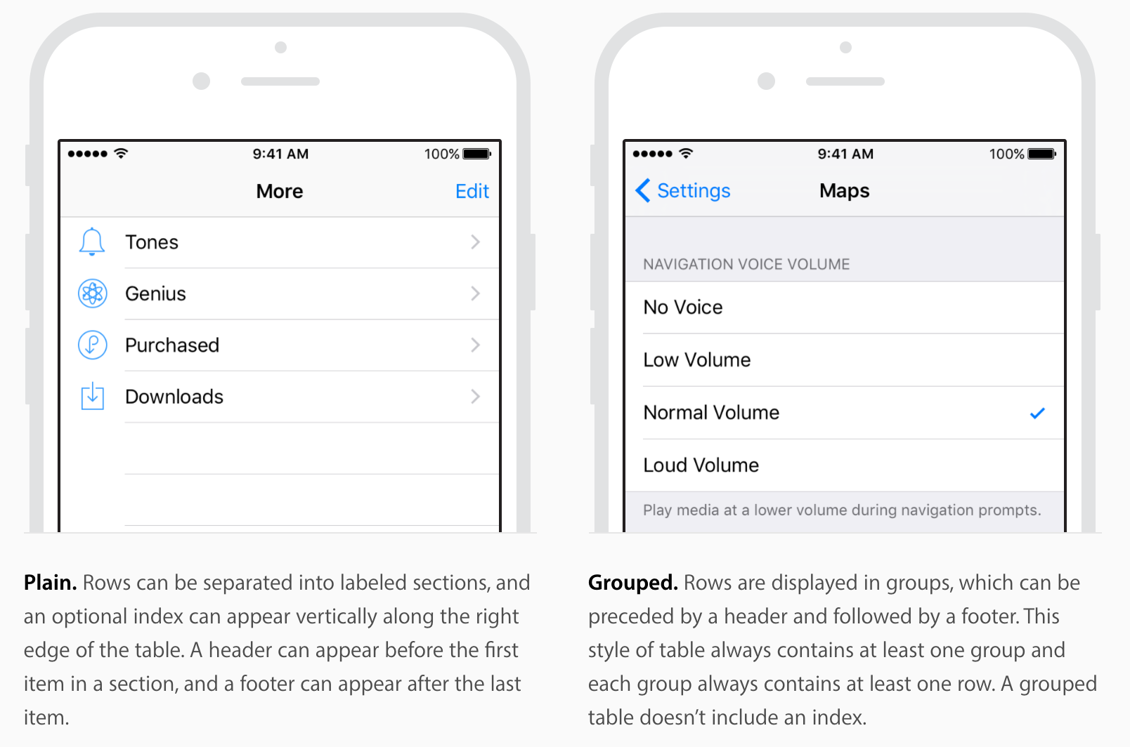
Basic

Slide 4
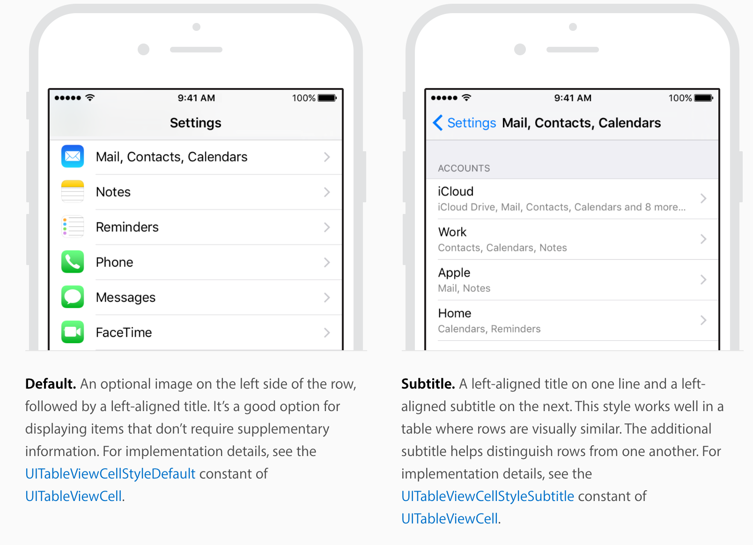
Basic

Slide 5
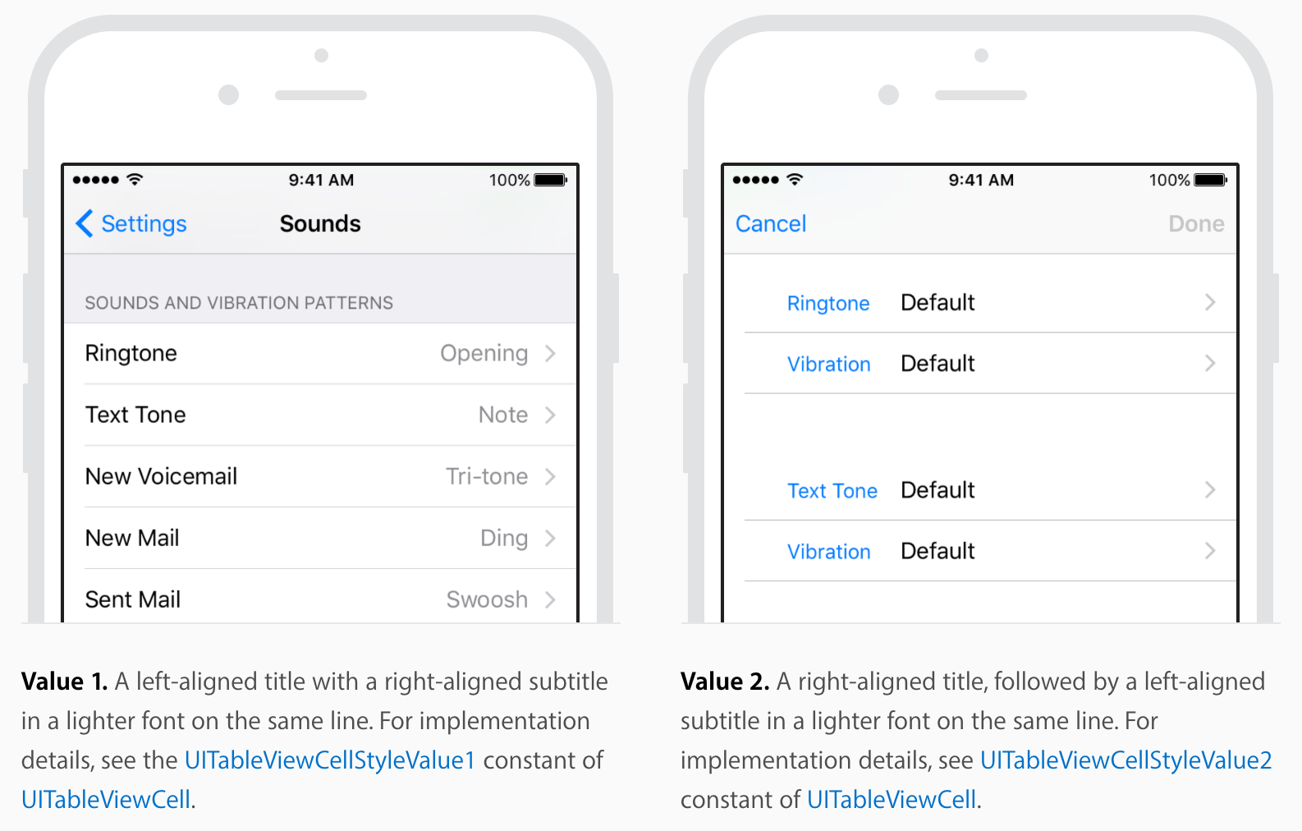
Right Detail
Left Detail

Slide 6
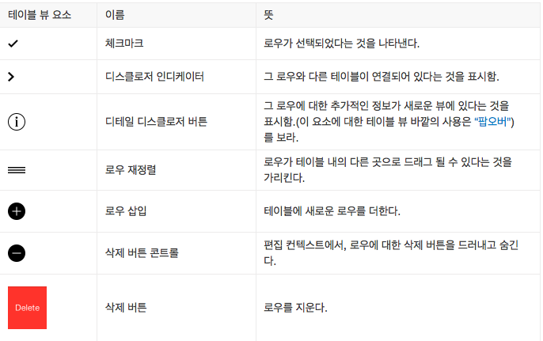

Slide 7
TableView를 만들면서 진행하기

Slide 8
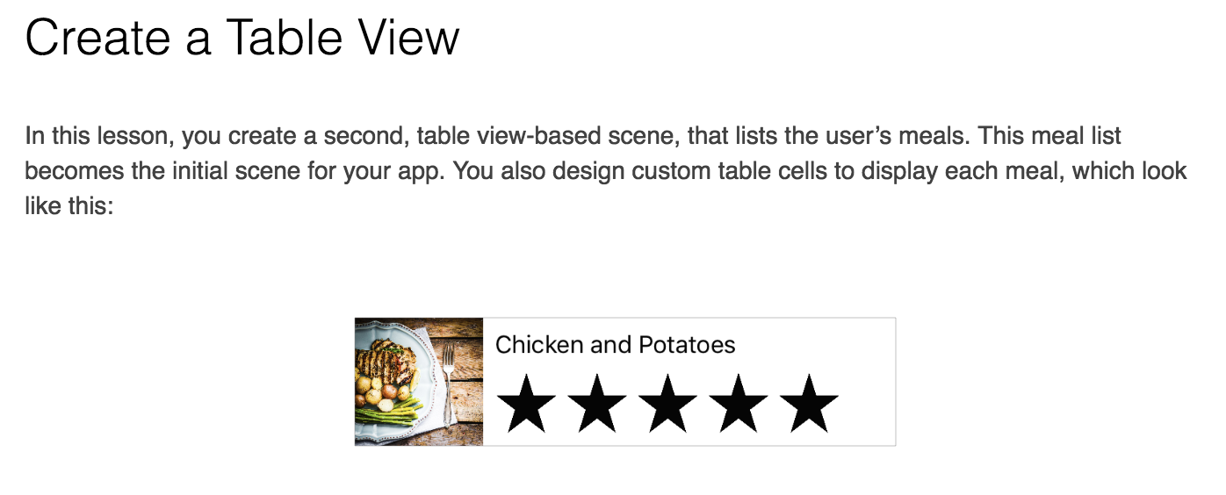
https://developer.apple.com/library/content/referencelibrary/GettingStarted/DevelopiOSAppsSwift/CreateATableView.html

Slide 9
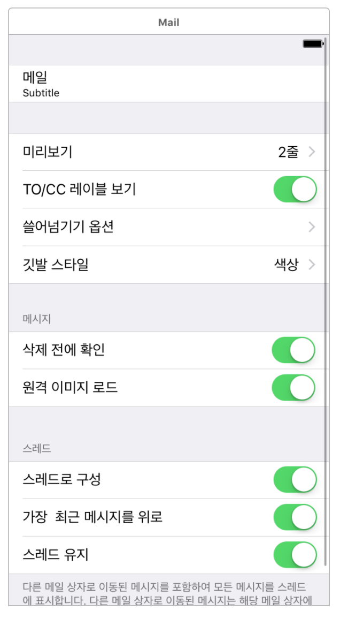

Story Board의 Attributes Inspectro를 사용해서 열심히 생성
numberOfSections / tableView-numberOfRowsInSection
tableView-cellForRowAt
implements 후, 앱 크래쉬

Slide 10
PHAsset
A representation of an image, video or Live Photo in the Photos library
https://developer.apple.com/reference/photos/phasset
PHFetchResult
An ordered list of assets or collections returned from a Photos fetch method
- https://developer.apple.com/reference/photos/phfetchresult
PHImageManager
Provides methodos for retrieving or generating preview thumbnails and full-size image or video data associated with Photos assets.
https://developer.apple.com/reference/photos/phimagemanager
Notes:
http://stackoverflow.com/questions/33935833/multiple-selection-of-image-in-ios

