Slide 1
Computer Architectures Session 2
RISC-V Processor Pipelining
TAs :
Xiaoling Yi (xiaoling.yi@kuleuven.be)
Chao Fang (chao.fang@kuleuve.be)
Adrian Kneip (adrian.kneip@kuleuve.be)

Slide 2

Timeline
Submission Deadline [May-1]
Session 1
Session 2
Session 3
Session 4
[Mar-04/05]
[Apr-01/02]
[Apr-23/24]
[May-11/12]
Functional single cycle processor
Single cycle processor with multiplication
Pipelined processor
Control hazard resolution
Project Feedback
Data hazard resolution
Advanced acceleration
Written Exam Exercises
Simulation
Backend flow (synthesis-only)

Slide 3

Last session recap
Session 1
Session 2
Session 3
[Mar-04/05]
Single cycle processor skeleton
Functional single cycle processor
Single cycle processor with multiplication
Pipelined processor
Pipelined processor with data hazard resolution
Advanced acceleration
Simulation
Backend flow (synthesis-only)
Backend flow (basic)

Slide 4
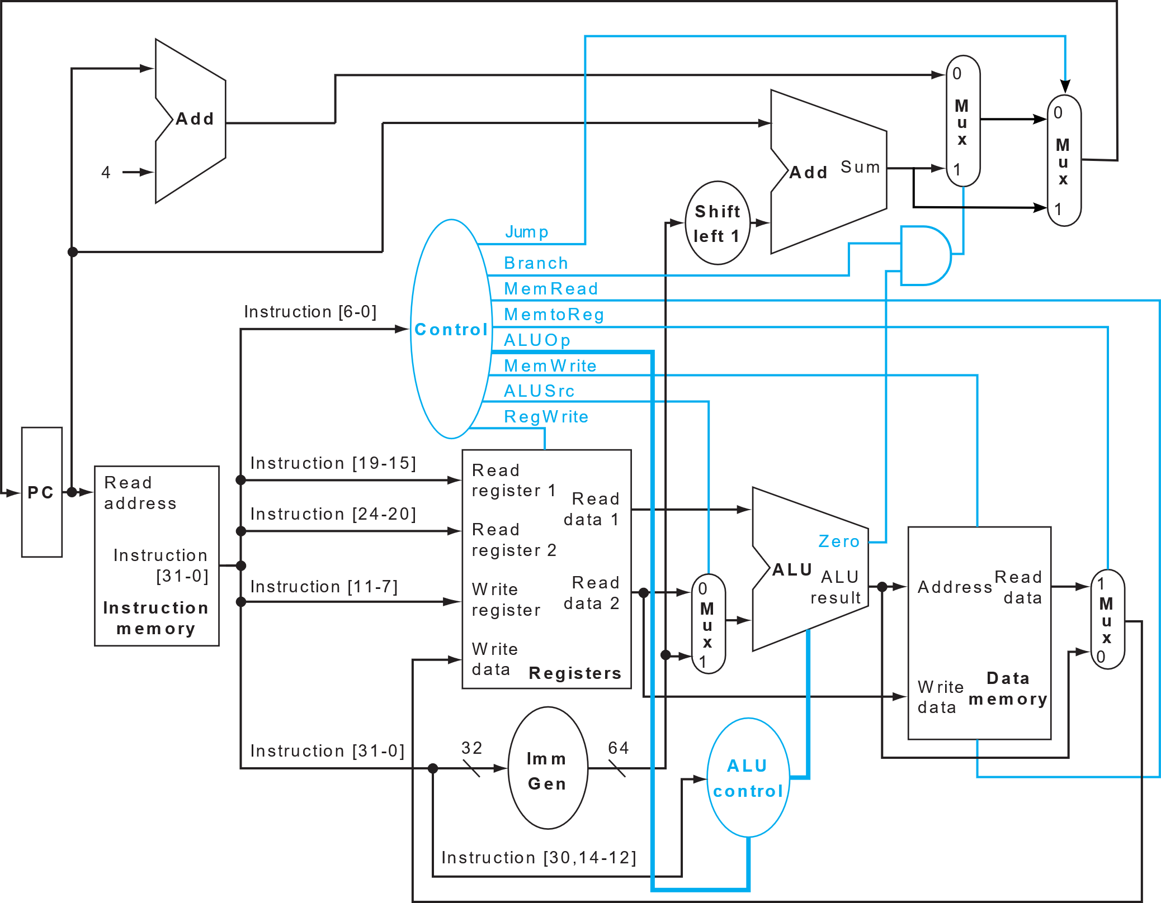
Last session recap
Single-cycle Processor
Simple_program
Mult1
Mult2
Prerequisite for this session!

Slide 5
Today’s session: Pipelined processor
Session 1
Session 2
Session 3
[Apr-01/02]
Single cycle processor skeleton
Functional single cycle processor
Single cycle processor with multiplication
Pipelined processor
Pipelined processor with data hazard resolution
Advanced acceleration
Simulation
Backend flow (synthesis-only)
Backend flow (complete)

Slide 6
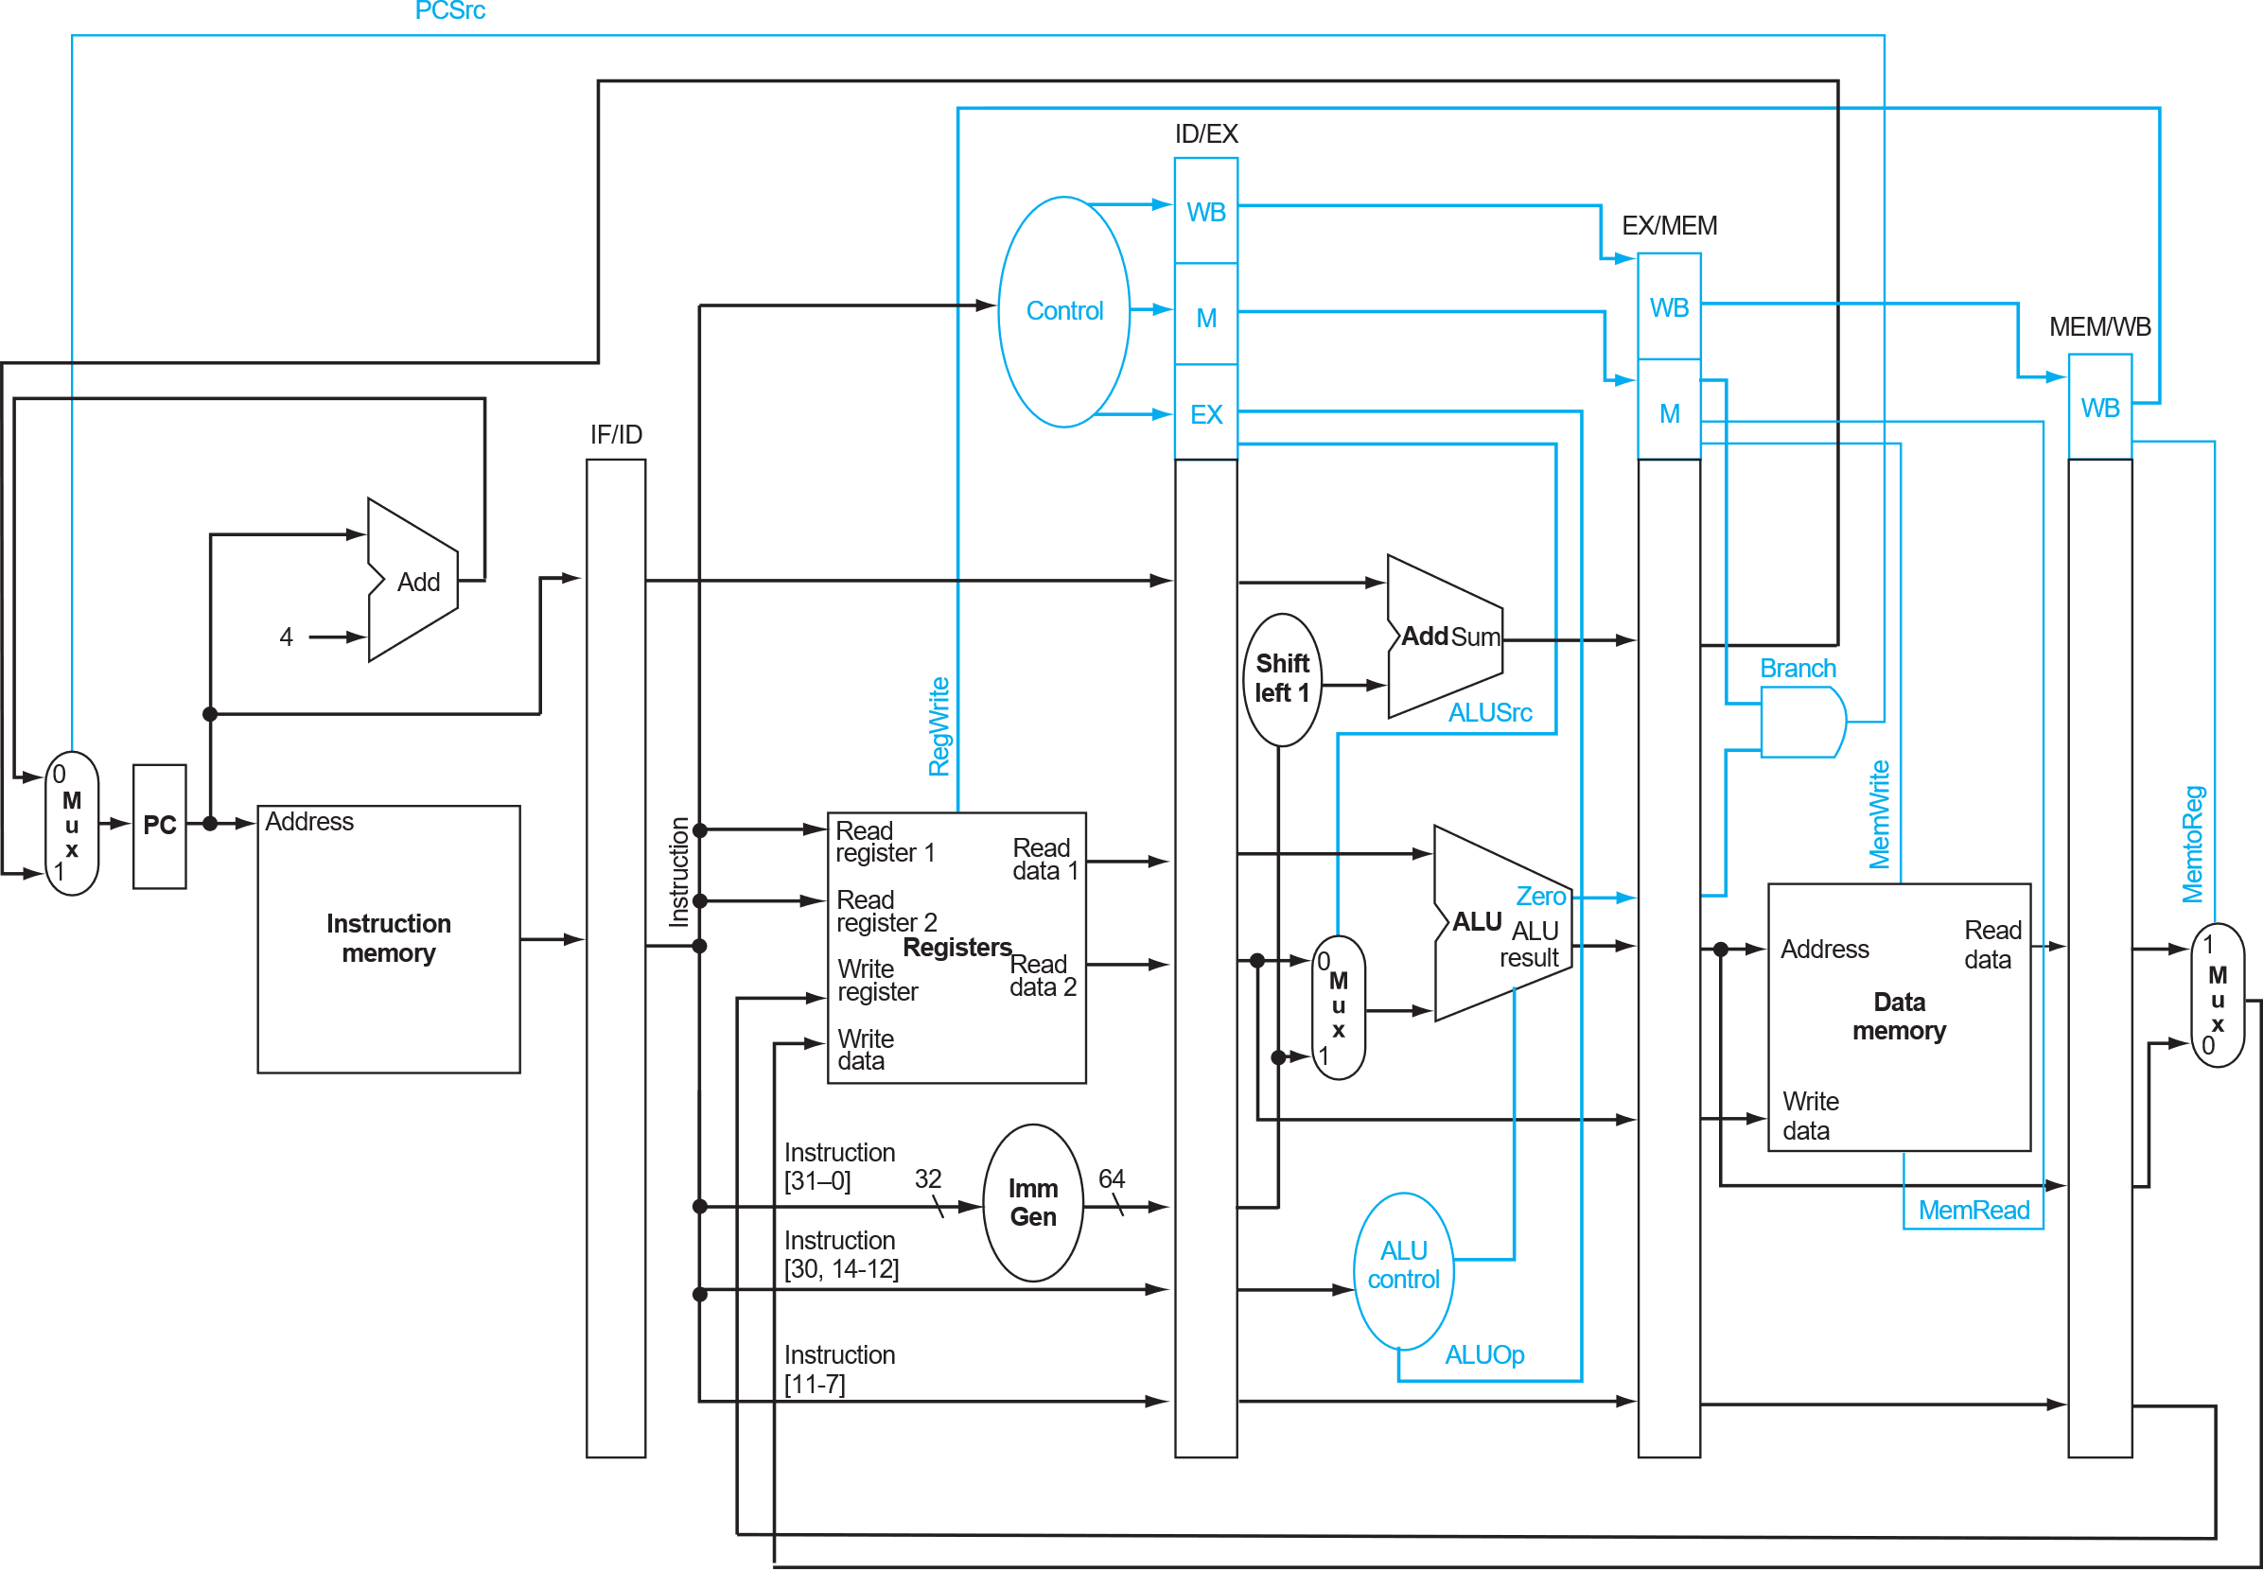
5-stage Pipelining
Define pipeline stages
Allocate processor modules
Insert pipeline registers (---)
Fetch
Decode
Execute
Memory
Write Back

Slide 7

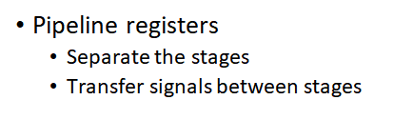
5-stage Pipelining
Pipeline registers

Slide 8
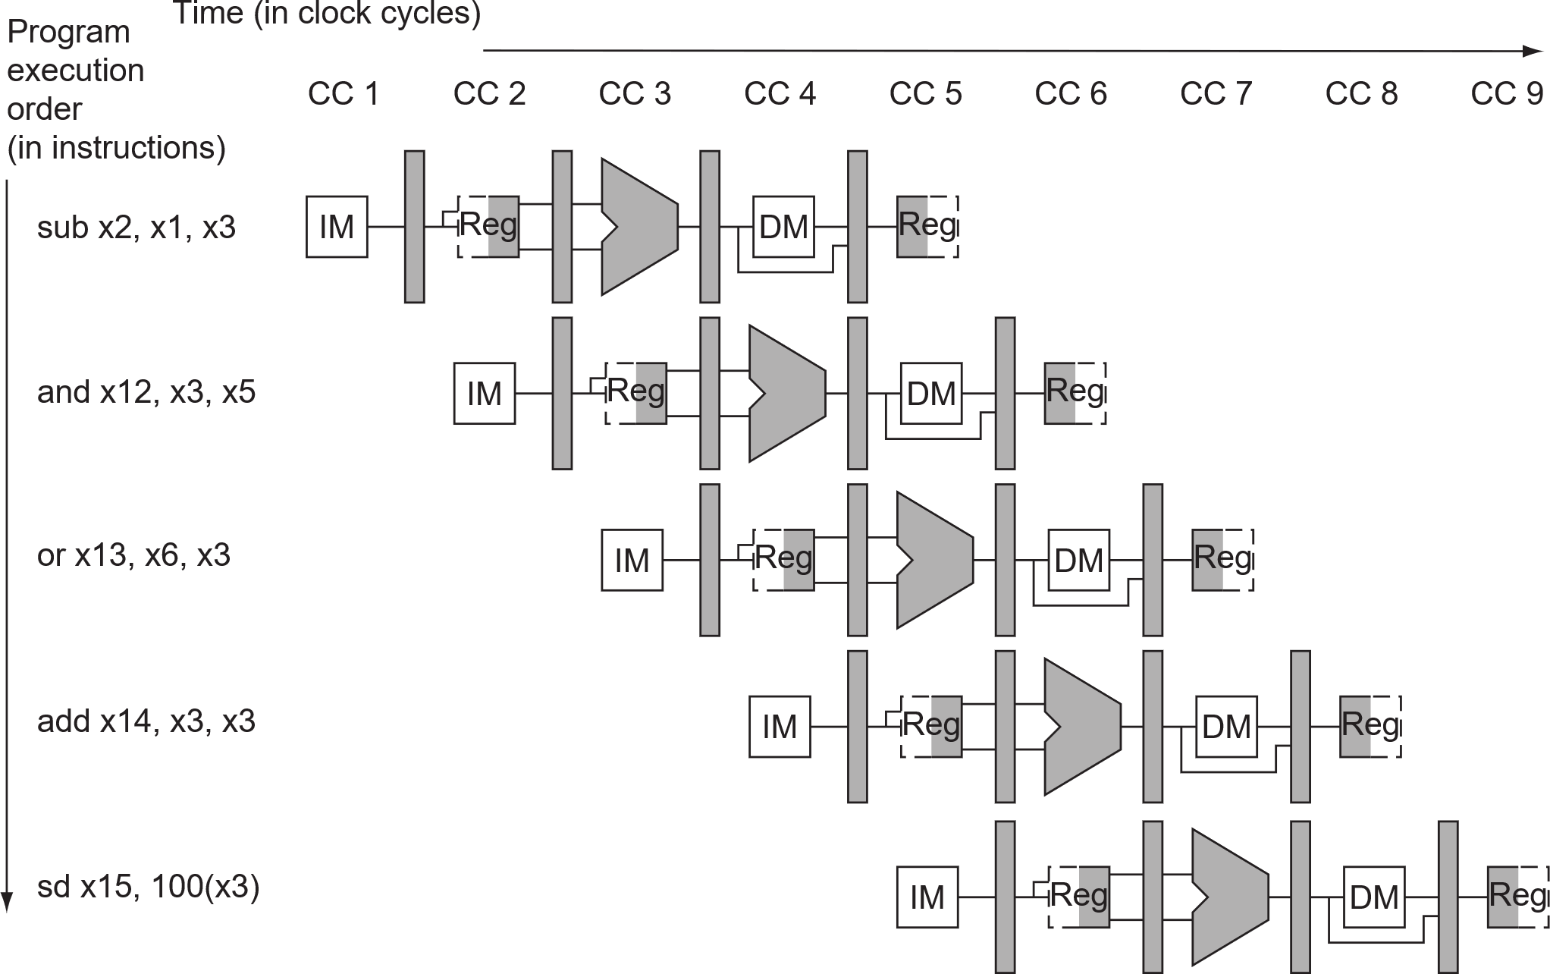
5-stage Pipelining
At clock cycle 5:
Inst 1 -> write back
Inst 2 -> data
Inst 3 -> execute
Inst 4 -> decode
Inst 5 -> fetch

Slide 9
Today’s session: Pipelined processor
Session 1
Session 2
Session 3
[Apr-01/02]
Single cycle processor skeleton
Functional single cycle processor
Single cycle processor with multiplication
Pipelined processor
Pipelined processor with data hazard resolution
Advanced acceleration
Simulation
Obj-1: mult2
Backend flow (synthesis-only)
Backend flow (complete)

Slide 10
Obj-1: mult2
Pipelined processor
MULT2
Pipelined processor
Introduce the pipeline registers to cpu.v to support pipelined execution
Run MULT2
Run backend flow, track the timing and area change along the steps.
Synthesis -> Floorplan -> Signoff
Complete the report
# load operands
ld x8, 0(x0)
ld x9, 8(x0)
ld x10, 16(x0)
ld x11, 24(x0)
ld x12, 32(x0)
ld x13, 40(x0)
ld x14, 48(x0)
ld x15, 56(x0)
ld x16, 64(x0)
ld x17, 72(x0)
# multiplication
mul x18, x8, x9
mul x19, x10, x11
mul x20, x12, x13
mul x21, x14, x15
mul x22, x16, x17
#sums
addi x23, x0, 0
nop
nop
nop
add x23, x23, x18
nop
nop
nop
add x23, x23, x19
nop
nop
nop
add x23, x23, x20
nop
nop
nop
add x23, x23, x21
nop
nop
nop
add x23, x23, x22
nop
nop
nop
nop

Slide 11
Implementation Method
Stage | IF | ID | EXE | MEM | WB
Data Path resources | instruction_memory | register_file
Pipe. Reg. | IF/ID | ID/EXE | EXE/MEM | MEM/WB
Signals | instruction
You can find this helper table in TASKS TO BE DONE of session_guide.pdf
EXAMPLE

Slide 12
Implementation Method
// IF STAGE wire [ 31:0] instruction, instruction_IF_ID, instruction_MEM_WB;
sram_BW32 #( .ADDR_W(9 ), .DATA_W(32) ) instruction_memory( .clk (clk ), .addr (current_pc ), .wen (1'b0 ), .ren (1'b1 ), .wdata (32'b0 ), .rdata (instruction ), // Wiring component .addr_ext (addr_ext ), // to appropriate stage .wen_ext (wen_ext ), .ren_ext (ren_ext ), .wdata_ext(wdata_ext ), .rdata_ext(rdata_ext ) );
// IF_ID Pipeline register for instruction signal reg_arstn_en#( .DATA_W(32) // width of the forwarded signal )signal_pipe_IF_ID( .clk (clk ), .arst_n (arst_n ), .din (instruction ), .en (enable ), .dout (instruction_IF_ID) )
// ID STAGE
register_file #( .DATA_W(64) ) register_file( .clk (clk ), .arst_n (arst_n ), .reg_write(reg_write ), .raddr_1 (instruction_IF_ID[19:15]), // Wiring component .raddr_2 (instruction_IF_ID[24:20]), // to appropriate stage .waddr (instruction_MEM_WB[11:7] ),// Reg_write addr .wdata (regfile_wdata ), .rdata_1 (regfile_rdata_1 ), .rdata_2 (regfile_rdata_2 ) );
Coding Example (cpu.v)
Stage | IF | ID | EXE | MEM | WB
Data Path resources | Instruction_memory | register_file
*_ext wires are only for the testbench (do not change).
Pipe. Reg. | IF/ID | ID/EXE | EXE/MEM | MEM/WB
Signals | Instruction_IF_ID |  |  | Instruction_MEM_WB
The IF_ID Pipeline Register.
You can find this helper table in TASKS TO BE DONE of session_guide.pdf
Tips:
Be careful with each register’s DATA_WIDTH.
Always define the signal before usage in coding.
EXAMPLE

Slide 13
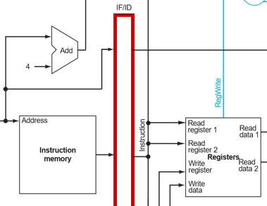
Implementation Method
// IF STAGE wire [ 31:0] instruction, instruction_IF_ID, instruction_MEM_WB;
sram_BW32 #( .ADDR_W(9 ), .DATA_W(32) ) instruction_memory( .clk (clk ), .addr (current_pc ), .wen (1'b0 ), .ren (1'b1 ), .wdata (32'b0 ), .rdata (instruction ), // Wiring component .addr_ext (addr_ext ), // to appropriate stage .wen_ext (wen_ext ), .ren_ext (ren_ext ), .wdata_ext(wdata_ext ), .rdata_ext(rdata_ext ) );
// IF_ID Pipeline register for instruction signal reg_arstn_en#( .DATA_W(32) // width of the forwarded signal )signal_pipe_IF_ID( .clk (clk ), .arst_n (arst_n ), .din (instruction ), .en (enable ), .dout (instruction_IF_ID) )
// ID STAGE
register_file #( .DATA_W(64) ) register_file( .clk (clk ), .arst_n (arst_n ), .reg_write(reg_write ), .raddr_1 (instruction_IF_ID[19:15]), // Wiring component .raddr_2 (instruction_IF_ID[24:20]), // to appropriate stage .waddr (instruction_MEM_WB[11:7] ),// Reg_write addr .wdata (regfile_wdata ), .rdata_1 (regfile_rdata_1 ), .rdata_2 (regfile_rdata_2 ) );
Sample Code Snippet
Stage | IF | ID
Data Path resources | Instruction_memory | register_file
①
*_ext wires are only for the cpu_tb.v initialization.
①
②
①
②
The IF_ID Pipeline Register.
Pipe. Reg. | IF/ID
Signals | Instruction_IF_ID
②
Refer to the 5-stage pipeline to implement step by step.
Tips:
Be careful with each register’s DATA_WIDTH.
Always put the signal definition before usage.
EXAMPLE

Slide 14
Implementation Method
Module instantiation
1. The Template Definition
2. The Instance Declaration
// reg_arstn_en.v
module reg_arstn_en#(
parameter integer DATA_W = 20,
parameter integer PRESET_VAL = 0
)(
input clk,
input arst_n,
input en,
input [ DATA_W-1:0] din,
output [ DATA_W-1:0] dout
);
// cpu.v
reg_arstn_en#( .DATA_W(32) )signal_pipe_IF_ID( .clk (clk ), .arst_n (arst_n ), .din (instruction ), .en (enable ), .dout (instruction_IF_ID) )
Template Name
Parameterization
Instance Name
Port
Name
Signal
Connection
If you need a customized module, you should also follow this approach.
EXAMPLE

Slide 15
Linting your code.
Implementation Method
// IF STAGE BEGIN
... // IF STAGE END
// IF_ID REG BEGIN
... // IF_ID REG END
// ID STAGE BEGIN
... // ID STAGE END
// ID_EX REG BEGIN
... // ID_EX REG END
// EX STAGE BEGIN
... // EX STAGE END
// EX_MEM REG BEGIN
... // EX_MEM REG END
// MEM STAGE BEGIN
... // MEM STAGE END
// MEM_WB REG BEGIN
... // MEM_WB REG END
// WB STAGE BEGIN
... // WB STAGE END
Sample Code Snippet
What should the final table be like?
Stage | IF | ID | EXE | MEM | WB
Data Path resources | IMEM PC | Control Unit Register File … | ALU … | … | …
Pipe. Reg. | IF/ID | ID/EXE | EXE/MEM | MEM/WB
Signals | Instruction_IF_ID | ControlSignals_ID_EX RegFile_data_1_ID_EX … | … | …
These should be the wire names (instances) you choose in your design.
Use it as a checklist to save the debugging time!
EXAMPLE

Slide 16
Today’s session: Pipelined processor w/ hazard
Session 1
Session 2
Session 3
[Apr-01/02]
Single cycle processor skeleton
Functional single cycle processor
Single cycle processor with multiplication
Pipelined processor
Pipelined processor with data hazard resolution
Advanced acceleration
Simulation
Obj-1: mult2
Obj-2: mult3
Backend flow (synthesis-only)
Backend flow (complete)

Slide 17
Data Hazard Resolution
MULT2
MULT3
# load operands ld x8, 0(x0) ld x9, 8(x0) ld x10, 16(x0) ld x11, 24(x0) ld x12, 32(x0) ld x13, 40(x0) ld x14, 48(x0) ld x15, 56(x0) ld x16, 64(x0) ld x17, 72(x0) # multiplication mul x18, x8, x9 mul x19, x10, x11 mul x20, x12, x13 mul x21, x14, x15 mul x22, x16, x17 #sums addi x23, x0, 0 nop nop nop add x23, x23, x18
# load operands ld x8, 0(x0) ld x9, 8(x0) ld x10, 16(x0) ld x11, 24(x0) ld x12, 32(x0) ld x13, 40(x0) ld x14, 48(x0) ld x15, 56(x0) ld x16, 64(x0) ld x17, 72(x0)
# multiplication mul x18, x8,x9 mul x19, x10, x11 mul x20, x12, x13 mul x21, x14, x15 mul x22, x16, x17
#sums addi x23, x0, 0 add x23, x23, x18 add x23, x23, x19 add x23, x23, x20 add x23, x23, x21 add x23, x23, x22
nop
nop
nop
add x23, x23, x19
nop
nop
nop
add x23, x23, x20
nop
nop
nop
add x23, x23, x21
nop
nop
nop
add x23, x23, x22
nop
nop
nop
nop
nop
nop
nop
nop
Pipeline clean up is still required!
x23 dependency
Pipeline clean up
Data Hazard resolved!
Software: Insert ‘nop’ to delay the pipeline.
Hardware: forwarding mechanism required.

Slide 18
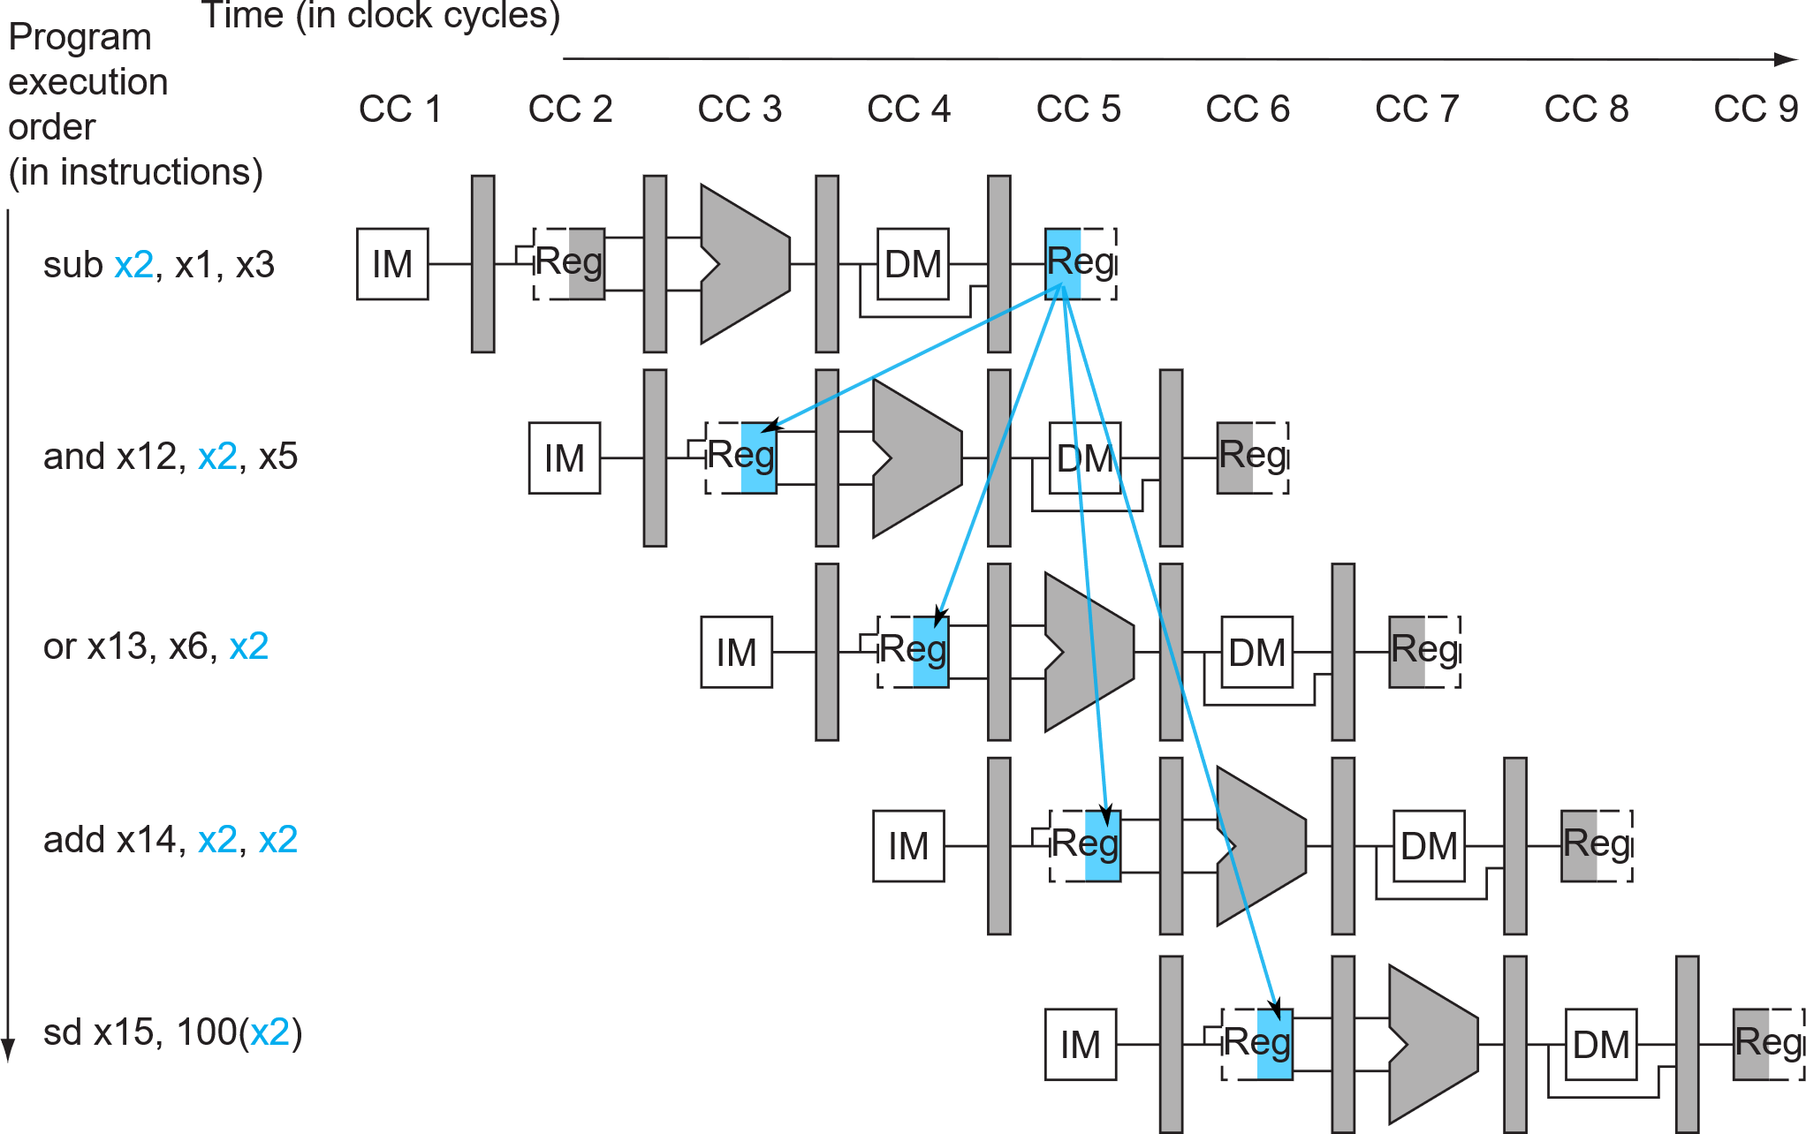
Data Hazard Example
Data is sent from the future.
Patterson Book. FIGURE 4.50

Slide 19
Data Hazard Resolution: Hardware
Forwarding from pipeline “shortcuts”
Patterson Book. FIGURE 4.51

Slide 20
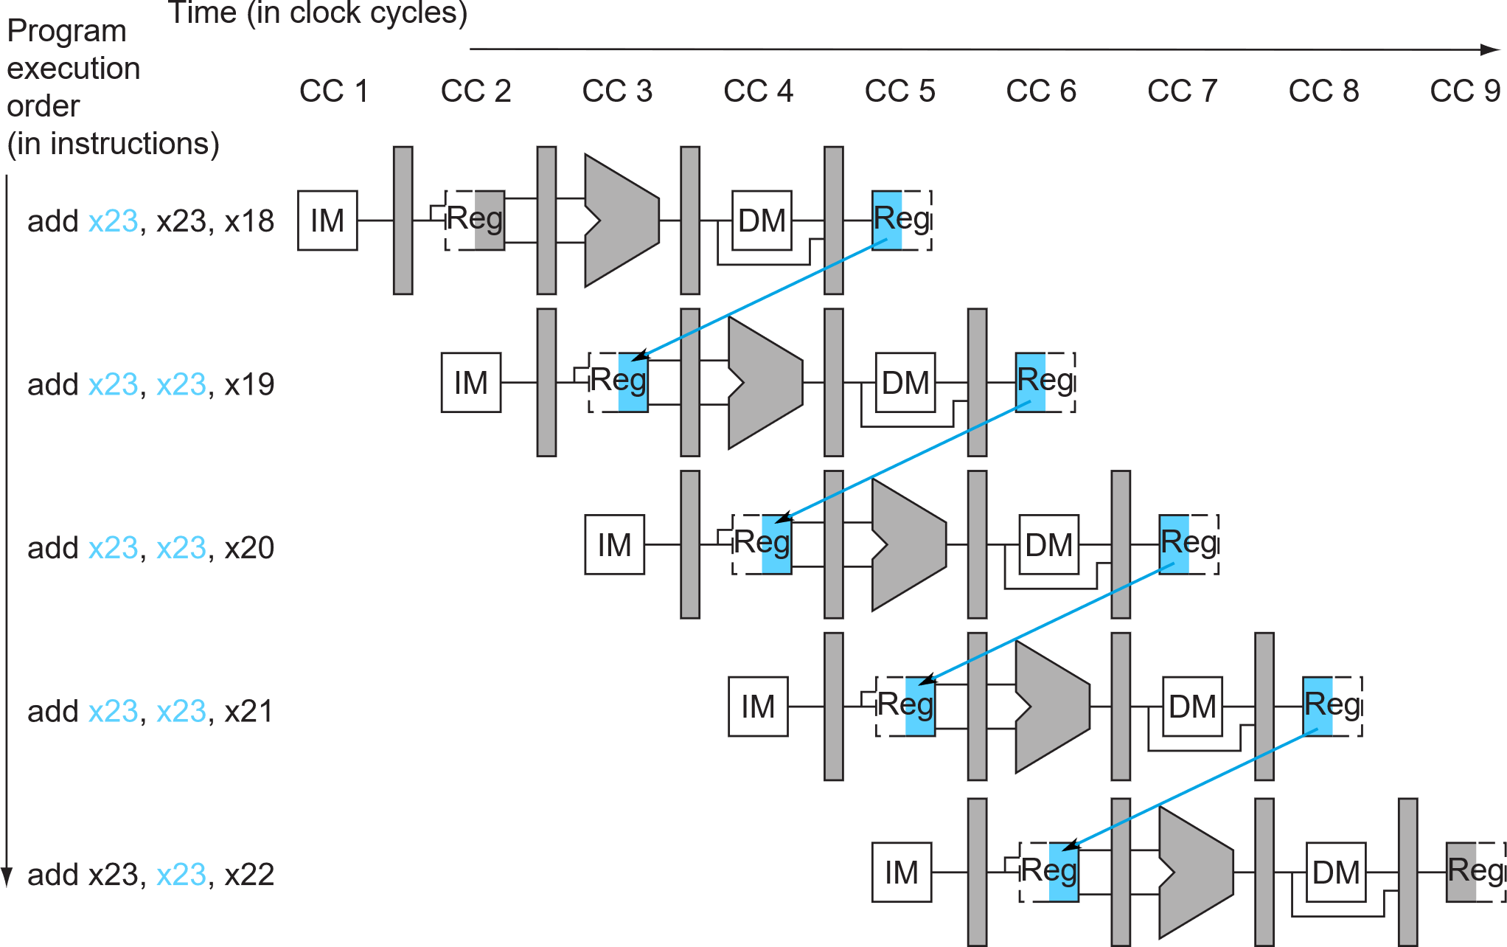
Data Hazard Resolution – MULT3
Implement this MEM->EX forwarding at least.
Notes:
rs1_ID_EX == rd_EX_MEM ?

Slide 21
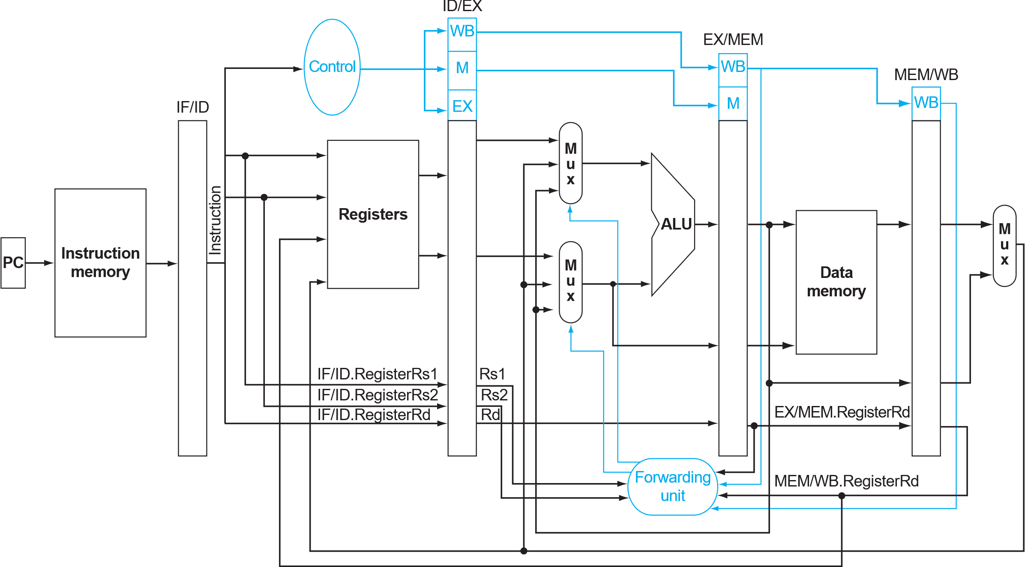
Implementation: Forwarding unit
// your_fw_fname.v or an/existing/Verilog/file
module YOUR_FW_UNIT_NAME#(
parameter integer … (if needed)
)(
input …,
input [ ?:0] …,
output [ ?:0] …
);
YOUR_FW_UNIT_LOGIC;
endmodule
Refer to slides: Implementation Method

Slide 22
Obj-2: mult3
MULT3
Pipelined processor with data hazard resolution
Implement a forwarding unit to resolve the data hazard
Run MULT3
Run backend flow
Synthesize
Complete the report
# load operands ld x8, 0(x0) ld x9, 8(x0) ld x10, 16(x0) ld x11, 24(x0) ld x12, 32(x0) ld x13, 40(x0) ld x14, 48(x0) ld x15, 56(x0) ld x16, 64(x0) ld x17, 72(x0)
# multiplication mul x18, x8,x9 mul x19, x10, x11 mul x20, x12, x13 mul x21, x14, x15 mul x22, x16, x17
#sums addi x23, x0, 0 add x23, x23, x18 add x23, x23, x19 add x23, x23, x20 add x23, x23, x21 add x23, x23, x22
Note:
Do not forget to update files_verilog.f in /SIM folder, if you add new RTL source file, or change the RTL location.
Please refer to the mux-2 to customize a mux-3, if needed.
Do not forget to add/modify all the signal wires in the top cpu.v according to your new modules.

Slide 23
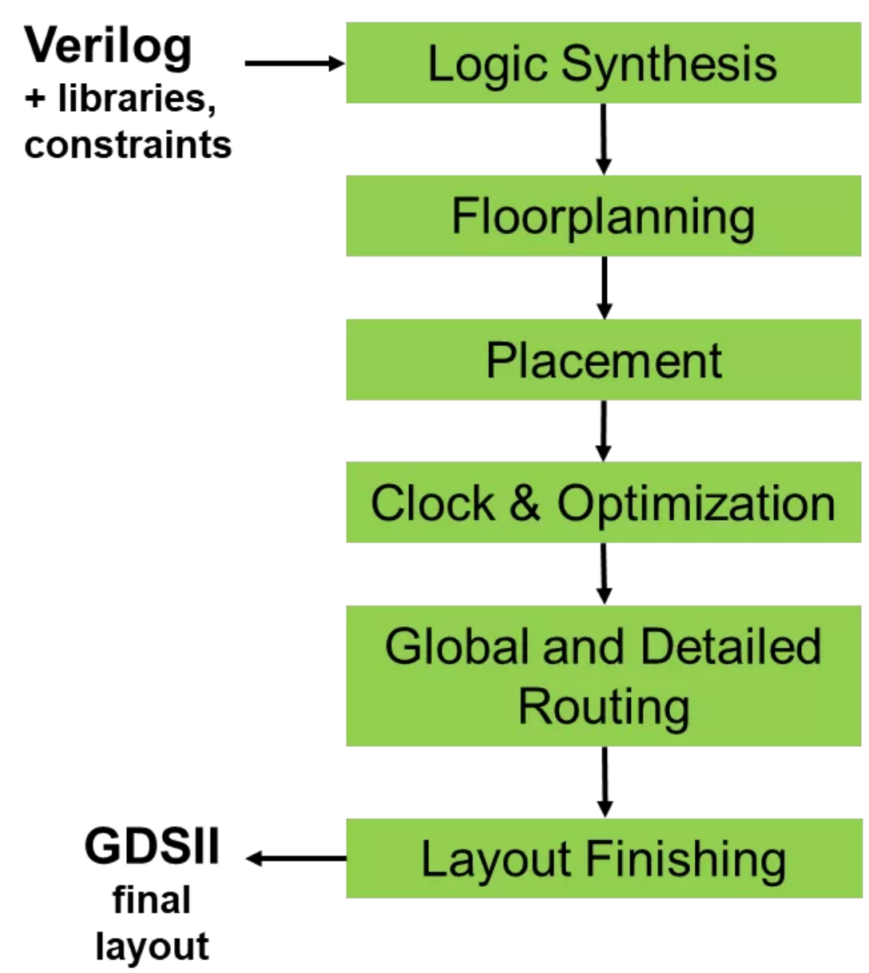
Today’s session: Backend flow
The RTL design is synthesized into a gate-level netlist.
Obj-2: mult3
Decide on the chip area and set memory macros location in the chip.
The synthesized gates are placed in the chip according to the floorplan.
A clock tree is generated to distribute the clock signal throughout the chip, while minimizing skew and ensuring timing requirements are met.
The global routing involves determining the overall routing paths between the blocks and macros; The detailed routing creates the actual metal interconnects between the gates.
Design rule checking: Once the routing is complete, the design is checked against a set of design rules to ensure that it is manufacturable.
Obj-1: mult2

Slide 24
Today’s session: task summary
With session_guide.pdf
Study the RUN CYCLE-ACCURATE SIMULATION and RUN BACKEND FLOW
Follow the TASKS TO BE DONE and fill in the report.docx
Copy-paste your finished /RTL/*.v into the SOLUTION folders.
Obj-1 → RTL_SOLUTION3_pipeline_basic_MULT2
Obj-2 → RTL_SOLUTION4_pipeline_hazard_MULT3
Note:
We use universal test patterns for fair grading.
Do not modify cpu_tb.v & sky130_sram_2rw.v
Do not modify *mem_content.txt

