Slide 1


Accpick was launched in 1988 …..after it became apparent that there was an increasing demand for an effective accounting solution at point of sale to assist with the management of small to medium sized businesses.
Accpick is a complete accounting solution, which addresses all POS requirements within small to medium size businesses and supports a number of enhanced features for general retail operations across various industries.

Slide 2


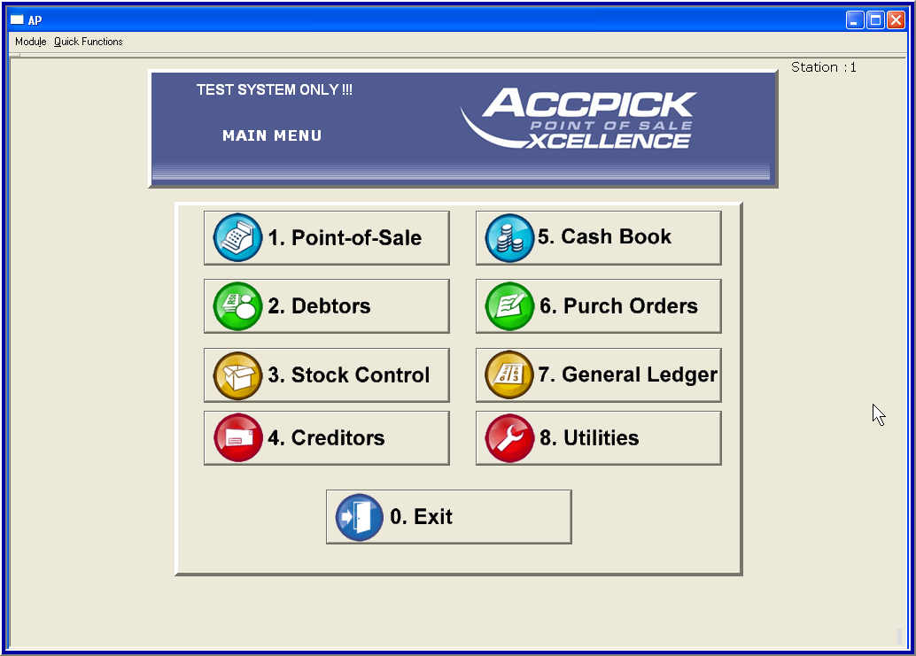
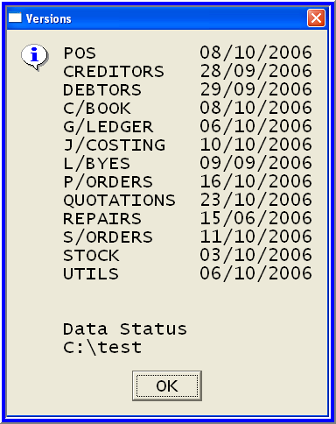

Slide 3
DATA PROCESS
POS
POINT OF SALE
TRANSACTIONS
CASH BOOK
OTHER INCOME
OTHER EXPENSES
INVOICE
CREDIT NOTE
RECEIPT
CASH SALE
CASH RETURN
CASH BOOK
CASH BOOK
RECEIPTS FROM DEBTORS
CASH BOOK
PAYMENTS TO CREDITORS
CASH CONTROL
DEBTORS
ACCOUNTS RECEIVABLE
DEBTORS
JOURNALS
BATCH RECEIPTS
INTEREST CHARGING
CREDITORS
ACCOUNTS PAYABLE
STOCK
CONTROL
CREDITORS
RECEIVE STOCK
RETURN STOCK
INVOICE - EXP CAT
RETURNS – EXP CAT
JOURNALS
POST PAYMENTS
RFC
CASH CONTROL
PAYOUTS
PAY & UPDATE TRANSACTIONS

Slide 4


Job Costing
Salesman accompanies customer to vehicle to record details – Reg no. vehicle make, etc.
Stock is allocated to the job immediately & becomes unavailable in Normal Stock (F10) i.e. stock is transferred from Normal Stock on Hand to Stock on Jobs
Job cards stored in the system are invoices waiting to be captured when customer returns to collect vehicle & pay for the job
Time & date of job completion can be validated
Issuing of stock is controlled where the Storeman is presented with a printed job card
Useful control where stores “lend” stock to each other

Slide 5
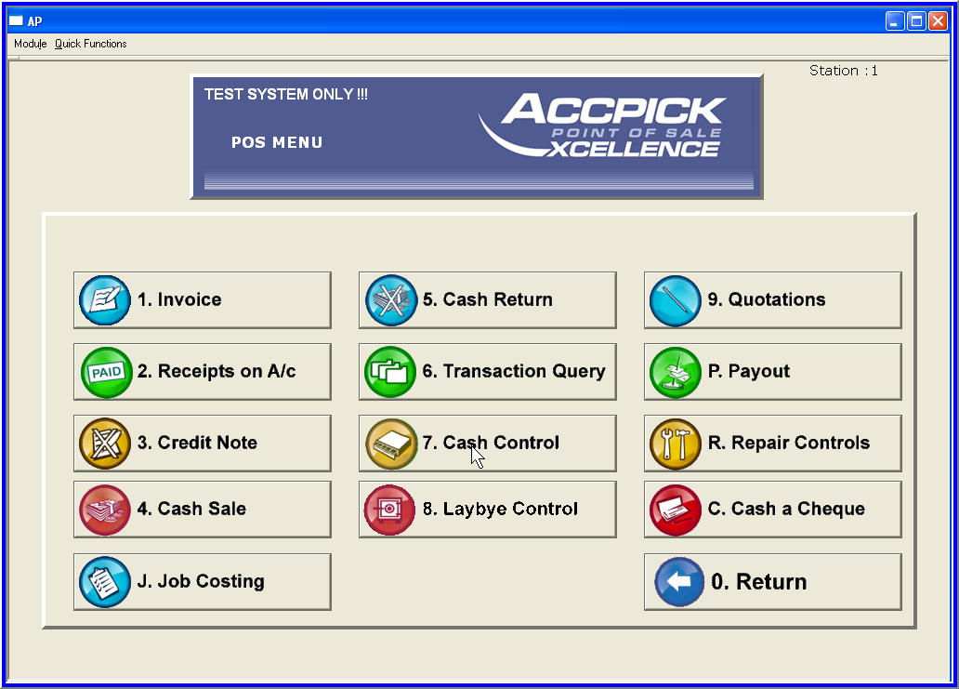
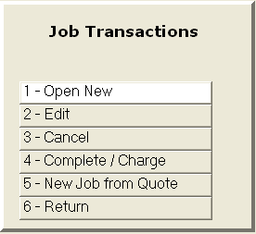
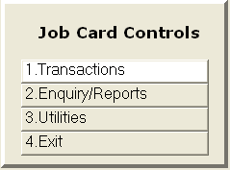
Job Costing

Slide 6

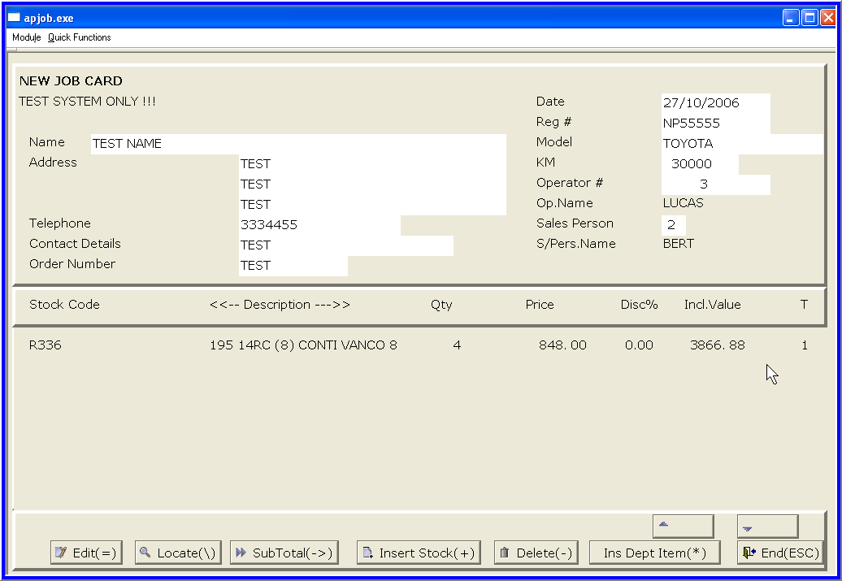

Slide 7

Debtors
Customers who purchase goods or services on account from your business & pay at the end of the month or later
These customers are invoiced & amounts outstanding are receipted when payment is made

Slide 8

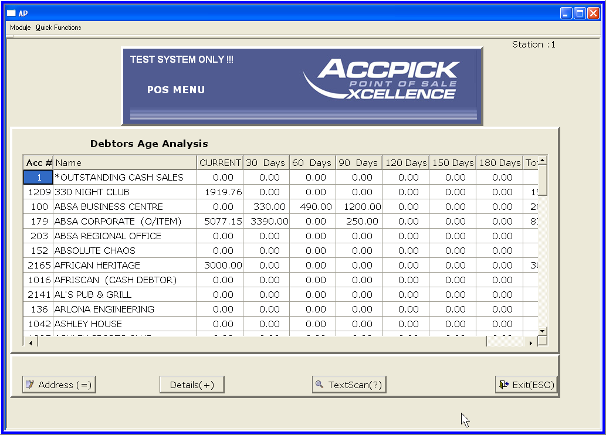
Debtors

Slide 9

Creditors
Suppliers of goods & services to your business
Your business has an account with these suppliers
Stock &/or other expenses/services from these suppliers generates a numbered GRN (Goods received note)

Slide 10
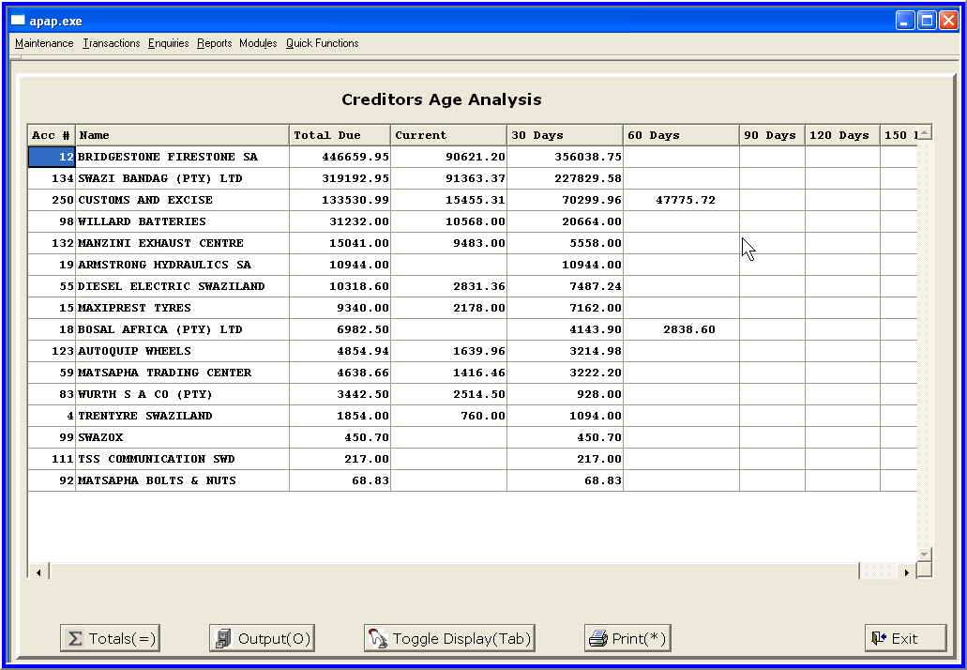
Creditors

Slide 11
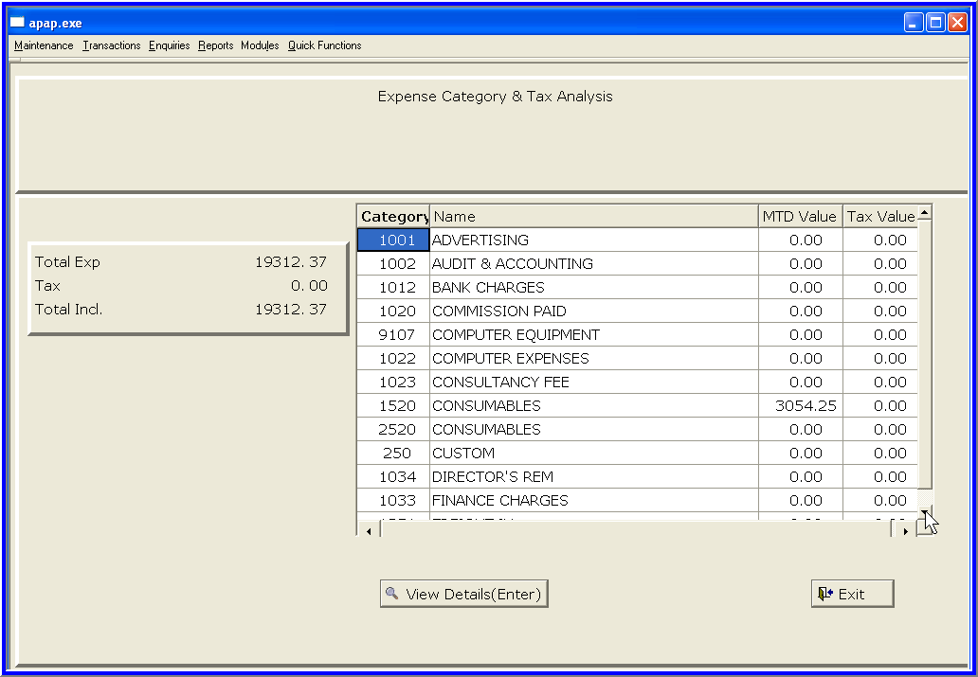
Creditors

Slide 12

Cash Book
Control of all deposits (income) into the bank account & all payments (expenses) out of the bank account
Assist in cash flow projection of the business

Slide 13




Cash Book
RECEIPTS FROM DEBTORS
(Direct Deposits)
- RD Cheques from Debtors
PAYMENTS TO CREDITORS
BANK RECON
Bank Statement is reconciled with the Cash Book
EXPENSES
Advertising
Bank Charges
Electricity
Insurance
Motor Vehicles – Petrol
Motor Vehicles - Repairs
Rent Paid
Salaries & Wages
Staff Loans
Telephones
INCOME
Cash Control (Daily Banking)
Speedpoint (Daily Banking)
Interest Received from Bank
Rebates/Product Bonus
Staff Loans Re-Paid
- RD Cheques from Cash Sales

Slide 14
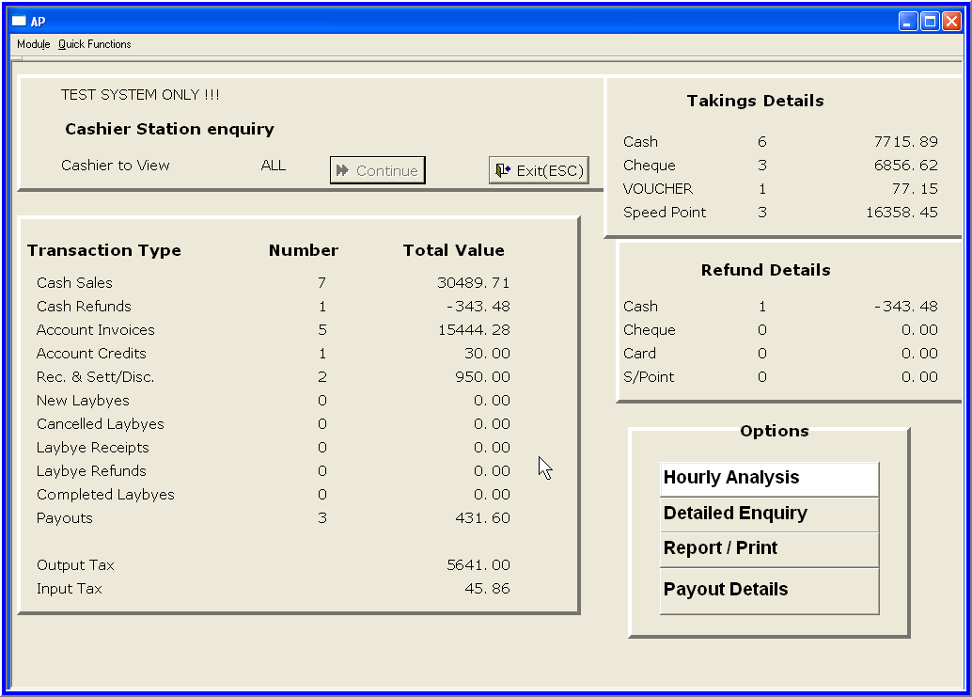
Daily Banking –
The Cash Control

Slide 15
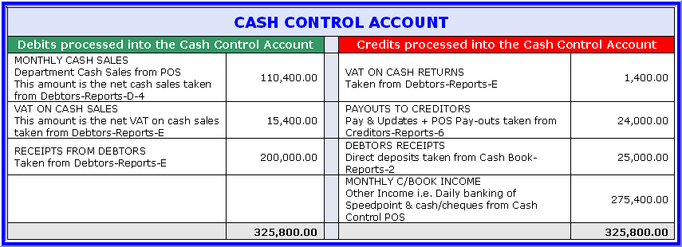
Analysis of Cash Control
THE NET EFFECT OF THE DEBITS AND CREDITS SHOULD BALANCE TO ZERO.
Reasons why Cash Control may not balance back to zero:
Where the Month End for All Modules excluding the Cash Book has been processed, there should be no further entries processed in the Cash Book relating to Payments to Creditors and/or Receipts from Debtors prior to month ending the Cash Book i.e. only Other Income or Other Expenses ought to be processed.
Cash not banked for cash sales and not recorded as Payouts or Pay & Update transactions.
Cash sale monies received on the last day of the month and only banked on the 1st day of the new month that were not reflected as deposits in the Cash Book for the last trading day.

Slide 16
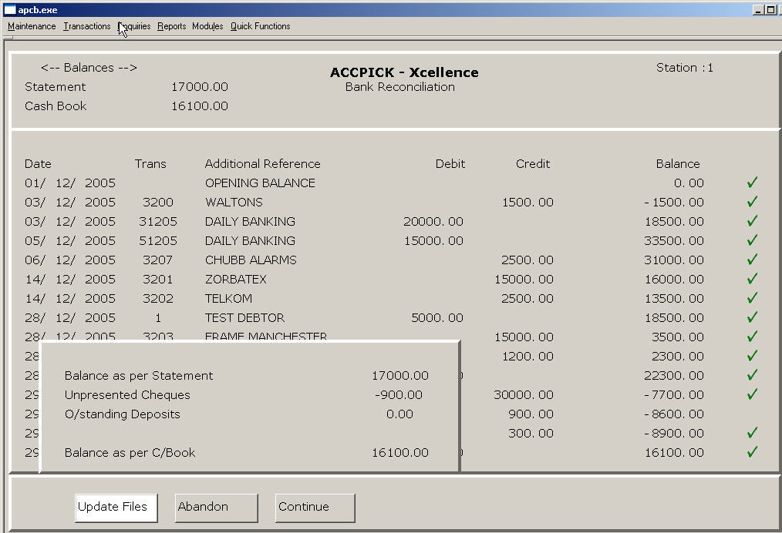
Cash Book

Slide 17

The General Ledger
A business is established to make a profit
Management need to know if this primary goal is being achieved
This information is disclosed in the Income Statement (Profit & Loss Account)
The Balance Sheet discloses whether available financial resources have been effectively applied

Slide 18
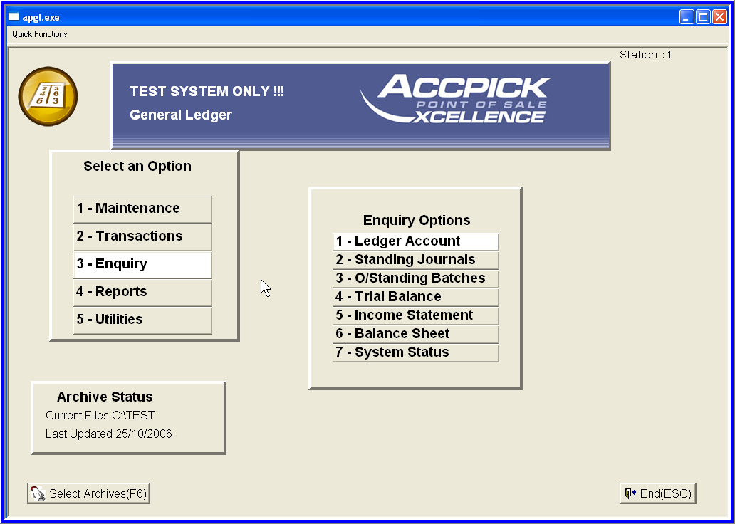
The General Ledger

Slide 19






Accpick POS
Best Value !
POS
DEBTORS
STOCK
CREDITORS
CASH BOOK
POINT OF SALE
ACCOUNTS RECEIVABLE
STOCK CONTROL
ACCOUNTS PAYABLE
CASH BOOK
Month
GENERAL LEDGER
All modules
Free!
Pay as you go
TRIAL BALANCE
INCOME STATEMENT
BALANCE SHEET

Slide 20
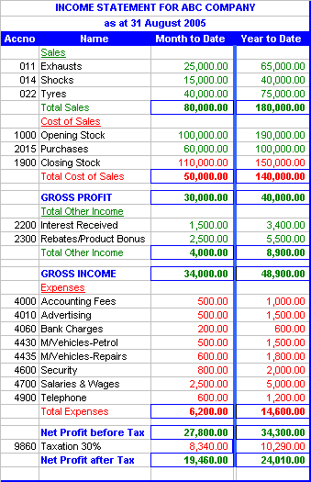
Formula:
Sales
- Cost of Sales
= Gross Profit
+ Other Income
= Gross Income
Expenses
= Net Profit before Tax
Taxation
= Net Profit after Tax (YTD amount to Retained
Income Current Year in the Balance Sheet)

Slide 21
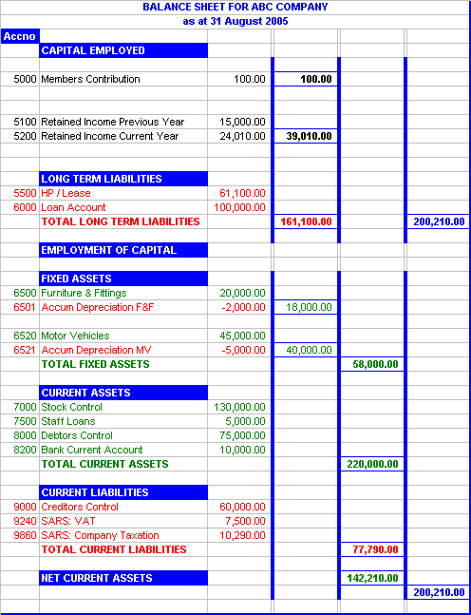
Formula:
FIXED ASSETS + NET CURRENT ASSETS
= CAPITAL EMPLOYED + LONG TERM LIABILITIES

Slide 22
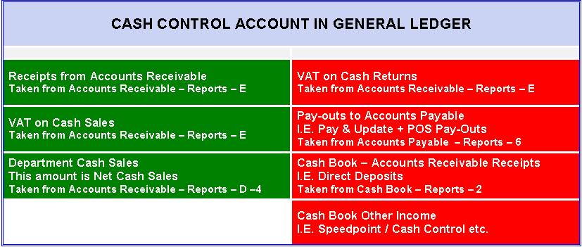
The Cash Control Account in General Ledger
The net effect of the debits and credits should balance to zero.
Reasons why Cash Control may not balance back to zero:
Where the Month End for All Modules excluding the Cash Book has been processed, there should be no further entries processed in the Cash Book relating to Payments to Creditors and/or Receipts from Debtors prior to month ending the Cash Book i.e. only Other Income or Other Expenses ought to be processed.
Cash not banked for cash sales & not recorded as Payouts or Pay & Update transactions.
Cash sale monies received on the last day of the month and only banked on the 1st day of the new month that were not reflected as deposits in the Cash Book for the last trading day.

Slide 23


Stock Take
Procedures
Print Stock Take Forms by Department
Physical Count
Capture physical count into the system – Stock Take
Print Variance Report by Department
Backup Data
Stock Take Update
Before Trading: i.e. right now
After Trading: i.e. after the date & time of the Stock Count

Slide 24
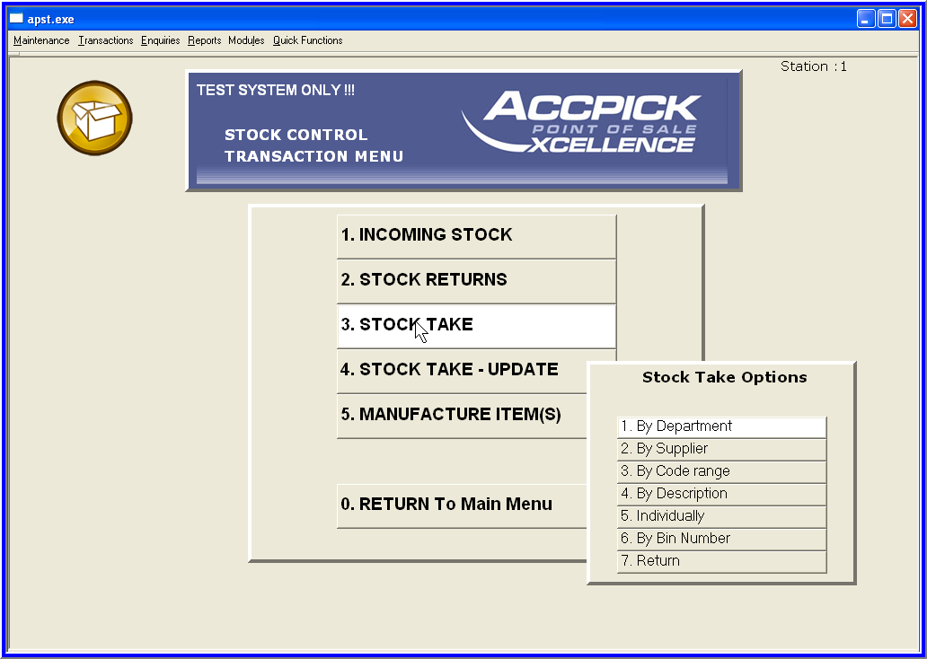
Stock Take
Procedures

