Slide 1
Unemployment and crime
November 29, 2018 Chris brady, dawit hailu, Horace Lin

Slide 2
AGENDA
Project Background
Methodology/Data Sources
Results/Conclusions

Slide 3
Questions
Define unemployment:
1-90 days
91-180 days
more than 180 days
Define crime :
Any crime
Violent crimes
Theft
Drug offenses
Drunken driving
Crime rates by time:
Which year?
Which months of the year (holiday season, summer…)
Which days of the week (weekdays? weekends
Day time/night time
Save PNG images of your visualizations
Use API ,for the primary research questions
Summary of major findings
Analysis
• Does the data/empirical analysis reveal large and statistically significant effects of unemployment on several types of crime.
• What is the magnitude of the effect is similar across different races, age, gender

Slide 4


Project Background
The unemployment rate in the United States has decreased from 9.9% in 2010 to 3.7% in 2018
Locally, did we see a reduction in crime rate that could be explained by the falling unemployment rate?

Slide 5
Methodology
Monthly Unemployment data
CA EDD website API
JSON requests for 4 areas
CA, OAK, SF, LA
Create DataFrame to hold EDD Data
Add column for crime rate

Slide 6
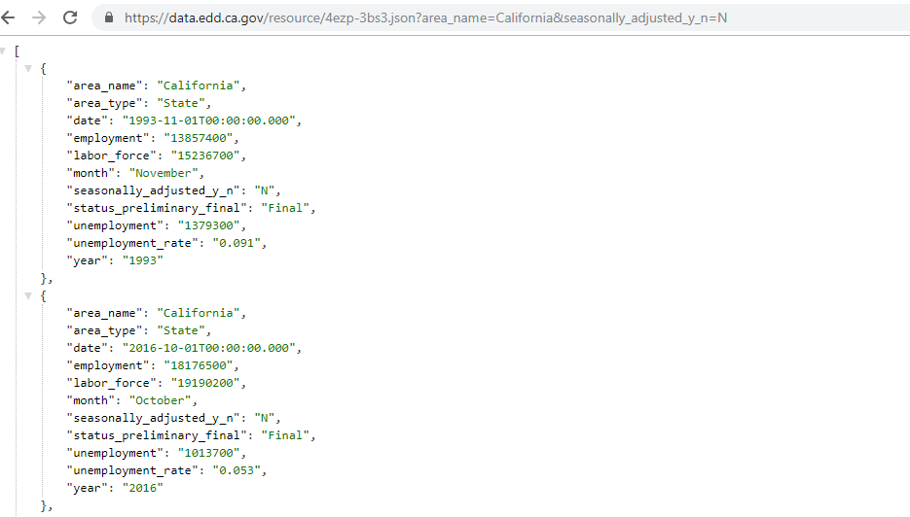
Methodology
https://data.edd.ca.gov/resource/4ezp-3bs3.json?area_name=California&seasonally_adjusted_y_n=N

Slide 7
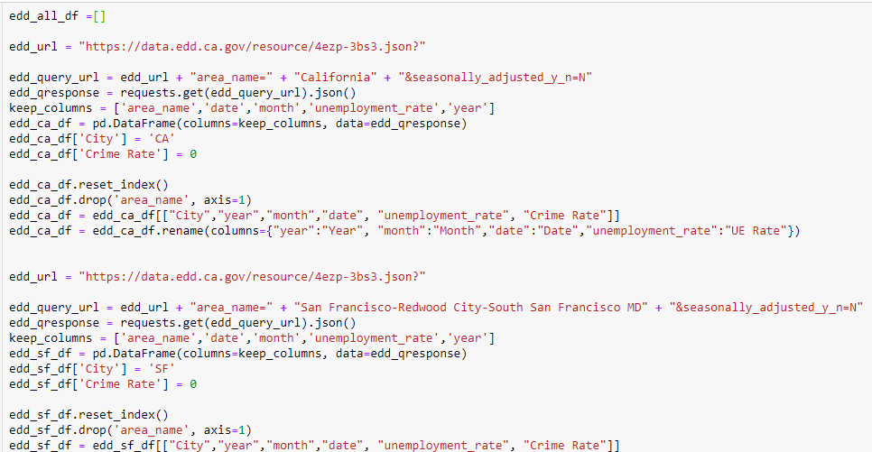
Methodology

Slide 8
Methodology
Crime Rate Information
CA Dept of Justice (.csv file)
Total annual crimes for 4 regions
FBI Uniform Crime Reporting Statistics
San Francisco Open Data
Oakland Open Data
Populations for regions by year from the web (est.)
Total crimes / Population / 100k

Slide 9
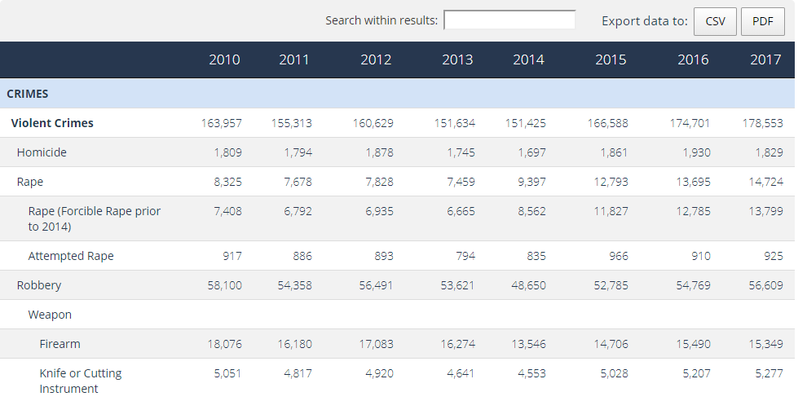
Methodology
https://openjustice.doj.ca.gov/crime-statistics/crimes-clearances

Slide 10
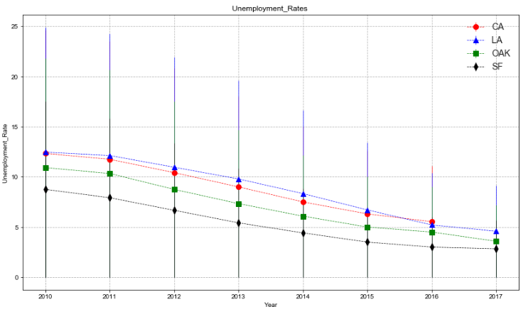
Results – Unemployment Chart

Slide 11
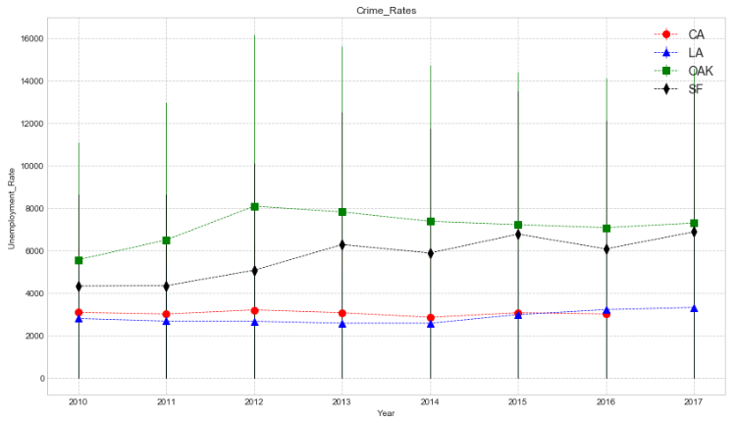
Results – Crime Rate Chart

Slide 12
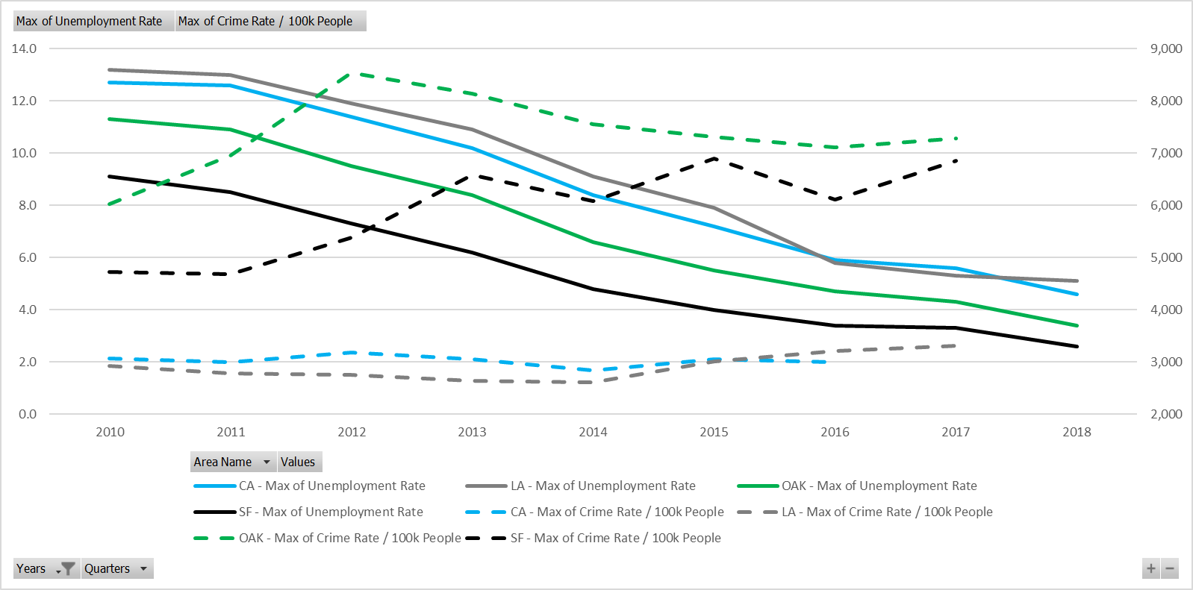
Results – Chart 4 (ALL)

Slide 13
Conclusion
While data for Oakland appeared to show a correlation between unemployment and crime rate, it was not consistent.
Also, the other regions were inconclusive.
Based on this analysis, we cannot conclude there is a relationship between unemployment and the crime rate.

Slide 14
DATA SOURCES
CA Employment Development Department
Local Area Unemployment Statistics
API: https://data.edd.ca.gov/resource/4ezp-3bs3.json
CA Department of Justice
Crimes and Clearances Statistics
SFPD Incident Reports
API: https://data.sfgov.org/resource/cuks-n6tp.json
USDOJ Uniform Crime Reporting Statistics
Agency Reported Crime

Slide 15

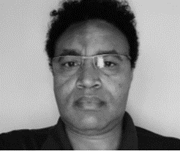

Team
Chris Brady
Dawit Hailu
Horace Lin
COO
COO
COO
UC Berkey Extension
Data Visualization
Coding Bootcamp
UC Berkey Extension
Data Visualization
Coding Bootcamp
UC Berkey Extension
Data Visualization
Coding Bootcamp

Slide 16
Thank You
BHL Data LLC.

