Slide 1
TMDBot
Desmond Teo, Hua Ting, Yu Rong

Slide 2
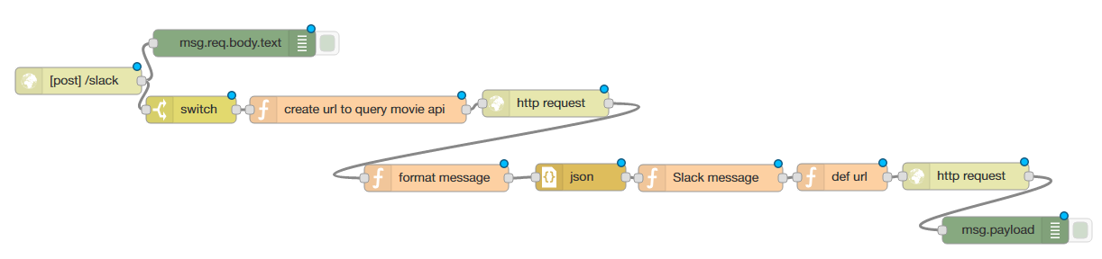
TMDBot
Messaging Bot
Helps users find out the rating scores of their desired movie
Utilizing Node-Red, The Movie Database API, Slack Webhook

Slide 3
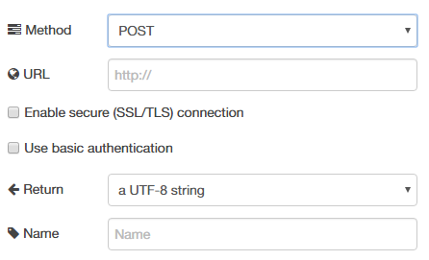
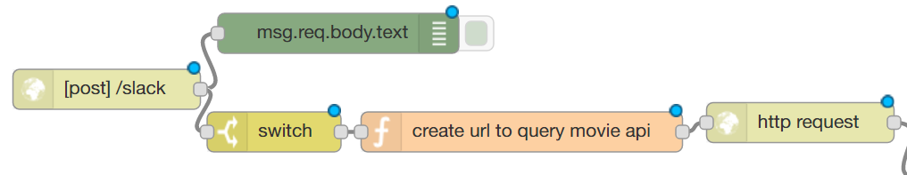
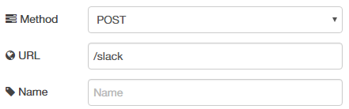
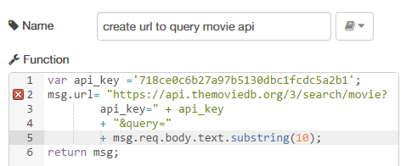
Logic Flow I

Slide 4
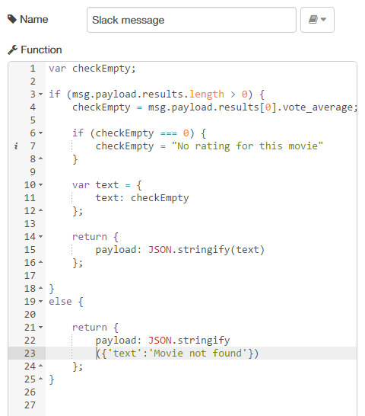
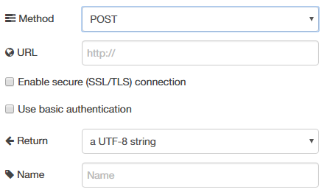
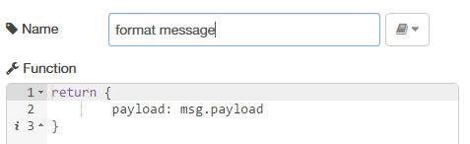
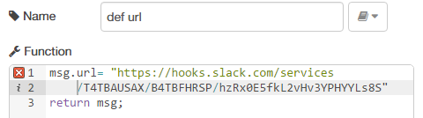
Logic Flow II

Slide 5
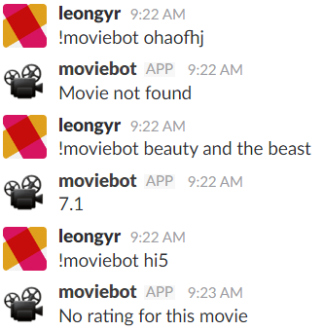
Sample
Checks if the movie is valid, or if there is a rating for the movie
Returns the ratings for a valid movie

