Slide 1
Gridlock Prevention 101
Dizahack presents…

Slide 2


How much longer?
Are you tired of waiting
in line for traffic to
move through?

Slide 3
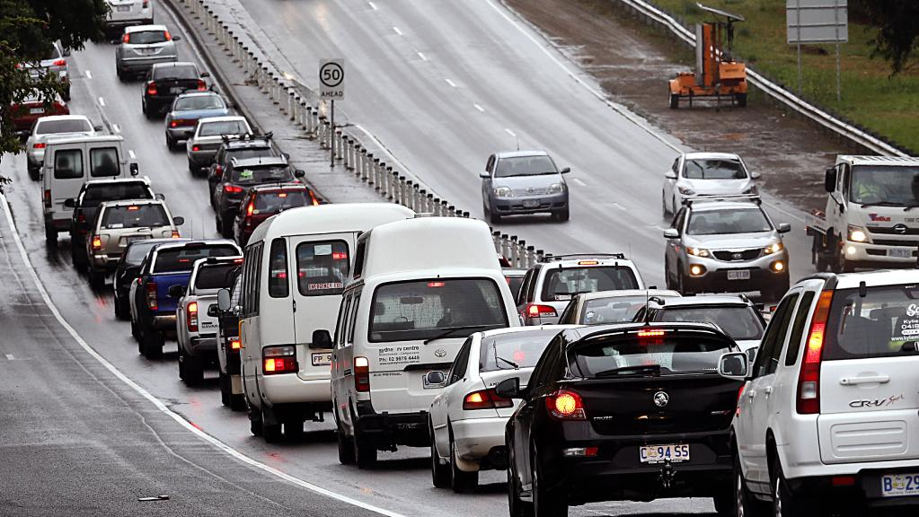
Are you tired of the same monotonous unnecessary waiting
period?

Slide 4
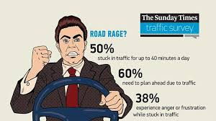
Isn’t it high time someone did something about it?

Slide 5
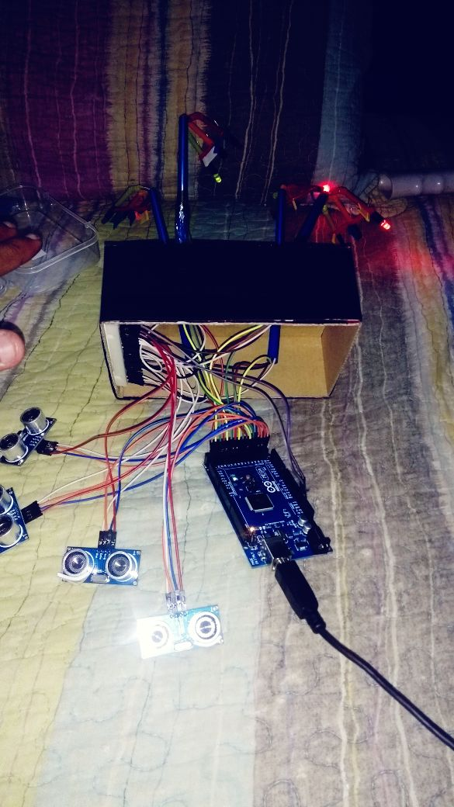
We’ve come up with a solution!

Slide 6
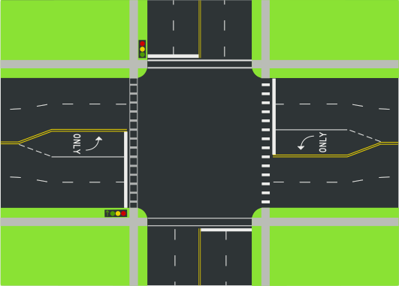
Initially all lights are green when no traffic is present on any lane
Case 1

Slide 7

Checks for cars on all three lanes
Case 2

Slide 14
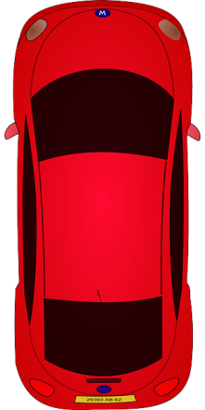
Checks all lanes for cars
Case 3

Slide 15

Detects presence of another car on the lane

Slide 16
South gets higher priority hence turns green first

Slide 24
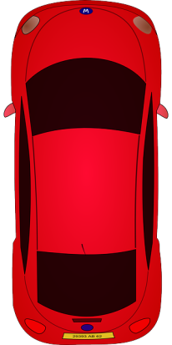
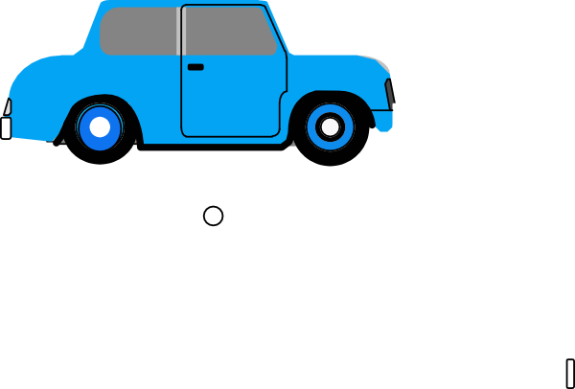

Case 4
All four lanes have cars

Slide 25

Lights turn green according to the priority north, west, south, east

Slide 28

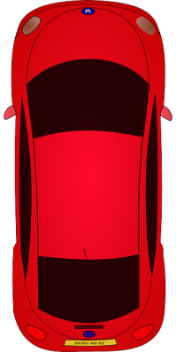

Slide 32


Slide 35


Slide 39


Slide 40
Not satisfied with the miniature model ? How about a simulation of traffic on a large scale basis

Slide 41
advantages
Since it doesn’t depend on the usual timer circuit used unnecessary traffic can be avoided
Future implementation can use autonomous cars which automatically avoid traffic using ‘gridlock prevention 101’ logic
Priority can be allotted for lanes by measuring the congestion in traffic using monitors or piezoelectric sensors

Slide 42
Hardware and software used
Arduino / Genuino UNO R3
ATMega328
HC-SR04 ultrasonic sensors
Sumo using python script (Simulation of project)
Arduino for the program code
Fritzing for framework implementation
Graphic design using PowerPoint
Light Emitting Diodes as signal indicators

Slide 43
Thank You
By Rohan , Yash , Sanjana

