Slide 1
Application title
Version 1.0
Project Selection
PROJECT BASELINE
PRELIMINARY DESIGN Stage Gate Reviews
Presented By:
Project Manager:
Notes:
The Operational Readiness Review is a formal inspection conducted to determine if the final IT solution that has been developed or acquired, tested, and implemented is ready for release into the production environment for sustained operations and maintenance support.

Slide 2
PROJECT STAGE GATE REVIEW STATUS
Stage Gate Review | Review Date | Status
Project Selection | <insert date>
Project Baseline Review | <insert date>
Preliminary Design Review | <insert date>
Operational Readiness | <insert date>

Slide 3
PROJECT OVERVIEW
Project Manager:
Project Sponsor:
Project Description:
Number of anticipated users:
Impact on the organization:

Slide 4
PROJECT OVERVIEW: Current status
Application has been developed ?
Worked with ? of OEB platform team to get application into Monarch
On QA server: QA link
Working with ? regarding security
Other applicable information

Slide 5
BUSINESS OR RESEARCH NEED
Limitations:
Limitations of current technology
Challenges:
Challenges in over coming limitations

Slide 6
BUSINESS OR RESEARCH NEED (cont.)
Why is this application/algorithm important? How does it overcome current technology or scientific limitations?
Provide application screenshots and/or high-level work flow

Slide 7
PROJECT SCOPE
Examples:
The web version of xxxx application will be freely available on the Internet as the interactive figures of the main paper to be submitted soon.
A standalone version xxxx application will be distributed as a standalone R Shiny package on GitHub with full functionality.
Provide detailed user tutorial
Allow communication between xxxx application development team and users

Slide 8
PROJECT MANAGEMENT PLAN SUMMARY
Executed by ?
Guided by the PI
Based on requirements from the PI or other <lab> users.
Monitored by PI through regular meetings/demos and feedback
from other <lab> colleagues.
v.1.0 is estimated to be complete and in prod env in <date>
(behind “firewall”)
Live to the public after passing security review by ISSO and passing
Operational Readiness stage gate

Slide 9
INITIAL RISK CATEGORIZATION
Example:
LOW
Temporary authentication required during review process of the main paper, but will be removed after publication.
Anonymous user access
User input data will not be saved
Notes:
9
Is this FIPS 199 categorization?

Slide 10
IDENTIFIED RISKS
Identify Risks specific to this project
Assess probability of occurrence and potential impact if risk becomes an event (Low, Medium, High)
Identify strategies to avoid, transfer, or mitigate potential risks
Risk | Probability (L, M, H) | Impact (L, M, H) | Mitigation Strategy

Slide 11
BASELINE OCICB PROJECT COST
Example:
OEB support = ? hours (moving to production environment)
SEB support = ? hours (review/assembly of security documents and package)
BCBB support = ? hours (assisting with standard look and feel; shepherding the
product through EPLC/security; analytics)
*We believe that OCICB resource cost going forward will be minimal
Notes:
11

Slide 12
BASELINE PROJECT SCHEDULE
EPLC gates
Operational Readiness Review <date>
Anticipated release
Version 1.0 <date>

Slide 13
DELIVERABLES PRODUCED
Example:
Software deliverables:
A web application
A standalone R Shiny package (to be placed on GitHub)
Code
User manuals
2. EPLC required documentation
3. Initial security docs

Slide 14
PROJECT SECURITY EVALUATION
E-authentication threshold analysis results
- reviewed and discussed with SEB <date>
NIH System Categorization (FIPS 199/NIST 800-60 SYSTEM CATEGORIZATION)
- reviewed and discussed with SEB <date>
Privacy Data (based on Privacy Impact Assessment)
- reviewed and discussed with SEB <date>

Slide 15
Phase | Deliverable | Estimated Completion Date
Initiation | Business Needs Statement | <date>
Concept | Business Case | <date>
 | Business Process Models | <date>
 | Project Charter | <date>
 | Project Management Plan | <date>
 | Project Schedule | <date>
 | Work Breakdown Structure (WBS) | <date>
 | Initial Security Planning Documentation | <date>
Planning | Privacy Impact Assessment | <date>
 | E-Authentication Threshold Analysis | <date>
Requirement Analysis | Requirements Document | <date>
Design | Design Document | <date>
 | Computer Match Agreement | <date>
 | Test Plan | <date>
 | Contingency/Disaster Recovery Plan | <date>
 | System of Record Notice | <date>

Slide 16
Phase | Deliverable | Estimated Completion Date
Development | O&M Manual | <date>
 | Systems Security Plan | <date>
 | Security Risk Assessment | <date>
 | Training Plan | <date>
 | Training Manuals | <date>
 | User Manual | <date>
 | Business Product | <date>
 | Validation Readiness Review | <date>
 | Independent Validation & Verification Assessment | <date>
Test | Implementation Plan | <date>
 | Test Reports | <date>
Implementation | Authority to Operate | <date>
 | SLA/MOUs | <date>
 | Project Completion Report | <date>
 | System Certification | <date>
 | System Accreditation | <date>

Slide 17
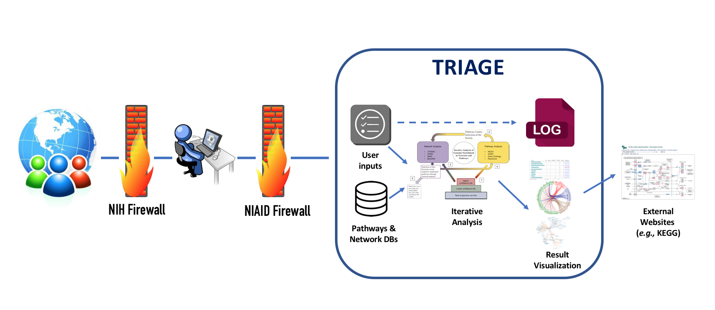
DESIGN OVERVIEW

Slide 18
ENTERPRISE RESOURCE REQUIREMENTS
Example
Local machine
Dev:
Monarch
Cloud QA:
Application: 1+ Docker containers running on QA ECS Cluster
1 x Application Load Balancer
Internal & External Route 53 Records
1 x S3 Bucket (stores application deployment configuration)
1 x DynamoDB table (supports application deployments)
1 x Logentries QA LogSet
Cloud Prod:
Application: 1+ Docker containers running on Prod ECS Cluster
1 x Application Load Balancer
Internal & External Route 53 Records
1 x S3 Bucket (stores application deployment configuration)
1 x DynamoDB table (supports application deployments)
1 x Logentries Prod LogSet
1 x DataDog External Site Monitor
External niaid.nih.gov DNS record provided by CIT
Source: OEB

Slide 19
Questions?

