Slide 1
Web-Based Lemery Colleges Student Affairs and Services with Android Support
Group 8 (John Cris Balbacal, Rhea Mae Magsino, Roizhel Reyes)

Slide 2
Table of contents
Chapter 1
Chapter 2
Project Context
Purpose and Description
Statement of the Problem
Objective of the Study
Scope and Limitation of the Study
Technical Background
Related Literature and Related Systems

Slide 3
Table of contents
Chapter 3
Operational Framework
HIPO CHART
Respondents of the Study
Sample Screenshot/Video of the System

Slide 4
Chapter 1

Slide 5
Project Context
As the world advances, technology has become an integral part of our daily lives. It makes our lives more efficient and convenient when it comes to work and school related activities.
According to Hoyt J. (2021), Student affairs and services can make the difference whether students succeed in college and realize their vision for future career.

Slide 6
Project Context
Student affairs and services in various schools also encounter problems.
The system makes the manual process of services computerized and will bring significance and convenience to the Office of the Student Affairs and Services.

Slide 7
Purpose and Description
The Student Affairs and Services is one of the busiest and hectic offices in the school. With that, the staff and officers assigned in the office encounter problems in school.
The system has the capability to lessen the amount of work required in processing documents and forms of the students for the services they need.

Slide 8
Statement of the Problem
This study aims to answer the following questions:
1. What are the common problems encountered by the staff and students in the manual process of providing and availing student services?
2. What are the benefits of the system "Web-Based Lemery Colleges Student Affairs and Services with Android Support" to the students and teachers of Lemery Colleges?

Slide 9
Statement of the Problem
This study aims to answer the following questions:
3. How can the developed system be assessed using the ISO 9126 standards in terms of:
3.1 Efficiency;
3.2 Accuracy and;
3.3 User-Friendliness?

Slide 10
Objective of the Study
1. To assess the problems encountered by the staff in terms of providing and the students in terms of acquiring student services manually.
2. The system has benefits to the teachers and students of Lemery Colleges that will deliver huge contributions in terms of better organization and utilization of student's record or information.

Slide 11
Objective of the Study
3. The developed system was able to assess using the ISO 9126 standards in terms of efficiency, accuracy and user-friendliness.

Slide 12
Scope and Limitation of the Study
This study mainly focused on the student services of the school such as the Guidance and Counseling, Discipline Office, Medical and Dental Office and the Student Organization.
The system allows the staff of the Office of Student Services to manage records easily, make announcements through SMS Notifications.
The system also provides a downloadable form for the students to easily fill-up. The form can also be printed for documentation.

Slide 13
Scope and Limitation of the Study
Only the students from Lemery Colleges can log-in and access their portal on the system. It is only intended for the staff and students of Lemery Colleges.

Slide 14
Chapter 2

Slide 15
Technical Background
The programmers use various application software to create the web-based system. To implement the web-based system, HTML, CSS, PHP, JavaScript, Bootstrap, Microsoft Visual Studio, MYSQL, and XAMPP will be used as programming languages. SMS API is also essential for the implementation of notifications.

Slide 16
Related Literature
According to Hoyt, J. (2021) "The Critical Role of Student Affairs and Academic Support Services in Retention Efforts" states that the connections established in college are transformative and redirect people's lives to make lasting impacts on others and in the world.
As stated by with Zhu R., et al. (2020) "Design of Student Affairs Management Platform Based on College System" as an effective carrier of quality education, the management mode of the college system has been gradually implemented by more and more colleges and universities.

Slide 17
Related Literature
As stated by Schreiber, B., et al. (2021) “Student Affairs and Services during Covid‑19 in Africa: Mitigating the Pandemic’s Impact on Student Success” discusses that the Covid‑19 pandemic has highlighted the challenges that present obstacles to equitable learning and development in higher education in various parts of the world.
According to Jasmis J., et al. (2021) the university is a place where students are taught to be an independent person, especially in decision-making. All activities carried out at a university are different from the secondary and primary levels because all student activities at the university are carried out by the students themselves under the purview of the Student Affairs Division UiTM Melaka Branch (UiTMCM).

Slide 18
Related Systems
According to Adigun, S. O., et al. (2022) "An Excutable Model for Student Registration System using Timed colouredPetrinets" is for the Student Registration System for Universities (SRSU) as a kind of management information system that cannot only record the information for student registration each term quickly and efficiently, but also do statistics on the students' basic information, registration information, and payment information and give results of the analysis.
According to Sari, I. P., et al. (2020) “Web-based Educational Administration System for Student Affairs” is a student administration system based on website and its database using the prototype method with CodeIgniter framework and MySQL for the database to create data-driven decision making for student affairs.

Slide 19
Related Systems
According to Rasyidah, R., et al. (2020) “Web-Based Information System for Student Affairs Letter Management” to create the official student affair letters in the Padang State Polytechnic computerized. Because of the manual system, students have to queue and it takes a long time. With this developed system, there is no longer a queuing process at the counter, students can fill out a form through the system and will receive a notification when the official letter has been confirmed from related section.
According to Cardoza, R. & Serwelas, E. (2019) “Android-Based Doctor-Patient Appointment System” which aims to help the patient in the clinic when it comes to the process of getting an appointment with the doctor. It also helps the doctor to prevent a long line in waiting for consultation which causes overcrowding inside the clinic. The developed system will also avoid the hard time for accessing and updating the patients’ records on time.

Slide 20
Chapter 3 RESEARCH AND METHODOLOGY

Slide 21
In this chapter discuses the methodologies that used on process of system development.
The information included in this chapter is to easily understand how the system works

Slide 22
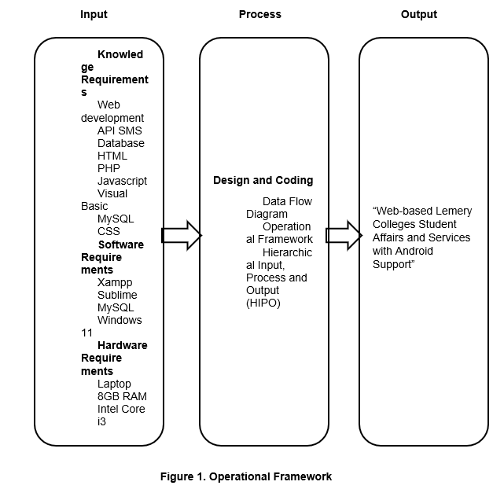
Operational Framework

Slide 23
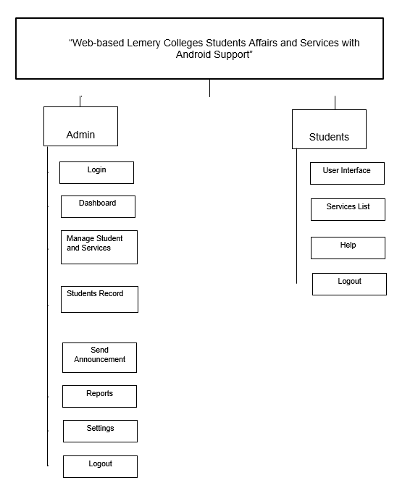
HIPO Chart

Slide 24
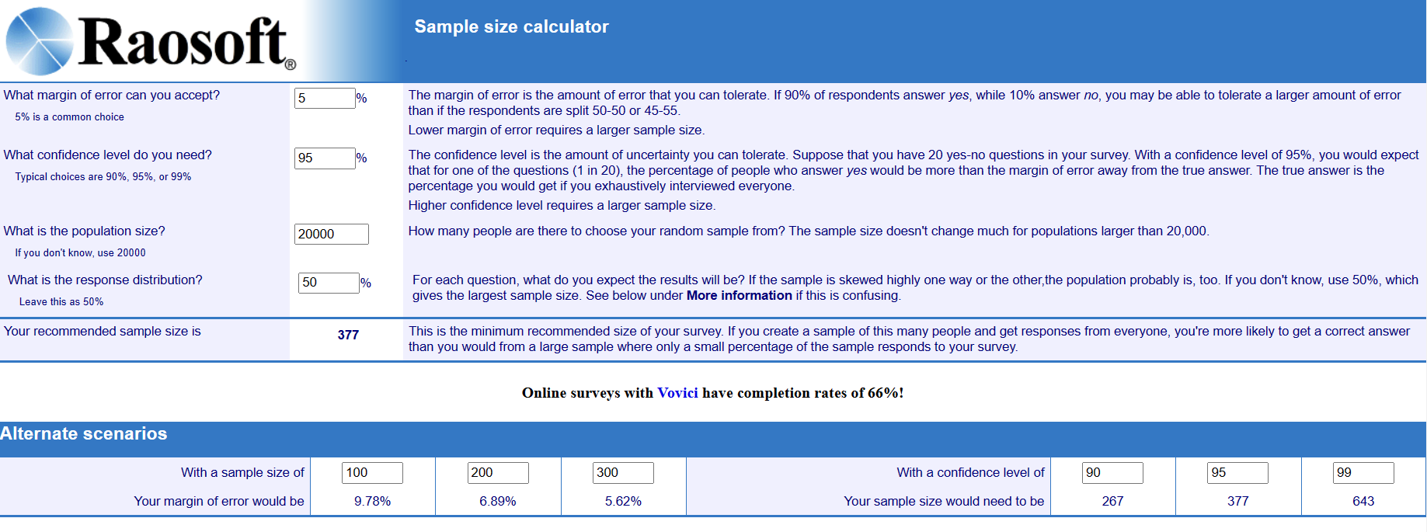
Respondents of the Study

Slide 25
Thank you

