Slide 1
Agentic Decision Intelligence Platform
SENTINEL
for B2B Staffing Operations
🎯 Planner-Orchestrated
🧠 VoI-Targeted Evidence
Dynamic agent routing, D1–D9 classification
DRE loop fetches only highest-value missing facts
S
elf-Evolving
⚖️ Multi-Objective Bidding
💡 Explainable by Design
E
nterprise
6 specialised bidders with hard compliance veto
Evidence-backed rationale, counterfactuals, precedent
N
ext-Best-Action &
T
rustworthy
🤝 Human-in-the-Loop
📈 Self-Evolving Memory
I
ntelligence
2-checkpoint sign-off; nothing auto-executes
Outcome-driven VoI + weight calibration over time
N
etwork for
Business Domain: B2B Staffing
E
vidence-driven
9
8
6
2
∞
L
earning
Decision Types
D1–D9
Specialised
Agents
Bidder
Agents
HITL
Checkpoints
Self-Evolving
Learning
IIM Lucknow · Hackathon PS-2 · 2025

Slide 2
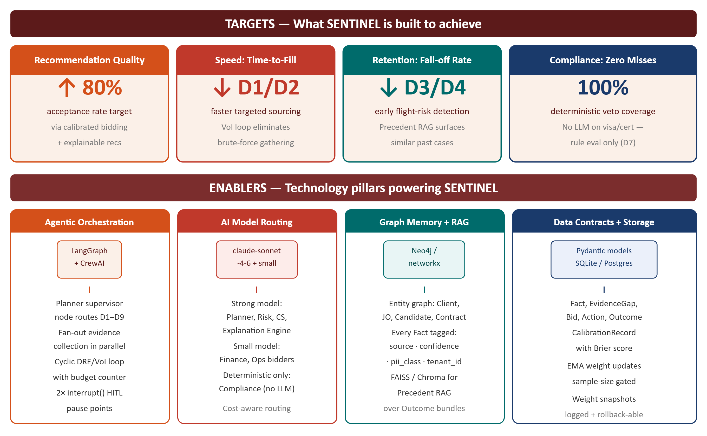
SENTINEL: Self-Evolving Enterprise Next-Best-Action & Trustworthy Intelligence Network for Evidence-driven Learning · B2B Staffing AI Platform
ISSUES
The Business Challenge
9 KEY DECISION TYPES — FULL DOMAIN COVERAGE
⚡ Fragmented Data
ATS, CRM, Email & Calls — siloed, no unified view
D1
Fulfillment Risk
D2
Candidate Shortlisting
D3
Flight-Risk / Fall-off
🔍 No Evidence Trail
Decisions lack rationale and supporting facts
⚠️ Compliance Risk
Manual checks miss visa & certification expiry
TRIGGER
TRIGGER
TRIGGER
JO open 5+ days, <2 submittals, SLA breached
New job order created — who to submit
Slow response, competing offer signal in email
TARGETS
KPI ↓ Time-to-Fill
KPI ↑ Submit→Interview Rate
KPI ↓ Fall-off Rate
D4
Contract End-of-Term
D5
Bench Monetisation
D6
Account Health / Churn
ENABLERS
TRIGGER
TRIGGER
TRIGGER
Contract end within 30/60 days
Candidate idle on bench > N days
Drop in requisitions, negative QBR sentiment
KPI ↑ Renewal Rate
KPI ↓ Bench Days
KPI ↑ Client Retention
D7
Compliance Exposure
D8
Pricing / Margin
D9
Cross-sell / Upsell
TRIGGER
TRIGGER
TRIGGER
Visa/certification expiring within X days
Client pushes back on rate; market rate shifts
High satisfaction + growing client headcount
KPI ↓ Compliance Incidents
KPI ↑ Gross Margin
KPI ↑ Revenue per Account
Each decision request is classified by the Planner Agent — classification drives which evidence checklist, agents, and VoI weights are applied
SENTINEL:
A Self-Evolving Enterprise NBA Platform that transforms recruiter/AM interactions into explainable, evidence-backed decisions — with human-in-the-loop sign-off, multi-objective bidding, and a continuous learning loop that gets smarter with every outcome.
Dynamic Planner + Agent Orchestration
Shared Evidence Memory Graph
Decision Readiness Evaluator (DRE) + VoI Loop
Multi-Objective Bidding Layer
Explainable Recommendations + HITL
Continuous Learning from Outcomes

Slide 3
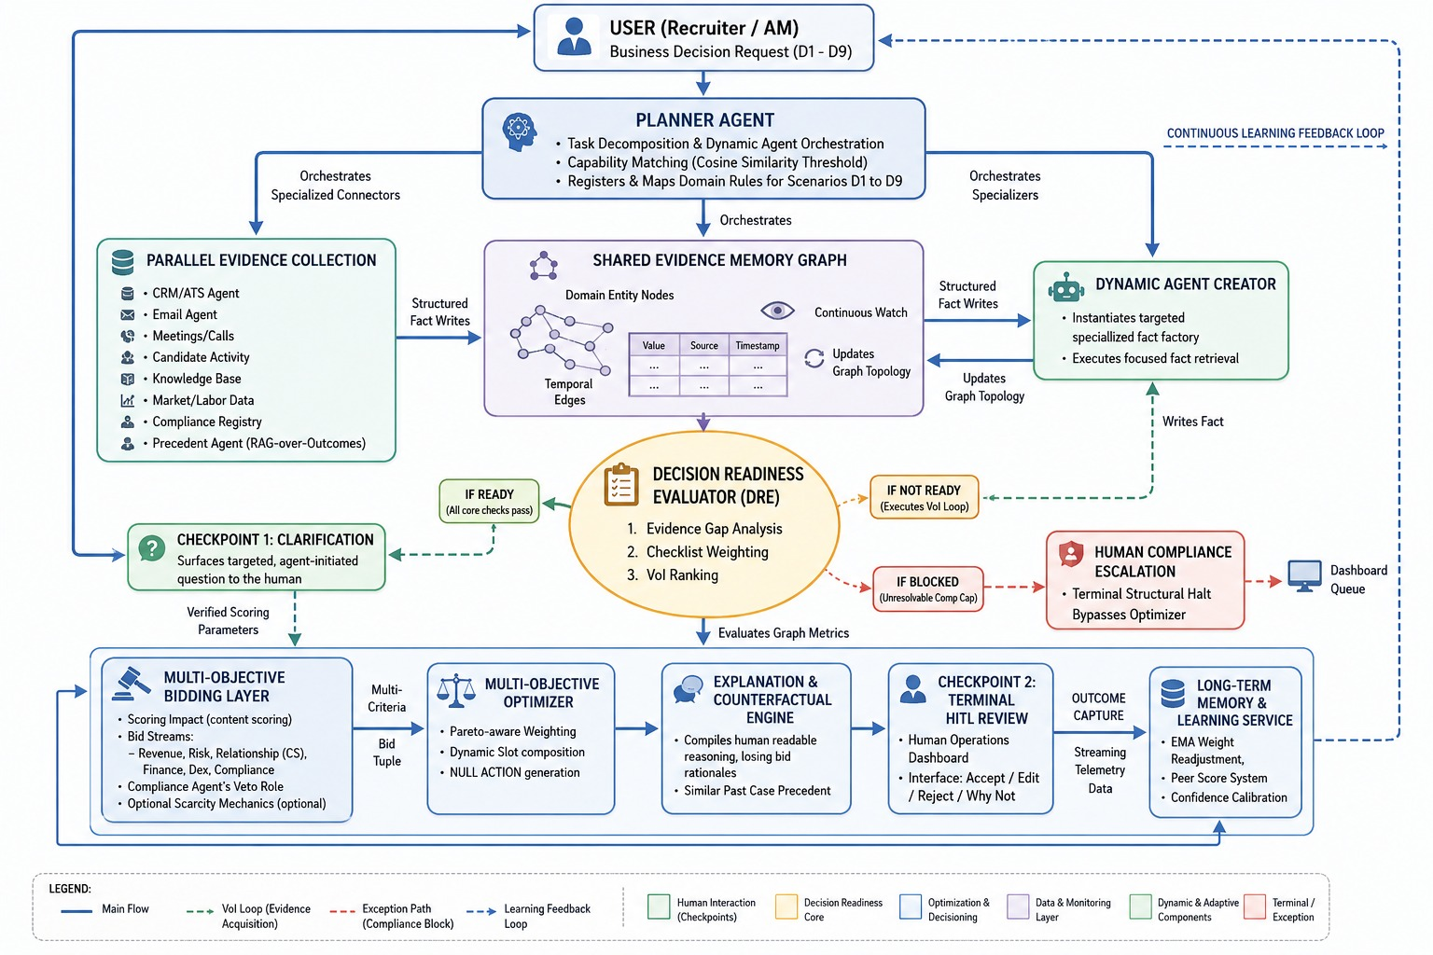
SENTINEL Architecture: Intelligent Agentic Decision Pipeline — Planner → Evidence → DRE/VoI Loop → Bidding → Explanation → HITL → Self-Evolving Learning

Slide 4
SENTINEL: Key Innovation Pillars — What makes this genuinely intelligent — not just RAG or a chatbot
CORE DIFFERENTIATOR
MULTI-AGENT DECISION MAKING
SHARED MEMORY & RAG
Decision Readiness Evaluator (DRE) + VoI Loop
Multi-Objective Bidding Layer + Optimizer
Shared Evidence Memory Graph + Precedent RAG
Per-decision-type checklist scores evidence completeness → Ready / Not Ready / Ready-with-caveats / Blocked
6 bidders: Revenue · Risk · Customer-Success · Finance · Compliance (hard veto) · Ops/Productivity
Graph store: entity nodes (Client, JobOrder, Candidate, Contract) + temporal edges with relationship types
Evidence Gap Analysis: ranks missing facts by weight × (1−confidence) — highest-impact gap fetched first
Every bid = (score 0–1, rationale, confidence, evidence_refs) — normalized common scale across ALL bidders
Every fact tagged: value · source_agent · confidence · timestamp · evidence_ref · pii_class · tenant_id
Dynamic Agent Creator: spins narrow single-purpose agent for ONLY the top-ranked gap — no brute-force
Compliance Agent: ALWAYS deterministic rule eval — NEVER an LLM call (irreversible veto power)
Contradiction Detector: flags conflicts from different sources; caps contradicted fact's confidence; can flip Ready → Not Ready
Blocked = terminal → Human Compliance Escalation; bypasses optimizer entirely
Optimizer: Pareto-aware weighted aggregation + typed slot composition — not a free-form LLM call
Precedent Agent: vector search over past Outcome+Fact bundles → top-k similar past decisions with actual outcomes
Ready-with-caveats: surfaces ONE targeted clarifying question to recruiter — agent-initiated, not passive
Null-action output: 'recommend nothing + why' is a valid explicit output — credibility signal
No-match floor: if similarity < threshold, nothing returned — no forced low-quality precedent matches
EXTENSIBILITY
EXPLAINABILITY & HITL
CONTINUOUS LEARNING
Dynamic Planner + Agent Factory
Explanation Engine + 2-Checkpoint Human-in-the-Loop
Outcome Capture + Memory Learning Service
Planner classifies request → D1–D9 (or hybrid) → decomposes into evidence sub-tasks → routes to agents
Checkpoint 1 (agent-initiated): fires on Ready-with-caveats — targeted question before recommendation finalized
Outcome model: human_decision + downstream_result + predicted_confidence + was_correct
Capability matching: cosine similarity ≥ 0.8 → existing agent; < 0.8 → templated factory spins new agent
Checkpoint 2 (terminal): Accept / Edit / Reject / 'Why not X' — nothing executes without human sign-off
Confidence calibration: Brier score = mean((pred_confidence − was_correct)²) per bidder/decision_type
New decision type: add DRE checklist + agent mapping — zero pipeline change
'Why not X': reads from already-computed Bid state — zero extra model calls, instant response
EMA weight updates gated by min sample-size per decision_type — low learning rate after gate — no noise-driven swings
New domain (SaaS/Energy): swap agent catalog + DRE checklist — Planner, Bidding, Memory all untouched
Explanation: winning rationale + losing bid reasons + counterfactuals + similar past cases from Precedent Agent
Override pattern tracking: cohort/team level ONLY — never individual-punitive without HR review step
Multi-tenancy: every Fact carries tenant_id; all memory queries tenant-scoped at storage layer
Priority queue inbox: decisions sorted by SLA-risk/urgency (not FIFO) — prevents alert fatigue
Cost-aware model routing: Compliance = deterministic; Ops/Finance = small model; Planner/Risk/CS = claude-sonnet-4-6

Slide 5
SENTINEL: Agent Catalog & Data Contracts — Every agent, its layer, inputs, and outputs — plus the Pydantic contracts that freeze component seams
REUSABLE AGENT CATALOG
DATA CONTRACTS (Pydantic Models)
ORCHESTRATION
Planner Agent
NL / structured request
Cosine ≥0.8 → existing; <0.8 → factory
Fact
TaskPlan · decision_type · agent routing
tenant_id: str # branch scope — all queries tenant-scoped
EVIDENCE
CRM / ATS Agent
Client/JO/Candidate IDs
Wraps ATS/CRM API
entity_type: Literal[Client|JobOrder|Candidate|Contract|Recruiter]
Pipeline status · account history
fact_type: str # e.g. competing_offer_signal, work_auth_status
Email Agent
Entity IDs · date range
NLP extraction, confidence-scored
value: str | float | bool | source_agent: str
Sentiment · commitments · objections
confidence: float # 0–1; human_input capped at 0.6 hard ceiling
Meetings/Calls Agent
Transcript IDs
Same pattern as Email Agent
evidence_ref: str # pointer to raw snippet (email/ATS record)
Decisions & commitments from calls
pii_class: Literal[none|standard|sensitive] # drives access scoping
Candidate Activity Agent
Candidate ID
Portal logs + timesheet patterns
Engagement & flight-risk signals
EvidenceGap
Knowledge Base Agent
Decision type · geo
Compliance rules + rate-card policy
Policy / playbook facts
fact_type: str | checklist_weight: float # hand-set VoI weight
Market/Labor Data Agent
Skill · geo
Pricing & sourcing strategy
current_confidence: float # 0.0 if entirely missing
External rate / supply benchmarks
is_compliance_relevant: bool # triggers Blocked if unresolvable
Compliance Registry Agent
Candidate/Contract ID
Feeds Compliance bidder — deterministic
Auth / cert / BGC status
Bid
Precedent Agent (RAG)
Decision type · entity
Vector search; no-match floor enforced
bidder: Literal[Revenue|Risk|CustomerSuccess|Finance|Compliance|Ops]
Top-k past decisions + outcomes
score: float # normalized 0–1 'expected positive impact' — common scale
CONTROL
Decision Readiness Evaluator
Shared memory + decision type
Blocked = terminal → compliance escalation
confidence: float # = f(own reasoning, min(evidence_ref confidences))
Ready / Not Ready / Caveats / Blocked
evidence_refs: list[str] # shared-memory IDs only — no hallucination
Dynamic Agent Creator
Top-ranked evidence gap
Templated factory — not arbitrary code-gen
is_veto: bool # Compliance only; hard-removes action ignoring score
New narrow agent instance
BIDDING
Revenue / Risk / CS / Finance / Ops
Shared memory + candidate actions
LLM call with structured output schema
Action / FulfillmentAction
score 0–1 · rationale · confidence · refs
Compliance Bidder (VETO)
Compliance Registry facts
ALWAYS deterministic — NEVER LLM
action_type: Literal[recommended|null_no_action] # explicit null output
is_veto: true/false — hard removal
candidate_slots: list[SlotAssignment] # typed slots, rule-composed
OUTPUT
Multi-Objective Optimizer
All bids
Rule-based slot composition; no LLM
composed_from: list[str] # bid IDs → traceability for 'why not X'
Typed slot-filled Action OR null_no_action
status: Literal[proposed|human_approved|human_edited|human_rejected]
Explanation/Counterfactual Engine
Winning + losing bids · precedent
Cites shared-memory facts only
Rationale + counterfactuals + similar cases
Outcome + CalibrationRecord
Memory / Learning Service
Human decision + downstream outcome
Sample-size gated; correlational v1
human_decision: Literal[accept|edit|reject]
Updated VoI priors · EMA weights · Brier
predicted_confidence: float # stated confidence at decision time
was_correct: Optional[bool] # null until downstream result known
brier_score: float # mean((pred_conf − was_correct)²) per bidder
sample_size: int # only reported once ≥ minimum threshold

Slide 6
SENTINEL in Action: End-to-End Scenarios — Concrete walkthroughs demonstrating every pipeline stage across three real staffing decision types
D1 Fulfillment Risk
D3 Flight-Risk / Fall-off
D4+D9 Contract End + Upsell
TRIGGER: JO-2291: .NET Dev @ Meridian Health — open 5 days, 1 submittal vs. 3-day SLA breached
TRIGGER: Arjun Mehta @ Vantage: 2 rescheduled calls, timesheet 2 days late, vague email language
TRIGGER: Contractor @ Orion Labs: 45 days to contract end — client also growing headcount
ISSUES
JO aging with no quality submittals
ISSUES
Candidate going quiet — low engagement signals
ISSUES
Contract end approaching — renew, convert, or release?
Bench availability unknown — low confidence in ATS
Competing offer presence unconfirmed (confidence: 0.35)
Current bill rate $85/hr vs. market $97/hr (+14.1% gap)
SOLUTION
1
Planner → CRM + KB + Market Data agents
SOLUTION
1
Email Agent extracts 'exploring options' — low confidence
SOLUTION
1
Planner: D4 primary + D9 secondary — both checklists run
2
DRE: low confidence on 'bench skill match' → VoI ranks it #1
2
Candidate Activity Agent: portal login spike, 3× profile update rate
2
DRE: D4 Ready on first pass (well-instrumented type)
3
Dynamic Agent Creator spins bench-skill-match agent → new Fact written
3
DRE: competing_offer_signal needs ≥0.6 → Not Ready; VoI ranks it #1
3
Finance Agent: bill rate below market → renegotiation opportunity
4
Compliance Agent: VETO on candidate with pending BGC (deterministic rule)
4
Dynamic Agent: deep call-note scan → 'another opportunity' phrase found → 0.68 confidence → Ready
4
Compliance Agent: work auth confirmed through extension date — no veto
5
Optimizer: re-fills backup slot after veto; Ops flags recruiter over capacity
5
Optimizer: AM retention call within 24h + pre-qualify 1 backup quietly
5
Optimizer: propose renewal + rate adjustment with market data packaged for AM
IMPACT
✓ Filled in 2 more days
IMPACT
✓ AM retention call scheduled
IMPACT
✓ Renewal proposed with rate justification
✓ Compliance veto logged correctly
✓ Backup pre-qualified silently
✓ D9 upsell flagged separately
✓ bench-skill VoI weight reinforced
✓ Fall-off outcome feeds D3 VoI priors
✓ Revenue per account ↑
HITL Checkpoint 2: Nothing executes without recruiter/AM sign-off (accept / edit / reject / 'why not X')
HITL Checkpoint 2: Nothing executes without recruiter/AM sign-off (accept / edit / reject / 'why not X')
HITL Checkpoint 2: Nothing executes without recruiter/AM sign-off (accept / edit / reject / 'why not X')
OUTCOME CAPTURE → LEARNING LOOP
VoI Weight Update
EMA Bidding Weights
Brier Score Calibration
Override Pattern Tracking
Evidence types that mattered reinforced for future same decision_type
Recalibrated per branch from real outcomes — min sample-size gated
mean((pred_confidence − was_correct)²) per bidder — batch computed
Cohort-level only; never individual-punitive without HR review

Slide 7
SENTINEL: Business Outcomes, Evaluation & Responsible AI — KPIs · Evaluation methodology · Reusability proof · Privacy & fairness safeguards · Tech stack
MEASURABLE BUSINESS KPIs
PLATFORM REUSABILITY — DOMAIN SWAP PROOF
↓ Time-to-Fill
↑ Submit→Interview
New Decision Type →
Add DRE checklist entry + map existing agents. Zero pipeline change. Planner picks up via decision_type tag.
Faster sourcing via DRE/VoI targeting (D1, D2)
Better-matched shortlists from bidding layer (D2)
↓ Fall-off Rate
↓ Bench Days
New Evidence Source →
Wrap as Evidence Agent implementing (value, source, confidence, timestamp, evidence_ref, pii_class) contract.
Flight-risk caught early before drop (D3)
Bench monetisation proactive marketing (D5)
↑ Renewal Rate
↑ Gross Margin
New Business Objective →
Add one Bidder Agent with (score 0–1, rationale, confidence, evidence_refs) output. Optimizer includes automatically.
Contract end-of-term + rate renegotiation (D4)
Pricing decisions vs. market benchmarks (D8)
↓ Compliance Incidents
↑ % Recs Accepted
New Domain (SaaS/Energy) →
Swap agent catalog + DRE checklist only. Planner, DRE/VoI, Bidding, Explanation, Memory all untouched.
Hard deterministic veto; no LLM on visa/cert (D7)
Learning loop calibrating recommendations over time
EVALUATION METHODOLOGY (Offline Simulation)
RESPONSIBLE AI — PRIVACY, ACCESS CONTROL & FAIRNESS
Acceptance Rate
% accept/edit/reject from Outcome.human_decision — primary signal recs are useful
Multi-Tenancy
Every Fact/DecisionRequest carries tenant_id. All memory queries tenant-scoped at storage layer — never by prompt convention.
VoI Call Efficiency
PII Access Control
Background-check, work-auth, compensation facts tagged pii_class: 'sensitive'. Role-scoped read access enforced at query layer.
Avg DRE iterations vs. 'gather-all' baseline — validates targeted evidence approach
Confidence Calibration
Override Pattern Fairness
Recruiter override tracking = cohort/team level ONLY. Never individual-punitive without human HR review step. Logged/auditable.
Brier score mean((pred_conf−was_correct)²) per bidder; suppressed if sample_size < min
Bidding-Weight Stability
Prompt-Injection Hygiene
Email/transcript content treated strictly as data-to-extract — never as instructions-to-follow. Enforced at prompt-construction layer.
EMA weight variance across updates — confirms sample-size guard working
Business Outcome Movement
Compliance = Deterministic
Compliance Agent: ALWAYS rule eval against Registry facts. Never LLM. Veto is irreversible. Human input CANNOT resolve compliance gap.
Directional change in time-to-fill/fall-off/redeployment vs. §2.4 KPI table
Eval set: seeded synthetic history (20–30/type warm-start) + separate held-out set (~50 decisions, D1+D3). Stated as illustrative — not a production claim. v1 outcome capture is correlational; causal attribution = v2 upgrade.
HACKATHON BUILD ORDER (depth on D1+D3 beats breadth on all 9)
TECHNOLOGY STACK
① Shared memory graph + CRM/ATS + Email agents (mocked data, D1+D3)
② Planner routing + DRE with checklist for D1 & D3 only
Orchestration:
LangGraph · Python · CrewAI-style supervisor
③ VoI loop + Dynamic Agent Creator — live 'aha' demo moment
④ Bidding layer: Revenue · Risk · Compliance (veto) · CS — visual
AI Models:
claude-sonnet-4-6 (Planner/Risk/CS/Explanation) · Small model (Finance/Ops) · Deterministic (Compliance)
⑤ Explanation engine + HITL UI (accept/edit/reject/'why not X')
⑥ Outcome logging + one visible EMA weight-change moment
Memory/Graph:
Neo4j or networkx (in-memory) · FAISS / Chroma (precedent vector index)
⑦ (Half-day adds) Precedent Agent · Null-action · Agent clarification
⑧ (Stretch only) Decaying-influence-budget real auction mechanic
Storage:
SQLite / Postgres (outcome + calibration records) · Pydantic (data contracts)

