Slide 1

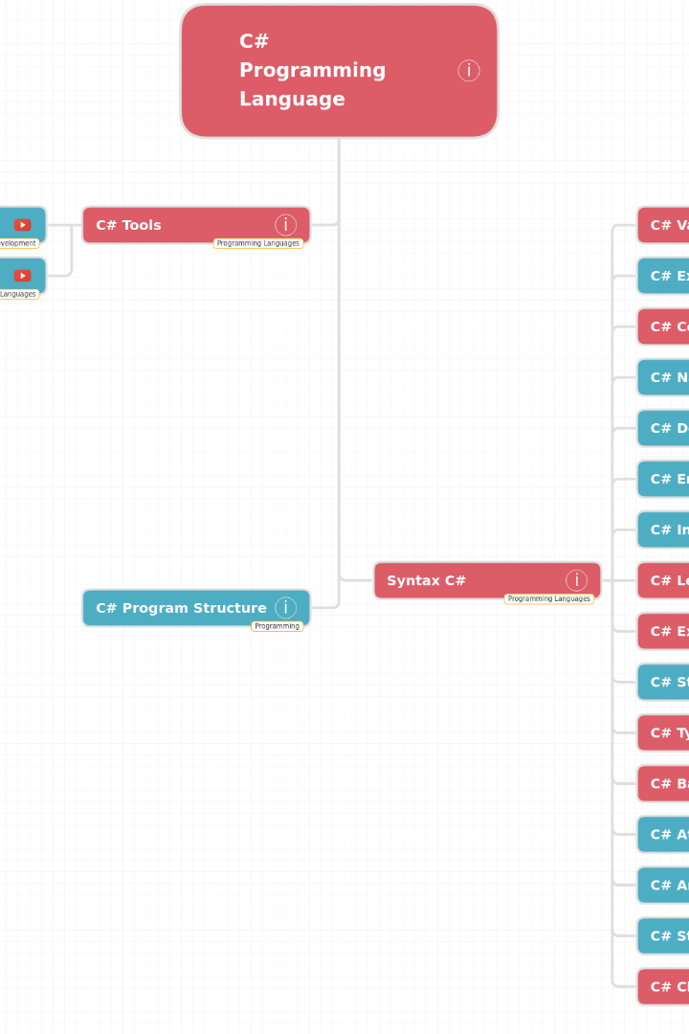


C vs. Python
Welcome, curious college students! Today, we'll explore the differences between two popular programming languages: C and Python.
by boppana visesh

Slide 2

Readability
C
Python
C has a more complex and stricter syntax compared to Python, which can make it less readable for beginners.
Python is known for its clean and easy-to-read syntax, making it a great choice for those new to programming.

Slide 3

Typing System
1
C
C is statically typed, meaning variable types must be declared at compile time.
2
Python
Python is dynamically typed, allowing you to change variable types at runtime without explicit declarations.

Slide 4

Performance
1
C
C is a compiled language and typically faster than Python due to its low-level memory management and optimization.
2
Python
Python is an interpreted language and generally slower than C because it sacrifices performance for readability and ease of use.
3
But...
Python offers ways to speed up performance, like using external libraries such as numpy and utilizing just-in-time (JIT) compilers such as PyPy.

Slide 5

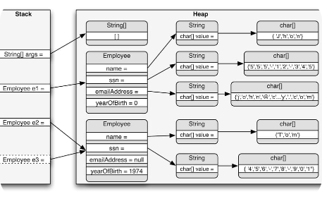
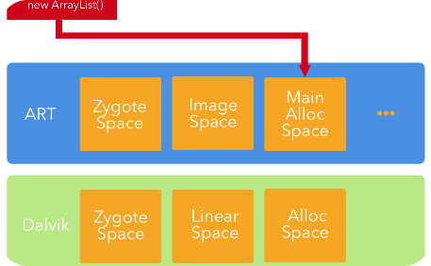
Memory Management
C
Python
Watch out for memory leaks!
In C, you have direct control over memory allocation and deallocation, which can lead to more efficient memory usage.
Python has automatic memory management, but it may result in less control over memory compared to C.
Regardless of the language you choose, it's important to be mindful of memory management to avoid memory leaks and errors.

Slide 6
Portability
1
C
2
Python
Code written in C can be less portable because it's often platform-dependent and may require modification for different systems.
Python code is highly portable, as it is typically written once and runs on different platforms without modification.

Slide 7
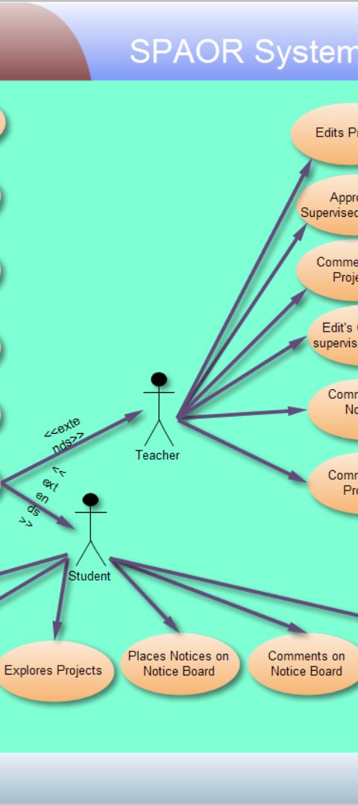
Use Cases
1
C
C is commonly used for system programming, embedded systems, and high-performance applications where efficiency and low-level control are critical.
2
Python
Python is favored for web development, data analysis, scripting, and rapid application prototyping due to its ease of use and high-level abstractions.

Slide 8
Libraries and Ecosystem
C
Python
C has a limited standard library, and you often need to rely on external libraries for additional functionality.
Python has a rich standard library and a vast ecosystem of third-party packages, making it easy to access a wide range of pre-built functionality.

Slide 9
Debugging
C
Python
Debugging C code can be more challenging, as it often involves tools like gdb and manual memory management.
Python offers a more user-friendly debugging experience with tools like pdb and built-in error messages.

Slide 10
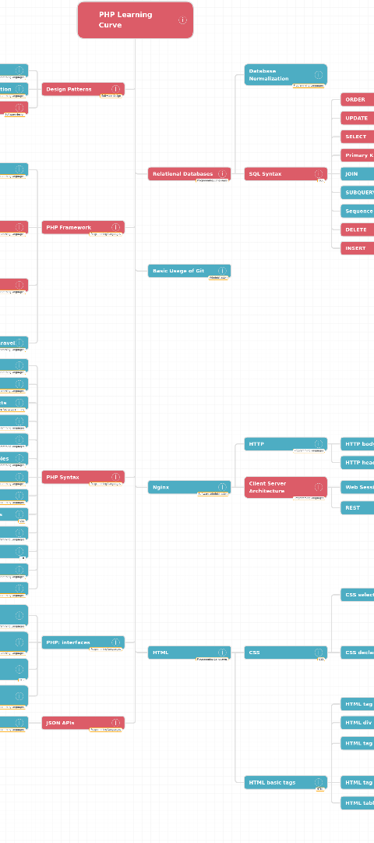
Learning Curve
1
C
C has a steeper learning curve, especially for beginners with no prior programming experience.
2
Python
Python is known for its low learning curve, making it more accessible to beginners.

Slide 11
Community and Support
C
Python
C has a well-established community and is widely used in various domains, but it may lack some of the robust online support and resources that Python enjoys.
Python has a large and active community, which means there is a wealth of documentation, forums, and resources available for assistance.

