Slide 1


Final Project: The DIF Dashboard 2021 Report
Prepared by
Shokouh Rahsepar
Rahin Hamadi
Bora Aydın
Abdullah Mohammed Ayedh
09-09-2023

Slide 2
Outline
Intoduction
Problem / Solution
Project Timeline
Results
Conclusion & Recommendations
Q & A
Methodology

Slide 3


Introduction
Deloitte is a global professional services firm providing a wide range of services, including audit, consulting.
With a presence in over 150 countries, Deloitte is one of the world's largest and most influential professional services organizations.
Deloitte organization serves four out of the five Fortune Global 500® companies.
The Deloitte Impact Foundation, or DIF, is the philanthropic arm of Deloitte dedicated to making a positive societal impact.
It focuses on various areas, including education, community support, innovation, and sustainability.
With 1.1M hours spent on volunteer & pro-bono efforts DIF's aim to empower individuals, organizations, and communities to thrive and contribute to a better future.

Slide 4
Problem / Solution
Problem
The ongoing expansion of DIF presents a major challenge in the maintaining of a comprehensive oversight. Tracking diverse activities, financial management, aligning with strategic goals, and ensuring transparency have become increasingly complex. Addressing these issues is crucial to optimize the foundation's operations and uphold its mission.
Solution
The proposed solution is to develop an interactive dashboard that offers the DIF management an integrated view of various aspects of DIF projects and allocated hours. This tool aims to facilitate informed decision-making by providing valuable insights and fostering better project management practices for future endeavors.

Slide 5
Project Timeline
Testing
&
Deployment
Dashboard
Design
Analyzing integrated data to provide insights into hours spent, budgeted times, project themes etc.
Collecting the data in CSV format, ensuring its quality, cleaning the data, combining data tables
Development of the dashboard interface, implementation of filters, getting feedback from the facilitator
Conducting testing, gathering feedback, making necessary adjustments to the dashboard and deploying the dashboard in Power BI platform for DIF management
Project Initiation
Analysis
&
Insights
Data Processing
Kick-off meeting with the
facilitator, understanding the
assignment, defining the scope and requirements of the dashboard, team formation and project plan development

Slide 6
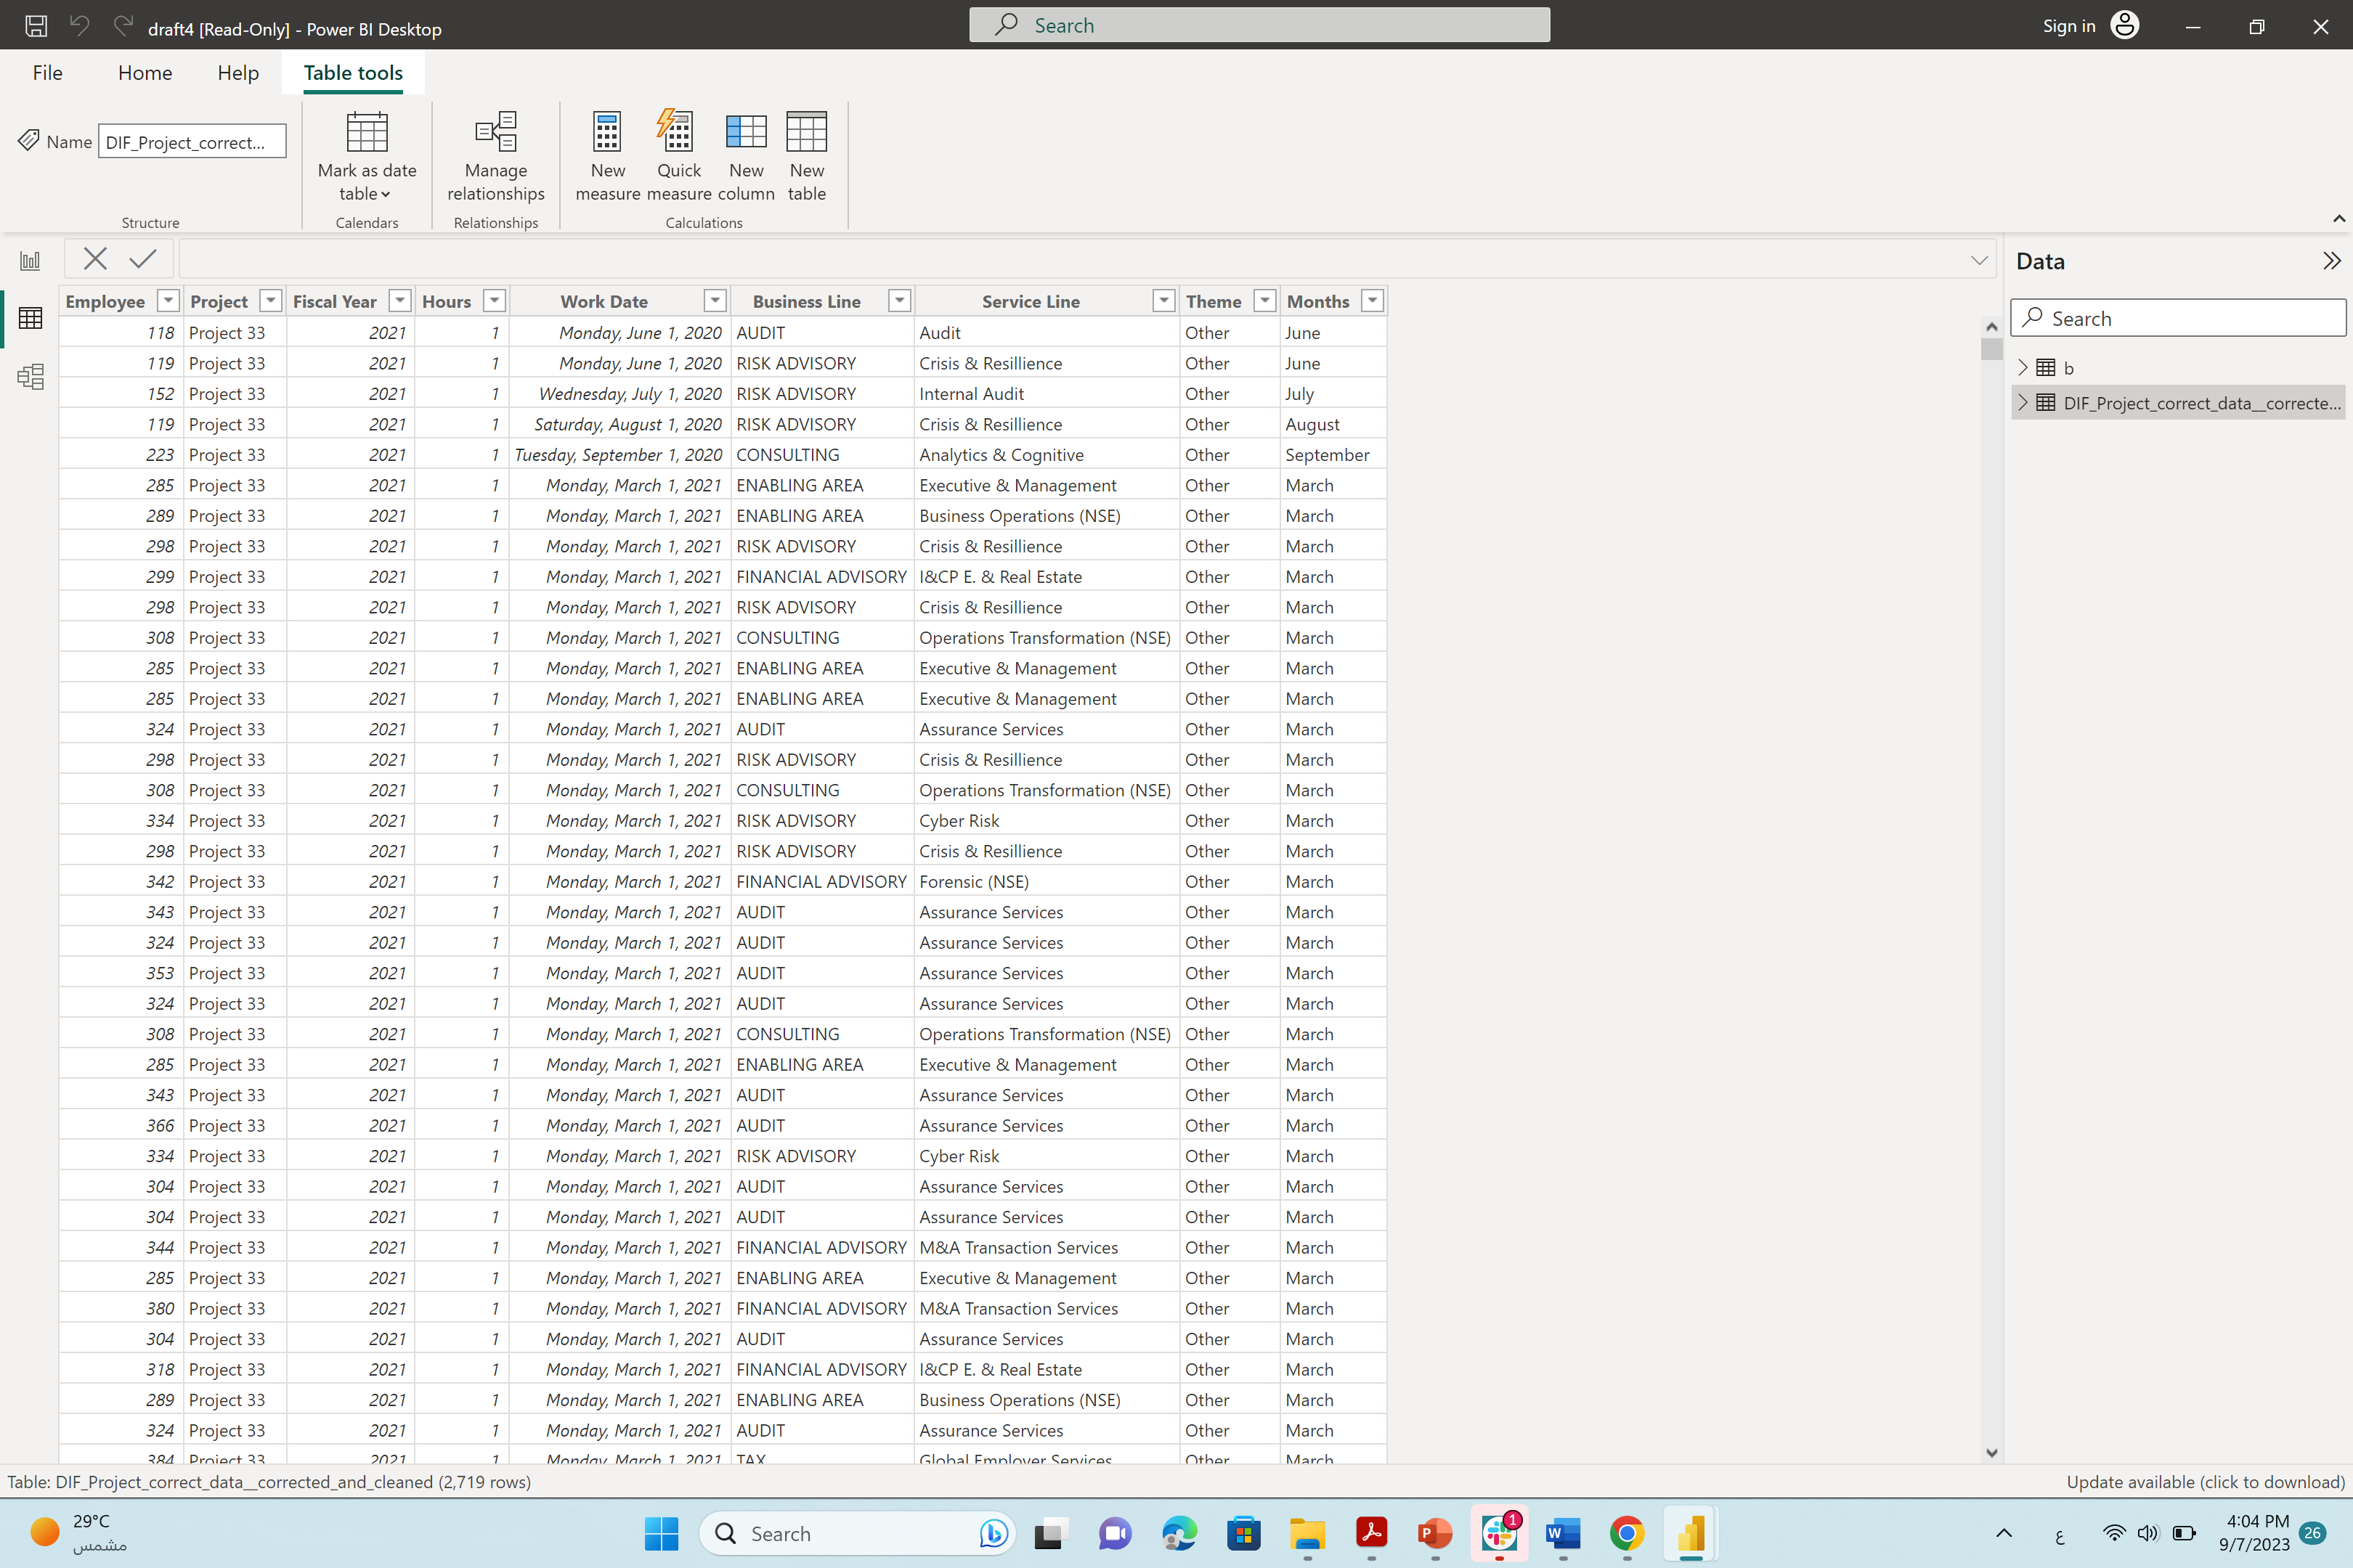
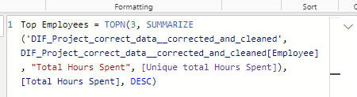
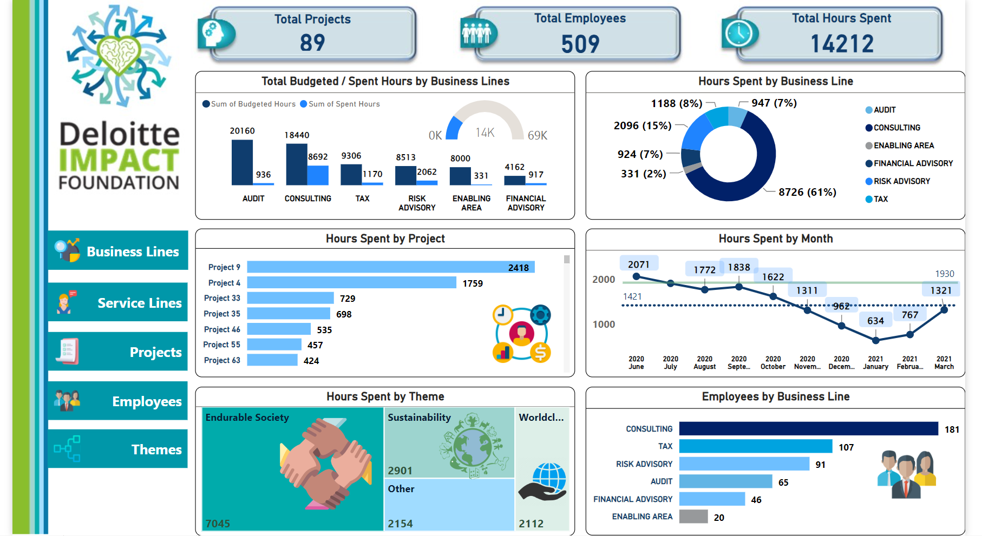
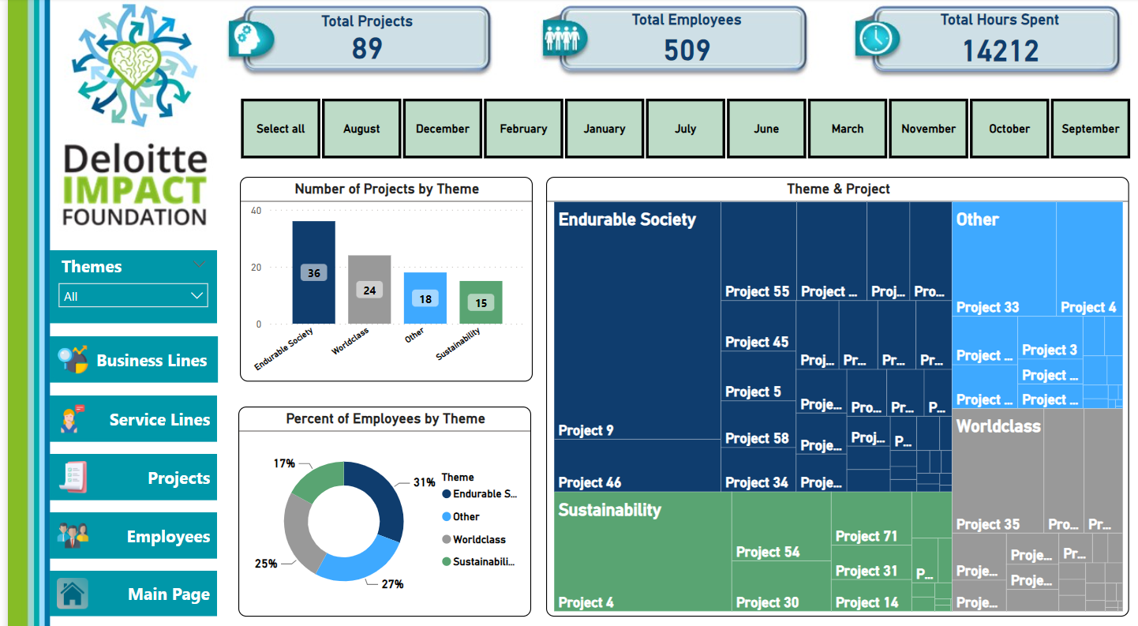
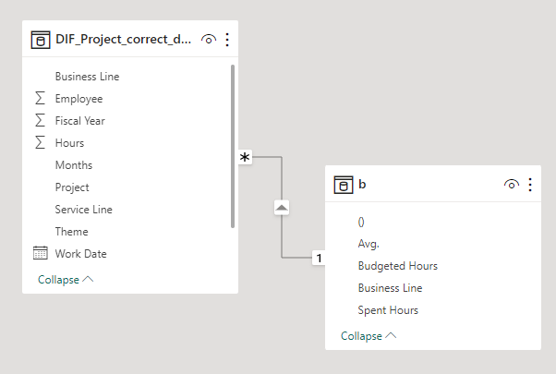
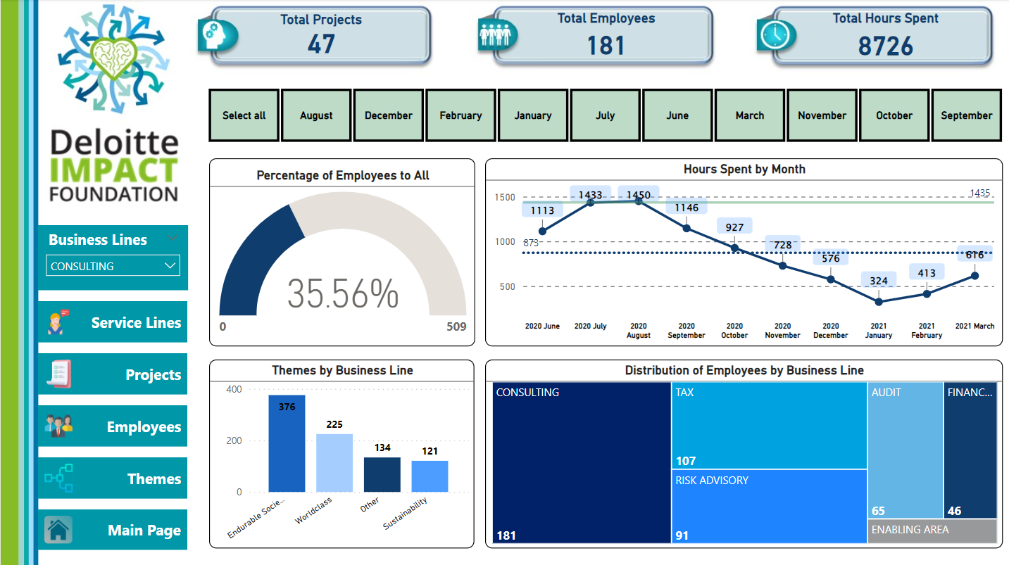
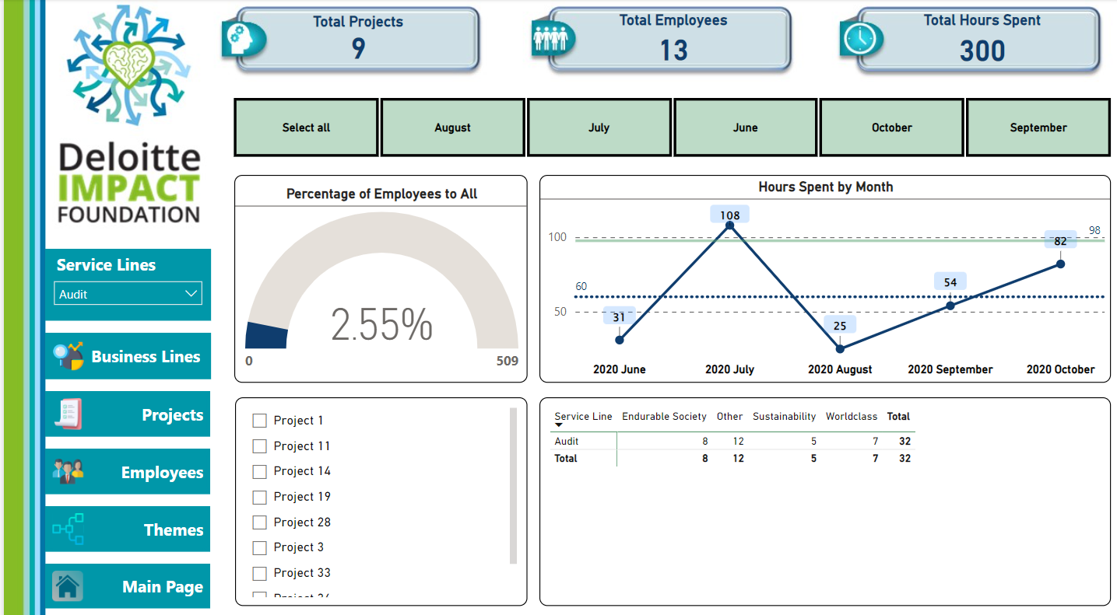
-Creating table of the “Budgeted Hours”
-Joining the budgeted hours table with the main table in Power BI
-Writing necessary DAX formulas
Methodology
Data preparation
Data Modeling
Creating Dashboard in Power BI
-Dealing with inconsistency of the labeling and names
-Dealing with unused columns
-Dealing with negative and null values

Slide 7
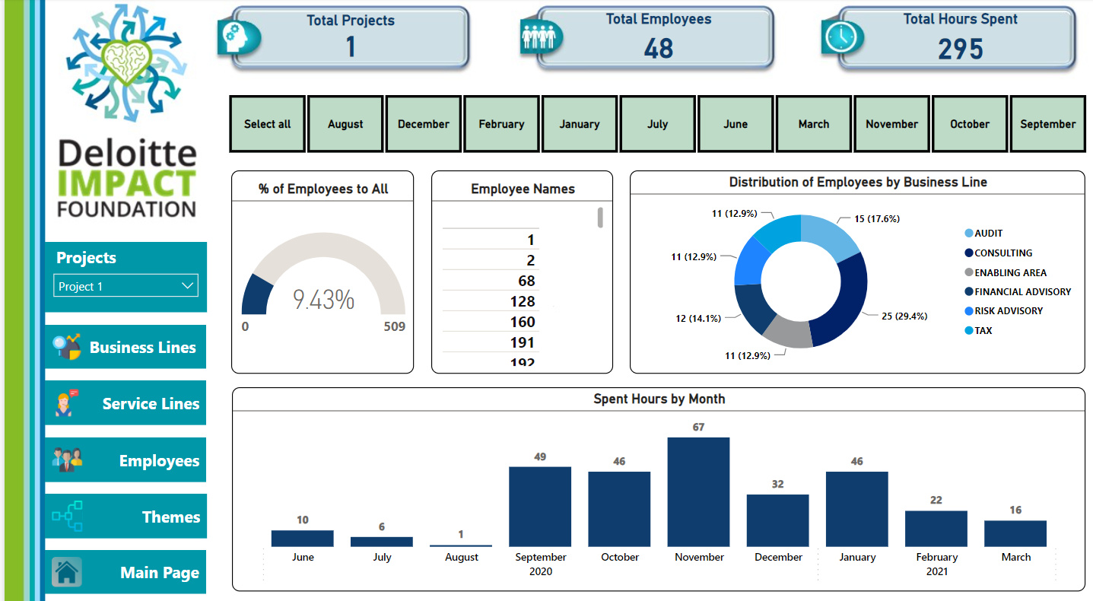
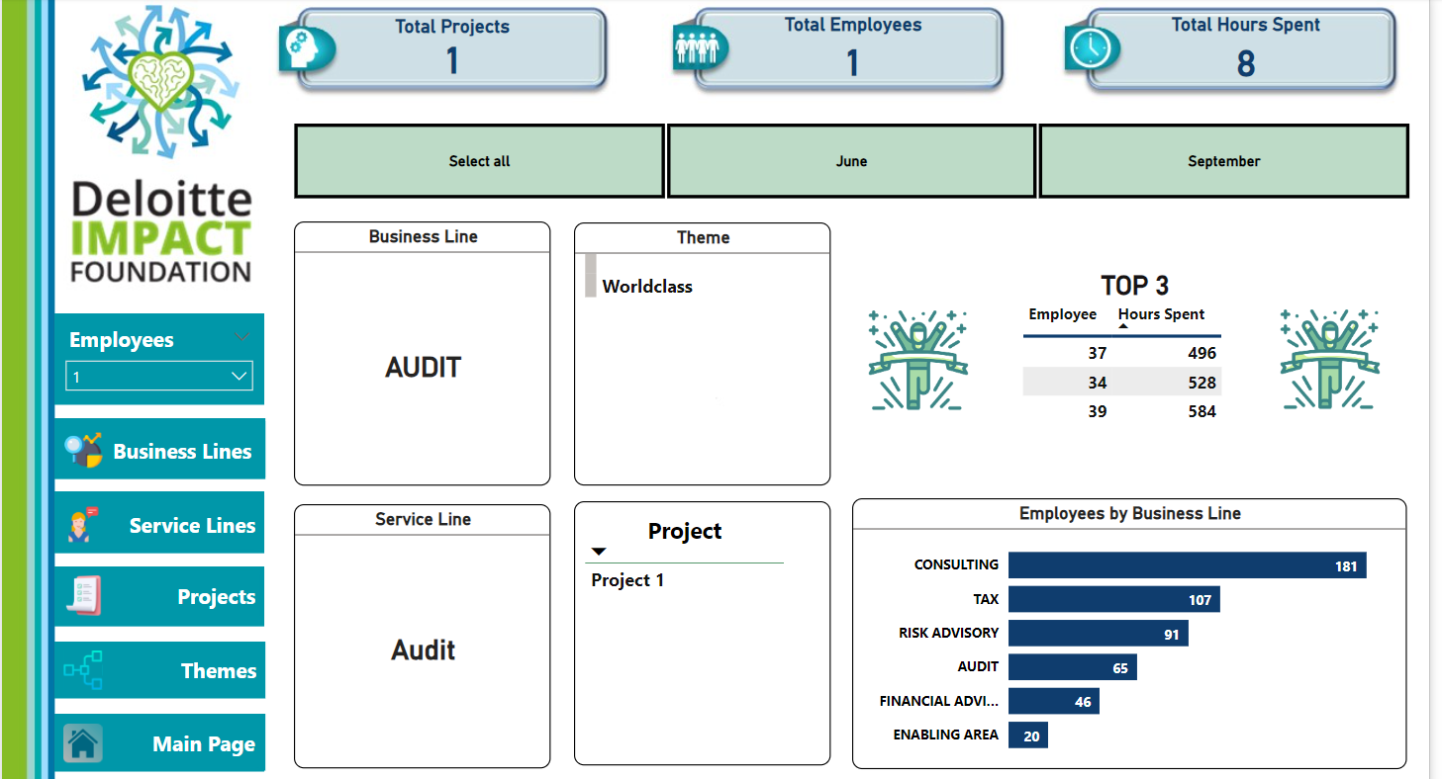
Results

Slide 8
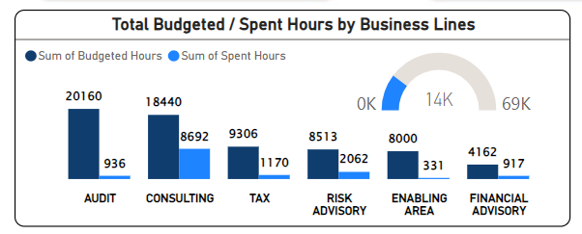
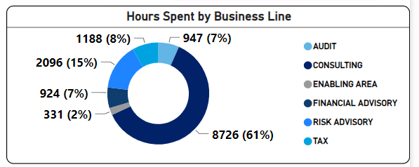
Results
A substantial variance occurs between budgeted volunteer hours and actual volunteer hours.
“Audit” and “Consulting” business lines are the highest in term of budgeted hours.
“Consulting” department is leading the list of business lines by 61% with 8726 hours in “Hours Spent”.
In comparison to “Consulting”, other business lines are significantly below in “Hours Spent”.

Slide 9
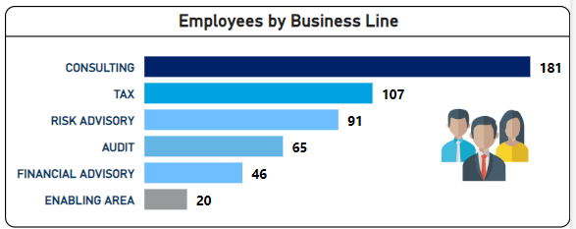
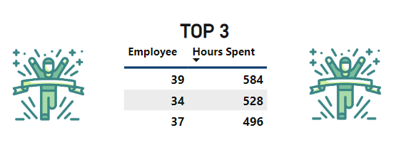
Results
According to the data, the “Consulting” department has the highest number of participating employees.
In the “Hours Spent” for projects, some employees’ outstanding performances are highly remarkable.

Slide 10
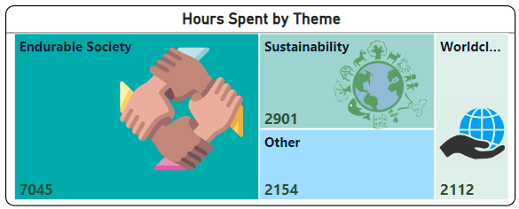
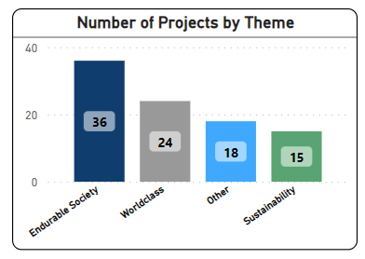
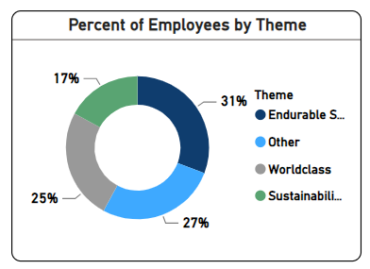
Results
The most significant time investment was dedicated to “Endurable Society”, totaling 7045 hours, while sustainability followed closely behind with 2901 hours.
In the Themes, “Endurable Society” is leading both in the number of the projects and also employees.

Slide 11
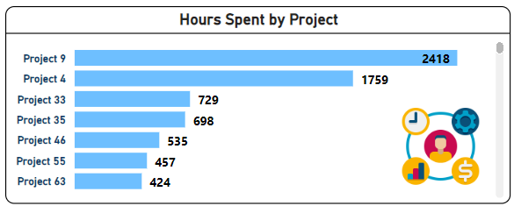
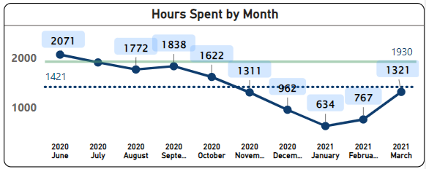
Results
Project 9 & 4 are leading in the “Hours Spent” (by 2418 and 1759 hours respectively).
As an average, the highest “Hours Spent” are on June, July, August and September but this changes in business lines .
The “Hours Spent” in total drops dramatically on the beginning of the year (Jan & Feb ) but not for every business line in detail when we look at individually.
The 90% percentile line statistically shows that Deloitte employees used their time efficiently in the projects.

Slide 12
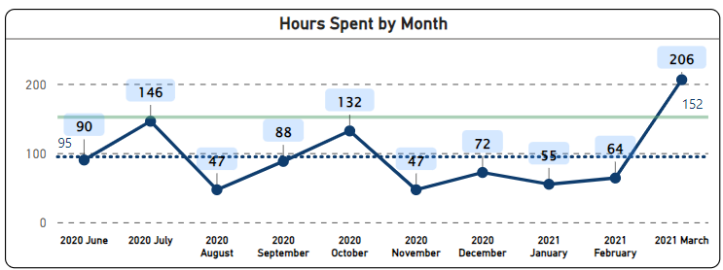
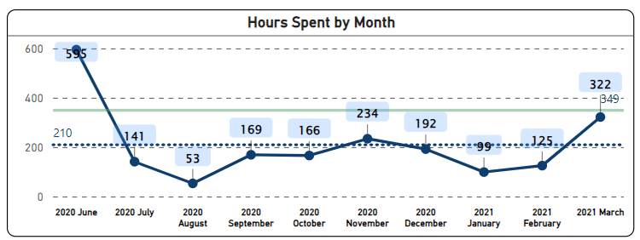
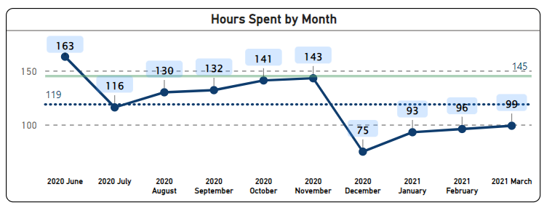
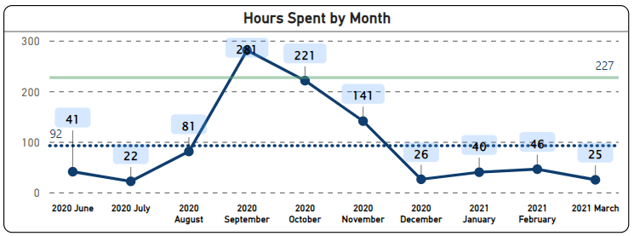
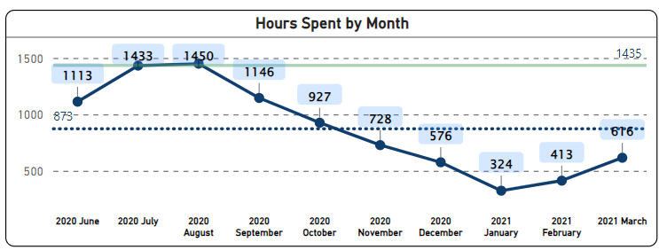
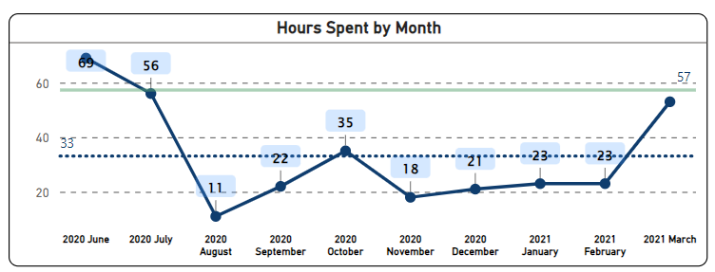
Results
Audit
Risk Advisory
Tax
The "Hours Spent by Month" data shows significant variations among the different business lines. In addition, according to the 90% percentile line, the most efficient department in spending time in projects is “Consulting”.
Financial Advisory
Consulting
Enabling Area

Slide 13
Conclusion & Recommendations
The actual hours spent as an average are only 21% compared to the planned and budgeted hours:
This might indicates significant challenges in resource management, efficiency, and meeting DIF goals.
The DIF should consider conducting in depth analysis to identify the root causes and take corrective actions to address the issues and better align resource allocation with its goals and objectives.
The imbalanced distribution of the hours spent and budgeted in all data dimensions (business line, service line, project, and theme).
The DIF should assess the causes of these imbalances, whether they result from inefficiencies, changing priorities, or resource constraints. Addressing these imbalances is essential for optimizing resource utilization and achieving organizational goals.
The data limitation (lack of types and subjects of projects, having no demographical data about the employees or their total number in each business lines, insufficient info of budgeted hours for individuals etc.) restricts us for further analysis and recommendations.

Slide 14
Q&A

