Slide 1



MRC River Monitoring Technology Competition
Topic: Water Quality Monitoring System
Virbora NY, Socheata LEAVCHUM, Sokheang EANG
National Polytechnic Institute of Cambodia
Phnom Penh, Cambodia

Slide 2
Table of Contents
Introduction
Methodology
Design and Implementation
Hardware Design
Software Design
Prototype Testing
Conclusion
Reference

Slide 3
1. Introduction
Water Quality Monitoring System is used for measure the water quality and send data from the station to the server via wired or wirelessly. By using different type of sensors, the system is able to monitor the following parameters:
Turbidity
pH (Potential of Hydrogen)
Dissolved Oxygen
Water Temperature

Slide 4
2. Methodology
Concept Design
Send data from sensors to the server every three minutes
Wired and multi-wireless communication
Solar Powered
2 DOF solar tracker
Smart Data Backup System
Durable to harsh weather conditions (Rain, Dust, …)

Slide 5
2. Methodology
Communication Feature
Ethernet
LoRa
GSM
IoT Cloud
Smart data backup using SD-Card

Slide 6
2. Methodology
2.1 System Block Diagram

Slide 7
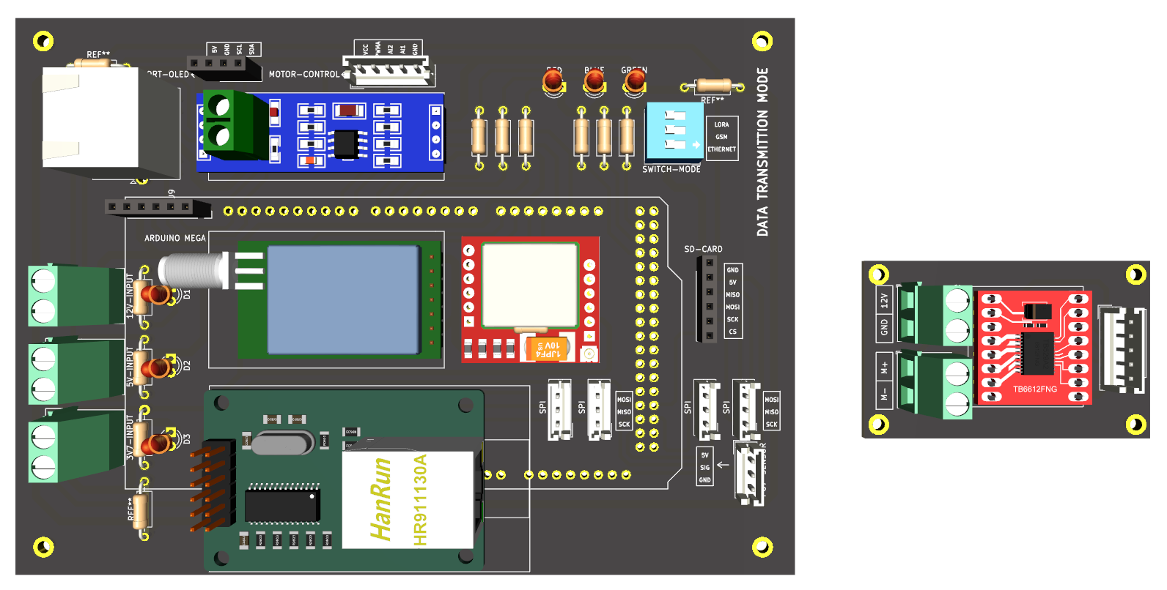
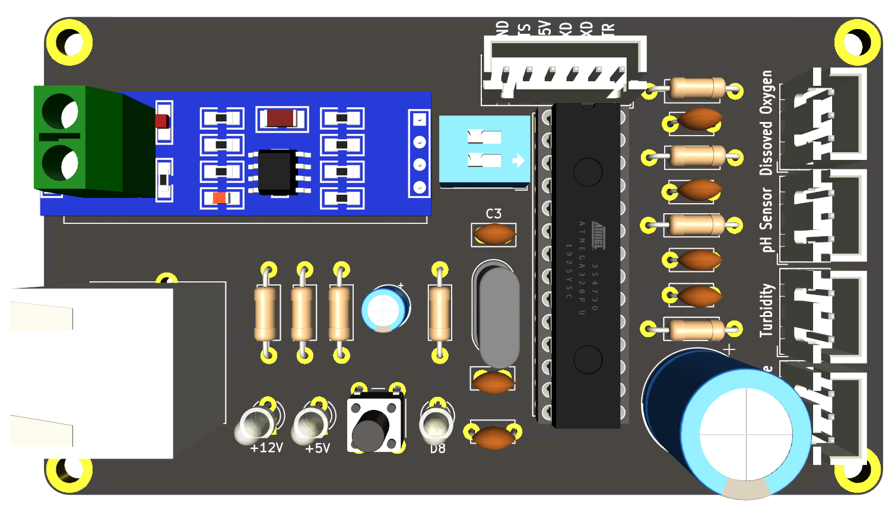
3. Design and Implementation
Hardware Design
(a) Main System Hardware
(b) Sub System Hardware
3.1 PCB Hardware Design

Slide 8
3. Design and Implementation
Hardware Design

Slide 9
3. Design and Implementation
Software Design

Slide 10
4. Prototype Testing

Slide 11
5. Conclusion

Slide 12
Reference

Slide 13

សូមអរគុណ
Thank You

