Slide 1
Bank of Baroda Hackathon 2024
Your Team Name : Nerd Bytes
Date : 29/Jun/2024

Slide 2
Problem Statement?
To revolutionize financial advisory services using generative AI to personalized, data-driven financial advice to customer

Slide 3
Pre-Requisite
The Alternative in the realm of financial assistance:
Human Advisors: These are experienced with the years of trust.
Hybrid model: This type of model are used for pattern recognition with human insights.
Blockchain and crypto solution: emerging technologies like blockchain, offering decentralized and automation.

Slide 4
Any Supporting Functional Documents
RECOMMENDATION : Conduct a thorough analysis of the client's current financial status, including income, expenses, assets, liabilities, investments, and tax situation. Based on the analysis and assessment, create a personalized financial plan that outlines specific recommendations and strategies to achieve the client's financial goals.
ACCURACY: Regularly monitor the client's portfolio and financial situation to ensure alignment with their goals. Adjust the plan as necessary based on changes in the client's life circumstances, market conditions, or financial goals.
NEW IN MARKET: Educate clients about financial concepts, investment strategies, and the rationale behind recommendations. Maintain open communication to address any questions or concerns.

Slide 5
Key Differentiators & Adoption Plan
Successful advisors personalize their services to meet the specific goals, risk tolerance, and financial circumstances of each client. This tailored approach ensures that recommendations align closely with client objectives.
Effective advisors regularly communicate with clients, providing updates on their portfolios, market insights, and proactive recommendations based on changing circumstances. They also educate clients about financial concepts and decisions.

Slide 6
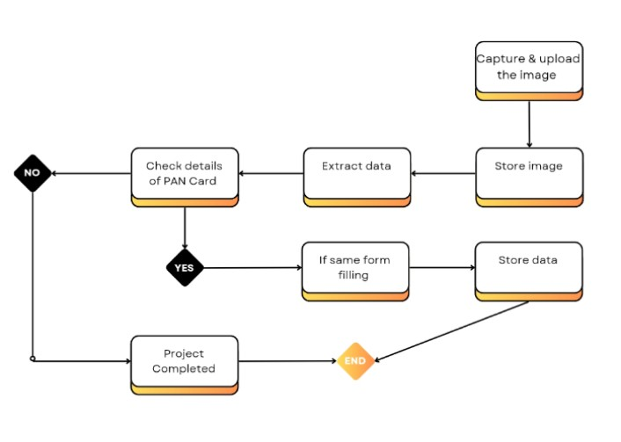
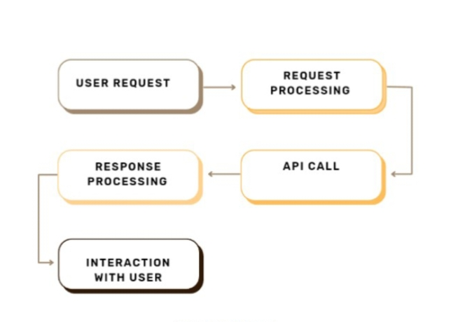
GitHub Repository Link & supporting diagrams
GitHub Repository :

Slide 7
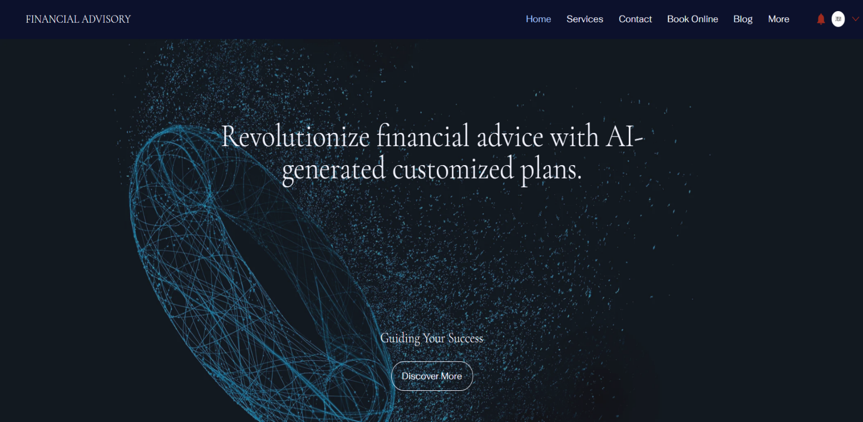
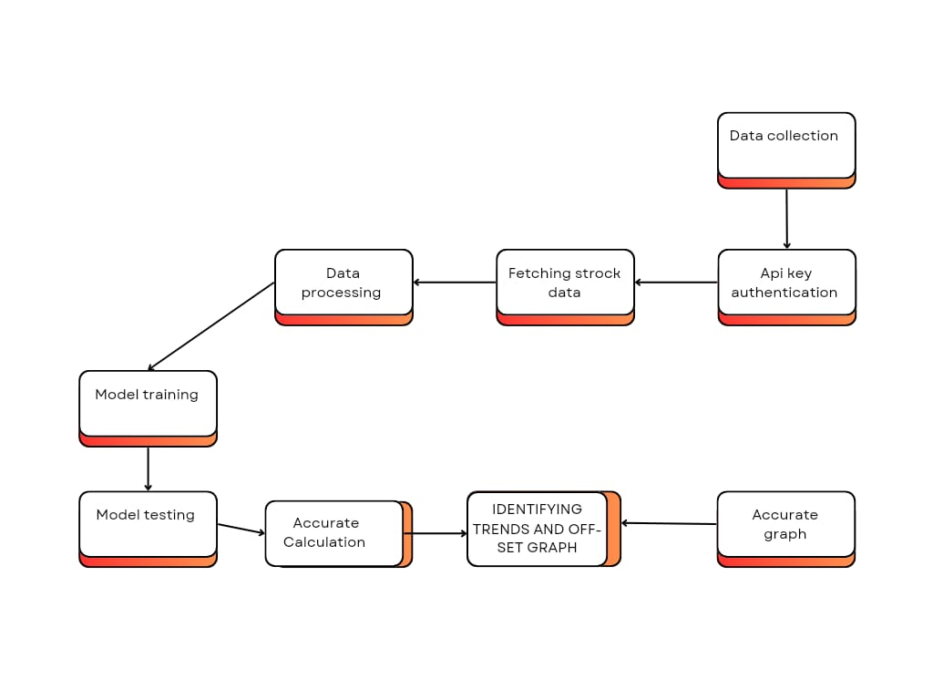
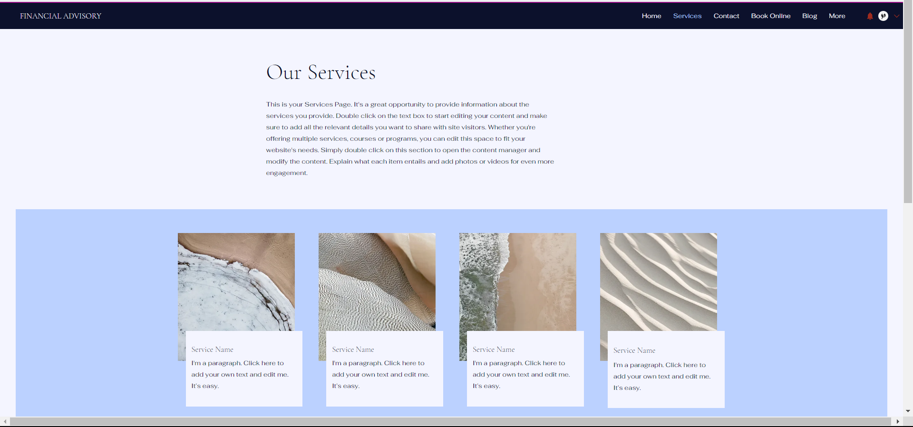
GitHub Repository Link & supporting diagrams

Slide 8
Business Potential and Relevance
BUSINESS POTENTIAL: Our website can analyze lots of data fast, suggest personalized plans, and manage investments automatically. It helps spot patterns, manage risks better, and makes financial decisions more accurate and efficient.
RELEVANCE: It uses data to give smart advice, handles routine tasks like managing investments, and offers personalized recommendations based on your goals. It makes managing money easier, faster, and more accurate, improving how investments are handled and making customers happier.

Slide 9
Uniqueness of Approach and Solution
Both the user and the customer are checking out investment ideas on the same website where they manage their accounts.
You can get reports and graphs that show what you own assets and liabilities on that website. It helps you see your financial picture visually.
To save time, the form-filling process will be automated, making it quicker and easier for customers to complete. This automation streamlines the experience, ensuring efficiency and convenience in managing tasks online.

Slide 10
Ease of Deployment and Maintenance
FRAUD DETECTION: Utilizes AI algorithms to analyze patterns and anomalies in financial transactions, swiftly identifying and mitigating potential fraudulent activities.
USER FEEDBACK INTEGRATION: Collecting and using input from users to make financial advisory better and more useful for them over time.
BAIS MITIGATION: Identifying and reducing unfair influences in algorithms to ensure fair decisions in financial advisory.

Slide 11
Security Considerations
ENCRYPTION- To converts sensitive data into a secure format to prevent unauthorized access. It ensures that even if data is intercepted, it cannot be read without the decryption key.
SECURE STORAGE- Involves storing data in protected environments, such as secure servers or cloud platforms with stringent access controls and encryption protocols.
STRONG AUTHENTICATION- To verify user identity before granting access to sensitive information or transactions.

Slide 12
Thank You
Bhalala Zankarben Pareshbhai
Borad Jashkumar Hareshbhai

