Slide 1

Hardware for LSH minhash acceleration
Students: Boran Swaid, Dima Ali Saleh
Supervisor: Robert Hanhan

Slide 2

Background and motivation
The motivation:
For building a hardware accelerator for LSH MinHash is the need for faster, more scalable, and energy-efficient solutions in data processing.
Due to the large number of reads produced by modern high-throughput sequencing technologies and the rapidly increasing number of available reference genomes corresponding software tools suffer from either long runtimes, large memory requirements or low accuracy such as Kraken and CLARK.

Slide 3
Background and motivation
DNA sequence classification:
Classification is used to predict the category of items with unknown labels based on data derived from a training set. They work well with discrete variables or categorical data, acting as the perfect solution for analysing DNA data. Classification can help assist in gene identification in DNA molecules.
Despite the significant advancements in sequencing technologies, there are several challenges and limitations that create bottlenecks in the sequencing workflow:
Throughput and speed
Data Processing and Analysis
Accuracy and Error Correction.

Slide 4

Background and motivation
Minhash Algorithm and Murmur3 function:
Minhash algorithm or locality sensitive hashing is a technique for quickly estimating how similar two sets are using Jaccard similarity coefficient which is a commonly used indicator of the similarity between two sets. Let U be a set and A and B be subsets of U, then the Jaccard index is defined to be the ratio of the number of elements of their intersection and the number of elements of their union: $J\left(A,B\right)=\frac{|A∩B|}{|A∪B|}$ .
This value is 0 when the two sets are disjoint, 1 when they are equal, and strictly between 0 and 1 otherwise. Two sets are more similar (i.e. have relatively more members in common) when their Jaccard index is closer to 1. The goal of MinHash is to estimate J(A,B) quickly, without explicitly computing the intersection and union.

Slide 5
Background and motivation
In this project we used Murmur3 Minhash function to implement the Algorithm. Murmu3 is widely used in streaming algorithms because it is fast to compute and achieves low collision rates. It computes the hash value of the input using a sequence of multiplications, additions, and bitwise logic operations such as or, xor and bit shifts.

Slide 6


The Process of DNA sequence classification:
AATGGCCTTTATATATGGGCCCCTGGAAAAAATTTCGTTCGGGTTATTTTAAAAAATG..
Offline: Genome
Online : input: read
Window_index
DNA sample
Sequencing machine
Reads
LSH minhash
DNA classification is performed as follows: a sample potentially containing DNA of multiple organisms is obtained and prepared. The sample is sequenced; the sequencer outputs DNA reads; DNA sequencers are prone to sequencing errors, such as indels and replacements.

Slide 7

Project definition and goals
DNA pre-alignment is a process used in DNA genome analysis pipeline in order to filter our reads which do not belong to a DNA reference. In this project we will design a hardware accelerator for DNA pre-alignment used to detect and classify DNA reads .
The goals of this project:
To Learn digital VLSI design tools and flow.
Design a novel accelerator for genomic applications.
Gain speedup over commercial software based tools.

Slide 8
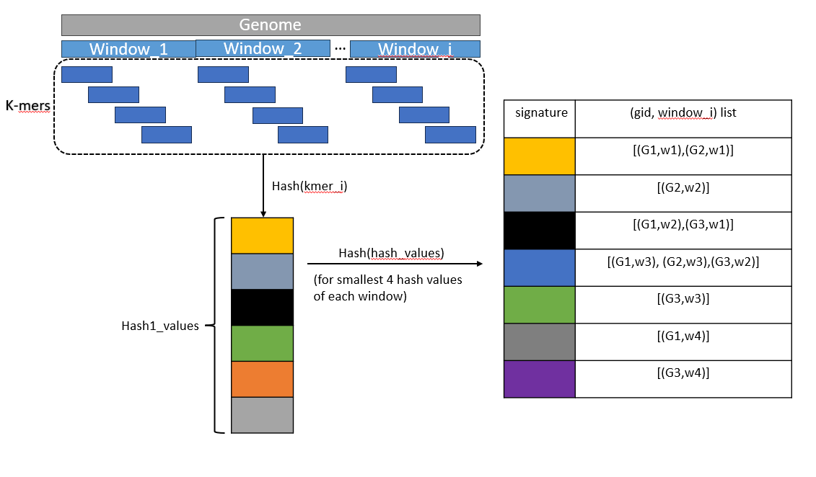
Description of the algorithm:
Offline:
Pick a 3-reference genome.
Place 3 refs in memory as follows:
Divide each ref into windows of length 128 byte.
Divide every window into k-mers of length 16 byte with overlap of 8 byte.
For every window, find its signature using murmur function.
Hash smallest 4 signatures using murmur into table that represents the memory.

Slide 9
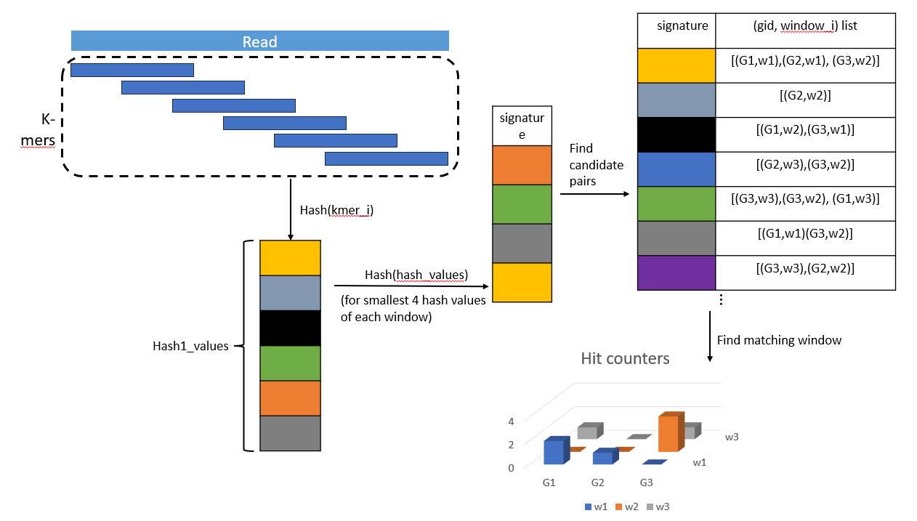
Description of the algorithm:
online:
Input: read of length 128 byte.
Create an empty list called hash2_values.
Hash the read into memory as described in offline and save its hash2 values in hash2_values list.
Find candidate pairs by going on the hash2_values list in memory and increment counters.
Repeat the steps 1-4 with the reversed read so we can compare with the reversed DNA.
Return the window and genome id which has the highest count of hits, if there isn’t, return (-1,-1).

Slide 10
Software part
The software simulation was implemented using python to research the algorithm and to find the parameters that gives optimal results with taking in consideration high accuracy ratio with memory and runtime efficiency.
The main class is MinHash that contains all the parameters and functions of the algorithm.
The test bench that contains the COVID19 reference genome and Bacteria reference to test the reference variant.

Slide 11
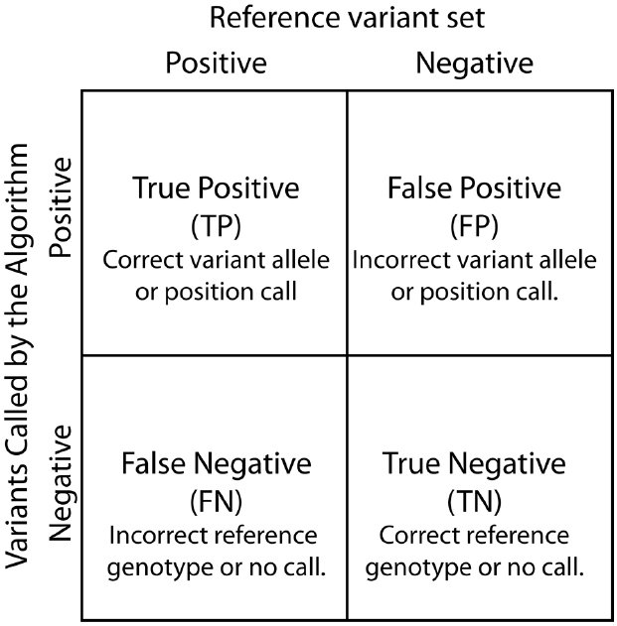
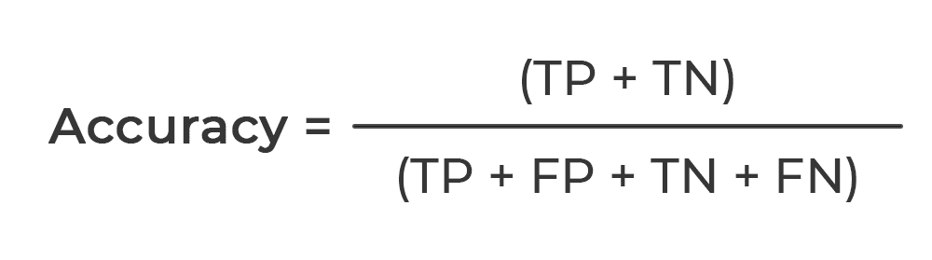

Slide 12
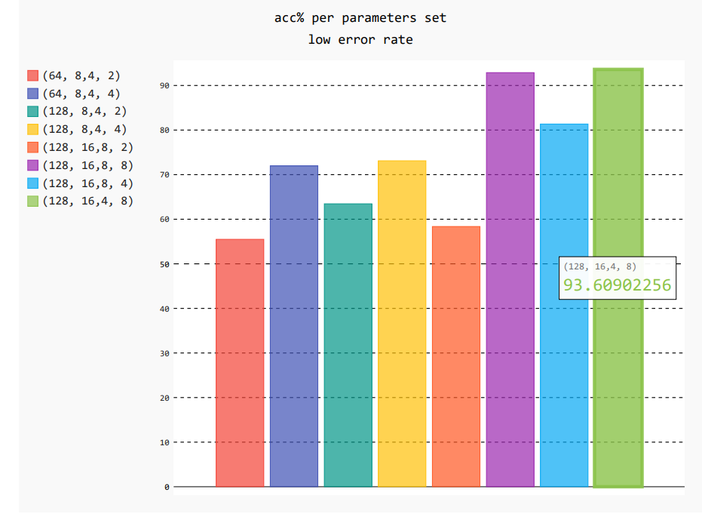
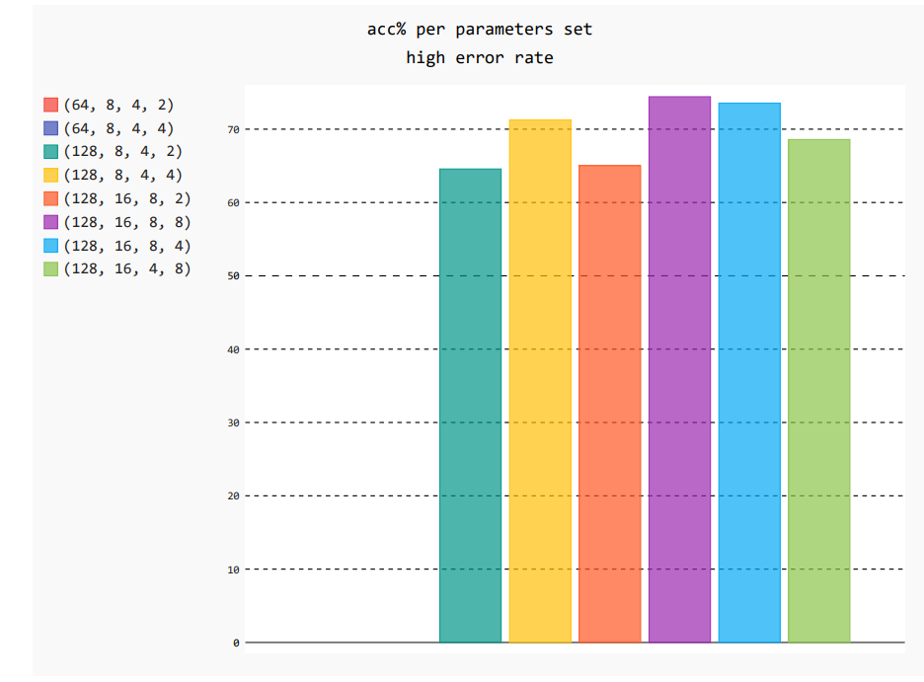
The results

Slide 13
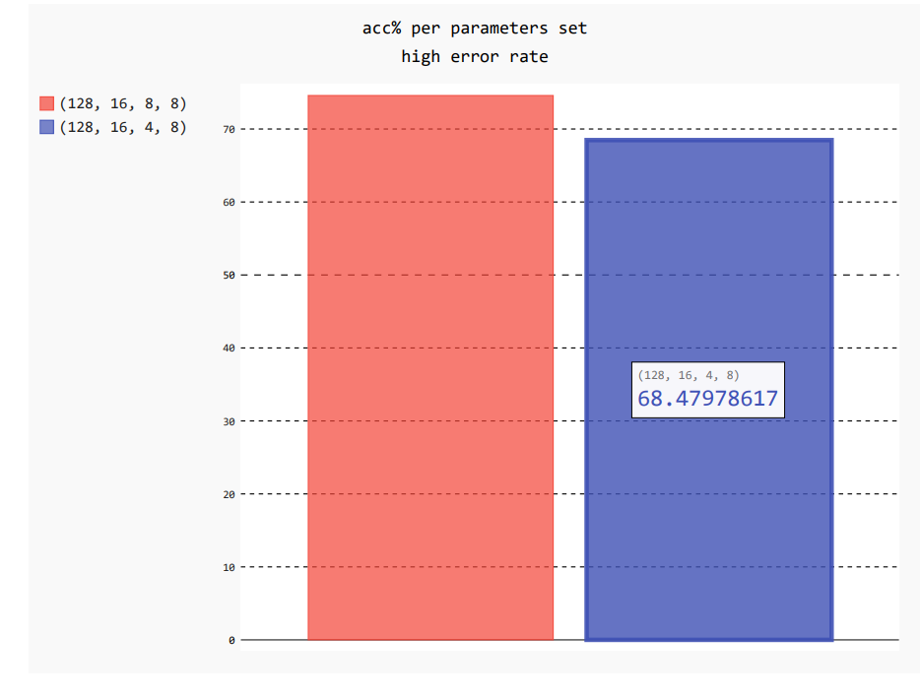
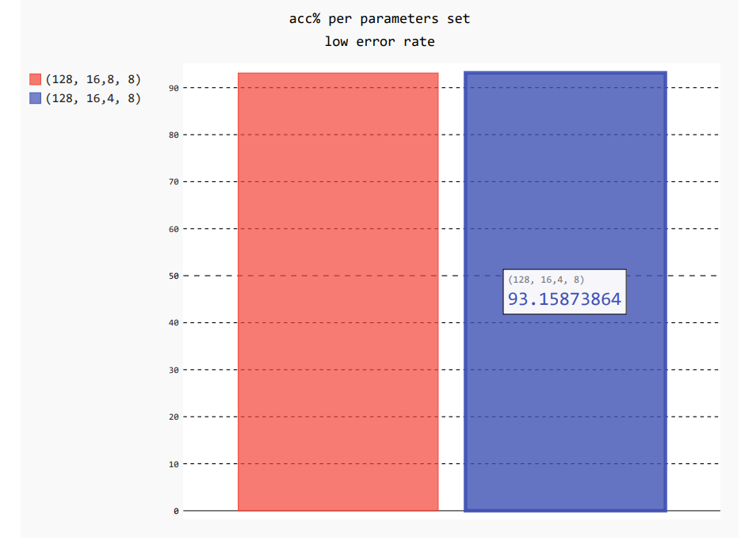
Zoom in:

Slide 14
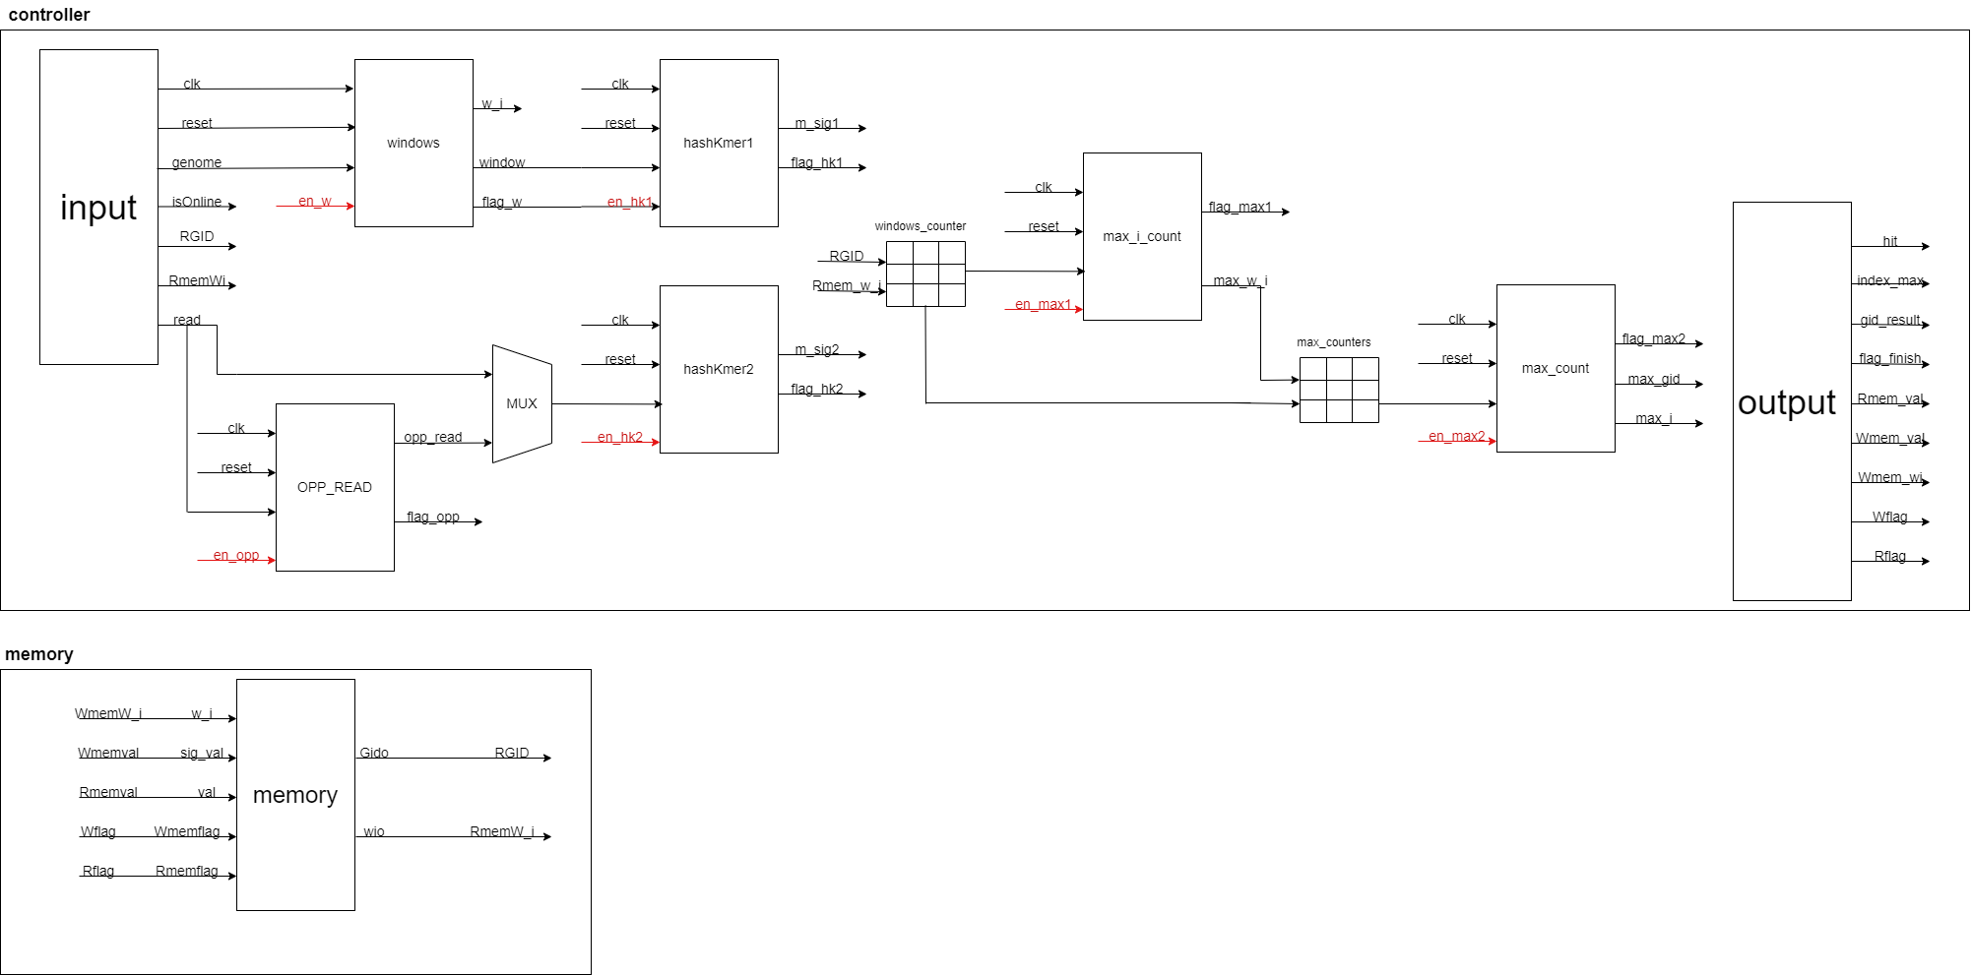

Architectural design

Slide 15
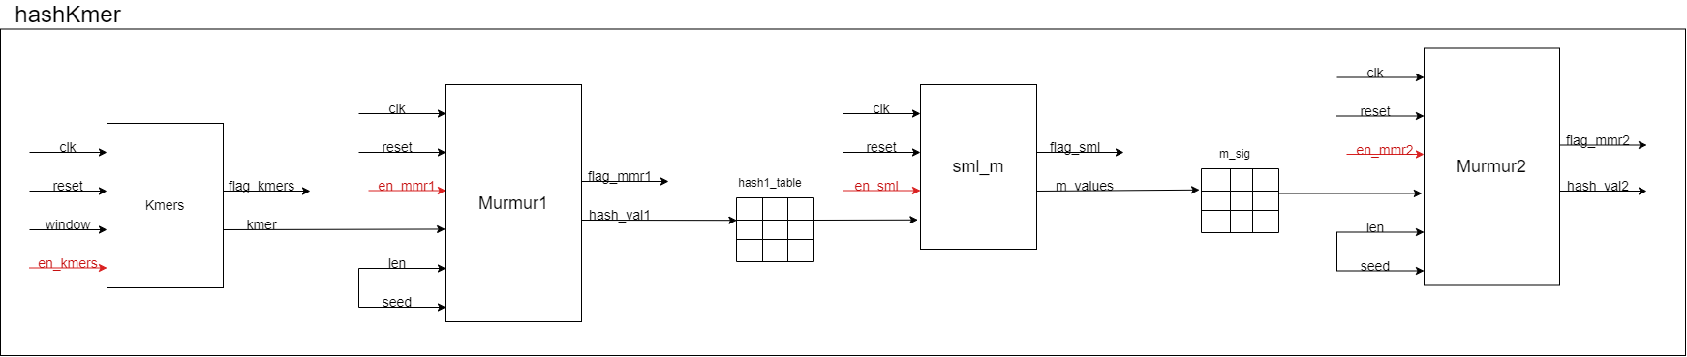

Slide 16
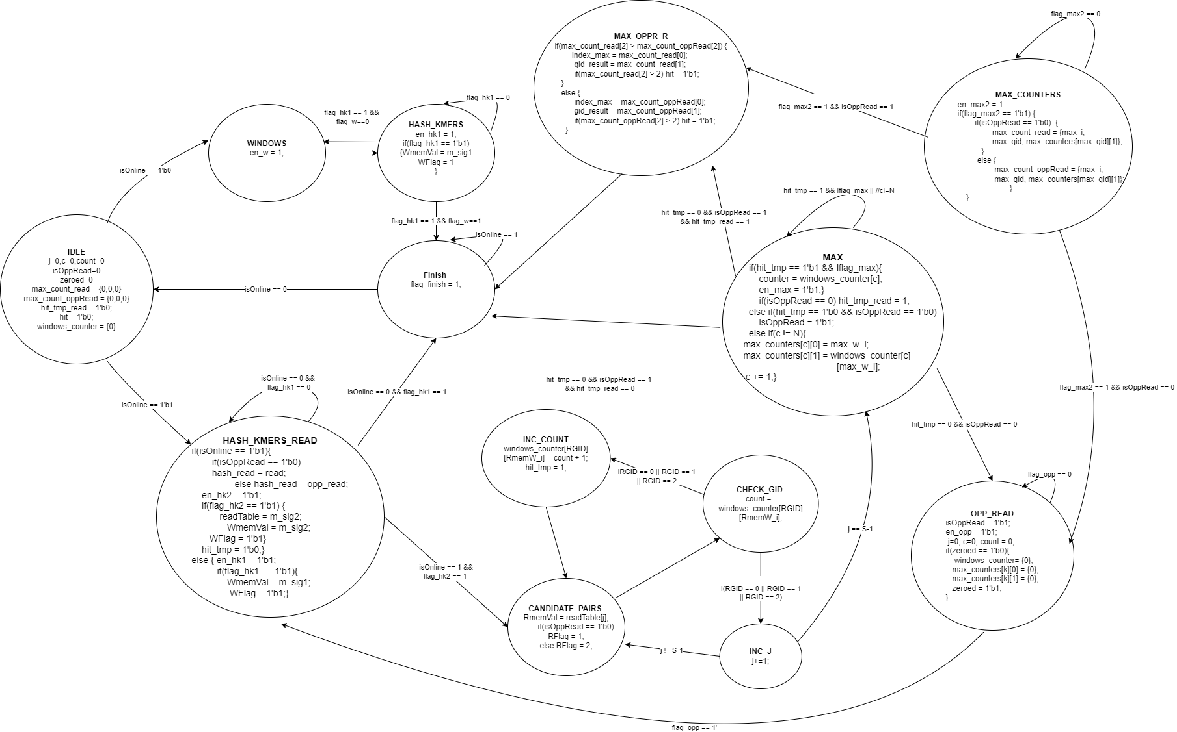
Controller FSM

Slide 17
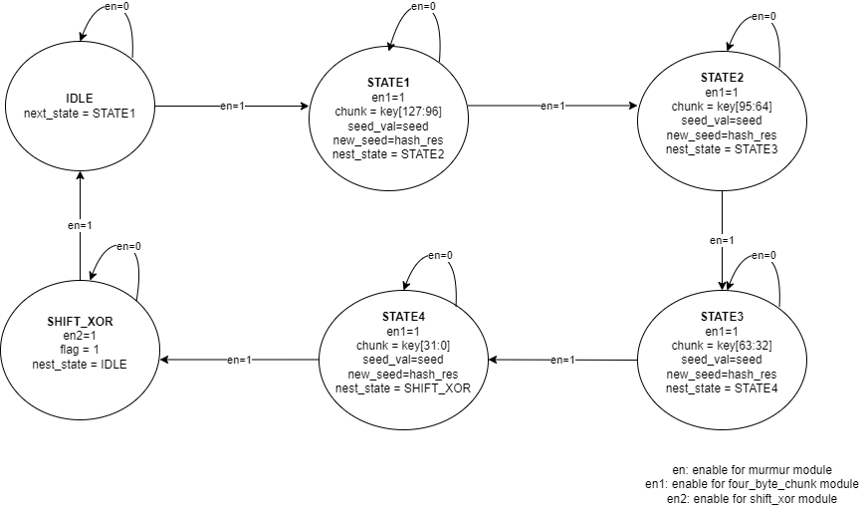
Murmur FSM (for 128 bit input)

Slide 18
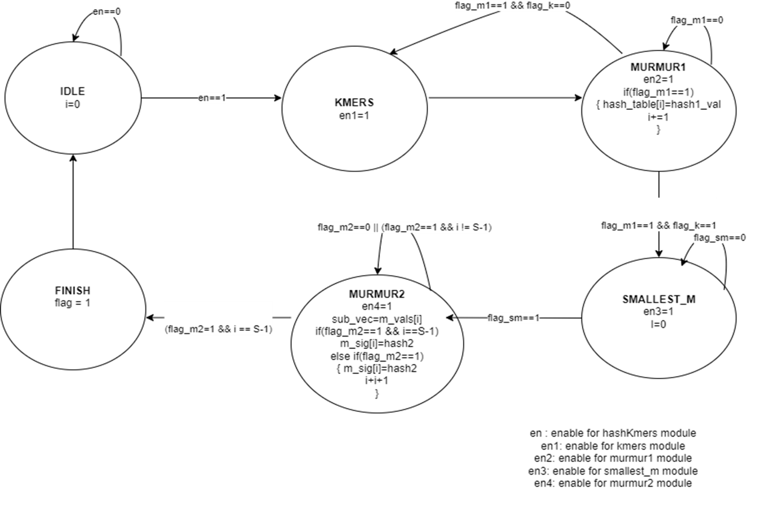
HashKmers FSM ​ ​

Slide 19
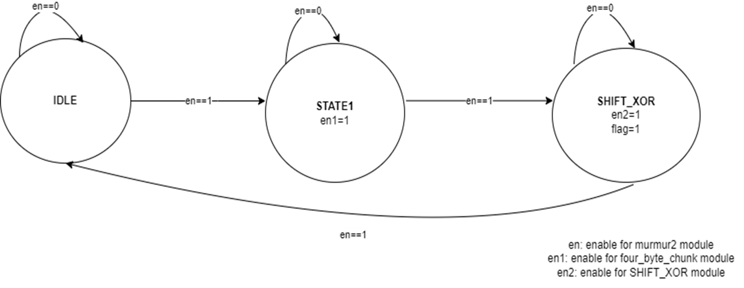
Murmur FSM
(for 32 bit input)
Murmur FSM
(for 32 bit input)

Slide 20
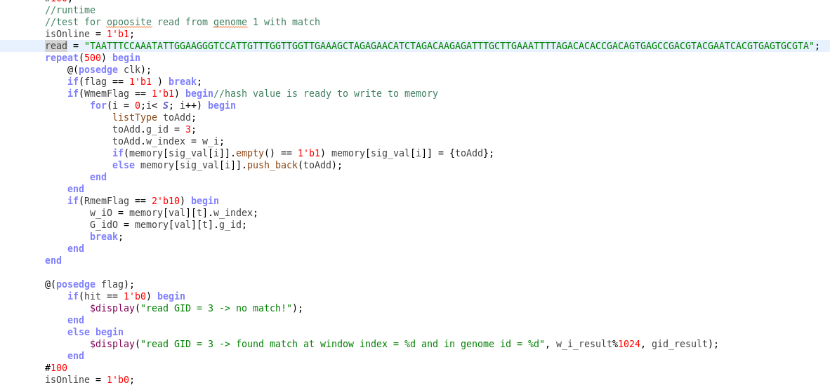
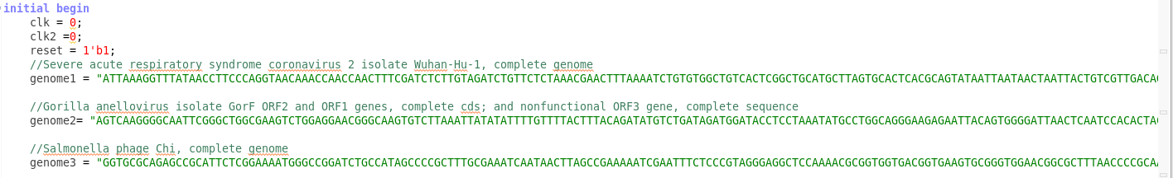
Test bench

Slide 21
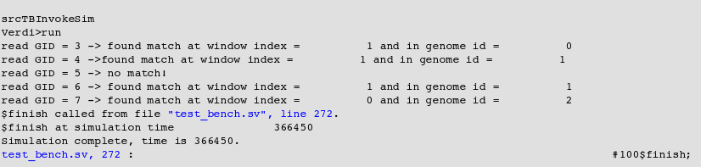
Test bench

Slide 22
Simulations
Windows division

Slide 23
HashKmers

Slide 24
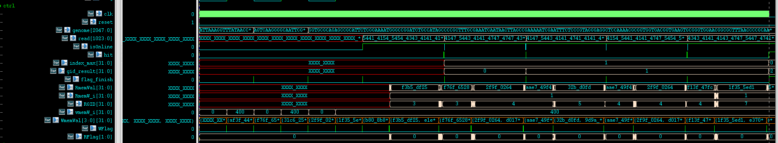
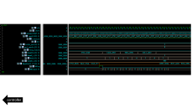
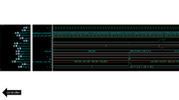
Controller

Slide 25
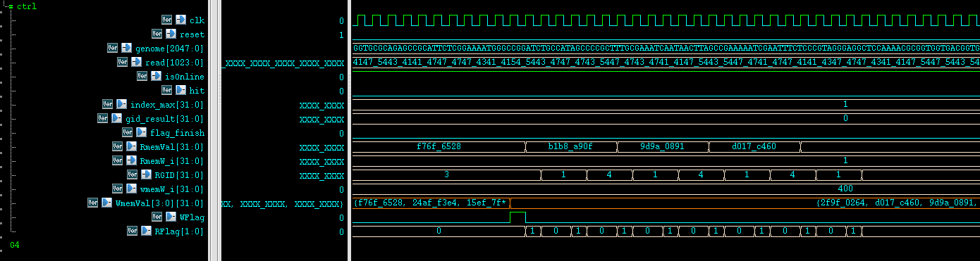
controller

Slide 26
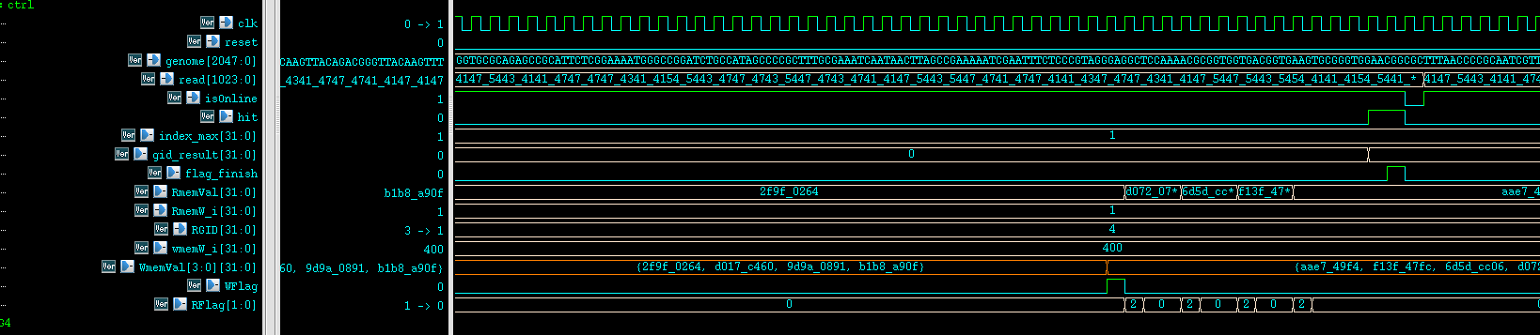
controller

Slide 27
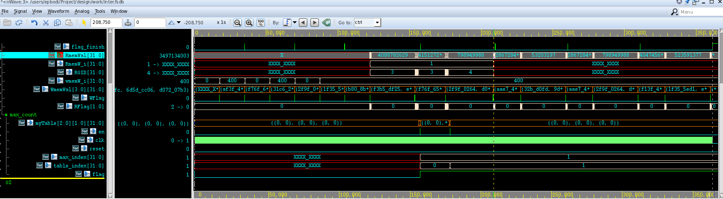
Bug and its solution

Slide 28
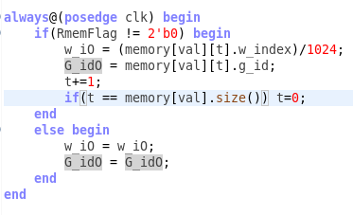
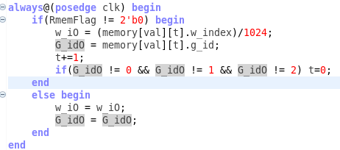
Description
The bug in the code:
Fix:

Slide 29
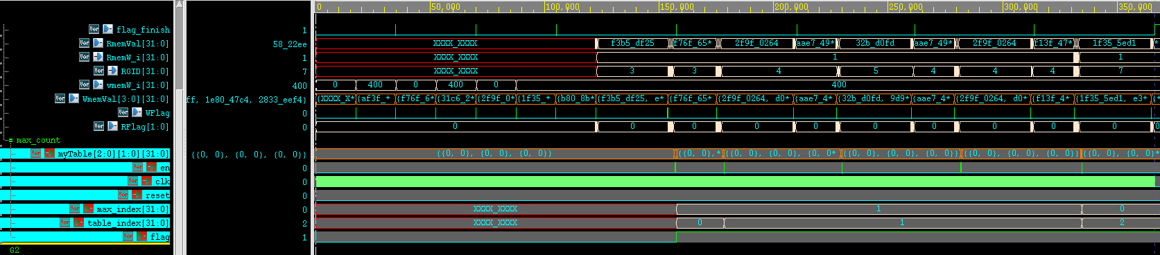

Slide 30
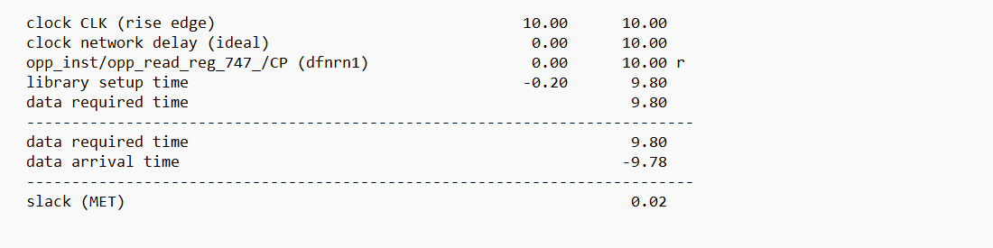
Calculate hardware simulation runtime:
=> T=9.8ns
From the waveform we calculated the cycles we need to classify one read, from when isonline rises to 1 until hit rises to 1.

Slide 31

Calculate hardware simulation runtime:
$$number of cycles=\frac{cycles}{one cycle}=523$$
$$Time=number of cycles ∙T=523∙9.8nsec=5.12∙{10}^{−6}sec$$

Slide 32
Comparison between Runtimes
Algorithm | Runtime(mrpm-million reads per minute)
Our python simulation | 0.15mrpm
Our hardware simulation | 11.7mrpm
Kraken | 1.4mrpm
MetaCache | 1.3mrpm
CLARK | 1mrpm
As we can see from the table above: we gained 78x speedup over our software tool, 8x over Kraken, 9x over MetaCache and 11x over CLARK.

Slide 33

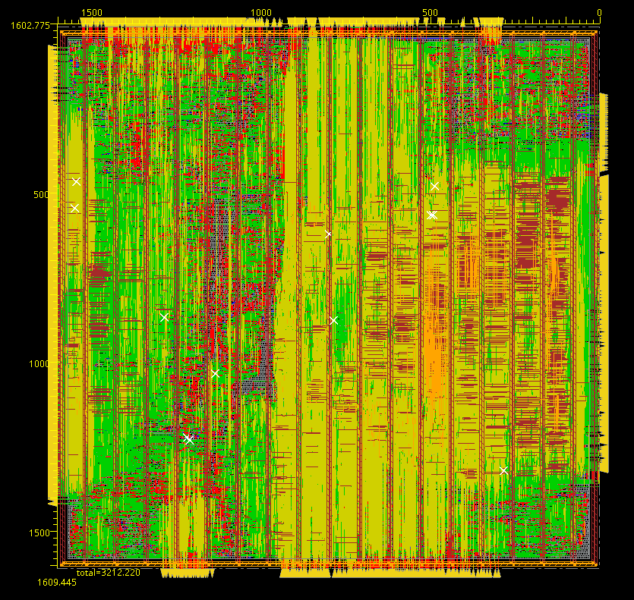
The result chip and its dimensions:

Slide 34
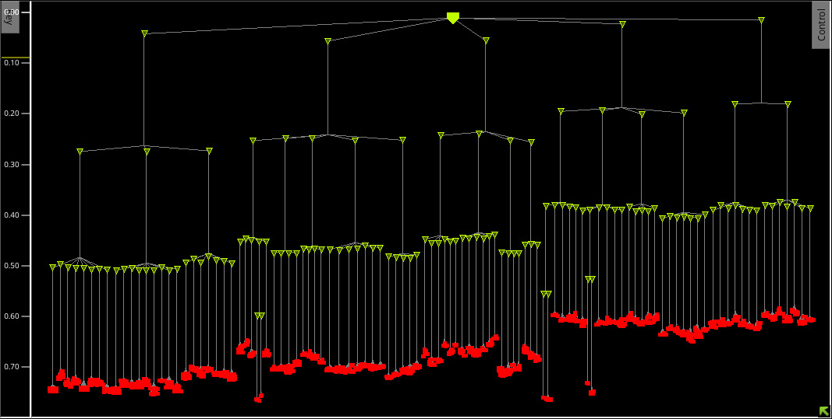
The clock tree:

Slide 35
Alternative solutions:
MetaCache:
A novel software for read classification using the big data technique minhashing.
MetaCache’s database consumes only 62 GB of memory while both Kraken and CLARK fail to construct their respective databases on a workstation with 512 GB RAM.
EDAM:
edit distance-tolerant content addressable memory for energy-efficient approximate search applications.
It includes over 2200 defined concepts and has successfully been used for annotations and implementations.

Slide 36
Summary and conclusions
The classification scheme is tuned towards classifying reads based on the amount of matching k-mers in a reference genome window of similar size to a read.
In conclusion, we have succeeded to build a hardware accelerator for LSH MinHash with an optimal parameters as our software search showed before. the optimal parameters: l=128byte, k=16byte, s=4 and OL=8byte.
We succeeded to get a significant acceleration in the hardware implementation: we gained 78x speedup over our software tool, 8x over Kraken, 9x over MetaCache and 11x over CLARK.
For a Future work:
The goal is to use a RAM not to build memory in the test bench.
Bigger data base (bigger reference genomes and more than 3 reference genomes).

Slide 37
Thank you for your time!

