Slide 1
ENM404 PRODUCTION SCHEDULING PROJECT
Evidence Track
Job Shop Scheduling with Simulated Annealing
• Formal JSSP model
• Operation-sequence decoder
• Simulated Annealing design
• Parameter tuning
• 5 benchmark instances
• 10 runs per instance
• Convergence and Gantt visuals
A benchmark-driven study covering mathematical formulation, from-scratch SA implementation, parameter tuning, convergence analysis, and live code demonstration.
Project Scope
Problem type: Job Shop Scheduling Problem (JSSP)
Metaheuristic: Simulated Annealing (SA)
Objective: minimize makespan (Cmax)
Benchmarks: FT and LA instances from JSPLIB / OR-Library
Assignment Compliance
The deck follows the brief structure: introduction, formulation, methodology, setup, results, discussion, conclusion, and live executable demo path.
Group Members
• Bora Özkaya
• Rıdvan Dündar
• Eren Tokgöz
• Tuğçe Soykan
• Şeymanur Bardakçı
Source: ENM404 project brief and local experiment workflow.
1

Slide 2
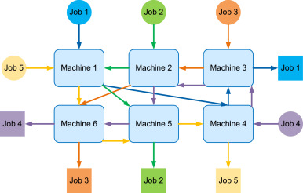
PROBLEM FRAMING
Job Shop is harder because every job has its own route.
Unlike flow shop, each job can visit machines in a different technological order. The search must coordinate job precedence and machine capacity at the same time.
Decision
Constraint
Objective
Find operation start times and machine orderings that produce a feasible schedule.
Each machine handles one operation at a time, and every job must follow its operation sequence.
Minimize makespan, Cmax, the completion time of the final operation in the schedule.
• Representation: each job id appears once for every operation
• Decoder converts a sequence into a feasible schedule
• SA searches by changing the operation sequence
Source: Local Python experiments, JSPLIB / OR-Library benchmarks.
2

Slide 3
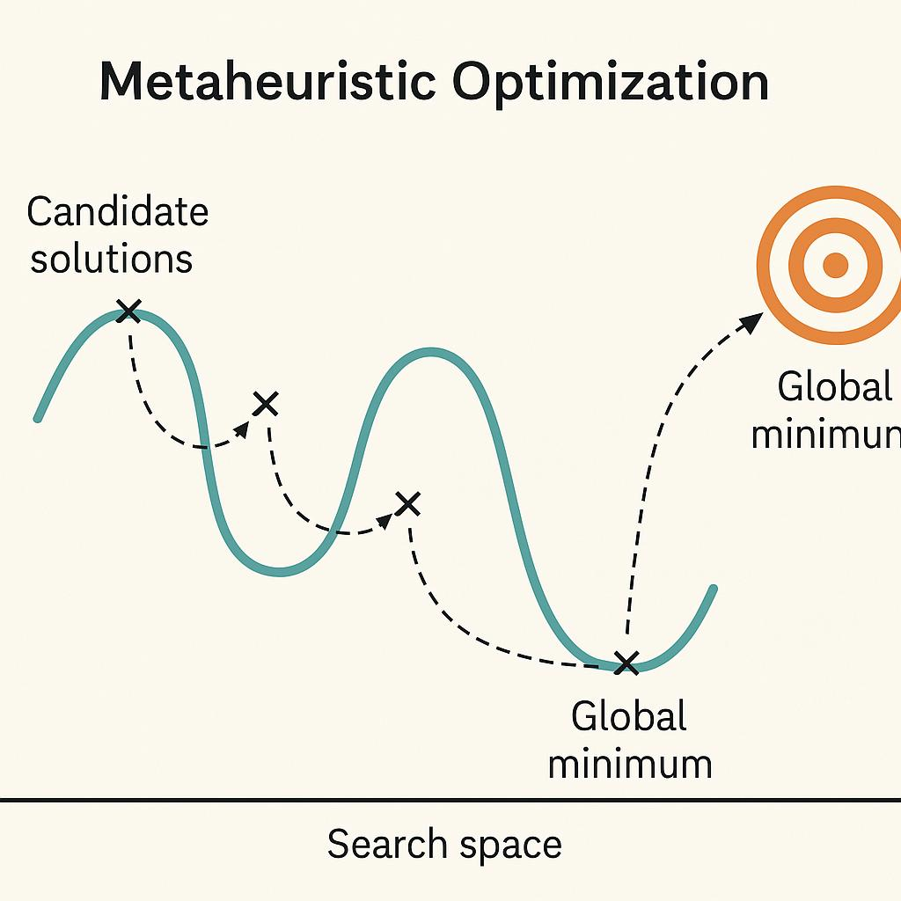
MATHEMATICAL MODEL
A solution is feasible only if precedence and machine capacity are both respected.
The model minimizes Cmax while enforcing route order for each job and no overlap on any machine.
Notation
Constraints
Objective
n jobs, m machines
p[j,k]: processing time
M[j,k]: required machine
C[j,k]: completion time
Cmax: maximum completion time
1. Job operation k+1 starts after operation k finishes.
2. A machine processes one operation at a time.
3. Operations are non-preemptive.
minimize Cmax
Cmax = max completion time over all scheduled operations
Source: Local Python experiments, JSPLIB / OR-Library benchmarks.
3

Slide 4
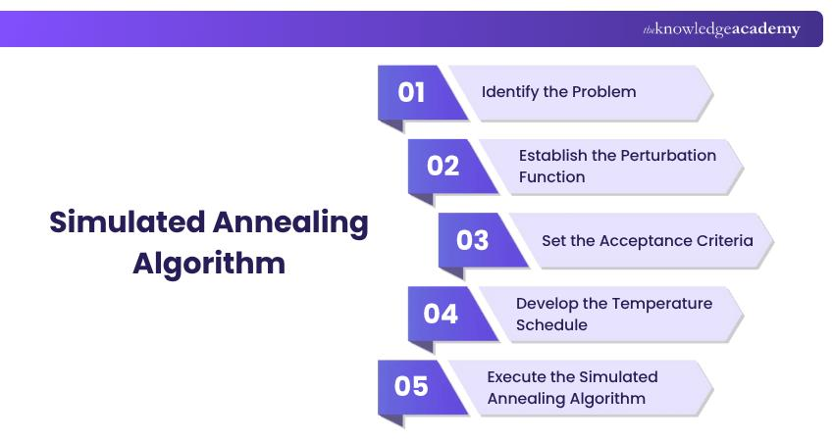
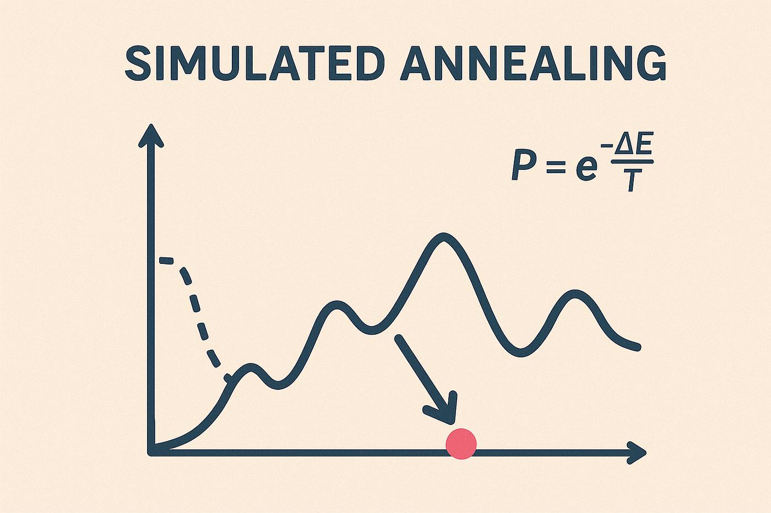
SA METHOD
Simulated Annealing accepts some worse moves early to escape local traps.
The algorithm starts from an SPT dispatch sequence, explores swap/insertion/reversal neighbors, and gradually reduces the probability of accepting worse schedules.
Initial Solution
Neighborhoods
Acceptance Rule
SPT dispatch sequence creates a quick feasible baseline. This baseline is intentionally simple, so SA improvement is visible.
Swap two positions
Insert one operation token elsewhere
Reverse a segment
All moves preserve the required number of operations per job.
If the candidate is better, accept it.
If worse, accept it with probability exp(-delta / T).
T cools every iteration.
Source: Kirkpatrick et al. (1983); local implementation.
4

Slide 5
IMPLEMENTATION
The code is structured for both grading and live demonstration.
The same scripts produce the tables, figures, and demo output used in the presentation.
Core Modules
Experiment Scripts
Live Demo
src/benchmark.py
- Loads JSPLIB instances
src/jssp.py
- Decodes sequences
- Computes schedules
src/sa.py
- Runs Simulated Annealing
run_experiments.py
- Tuning
- 10-run experiments
- CSV outputs
- Chart outputs
build_presentation_assets.py
- Slide-ready tables
demo_run.py
- Runs one instance fast
- Prints optimum, baseline, best result, gap, accepted moves, and convergence trace.
• Recommended command: python demo_run.py --instance ft10 --iterations 2500
• Full reproducibility command: python run_all.py
Source: Local Python experiments, JSPLIB / OR-Library benchmarks.
5

Slide 6
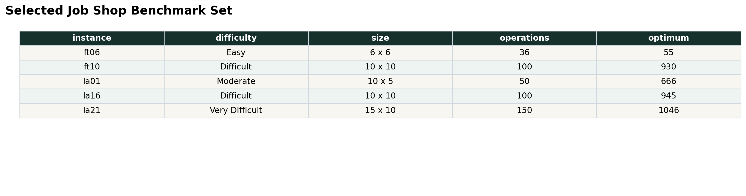
BENCHMARK SET
Five standard Job Shop instances cover easy through very difficult cases.
The selected FT and LA instances have known optimum references and are included locally in the data folder.
• FT06 and LA01 validate small and moderate behavior
• FT10 and LA16 test 10x10 difficult cases
• LA21 raises scale to 150 operations
Source: JSPLIB / OR-Library benchmark files included under data/raw/.
6

Slide 7
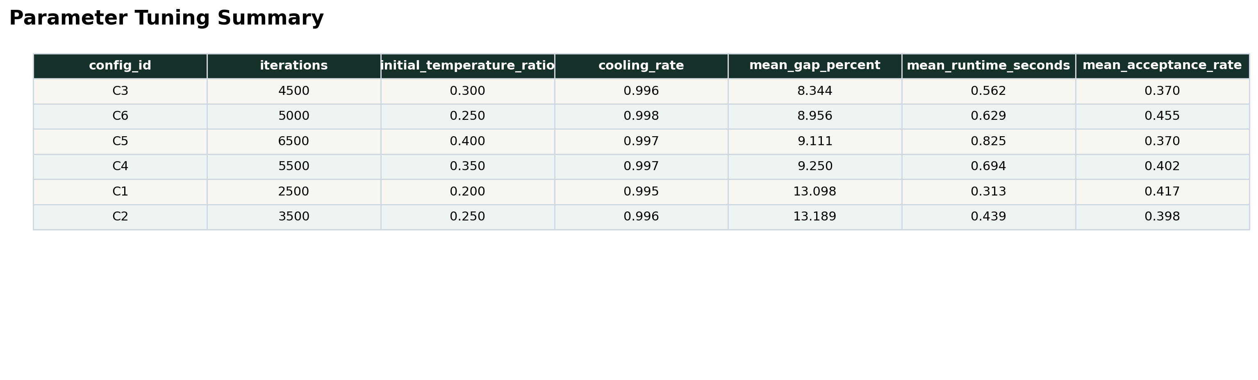
PARAMETER TUNING
The selected SA setting balances solution quality and runtime.
Six configurations were tested on FT10 and LA16 before running the final benchmark set.
Selected
Reason
Runtime
C3: 4500 iterations, T0 ratio 0.30, cooling 0.996
Lowest tuning score among tested configurations
Mean tuning runtime stayed below one second
Source: Local Python experiments, JSPLIB / OR-Library benchmarks.
7

Slide 8
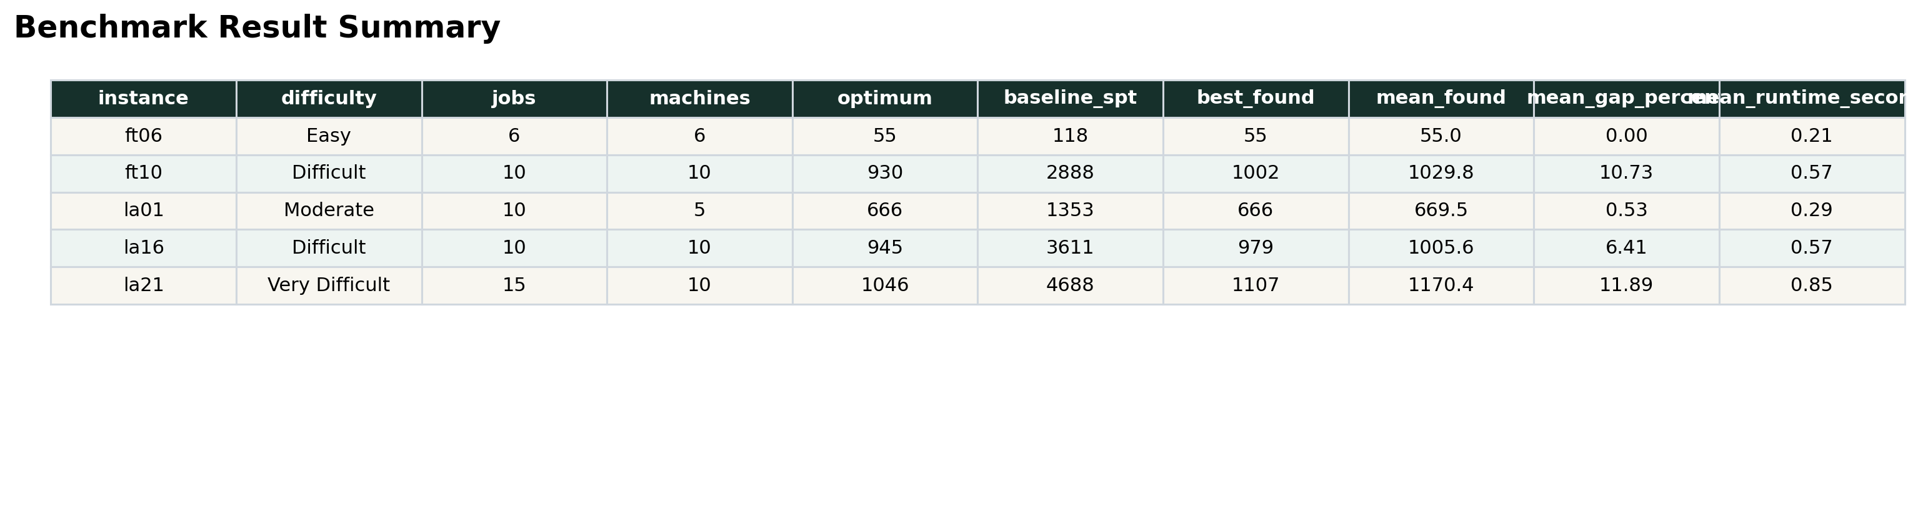
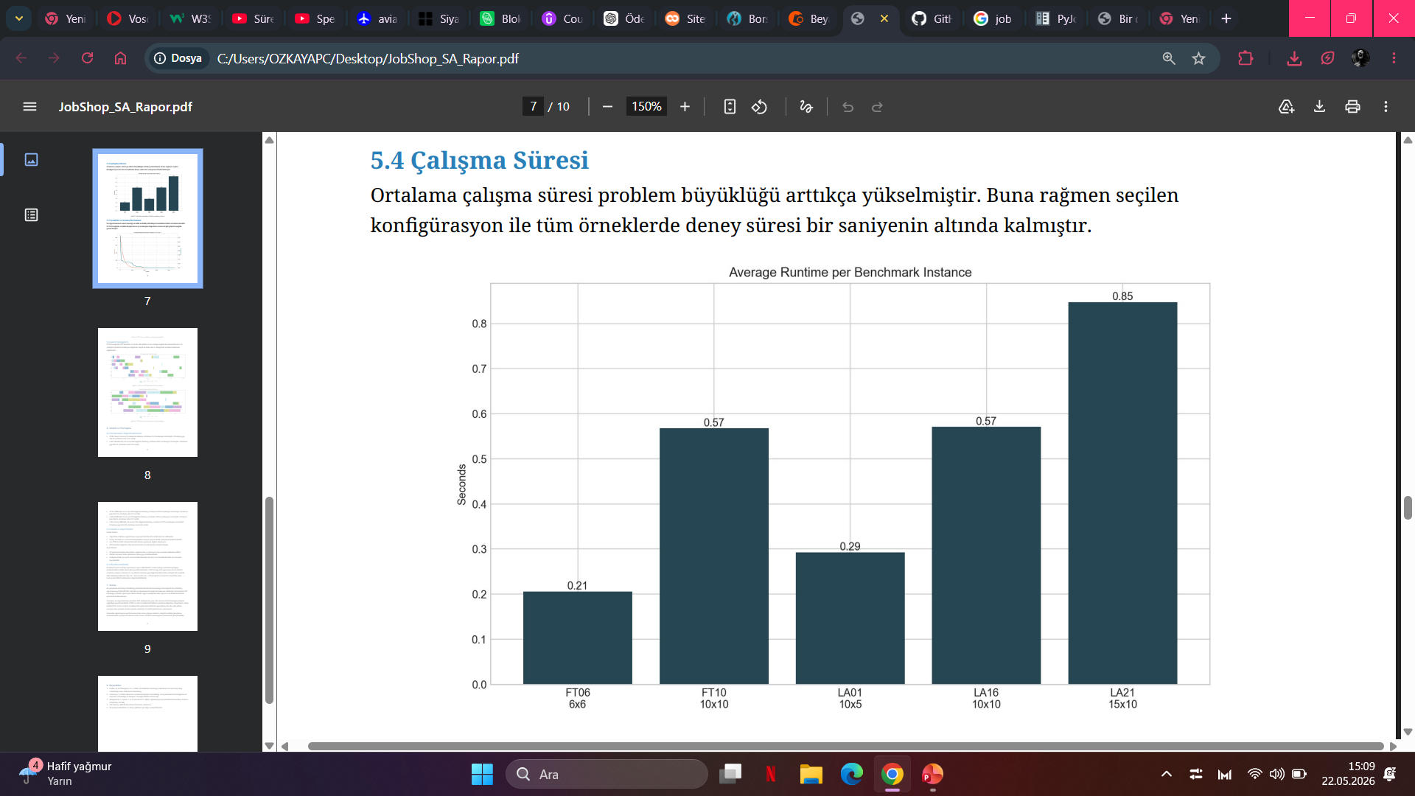
FINAL RESULTS
SA improves every selected benchmark against the SPT baseline.
Each instance was run 10 times using the selected tuned configuration.
• SA reached the known optimum on FT06 and LA01
• The difficult 10x10 and 15x10 cases keep non-trivial gaps
• All reported values come from run_experiments.py outputs
Source: Local Python experiments, JSPLIB / OR-Library benchmarks.
8

Slide 9
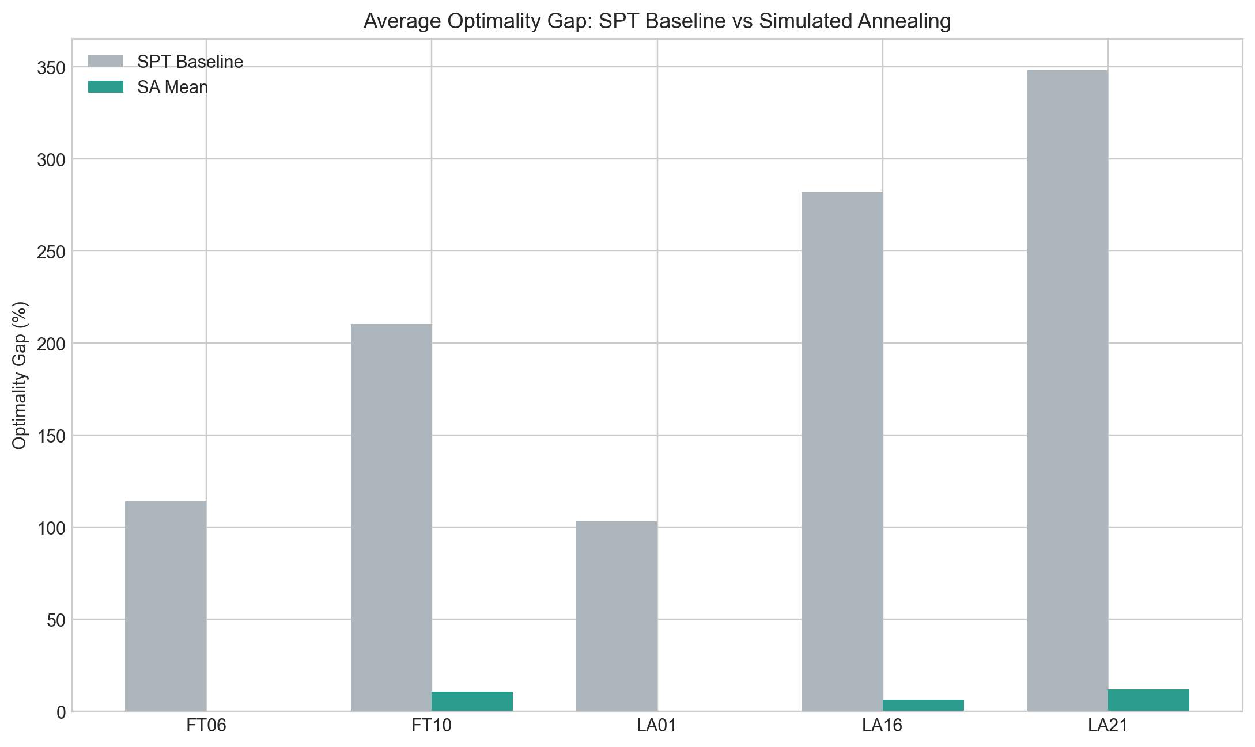
GAP COMPARISON
The baseline is intentionally simple; SA shows the search gain clearly.
Average gap versus the known optimum drops sharply across all selected instances.
Source: Local Python experiments, JSPLIB / OR-Library benchmarks.
9

Slide 10
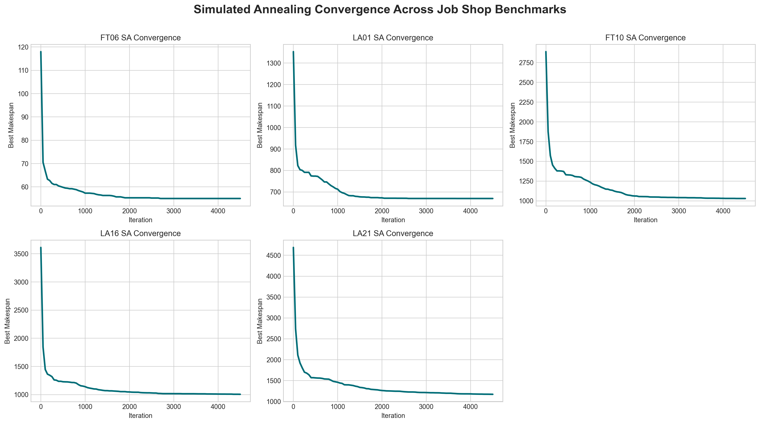
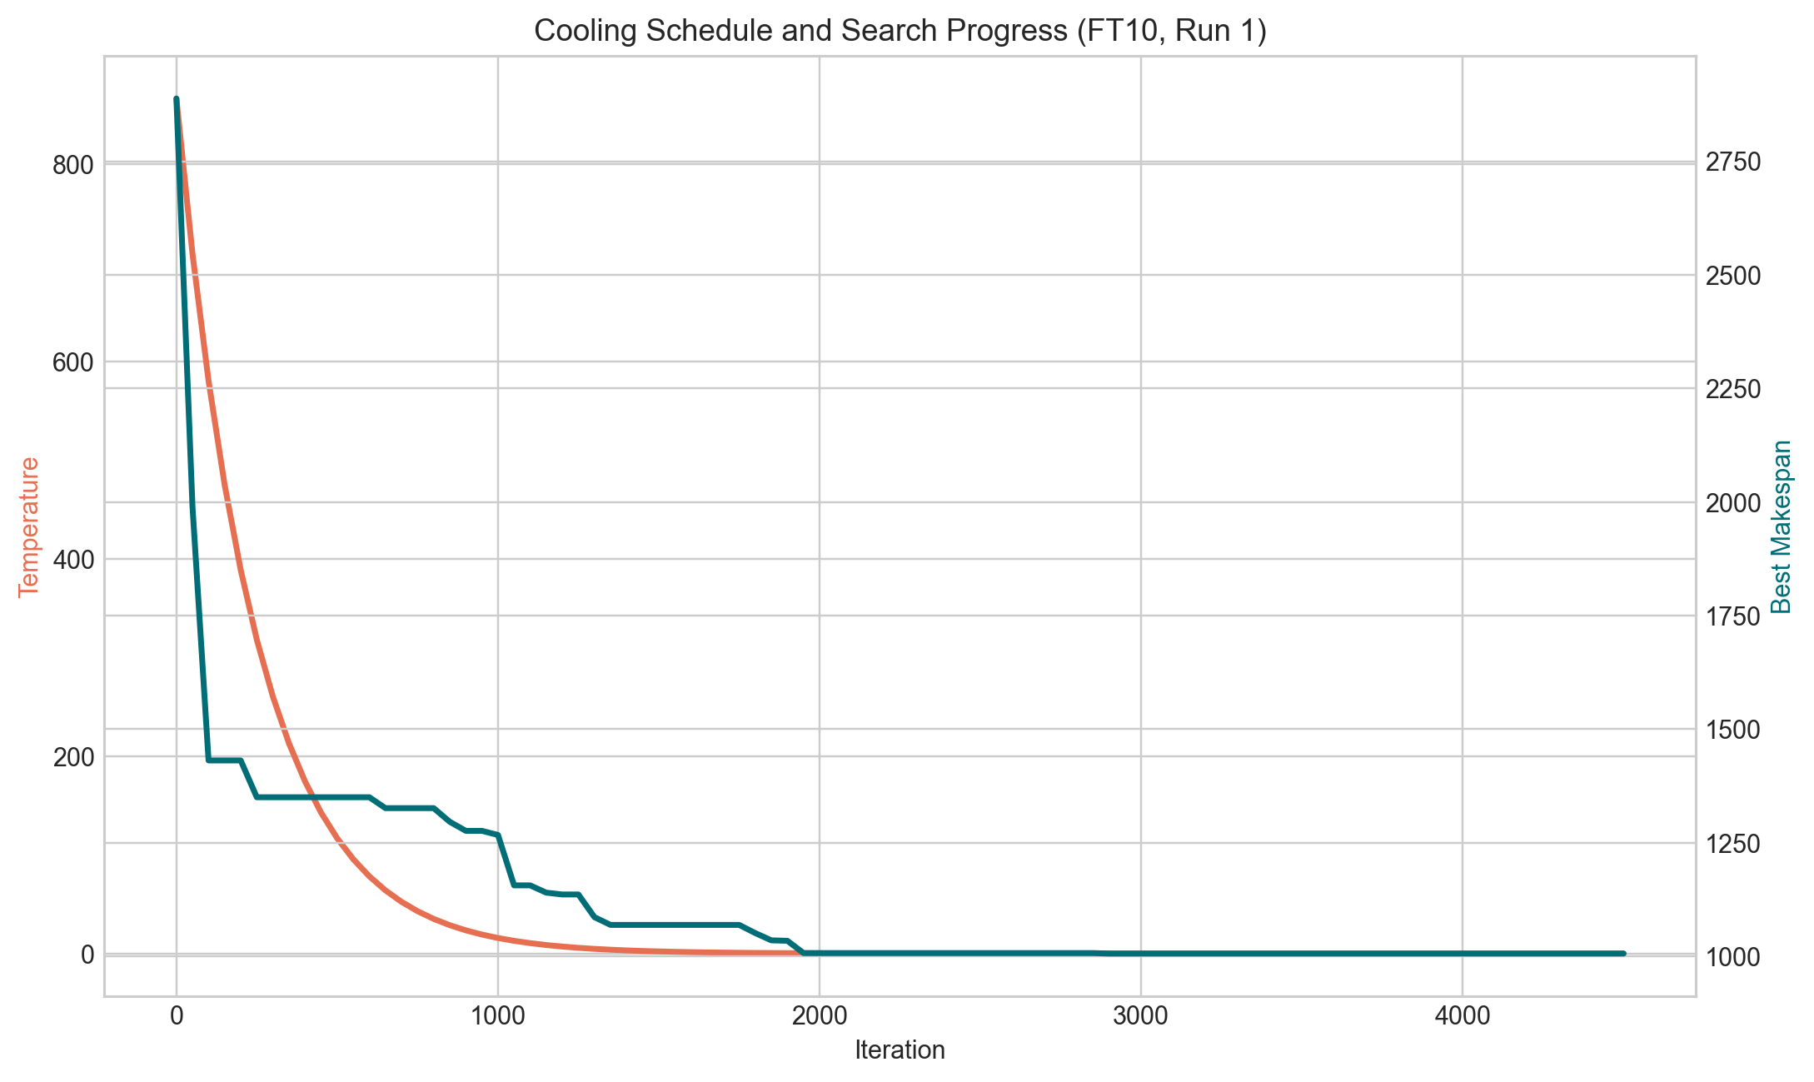
SEARCH DYNAMICS
Most improvement happens early, then cooling stabilizes the search.
Convergence and temperature plots show how SA moves from exploration toward refinement.
Source: Local Python experiments, JSPLIB / OR-Library benchmarks.
10

Slide 11
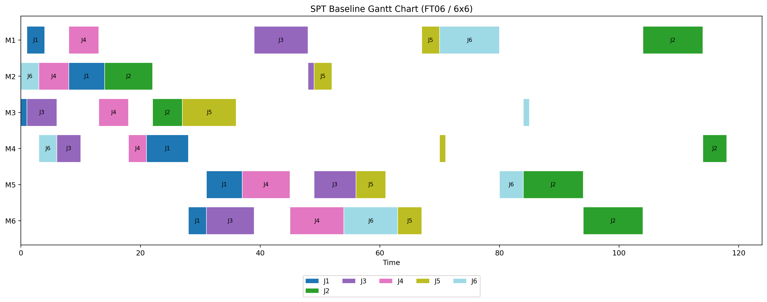
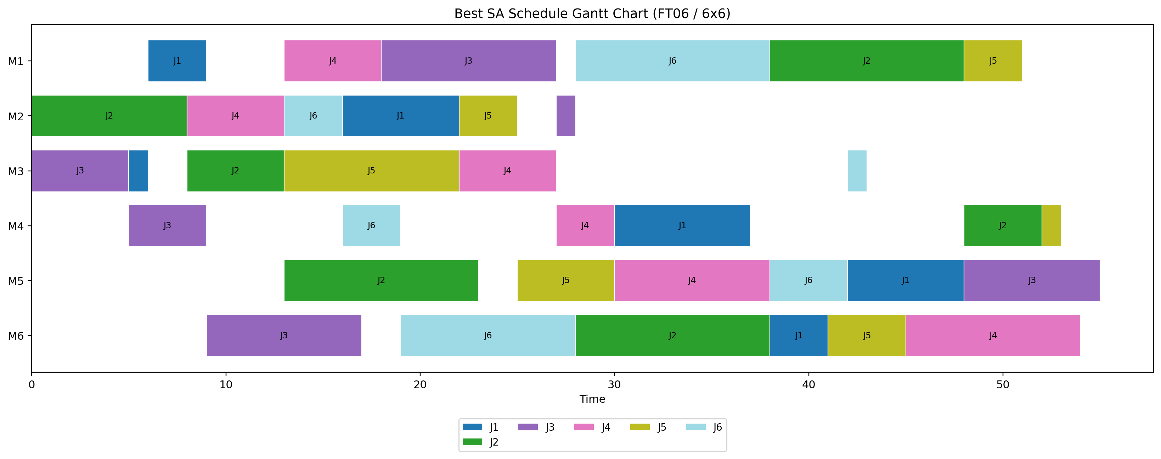
GANTT PROOF
The schedule visual confirms that the decoder creates feasible machine timelines.
The FT06 Gantt charts compare the SPT baseline and the best SA schedule from the experiment output.
SPT baseline
Best SA schedule
Source: Local Python experiments, JSPLIB / OR-Library benchmarks.
11

Slide 12
FINDINGS
The implementation is complete, reproducible, and strong enough for live explanation.
The strongest classroom story is how SA moves from a simple dispatch schedule to a tuned benchmark result.
What Worked
Limitations
How to Present
Reached optimum on FT06 and LA01
Improved all baselines
Fast enough for live demo
Visual outputs are generated by code
Cooling parameters matter
Large instances retain gaps
Decoder is reproducible but not a critical-path specialist
Show the deck first
Run demo_run.py live
Explain SPT baseline, best found, gap, and convergence trace
Source: Local Python experiments, JSPLIB / OR-Library benchmarks.
12

Slide 13
CLOSING
The project is ready for submission and live code demonstration.
The final package contains the deck, source code, real benchmark data, generated outputs, and a short demo path.
Submission Files
Live Commands
Group Members
presentation/job-shop-sa-final.pptx
docs/final_summary.md
outputs/tables/*.csv
outputs/figures/*.png
python demo_run.py --instance ft10 --iterations 2500
python run_all.py
Bora Özkaya
Rıdvan Dündar
Eren Tokgöz
Tuğçe Soykan
Şeymanur Bardakçı
All visual evidence in the deck is generated from the local experiment outputs.
Source: Local Python experiments, JSPLIB / OR-Library benchmarks.
13

