Slide 1
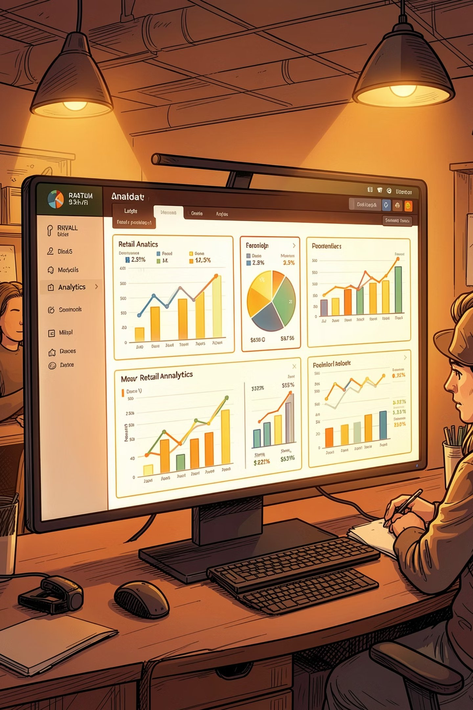
Customer Behavior Analysis
Shopping patterns, revenue trends, and demographics — powered by Python, SQL, PostgreSQL & Power BI

Slide 2

Project Overview
Python & Pandas
Data cleaning & preprocessing
PostgreSQL
Database storage via SQLAlchemy
Power BI
Interactive dashboard & visualization

Slide 3

Dataset Summary
Demographics
Purchases
Gender, age groups, subscription status
Categories, amounts, frequency, payment methods
Reviews
Shipping
Customer ratings & feedback
2-Day, Express, Free, Next Day Air, Standard, Store Pickup

Slide 4
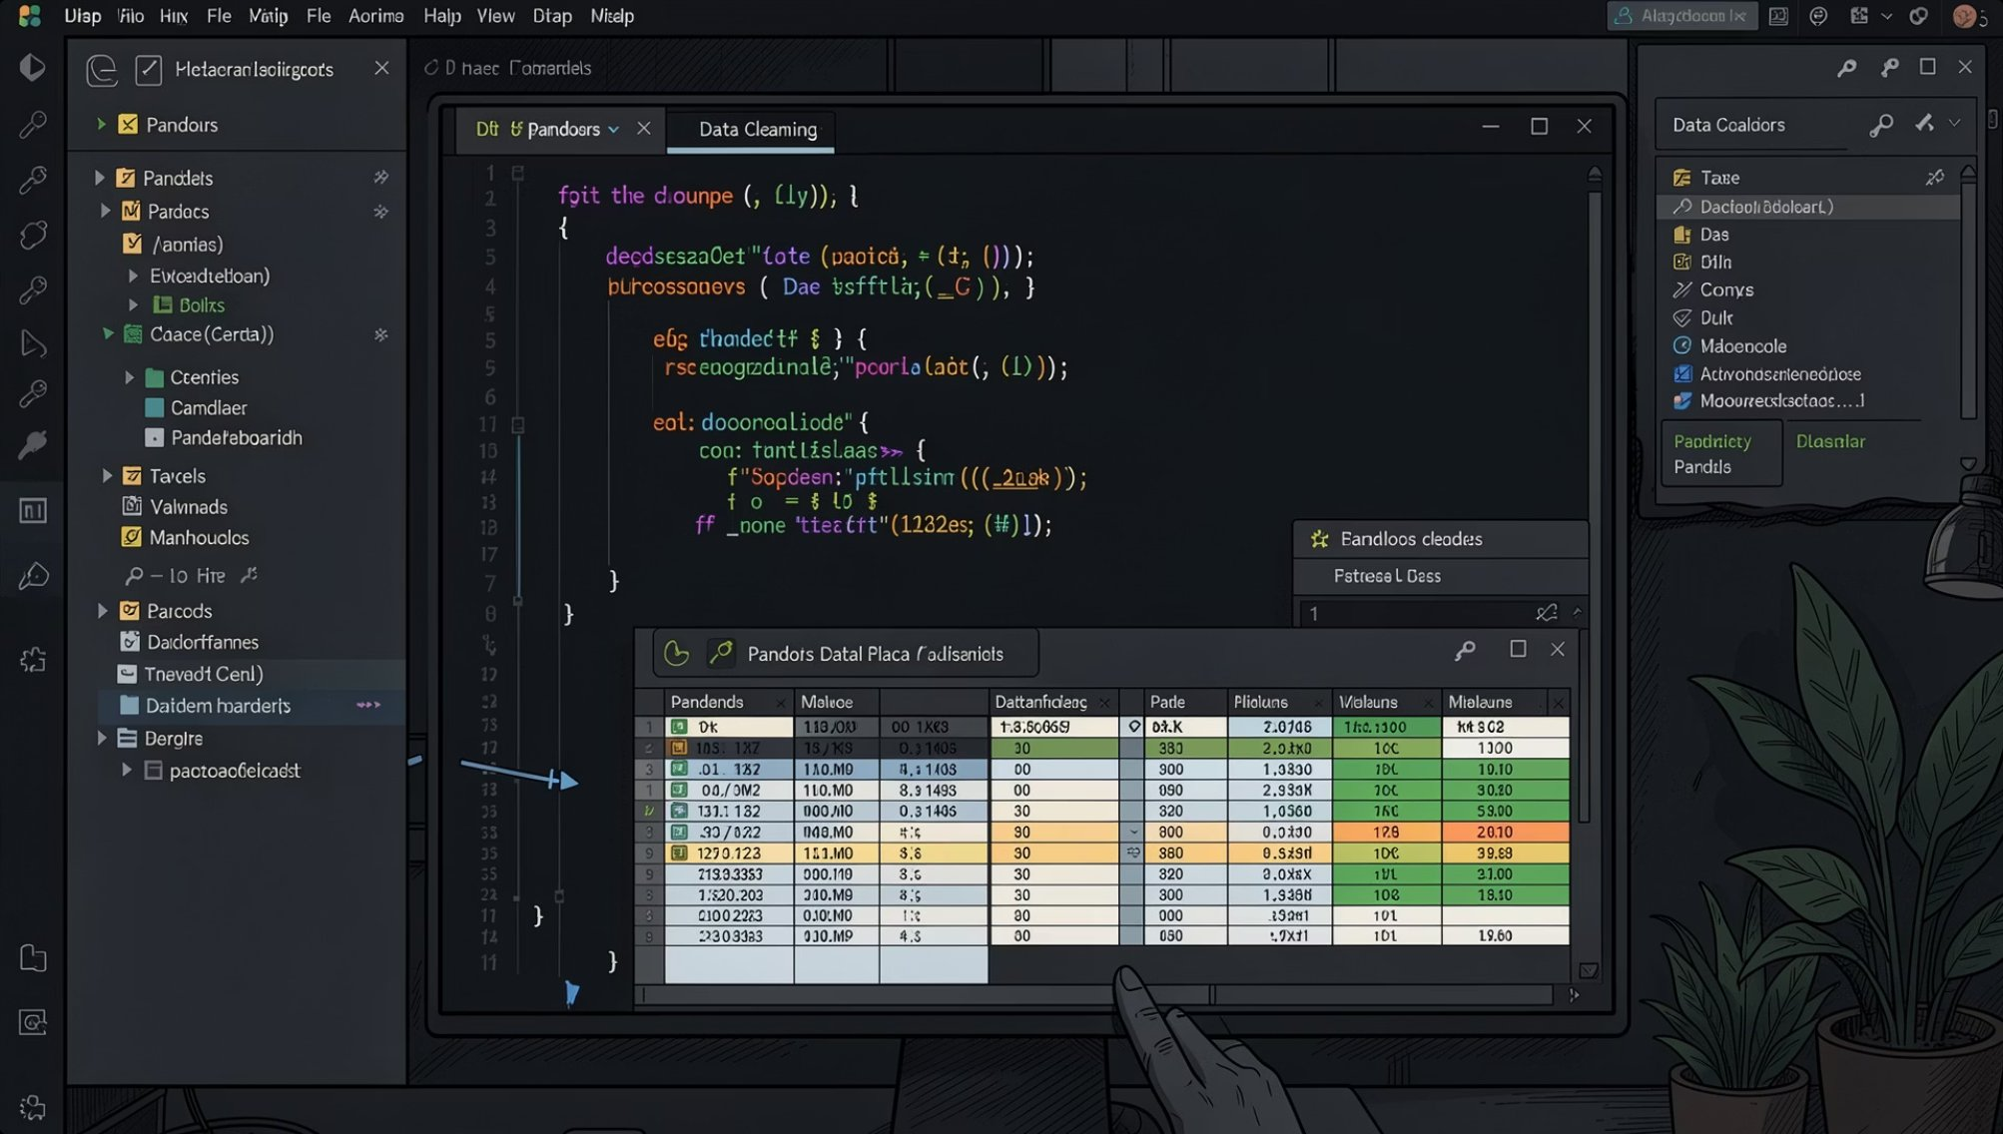
Exploratory Data Analysis
Python & Pandas Workflow
01
Standardize column names, remove unnecessary columns
02
Fill missing review ratings with median values
03
Segment customers: Young Adult, Adult, Middle-aged, Senior
04
Convert purchase frequency to numerical day format
05
Load cleaned dataset into PostgreSQL via SQLAlchemy

Slide 5
Key Metrics at a Glance
3.9K
$59.76
Avg Purchase
Total Customers
3.75
73%
Avg Review Rating
Non-Subscribers

Slide 6
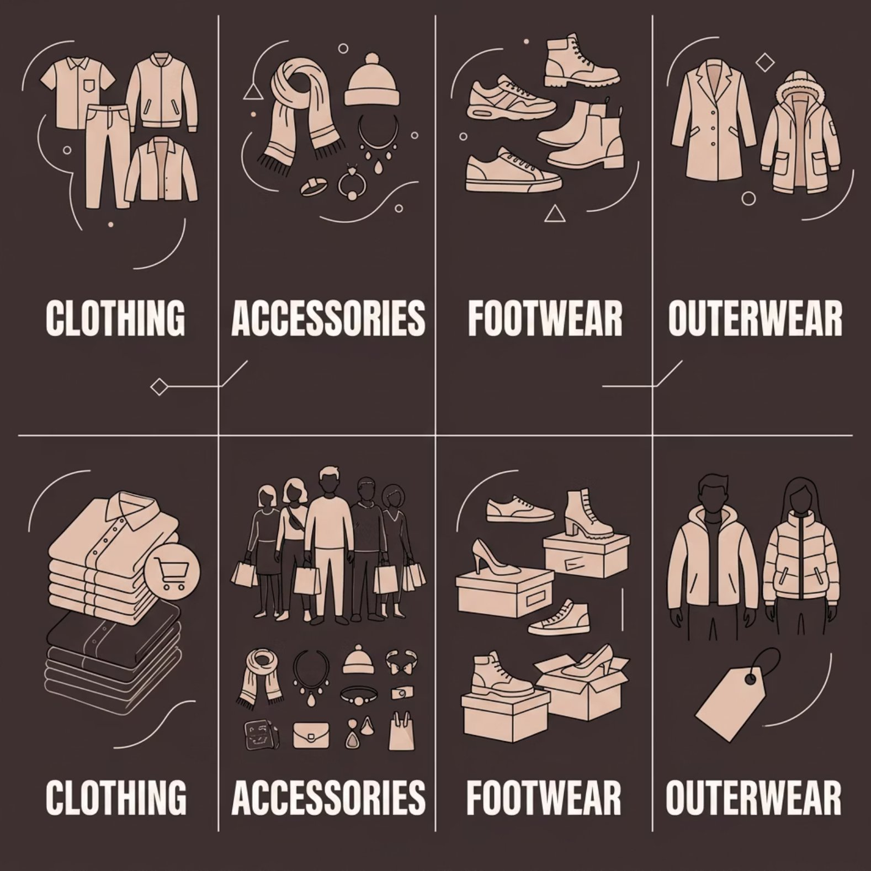

Revenue & Sales by Category
Category Performance
👗 Clothing
Highest revenue & sales volume
👜 Accessories
Second in revenue
👟 Footwear & Outerwear
Lower but consistent contribution

Slide 7
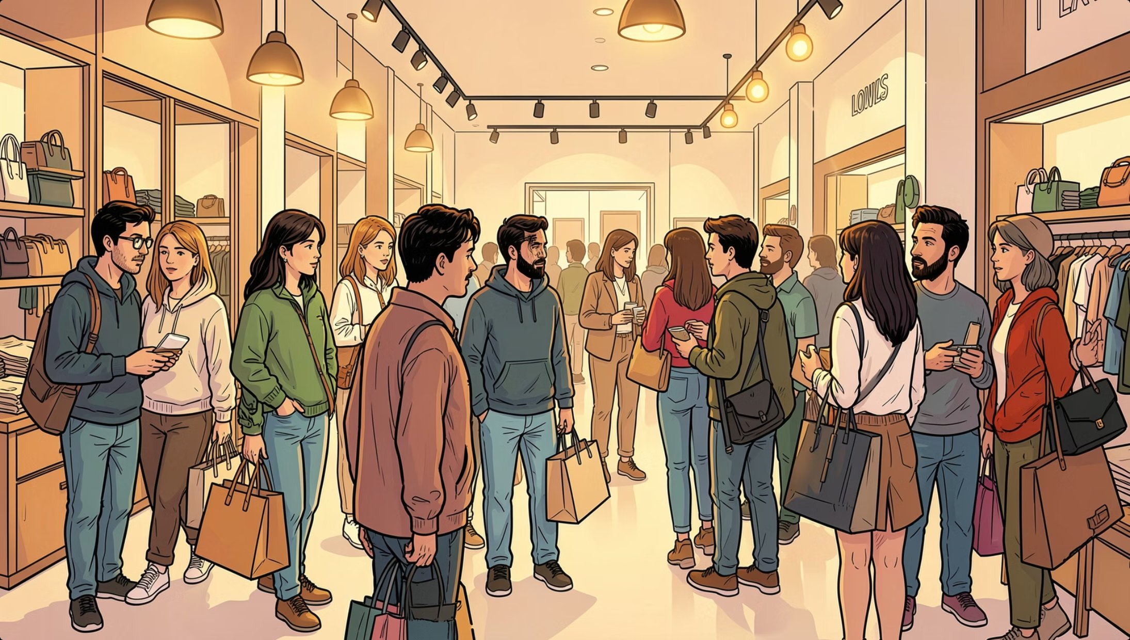
Customer Insights
Young Adults Lead
Highest sales & revenue across all age groups
Male Customers
Generated higher revenue than female customers
Subscription Gap
Only 27% subscribed — major growth opportunity

Slide 8

Business Recommendations
Boost Subscriptions
Loyalty rewards & exclusive offers
Focus on Clothing
Top revenue category — prioritize marketing
Target Young Adults
Personalized recs & social campaigns
Improve Engagement
Better shipping & customer support

