Slide 1

ML 2025 Project
Authors: Leonardo Celati · Damiano Degliotti · Daniele Melaccio
Team Name: CDM25
Master Degree: Informatica Umanistica
Type of Project: B
Notes:
[Sources]
- ML-2025-PRJ-Slides-Demo-v0.1.pptx (layout and reporting requirements)
- Local project notebooks listed in source-notes.txt

Slide 2
Objectives
Common
Evaluate state-of-the-art machine learning frameworks and use them to develop a structured collection of notebooks addressing the MONK and CUP type B assignment requirements.
PyTorch was used for neural-network implementation, while scikit-learn was adopted for other machine learning models (SVM, KNN,..).
Monk
Develop a reusable framework for model selection and comparison across KNN, kernel-based SVMs and neural networks on the three MONK classification tasks. For MONK-3, provide both regularized and unregularized neural-network configurations
The resulting framework serves as the methodological and software foundation for the CUP task.
CUP
Reuse the shared framework to build a regression pipeline for ML-CUP25, using Mean Euclidean Error as the primary model-selection metric.
Combine complementary models through ensemble weights learned exclusively from out-of-fold predictions.
Produce a reproducible blind-test submission in the required CUP format.
Notes:
[Sources]
- monk_SVM.ipynb; monk_KNN.ipynb; monk_NN_1.ipynb; monk_NN_2.ipynb; monk_NN_3.ipynb
- cup_KNN.ipynb; cup_SVM.ipynb; cup_NN_manual.ipynb; cup_Ensemble.ipynb

Slide 3
Model selection — methodological overview
Data preparation
MONK categorical attributes were transformed using canonical one-hot encoding.
CUP preprocessing was performed within each training fold to prevent data leakage.
The CUP labelled set was split once into 400 development and 100 internal-test cases.
Hyperparameter selection
Scikit-learn models: exhaustive GridSearchCV over discrete, model-specific search spaces.
Neural networks: sequential Optuna optimization to keep the search computationally feasible.
The task-specific validation metric (MEE for the CUP and MSE for MONK) was the primary selection criterion; training–validation gaps and complementary metrics such as MSE, RMSE and R² were used diagnostically for the CUP.
Verification and assessment
Nested CV was used on CUP to quantify selection optimism for scikit-learn models.
Dedicated manual NN notebooks were built to verify the Optuna-selected configurations.
All choices were frozen before the single evaluation on the untouched internal test.
Notes:
[Sources]
- MONK experiment notebooks
- cup_Ensemble.ipynb

Slide 4
Model selection — GridSearchCV methodology
GridSearchCV was used for the scikit-learn models because their hyperparameter spaces were discrete, bounded and computationally manageable for it evaluates every combination in each predefined model-specific grid. All preprocessing operations were included in a Pipeline, ensuring that scaling was fitted independently within each training fold and preventing information leakage. The workflow was:
Model-specific search spaces: separate grids were defined for each models according to the parameters relevant to each estimator.
Fold-local preprocessing: scaling and model fitting were combined in a single pipeline, so each candidate configuration was evaluated using only the training portion of each fold.
Exhaustive cross-validated search: every hyperparameter combination was evaluated on the development set using the same shared cross-validation strategy and MEE as the primary selection criterion.
Nested-CV diagnostic assessment: an inner three-fold GridSearchCV was embedded within the outer cross-validation loop to estimate selection bias and compare nested and non-nested results.
Configuration freezing and refit: eventually the selected configuration was frozen and refitted on the complete development set to perofrm a single internal-test assessment.
Notes:
[Sources]
- cup_common.py (deterministic 400/100 split)
- cup_Ensemble.ipynb (development-only OOF selection; internal evaluation; 500-row refit)

Slide 5
Model selection — Optuna methodology
Optuna hyperparameters were optimized sequentially with a coarse-fine approach to reduce the dimensionality of each search and make the computational cost manageable. For CUP we further compared three different run each with a fixed PyTorch TRAINING_SEED to provides a reproducible and computationally feasible model-selection procedure. Each selected config was then tested on manual notebook with three different seed resulting in 9 search in total from which we picked the best configuration based on metrics evaluation (see Monk and Cup section). Pipeline sequence:
Learning rate: establishes stable and effective convergence and the reliability of all subsequent comparisons. The search interval has been tuned by observing lr that didn’t fall at the boundary.
Batch size: controls gradient noise and optimization dynamics.
Weight decay: tuned under a reasonably stable training configuration, allowing its effect on generalization to be evaluated more clearly. Again the interval allow the results not to fall at the boundary.
Architecture and activation: they were explored at this stage because these choices are computationally more expensive and their comparison is meaningful only after the main optimization and regularization parameters have been stabilized.
Final cross-validation: verifies the complete selected configuration before internal assessment.
Notes:
[Sources]
- cup_common.py (deterministic 400/100 split)
- cup_Ensemble.ipynb (development-only OOF selection; internal evaluation; 500-row refit)

Slide 6
MONK KNN results and hyperparameters overview
KNN models were selected by 5-fold stratified cross-validation over k, distance weighting and Minkowski order, then refitted on each complete training set. Note: With distance-weighted KNN, the training error might be zero by construction, as each training point dominates its own prediction.
Task | Architecture and hyperparameters | MSE (TR / TS) | Accuracy (TR / TS)
MONK-1 | k=7; Manhattan (p=1); distance weights | 0.00000 / 0.17130 | 100.00% / 82.87%
MONK-2 | k=21; Manhattan (p=1); uniform weights | 0.32544 / 0.34954 | 67.46% / 65.05%
MONK-3 | k=35; Manhattan (p=1); distance weights | 0.00000 / 0.06019 | 100.00% / 93.98%
Notes:
[Sources]
- monk_KNN.ipynb
- MSE and accuracy recomputed from the final fitted models on the original MONK TR/TS sets.

Slide 7
MONK SVM results and hyperparameters overview
SVM models were selected by 5-fold stratified cross-validation over kernel-specific parameters and regularization strength C, then refitted on each complete training set. Note: all the Monk Learners lead towards Polynomial Kernel as the best performers.
Task | Architecture and hyperparameters | MSE (TR / TS) | Accuracy (TR / TS)
MONK-1 | Polynomial; C=1; gamma=1; degree=2 | 0.00000 / 0.00000 | 100.00% / 100.00%
MONK-2 | Polynomial; C=10; gamma=1; degree=2 | 0.00000 / 0.00000 | 100.00% / 100.00%
MONK-3 | Polynomial; C=10; gamma=0.1; degree=3 | 0.04098 / 0.01852 | 95.90% / 98.15%
Notes:
[Sources]
- monk_SVM.ipynb
- MSE and accuracy recomputed from the final fitted models on the original MONK TR/TS sets.

Slide 8
MONK NN results and hyperparameters overview
Optuna-derived NNs use SGD with common momentum and Nesterov acceleration, BCEWithLogits loss and mini-batches of 20. Note for MONK-3: (1) the unregularized run is a diagnostic comparison (2) Optuna was not particularly efficient in exploring the search space due to small train set so we ended up manually experimenting hyperparameters tuning.
Task | Architecture and hyperparameters | MSE (TR / TS) | Accuracy (TR / TS)
MONK-1 | 8 ReLU; η=0.02991; λ=6.42×10⁻⁶; μ = 0.9, 458 ep. | 2.52×10⁻⁶ / 4.76×10⁻⁴ | 100.00% / 100.00%
MONK-2 | 8–16 ReLU; η=0.02976; λ=2.93×10⁻⁵; μ = 0.9, 112 ep. | 7.09×10⁻⁷ / 1.12×10⁻⁶ | 100.00% / 100.00%
MONK-3 | 5 ReLU; η=0.02818; λ=0.05; μ = 0.9, 23 ep. | 0.07232 / 0.06169 | 93.44% / 97.22%
MONK-3 no reg. | 5 ReLU; η=0.02818; λ=0; μ = 0.9, 1000 ep.; no ES | 0.04934 / 0.02324 | 97.54% / 94.44%
Notes:
[Sources]
- monk_NN_1.ipynb
- monk_NN_2.ipynb
- monk_NN_3.ipynb
- Regularized TR/TS MSE and accuracy were recomputed from the final full-training models.
- The unregularized MONK-3 run is a hold-out diagnostic; its notebook reports test accuracy rounded to 95% and does not report final test MSE.

Slide 9
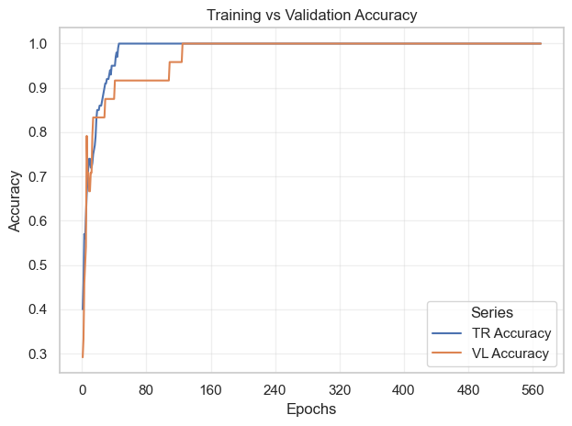
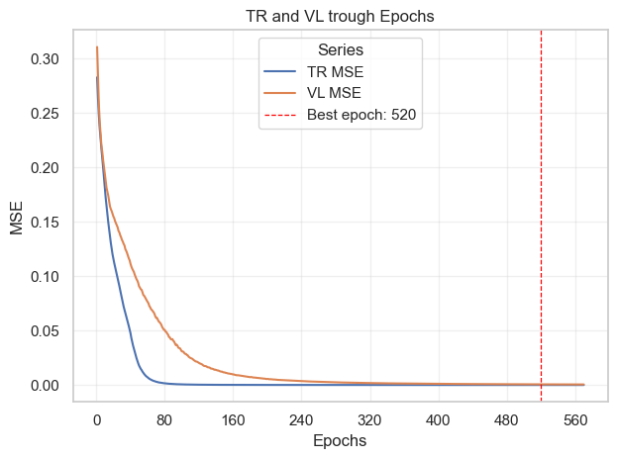
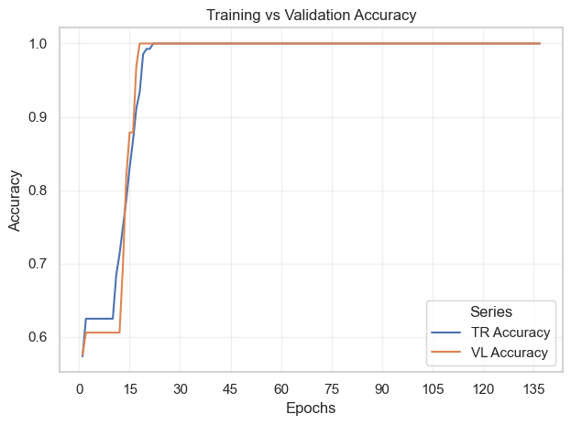
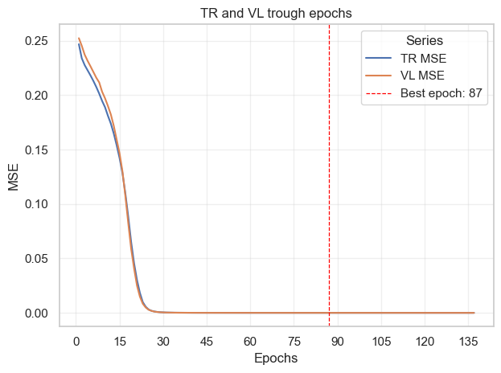
MONK NN results (1/2)
MONK-1 100% training and validation reaches accuracy, with both MSE curves converging smoothly. The hold-out curve selects epoch 520; the final model is refitted for 458 CV-median epochs, the median selected across CV folds.
MONK-2 rapidly reaches 100% training and validation accuracy, while the closely aligned MSE curves converge near zero. The hold-out curve selects epoch 87; the final refit uses 112 CV-median epochs.
Notes:
[Sources]
- monk_NN_1.ipynb
- Learning curves and reported final test accuracy are taken from the executed notebook outputs.

Slide 10
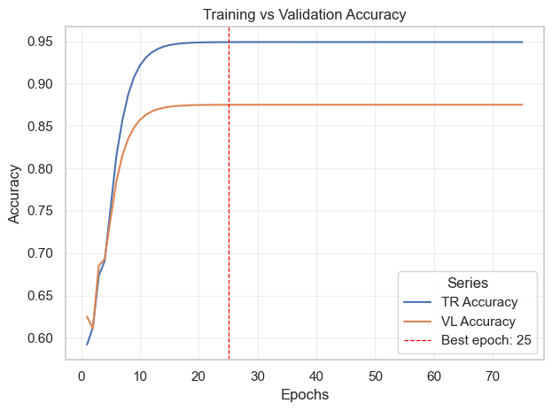
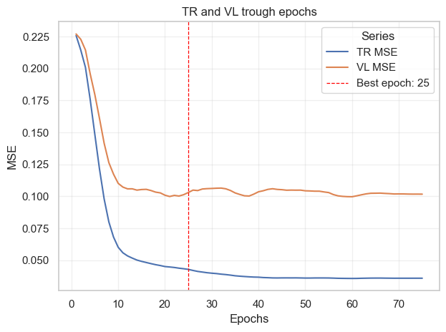
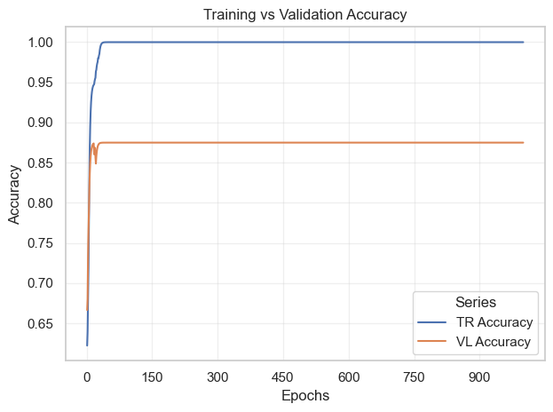
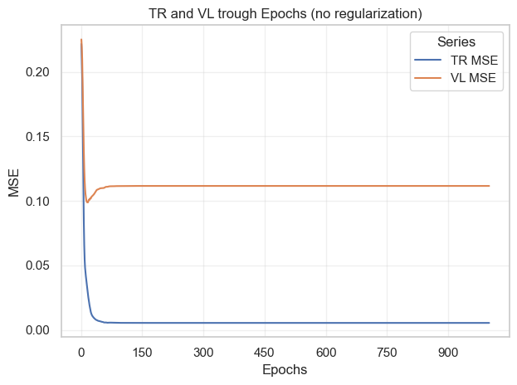
MONK NN results (2/2)
MONK-3 Regularization controls overfitting: hold-out validation MSE is minimized at epoch 25 where a model snapshot is taken. The final refit reaches 97% test accuracy.
MONK-3 Without early stopping and weight decay, training MSE keeps falling while validation MSE rises with a consistent gap trough remaining epochs. The final refit reach 94% test accuracy.
Notes:
[Sources]
- monk_NN_3.ipynb
- Learning curves and reported final test accuracy are taken from the executed notebook outputs.

Slide 11
CUP validation leakage controls
The following controls preserve the independence of model selection, internal assessment and blind-test prediction on CUP assignment:
Split isolation: the 100-case internal test is separated before model selection and remains untouched until the final assessment, i.e. with frozen configuration.
Fold-local preprocessing: scalers and other preprocessing operations are fitted exclusively on the training portion of each fold natively by scikit-learn and custom implemented by functions built on top of PyTorch.
Strict OOF predictions: every OOF prediction is produced by a model that was not trained on the corresponding example.
Training-only optimization: hyperparameters and ensemble weights are selected exclusively using development-set cross-validation and OOF predictions.
Frozen assessment: configurations and ensemble weights are fixed before the internal test is evaluated.
Blind-test isolation: the 1,000 blind examples are never used for preprocessing, model selection, weight optimization or performance estimation.
Bootstrap uncertainty: bootstrap resampling is applied only after all model choices have been frozen, providing an estimate of the variance and confidence interval of the final internal-test MEE without influencing model selection.
Notes:
[Sources]
- cup_Ensemble.ipynb
- cross_common.py
- nn_common.py

Slide 12
CUP model-selection — search space definition
All searches use only the 400-case development set. Scikit-learn configurations are selected by five-fold GridSearchCV while nested 5×3-fold CV is used as a less biased performance check. The NN search is organized as sequential Optuna studies eventually verified on the cup_NN_manual.ipynb with a combination of configuration – seed to explore metric consistency.
Model | Search and validation | Explored hyperparameters | Evaluations and criterion
KNN | 5-fold GridSearchCV; nested 5×3 check | k=1–39 odd; p={1,2}; uniform; Standard/Robust scaling | 80 configurations; min. mean CV MEE
SVR | 5-fold GridSearchCV; nested 5×3 check | Custom RBF/RBF/poly.; C=10⁻²–10⁴; γ=10⁻⁴–3/scale; ε=.01–.8; degree 2–3 | 348 configurations; min. mean CV MEE
LinearSVR | 5-fold GridSearchCV; nested 5×3 check | C=10⁻⁴–10³; ε-insensitive/squared; dual={T,F}; 20k iterations | 24 configurations; min. mean CV MEE
NN | Sequential Optuna; 3/5-fold CV; MedianPruner | η and λ: coarse→local; batch=16–128; 13 architectures;Activations: ReLU/Tanh/GELU | 160 trials; VL MEE + TR–VL gap diagnostic
Notes:
[Sources]
- cup_KNN.ipynb: 80 configurations; k=1..39 odd, p in {1,2}, uniform weights, StandardScaler/RobustScaler.
- cup_SVM.ipynb: 348 configurations across custom-RBF, RBF and polynomial grids.
- cup_LinearSVR.ipynb: 24 configurations across C, loss and dual settings.
- cup_NN_optuna.ipynb: sequential studies of 20 coarse-LR, 30 fine-LR, 20 batch-size, 20 coarse-weight-decay, 30 fine-weight-decay and 40 architecture trials (160 calls in total). The notebook defines a 35-trial fine-weight-decay variable, but its optimize call uses the 30-trial fine-grained variable; this slide reports the actual call.

Slide 13
CUP model-selection — Optuna sensitivity to training seed
With fixed Optuna sampling and CV folds, predictive performance remains relatively stable while the selected NN configuration changes across training seeds. This suggests that there are several regions of search space with comparable performance. The three finalists were therefore be re-evaluated under every seed on the dedicated cup_NN_manual.ipynb.
Run / training seed | MEE (TR / CV) · gap | Architecture | Optimization
Run 1 · seed 1 | 16.0696 / 21.0251 Gap 4.9554 | [256] · Tanh | Batch 64 · LR 0.10855 WD 4.67×10⁻⁵
Run 2 · seed 10 | 13.9237 / 20.3317 Gap 6.4079 | [128, 64] · GELU | Batch 16 · LR 0.04678 WD 6.55×10⁻³
Run 3 · seed 20 | 17.4577 / 21.4611 Gap 4.0034 | [64, 64] · GELU | Batch 32 · LR 0.10890 WD 5.27×10⁻⁶
Across runs | CV MEE 20.939 ± 0.465 Mean gap 5.122 | Three distinct optima | Stable error range; seed-sensitive choices
Notes:
[Sources]
- cup_NN_optuna.ipynb: three complete Optuna runs with TRAINING_SEED values 1, 10 and 20; OPTUNA_SEED=1 and CV_RANDOM_STATE=42 fixed.
- Aggregate CV MEE: mean 20.9393, population standard deviation 0.465; mean TR–VL gap 5.1222.
- The internal test was not used in this comparison.

Slide 14
CUP model-selection — NN frozen-model assessment
Performance evidence
The frozen [128, 64] GELU network reduced MEE from the 35.44 baseline to 22.83.
Cross-validation and the diagnostic hold-out agreed closely: 20.28 ± 0.82 versus 20.08 MEE.
The bootstrap OOB estimate, 22.72 ± 1.09 MEE, almost matched the independent internal result (Δ = 0.11).
The internal result was 2.55 MEE worse than CV, revealing moderate CV optimism on the 100 held-out cases.
Interpretation and decision
Final training reached the CV-derived target at epoch 171 (TR MEE = 15.52). The 7.31 TR–internal gap indicates residual overfitting, but bootstrap agreement and the strong baseline improvement support useful generalization. Configuration, training procedure and seed were frozen before assessment; the internal result is not used for further tuning.
There was insufficient evidence to override the systematically selected Optuna configuration. Any manual configuration we tried seemed to break the trade off between the hyperparams combination. Suggesting what we well know: the hyperparams are strictly interconnected.
Notes:
[Sources]
- cup_NN_manual.ipynb: frozen configuration-2 run with TRAINING_SEED = 1; CV, hold-out, bootstrap OOB, final-training and internal-test outputs.
- cross_common.py / nn_common.py: project metric and training implementations.

Slide 15
CUP model-selection — results and hyperparameters
On the untouched 100-case internal test, KNN remains the strongest individual model. RBF-SVR stays competitive, while the NN shows the largest generalization error. LinearSVR was eventually excluded form ensemble for poor performance and used more as an intermediate baseline.
Model | Architecture and selected hyperparameters | MEE (TR / internal TS) | CV validation MEE
NN | 128–64–32 GELU; AdamW; η=0.008375; λ=1.05×10⁻⁵; mini-batch 16 | 12.7045 / 22.0251 | 20.0802 ± 0.4017
KNN | k=5; Euclidean (p=2); uniform weights; StandardScaler | 13.2870 / 15.4430 | 17.1390 ± 0.2021
RBF-SVR | C=100; γ=3; ε=0.1; four independent outputs | 0.2599 / 18.1632 | 17.6784 ± 0.6903
LinearSVR* | C=0.01; squared ε-insensitive; dual=False; max_iter=20,000 | 24.9427 / 26.8403 | 25.1892 ± 0.8073
Notes:
[Sources]
- cup_NN_manual.ipynb: CV validation MEE 20.0802 ± 0.4017; training MEE 12.7045; internal-test MEE 22.0251.
- cup_KNN.ipynb: CV validation MEE 17.1390 ± 0.2021; training MEE 13.2870; internal-test MEE 15.4430.
- cup_SVM.ipynb: CV validation MEE 17.6784 ± 0.6903; training MEE 0.2599; internal-test MEE 18.1632.
- cup_LinearSVR.ipynb: CV validation MEE 25.1892 ± 0.8073; training MEE 24.9427; internal-test MEE 26.8403.

Slide 16
CUP model selection — complementary diagnostics
Complementary OOF metrics broadly preserve the same evidence: KNN and RBF-SVR are closely matched, while NN shows larger residuals. R² was not reported in the latest NN run.
Diagnostic | KNN | RBF-SVR | NN
MAE | 7.2924 — lowest; supports best MEE. | 7.7661 — slightly higher; supports MEE ranking. | 8.8193 — highest; supports worst MEE.
RMSE | 10.0911 — lowest; limited large residuals. | 10.1046 — near-tie with KNN. | 11.5288 — higher; larger residuals.
MSE | 102.2469 — lowest; near-tie with SVR. | 102.2488 — equivalent; MEE differentiates. | 134.4837 — much higher; supports weaker MEE.
R² | 0.6538 — ≈65% variance explained. | 0.6559 — negligible edge; no contradiction. | Not reported in latest NN run.
Notes:
[Sources]
- cup_KNN.ipynb: non-nested 5-fold OOF diagnostic metrics.
- cup_SVM.ipynb: non-nested 5-fold OOF diagnostic metrics.
- cup_NN_manual.ipynb: 5-fold OOF diagnostic metrics; R² disabled in the latest run.

Slide 17
CUP bootstrap stability — frozen individual models
Bootstrap OOB resampling (100 replicates) was performed on the development set after model selection. Its mean and dispersion complement—not replace—the single frozen internal-test assessment. Comparable estimates support stability; differences reflect resampling and finite-sample variability.
Model | Internal-test MEE | Bootstrap OOB MEE (mean ± SD) | Relative SD
KNN | 16.8191 | 17.66 ± 1.09 | 6.16%
RBF-SVR | 18.1632 | 18.45 ± 0.75 | 4.07%
NN | 22.8320 | 22.72 ± 1.09 | 4.78%
LinearSVR | 26.8403 | 25.22 ± 0.73 | 2.91%
Notes:
[Sources]
- cup_KNN.ipynb: bootstrap OOB MEE 17.66 ± 1.09; internal-test MEE 16.8191.
- cup_SVM.ipynb: bootstrap OOB MEE 18.45 ± 0.75; internal-test MEE 18.1632.
- cup_NN_manual.ipynb: bootstrap OOB MEE 22.72 ± 1.09; internal-test MEE 22.8320.
- cup_LinearSVR.ipynb: bootstrap OOB MEE 25.22 ± 0.73; internal-test MEE 26.8403.
Method: 100 bootstrap replicates with out-of-bag evaluation on the 400-case development set; all configurations were frozen.

Slide 18
CUP Ensemble — Final MEE summary
Training MEE is in-sample and optimistic; the untouched internal test is the primary generalization estimate. The ensemble preserves its OOF improvement on the internal split.
Model | Training | OOF validation | Internal test
KNN | 10.5313 | 16.3223 | 16.8191
RBF-SVR | 2.3408 | 17.7843 | 17.8229
NN | 15.5079 | 20.2779 | 21.7458
Ensemble | 9.0248 | 16.0993 | 16.5450
Notes:
[Sources]
- cup_Ensemble.ipynb: final Training, OOF Validation, and Internal Test MEE table.

Slide 19
Final model choice — frozen weighted ensemble
Final CUP predictor: weighted ensemble of KNN, RBF-SVR and NN.
Evidence: OOF MEE 16.0748 versus 16.3223 for KNN; internal-test MEE 16.6436 versus 16.8191.
Rationale: KNN is the strongest standalone model, while RBF-SVR and NN add complementary residual information.
Exclusion: LinearSVR was removed because of consistently weaker performance and considered as a model baseline.
Frozen OOF weights: KNN = 73.84%, RBF-SVR = 16.06%, and NN = 10.10%; the non-negative weights are constrained to sum to 100%.
Leakage control: components and OOF-derived weights were frozen before the single internal-test assessment and blind-test prediction.
Final training: after selection, every component was refitted on all 500 labelled examples and combined using the frozen weights.
Decision: the ensemble was selected because it delivered a consistent, independently confirmed improvement over the strongest standalone baseline.
Notes:
[Sources]
- cup_Ensemble.ipynb: OOF optimization, frozen ensemble weights, internal-test evaluation and final refit on all 500 labelled examples.
- cup_KNN.ipynb, cup_SVM.ipynb and cup_NN.ipynb: standalone model predictions used by the ensemble.
- cup_LinearSVR.ipynb: weaker standalone performance supporting its exclusion.

Slide 20
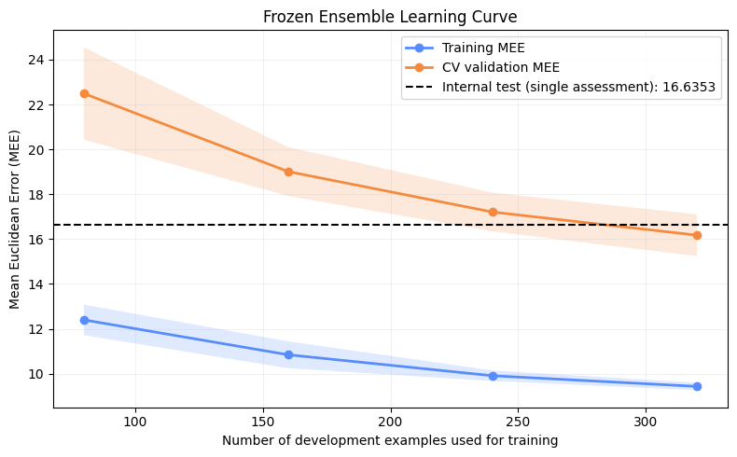
Ensemble Learning Curve
Since the final predictor is a weighted ensemble without an epoch-based training process, performance is analysed as a function of the training-set size. The persistent training–validation gap indicates some overfitting. Nevertheless, CV validation MEE steadily decreases and its variability narrows as more training examples become available suggesting that with a larger training set the gap might be reduced.
Notes:
[Sources]
- cup_Ensemble.ipynb
- cross_common.py
- nn_common.py

Slide 21
Discussion — findings and limitations
Weight initialization: the custom init_weights function was used to compare different initialization schemes. We forced initializing all weights to zero to experiment degenerated results in and unstable training behaviour. The final neural networks used Kaiming-uniform weight initialization, while biases were initialized to zero (see appendix for a concrete example).
Generalization gap: training MEE remains below CV validation MEE, indicating residual overfitting.
Learning curve: validation MEE falls as the training set grows, suggesting that additional labelled data could improve generalization.
Ensemble gain: improvement over KNN is modest—about 1.5% OOF and 1.0% on the internal test—but consistent.
Complementarity: lower-weight RBF-SVR and NN predictions help because their residuals differ from those of KNN.
Uncertainty: the internal test is a single held-out assessment, not a variance-free performance estimate.
Main limitations: limited data and a narrow performance margin. The ensemble provides a reproducible incremental improvement.
Notes:
[Sources]
- cup_Ensemble.ipynb: ensemble learning curve, OOF validation, internal-test assessment and residual-correlation analysis.
- cup_KNN.ipynb, cup_SVM.ipynb and cup_NN.ipynb: standalone evidence used to interpret ensemble complementarity.

Slide 22
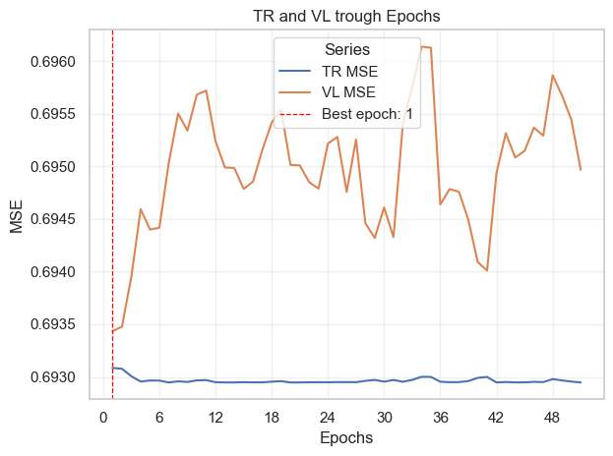
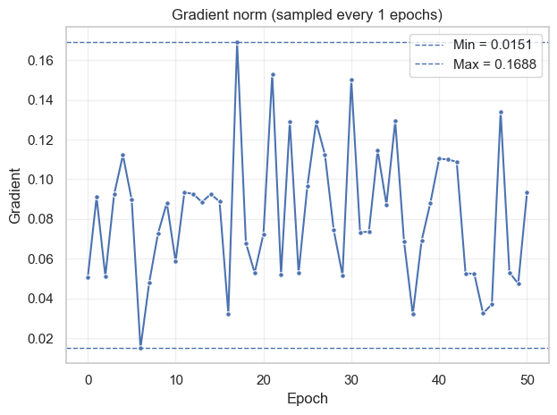
Appendix — Uniform Weight Initialization
Uniform zero-weight (or constant-weight) initialization causes the network to learn nearly identical representations. Below the learning curve and the gradient norm resulting from a run on MONK-1 with all weight set to zero.
Notes:
[Sources]
- ML-2025-PRJ-Slides-Demo-v0.1.pptx
- All local notebooks and common modules listed in source-notes.txt
- https://scikit-learn.org/stable/
- https://pytorch.org/docs/stable/

