Slide 1
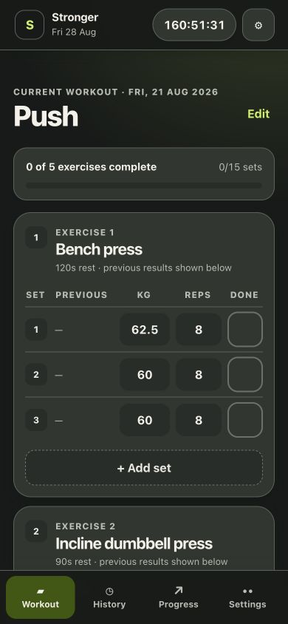
R&D REVIEW · 28 AUG 2026
Stronger R&D
Add decision support, not complexity
A non-destructive product review of the current app, six competitors, and the safest feature sequence for one personal user.
R&D only · no production source changes
Notes:
Open with the decision: preserve the fast local logger and add only a small decision layer.
[Sources]
- Local product screenshot: research/stronger-rd/audit/01-active-workout.png
- Local product description: README.md
[/Sources]

Slide 2
STRONGER R&D
Protect the advantage already built
Stronger is already a focused, offline-first tracker—not an empty shell.
Fast workout core
Useful history
Routines, blank workouts, prior results, set completion, rest timing, and resume.
Search, duplicate, per-exercise trends, best weight, e1RM, and volume.
Private by design
Good mobile discipline
IndexedDB + local fallback, offline shell, no account, ads, or server workout database.
Fixed thumb navigation, safe areas, 44 px targets, dark mode, and reduced-motion support.
02
Notes:
This slide establishes the non-negotiable product qualities that every proposal must preserve.
[Sources]
- Local: README.md
- Local: app/StrongerApp.tsx
- Local: app/storage.ts
- Local: app/globals.css
- Local: public/sw.js
[/Sources]

Slide 3
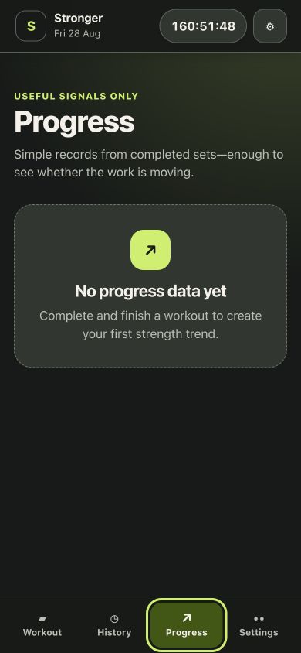
FLOW AUDIT
The current flow reveals two practical gaps
1
Session recovery
A week-old active workout continues past 160 hours. The user needs a safe resume, pause, or close decision—not silent timing forever.
2
Learning loop
History and Progress stay empty until a workout is finished. A weekly preview can teach the value of finishing without changing the logger.
Both fixes can be derived from data Stronger already stores.
03
Notes:
The screenshots are current-run evidence. Frame the timer as a recovery UX gap, not necessarily a data-loss bug.
[Sources]
- Local screenshot: research/stronger-rd/audit/01-active-workout.png
- Local screenshot: research/stronger-rd/audit/03-progress-empty.png
- Local: app/StrongerApp.tsx
[/Sources]

Slide 4
MARKET BENCHMARK
Competitors win in different ways
Six products were compared on their current official feature pages.
Product | Primary advantage | What Stronger can borrow | What not to copy
Strong | Fast, reliable logging | Execution quality; CSV portability | Feature breadth for its own sake
Hevy | Social discovery + adaptive trainer | RPE, plate math, editable suggestions | Social feed and moderation burden
Fitbod | Context-aware next workout | Equipment and limitation-aware choices | Opaque recovery percentages
Boostcamp | Multi-week program ecosystem | Blocks, alternatives, weekly review | Marketplace/network effects
Alpha Progression | Precise next-set guidance | Transparent load/rep suggestions | Advanced controls as defaults
JEFIT | Breadth across web/watch/mobile | Timed and tracked workout modes | Platform sprawl
The market rewards different operating models; Stronger only needs the pieces that improve a private personal workflow.
04
Notes:
Keep the competitive comparison qualitative. These are official product claims, not comparative performance tests.
[Sources]
- https://help.strongapp.io/article/228-what-is-strong
- https://www.hevyapp.com/features/
- https://help.fitbod.me/hc/en-us/sections/360001078993-How-Fitbod-Works
- https://www.boostcamp.app/features
- https://alphaprogression.com/en/subscribe
- https://www.jefit.com/use-case/workout-planner
[/Sources]

Slide 5
STRATEGIC TAKEAWAY
Adaptive plans are common; trust can win
Table stakes
Timers, templates, history, PRs, charts, and plate math no longer differentiate.
Crowded claim
Five of six competitors already market adaptive or recommended training.
Open position
Explain every suggestion, require approval, work offline, and keep personal data local.
Manual count from official feature pages; presence is not a quality score.
05
Notes:
The count is directional. The decision is to compete on transparency and control, not on claiming a novel algorithm.
[Sources]
- https://www.hevyapp.com/features/workout-plan-generator/
- https://help.fitbod.me/hc/en-us/sections/360001078993-How-Fitbod-Works
- https://www.boostcamp.app/features
- https://alphaprogression.com/en/subscribe
- https://www.jefit.com/
- https://help.strongapp.io/category/165-logging-a-workout
[/Sources]

Slide 6
PRIORITY
Start with features that help every workout
Feature | Why it helps you | Risk | Wave
Session rescue | Resolve stale workouts without losing logged sets | Low | 1
Weekly review | Turns goal + 4-day target into a useful training loop | Low | 1
Plate calculator | Removes arithmetic and phone switching in the gym | Low | 1
Backup hardening | Protects the only irreplaceable asset: workout history | Medium | 0
RPE / RIR + set types | Adds context to performance without changing the plan | Low–med | 2
Next-set suggestion | Makes progressive overload actionable and explainable | Medium | 2
Equipment substitutions | Keeps a workout usable across different gyms | Medium | 2
Blocks + deload planner | Adds long-range structure for advanced use | Higher | 3
Ranking lens: frequency of use, fit with existing data, reversibility, privacy, and PWA feasibility.
06
Notes:
This is an R&D prioritization judgment for one personal user, not a commercial roadmap score.
[Sources]
- Local: app/StrongerApp.tsx
- Local: app/storage.ts
- https://www.hevyapp.com/features/
- https://www.boostcamp.app/features
- https://alphaprogression.com/en/subscribe
[/Sources]

Slide 7
WAVE 1 · LOW RISK
Remove daily friction first
01
02
03
Session rescue
Weekly review
Plate calculator
When a workout is older than a chosen threshold, offer Resume, Pause timer, or Close safely. Never discard automatically.
Show sessions completed vs target, recent PRs, and the next planned routine. Use the goal and weekly-days settings already stored.
Enter target load, bar weight, and available plates. Keep it a temporary tool; it must not rewrite the set until accepted.
Why first: all three are local, reversible, and useful without changing workout history.
07
Notes:
These are the safest product changes because they are temporary or read-only until the user confirms an action.
[Sources]
- Local screenshot: research/stronger-rd/audit/01-active-workout.png
- Local screenshot: research/stronger-rd/audit/04-settings-top.png
- Local: app/StrongerApp.tsx
- https://help.strongapp.io/category/165-logging-a-workout
- https://www.hevyapp.com/features/
[/Sources]

Slide 8
WAVE 2 · USER-APPROVED
Guidance should not take control
A suggestion should explain itself, stay editable, and leave the current routine untouched until accepted.
1
Optional RPE / RIR
Off by default. Add working-set context and explain the scale inline; treat it as subjective input.
2
Deterministic next set
Example: “You reached the top of the rep range twice; consider +2.5 kg.” Show the evidence and require acceptance.
3
Equipment substitutions
Save simple gym profiles and swap to an equivalent movement without changing exercise history keys.
08
Notes:
The recommendation is intentionally rules-based first. Autoregulation can help, but RIR estimates are imperfect and should never be treated as objective truth.
[Sources]
- https://pubmed.ncbi.nlm.nih.gov/33776802/
- https://pubmed.ncbi.nlm.nih.gov/33337690/
- https://www.hevyapp.com/features/workout-plan-generator/
- https://help.fitbod.me/hc/en-us/sections/360001078993-How-Fitbod-Works
- https://alphaprogression.com/en/subscribe
[/Sources]

Slide 9
FOUNDATION · PROTECT FIRST
Data safety is part of the product
A
B
C
Versioned backup
Transactional restore
Migration tests
Keep full JSON backup, add human-readable CSV, and label schema version explicitly.
Validate and preview changes before replacement; failed imports must leave current data untouched.
Freeze legacy fixtures, preserve exercise keys and kg values, and restore a pre-migration snapshot on failure.
Boundary: keep photos, wearable streams, and analytics caches out of the whole-dataset snapshot.
09
Notes:
The current app writes one complete StrongerData snapshot and validates an exact formatVersion. That makes migration discipline a user-facing trust feature.
[Sources]
- Local: app/storage.ts
- Local: README.md
- Local screenshot: research/stronger-rd/audit/05-settings-backup.png
- https://help.strongapp.io/article/235-export-workout-data
[/Sources]

Slide 10
NOT IN THE FIRST R&D PACKAGE
Defer product-changing features
Defer | Why now is wrong | Revisit only when
Social feed / leaderboards | Moderation, privacy, content rights, and network effects | The product is intentionally multi-user
Opaque recovery score | Wearable inputs are noisy; a precise percentage implies false certainty | Evidence, permissions, and wording are validated
Silent AI program changes | Hard to explain, hard to undo, and risky during active training | Every change is constrained, previewed, and accepted
Cloud sync / accounts | Changes the threat model and the privacy promise | Cross-device need clearly outweighs local simplicity
Native watch / HealthKit | The current PWA cannot guarantee native background behavior | A separate native architecture is funded and scoped
Delaying these is a product choice, not a lack of ambition.
10
Notes:
The first package stays away from medical or injury claims. Wearable data should be contextual, not ground truth.
[Sources]
- https://pubmed.ncbi.nlm.nih.gov/39080098/
- https://pubmed.ncbi.nlm.nih.gov/41843416/
- https://developer.apple.com/documentation/healthkit/protecting-user-privacy
- https://developer.mozilla.org/en-US/docs/Web/Progressive_web_apps/Guides/Offline_and_background_operation
- https://www.hevyapp.com/features/social-features/
[/Sources]

Slide 11
RESPONSIBLE DELIVERY
Roll out in four guarded waves
WAVE 0
WAVE 1
WAVE 2
WAVE 3
Protect
Derive
Guide
Experiment
Source snapshot, real backup, schema fixtures, migration and lifecycle tests.
Session rescue, weekly review, plate math. Read-only or temporary first.
Optional RPE/RIR, explainable next-set prompts, substitutions.
Program blocks and dismissible deload planning on copied data.
Each wave earns the next: old backups import, active workouts survive, and suggestions stay optional.
11
Notes:
The folder currently has no Git history, so Wave 0 begins before any implementation. Test on copied data and a separate origin.
[Sources]
- Local: app/storage.ts
- Local: public/sw.js
- Local: tests/rendered-html.test.mjs
- Local repository inspection on 2026-08-28: no .git directory available
[/Sources]

Slide 12
RECOMMENDATION
Prototype four things
on copied data
Success means
• Faster decisions during a workout
• No silent routine or history changes
• Old backups still work
• Active workouts survive reloads and updates
• Every recommendation is explainable and dismissible
1. Session rescue
2. Weekly review
3. Plate calculator
4. Versioned backup + safe restore
Do not touch production until the copied-data prototype passes the gates.
Stronger R&D · 28 Aug 2026
Notes:
Close on the exact decision. The next step is a separate prototype or branch only after a recoverable source baseline exists.
[Sources]
- Synthesis of the local product audit, competitor feature review, and sources cited throughout this deck
[/Sources]

