Slide 1

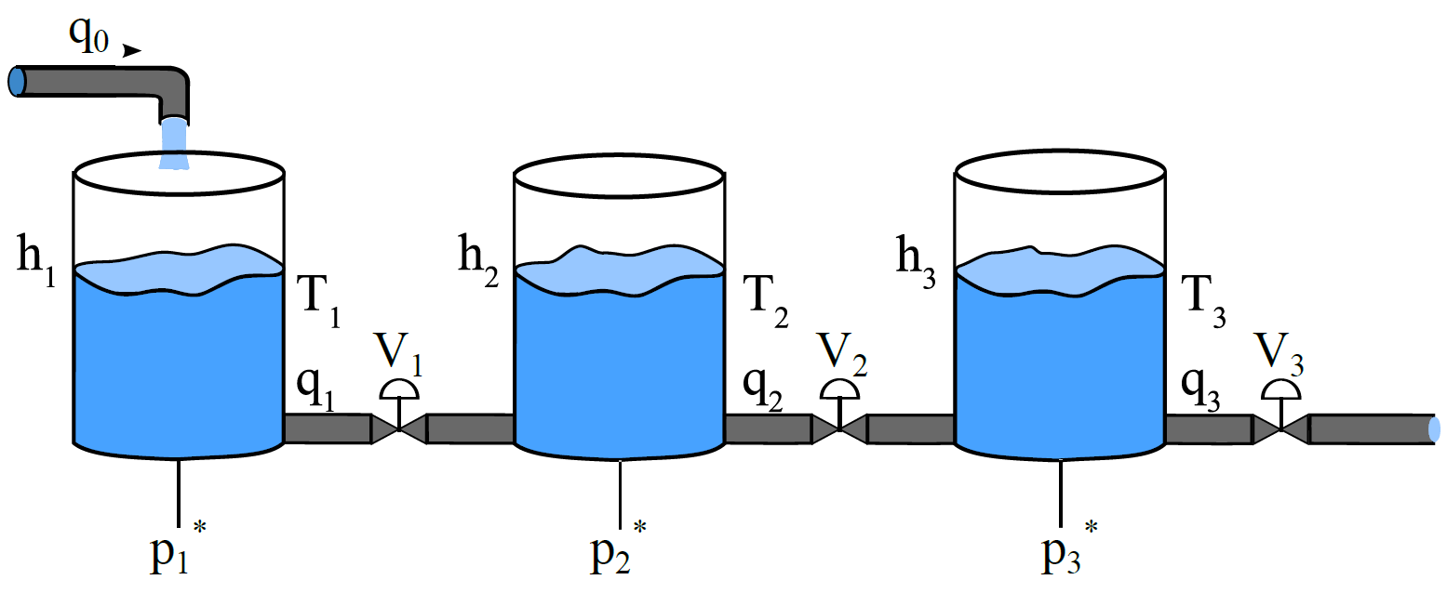
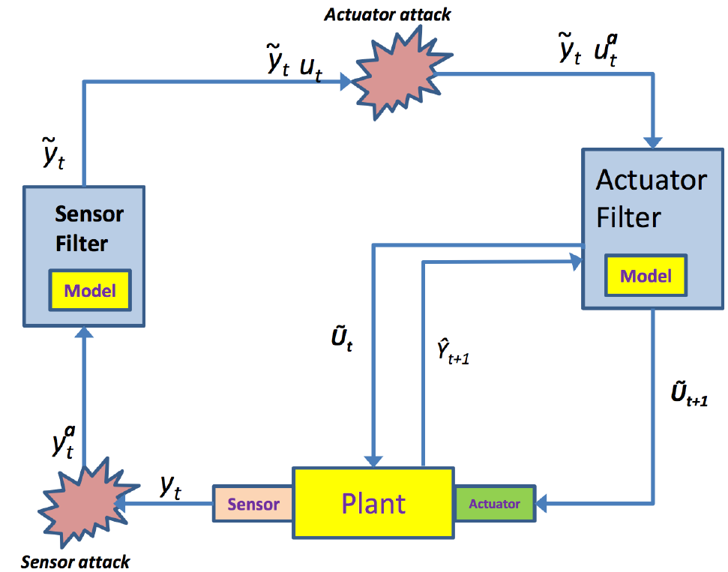
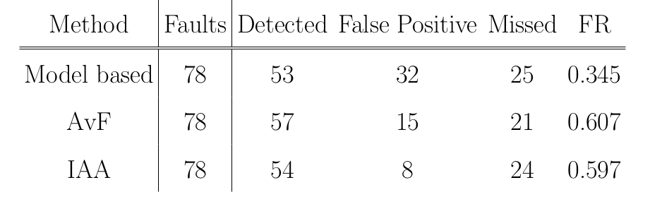
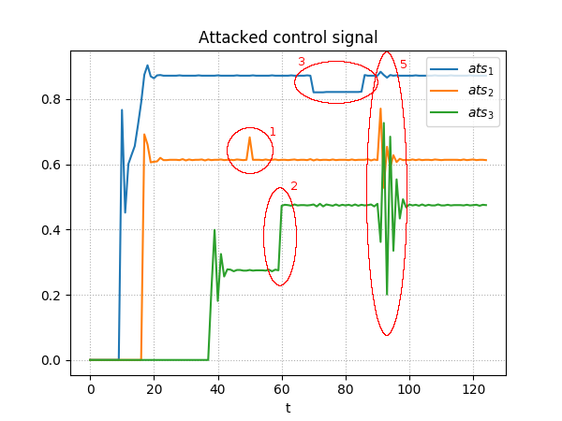
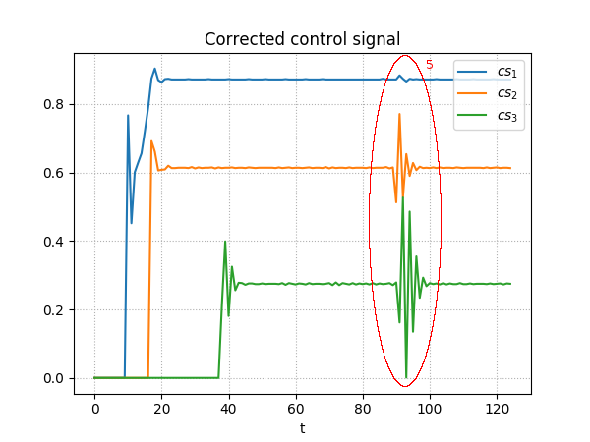
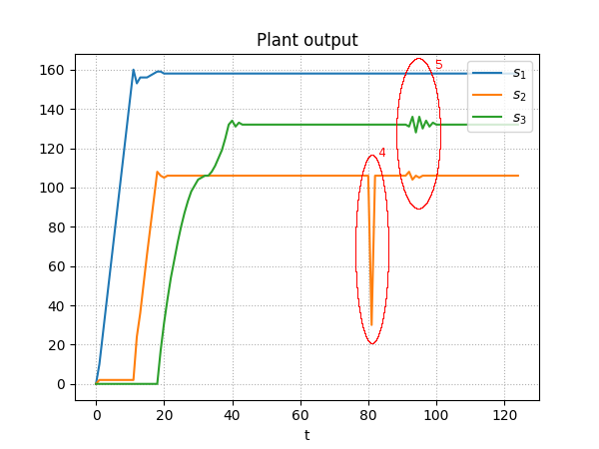
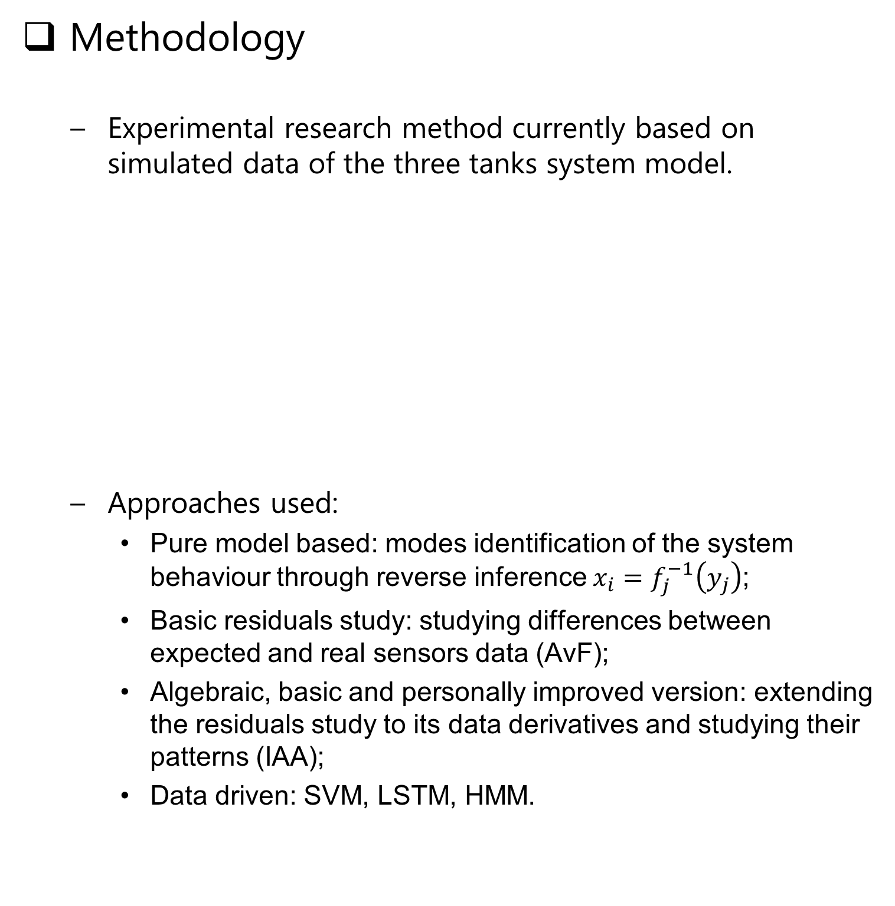
Improving security and resilience of Cyber Physical Systems
Riccardo Orizio, Prof. Gregory Provan
General Problem
Cyber Physical Systems can represent many real systems, including complex and safety critical ones such as transportation networks, electrical and gas distribution, water treatment plants and SCADA systems.
These critical systems need to operate reliably in all circumstances, regardless of the number and nature of the anomalies.
Can we create a tool that
can help Cyber Physical
Systems in detecting,
identifying and
correcting an anomaly
whenever one would occur?
Can it be used for time critical systems?
Methodology
Experimental research method currently based on simulated data of the three tanks system model.
Approaches used:
Pure model based: modes identification of the system behaviour through reverse inference $x_{i}=f_{j}^{−1}\left(y_{j}\right)$;
Basic residuals study: studying differences between expected and real sensors data (AvF);
Algebraic, basic and personally improved version: extending the residuals study to its data derivatives and studying their patterns (IAA);
Data driven: SVM, LSTM, HMM.
Results
Comparison results of the different approaches shows that the algebraic approach seems better, even when the system is experiencing simultaneous anomalies.
Distinction of the anomaly type: attack or fault.
Future
Currently working on the data driven approach;
Identifying a small set of approaches that can have good performances having limited computational resources;
Improving the results effectiveness combining results from different approaches;
Working with real systems data (e.g. FCU and HVAC systems).
Publications
Physics-Based Methods for Distinguishing Attacks from Faults, CENICS 2017
Comparing Physics-Based Methods for Distinguishing Attacks from Faults, DX’18
Physics-Based Methods for Responding to Attacks and Faults, WIP

