Slide 1

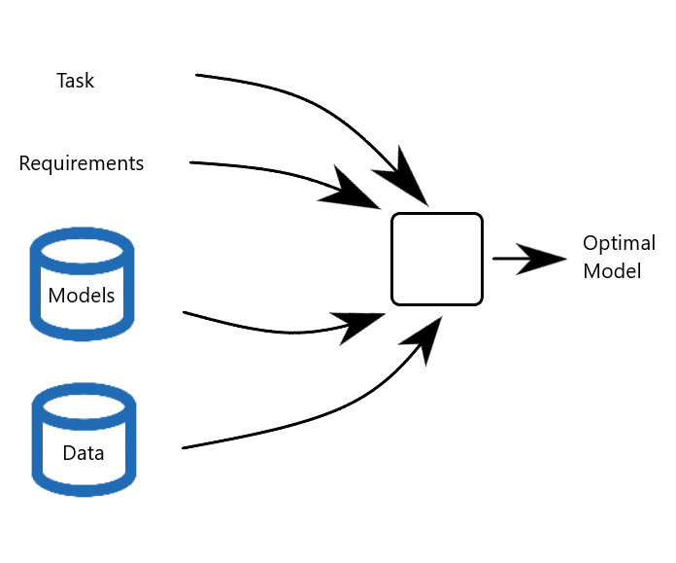
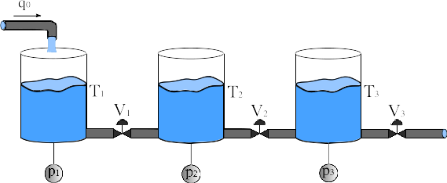
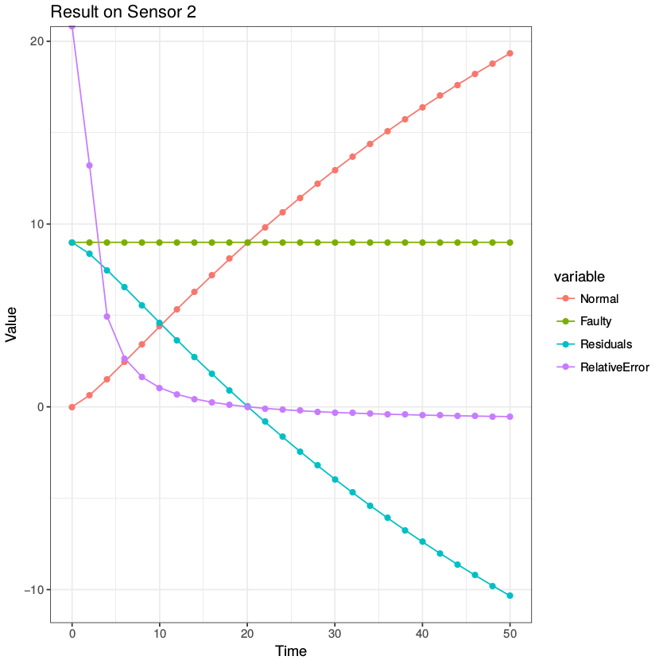
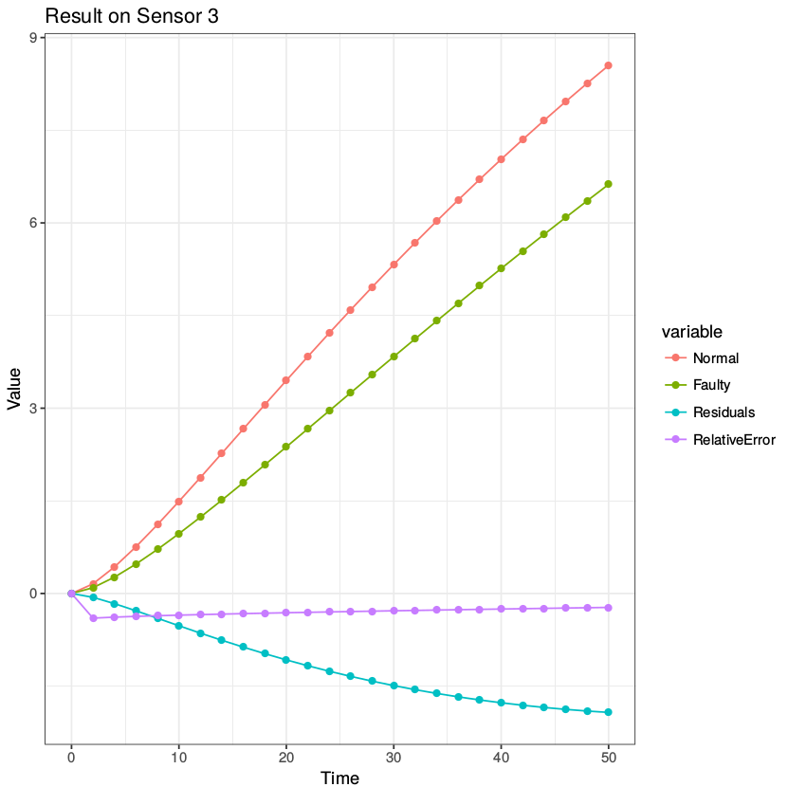
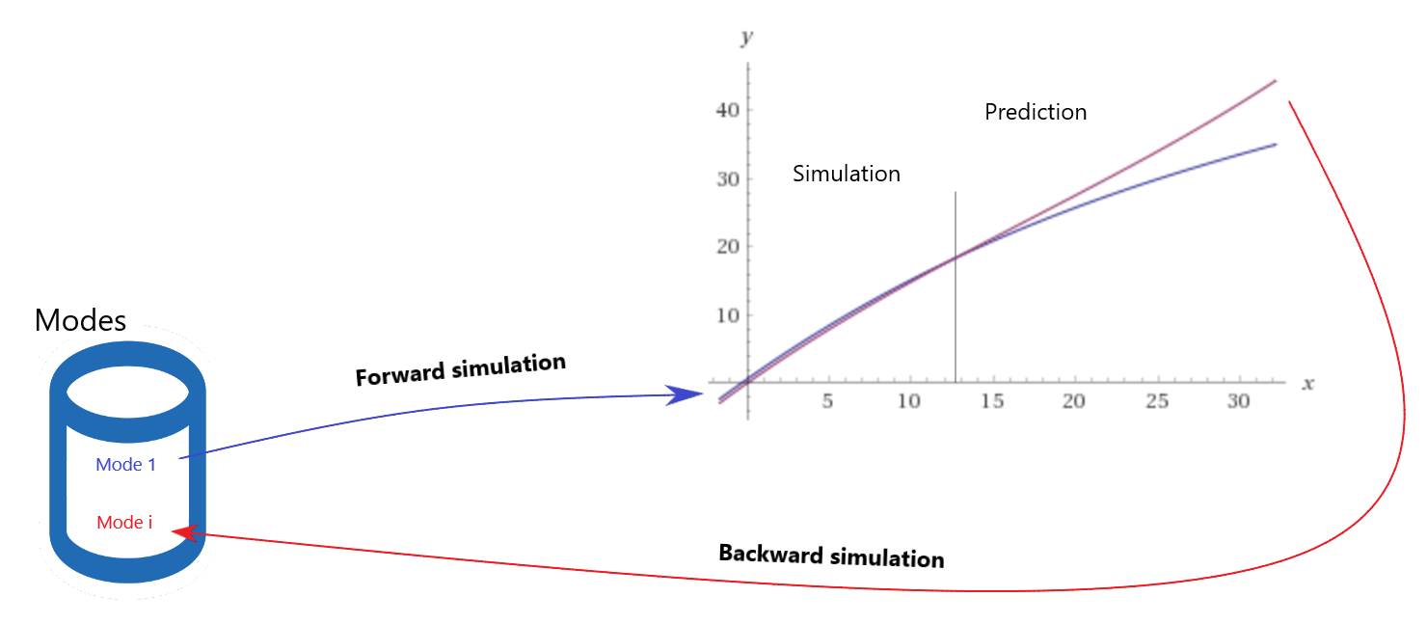
Task-based Model Selection/Optimisation
Riccardo Orizio, Prof. Gregory Provan
General Problem
Current complex systems models have high computational costs, some even require days before results could be calculated, which is the case for weather forecasts for example.
For this reason, given a specific task and its requirements, we need to find a procedure able to build a model balanced between its accuracy and the computational costs required to run it.
State of art
Forward simulation:
Data prediction from a known model, based on the mode notion. A mode represent a real system behaviour.
It is focused on studying the effects of a single active mode per simulation.
Ensemble of models:
Machine learning apporach to merge different simple models in a more accurate and effective one.
Design optimization is really important for selecting the key features in the model creation process.
Surrogate models and Reduced-order models
Data-fit approach based on regression, interpolation, gaussian processes or SVM focused on extracting a simpler model of the real system.
Goals
Multi active modes:
Extending the forward simulation to include different modes at the same time.
Inverse inference:
As opposed to forward simulation, we have to identify which mode(s) led to the current state. Reverting the process is computationally more demanding due to overlaps and synergies that modes can have with each other.
Diagnosis can be achieved from here, using the inverse approach to identify the faults compared to the normal mode of the system.
Achievements
We used the three tanks model to run some experiments on faulty behaviours.
Currently we are able to identify when a fault occurs and we can distinguish if the fault is genuine or induced by some attacker.
Examples: An easy to detect attack on a sensor (left image); synergies of different modes on the system creates similar to normal behaviour of the system, making them harder to detect (right image).
Future work
Add machine learning and/or statistical methods to improve the modes detection process.
Build a complete task-based diagnosis framework.

