Slide 1

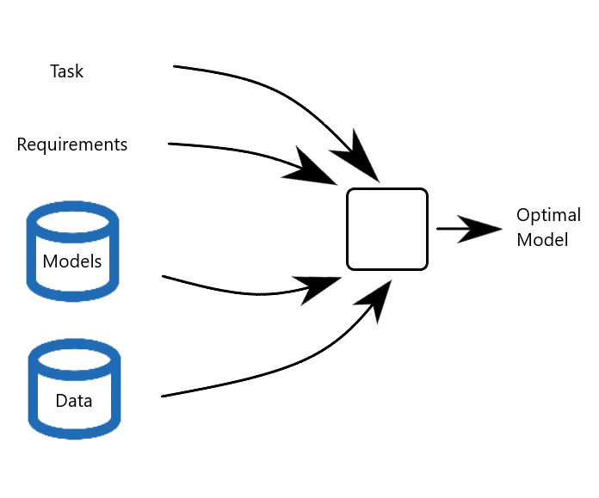
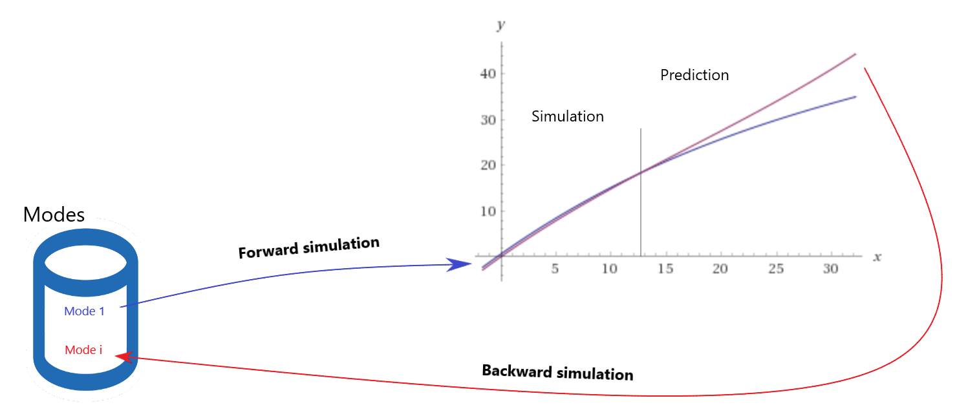
Task-based Model Selection/Optimisation
Riccardo Orizio, Prof. Gregory Provan
General Problem
Given a task and a set of requirements, paired with databases of plausible models and data, find the best model for simulating such task.
Background
Forward simulation:
Data prediction from a known model.
Usually focused on a single active mode of the system.
Model simplification:
Techniques to reduce the complexity of models.
Surrogate modeling and reduced-order modeling are two approaches used for accomplishing this task.
Ensemble of models:
Machine learning approach to extract an optimal model combining different known basic ones considering their properties.
Set of Tasks
Inverse problems:
Recognition of the active mode(s) of the system that produced the “unexpected” simulated prediction. Also known as backward simulation, which will lead to diagnosis.
Accomplishments
Polynomial models approximation of generic example data
Corrective models generation for faulty modes achieved by minimizing the mean squared errors compared to normal mode
Future work
Single modes identification
Identification of multi active modes through machine learning and/or statistical methods
General diagnoser framework

