Slide 1

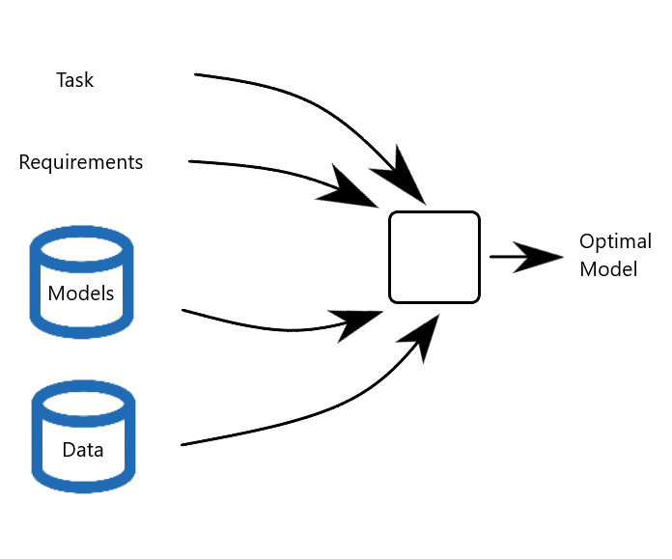
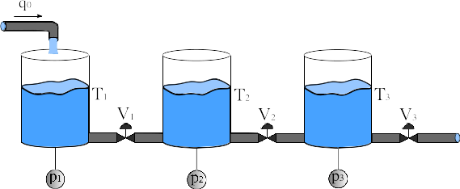
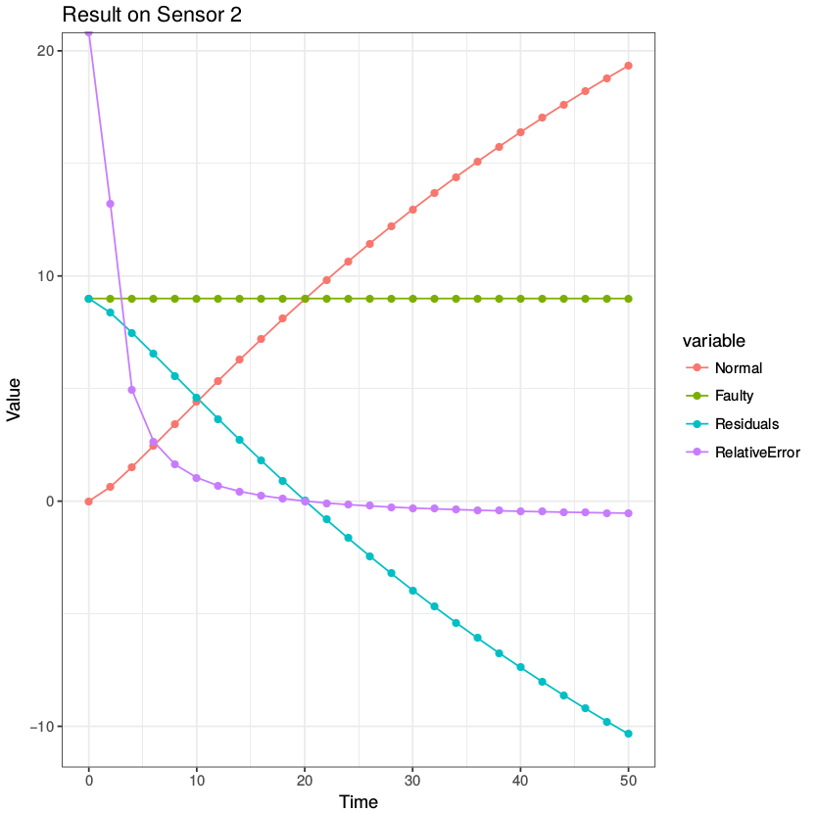
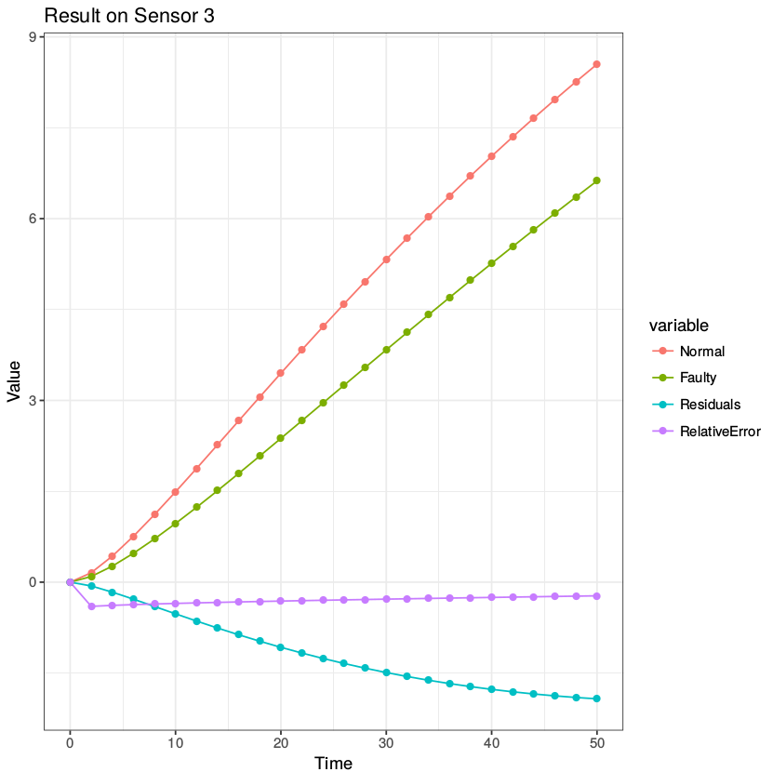
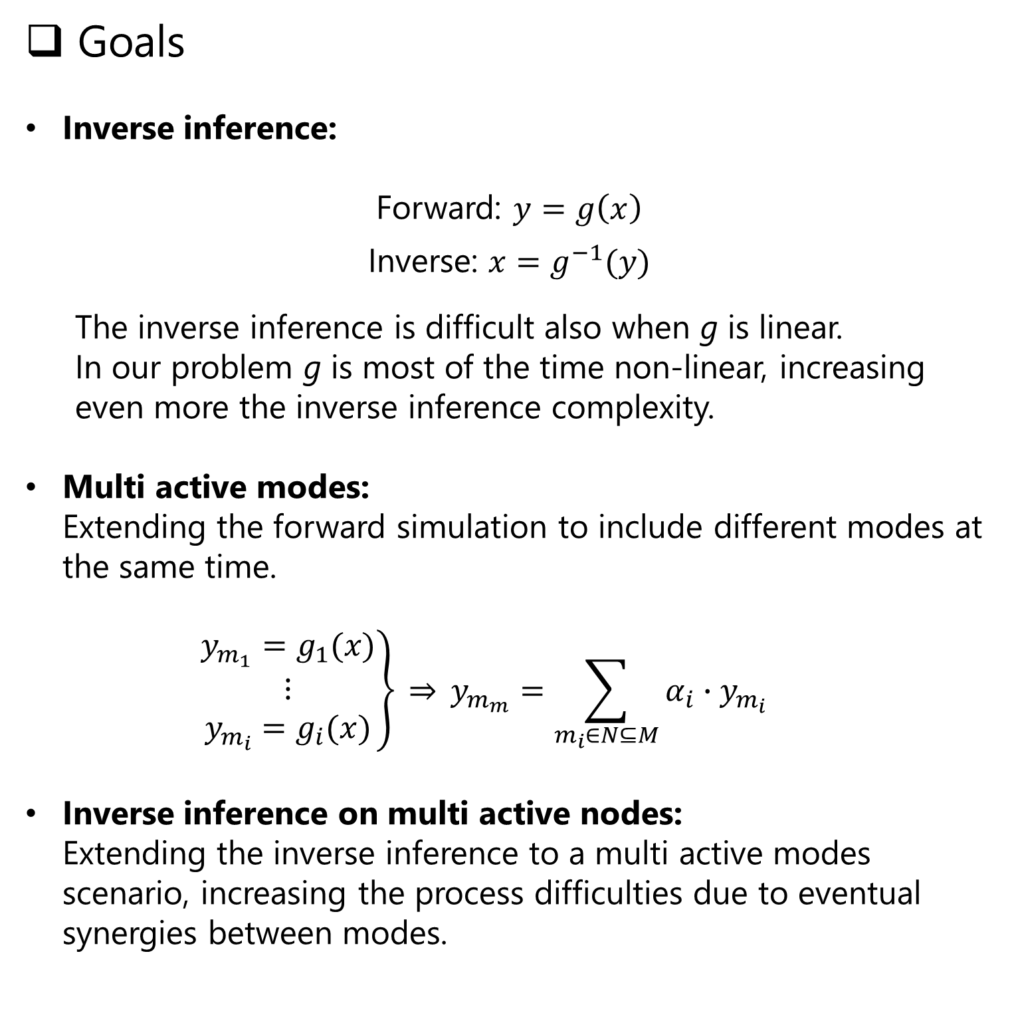
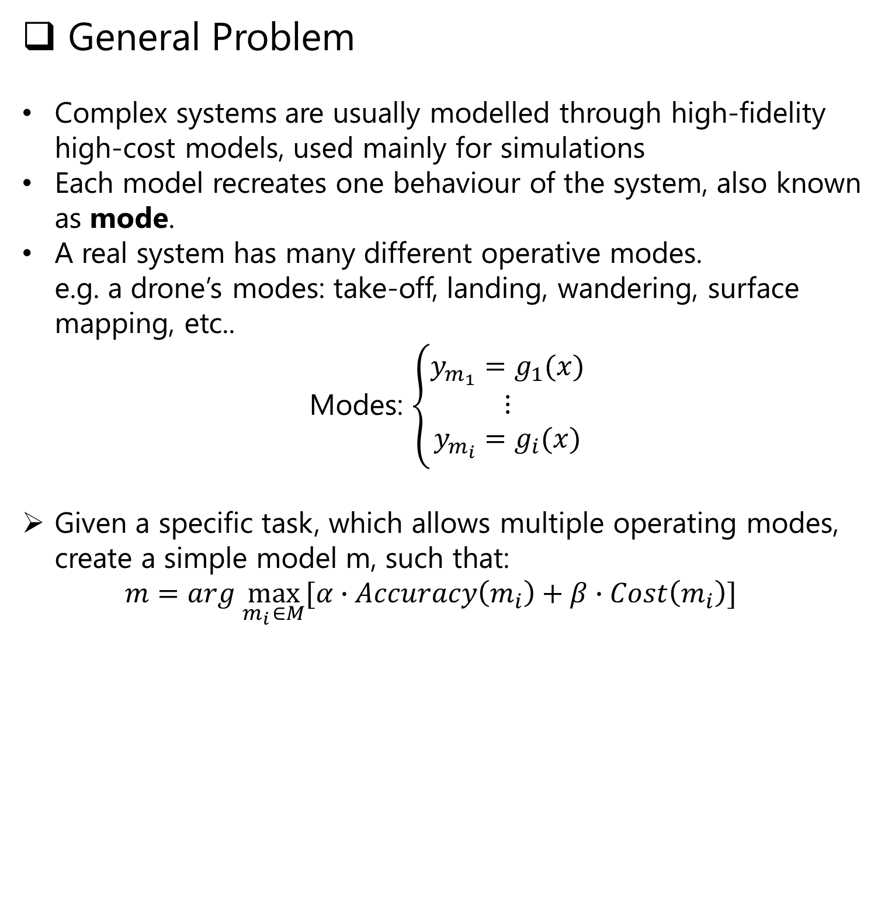
Task-based Model Selection/Optimisation
Riccardo Orizio, Prof. Gregory Provan
General Problem
Complex systems are usually modelled through high-fidelity high-cost models, used mainly for simulations
Each model recreates one behaviour of the system, also known as mode.
A real system has many different operative modes. e.g. a drone’s modes: take-off, landing, wandering, surface mapping, etc..
Modes: $\left\{\begin{aligned}y_{m_{1}}=g_{1}(x) \\ ⋮ \\ y_{m_{i}}=g_{i}(x)\end{aligned}\right.$
Given a specific task, which allows multiple operating modes, create a simple model m, such that: $m=arg \max_{m_{i} ∈M}{[α∙Accuracy\left(m_{i}\right)+β∙Cost\left(m_{i}\right)]}$
State of art
Currently the problem is approached through:
Surrogate models: Data-driven approach to extract a simpler model of one mode of the system.
Ensemble of models: Optimisation of surrogate models to achieve higher accuracy using a small amount of high-fidelity model data.
Forward simulation on single independent modes: Data prediction of a known mode. Focused on studying the effects of a single active mode per simulation.
Goals
Inverse inference:
Forward: $y=g\left(x\right)$
Inverse: $x=g^{−1}(y)$
The inverse inference is difficult also when g is linear. In our problem g is most of the time non-linear, increasing even more the inverse inference complexity.
Multi active modes: Extending the forward simulation to include different modes at the same time.
$$\left.\begin{aligned}y_{m_{1}}=g_{1}(x) \\ ⋮ \\ y_{m_{i}}=g_{i}(x)\end{aligned}\right\} \underset{⇒}{} y_{m_{m}}=\sum_{m_{i}∈N⊆M}{α_{i}∙y_{m_{i}}}$$
Inverse inference on multi active nodes: Extending the inverse inference to a multi active modes scenario, increasing the process difficulties due to eventual synergies between modes.
Achievements
All experiments are based on the three tanks model system, a common problem based on a non linear model.
Non linear vs linear models: Based only on data gathered from simulation, we simplified the non linear model to a linear one.
Attacks vs. Faults isolation: Inverse inference application to identify if the system is having some internal faults or is under attack.
Examples: An easy to detect attack on a sensor (left image); synergies of different active modes on the system creates similar to normal behaviour of the system, making them harder to detect (right image).
Future work
Use machine learning to improve the mode identification process.

