Slide 1
Local Network Tic tac toe
Ben Price, Andromeda Weir, Areli Morales-Hernandez

Slide 2
Requirements (to Delete)
Produce a comprehensive video presentation that focuses on the technical aspects of the project. Utilize PowerPoint slides to highlight project goals, algorithms employed, implementation details, evaluations, challenges encountered, and insights gained. Additionally, ensure the video includes a live demonstration of the project to provide a practical illustration of its functionality.

Slide 3
Project goals
Create a local network multiplayer tic-tac-toe game
Implement a functional GUI for the game
Define and program the underlying logic of the game
Use socket programming to connect a host and opponent on the same network
Learn about socket programming and its implementation

Slide 4
Algorithms used
….

Slide 5
implementation
GUI
Logic
Socket Connection
Programming Language: Python
Version control: GitHub
GUI constructed using tkinter Python library
...

Slide 6
implementation
The code base is split across 4 Python files, each of which contains at least one class:
Main.py
TicTacToe.py
GameEndException
TicTacToe
TicTacToeGUI.py
Player
TicTacToeBoard
Connections.py
formalConnectionInterface
TicTacToeServer
TicTacToeClient

Slide 7
challenges
Communication between components
Figuring out tkinter

Slide 8

insights
It is possible to make a decent Python GUI with tkinter

Slide 9
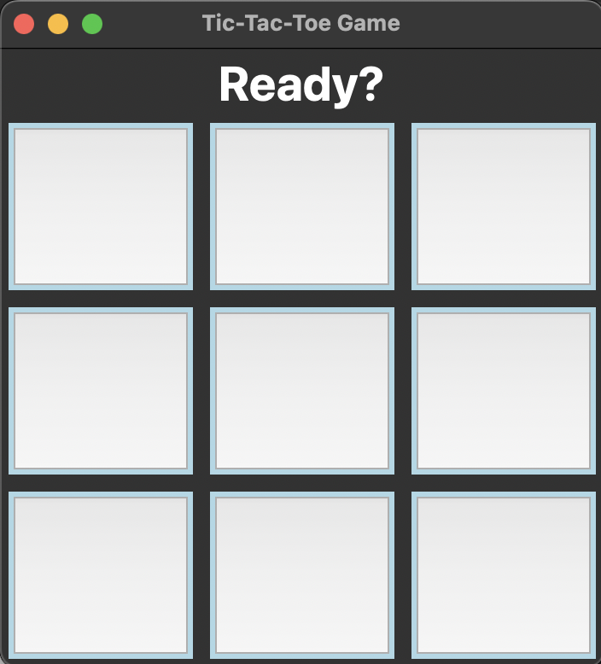
Game demo

Slide 10

Thank you

