Slide 1
Introduction to Using Hadoop on the Gordon Data Intensive Cluster
Mahidhar Tatineni
January 31, 2013

Slide 2
Overview
Hadoop framework extensively used for scalable distributed processing of large datasets. High interest from XSEDE user base.
MapReduce algorithms make use of locality of data, processing data on or near the storage assets to minimize data movement.
Map Step: The master node divides problem into smaller sub-problems, and distributes them to slave nodes.
Reduce Step: Processed data from slave nodes is combined in some way to form the output.
Hadoop allows use of the MapReduce framework in tandem with a distributed filesystem in a cluster environment.

Slide 3
Overview : Scientific Applications
Data intensive scientific applications can make use of the Hadoop MapReduce framework. Application areas include:
Bioinformatics and computational biology
Astronomical image processing
Natural Language Processing
Geospatial data processing

Slide 4
Overview : Hadoop on Gordon
Gordon architecture presents potential performance benefits with high performance storage (SSDs) and high speed network (QDR IB).
Storage options viable for Hadoop on Gordon
SSD via iSCSI Extensions for RDMA (iSER)
Lustre filesystem (Data Oasis), persistent storage
Approach to running Hadoop within the scheduler infrastructure – myHadoop (developed at SDSC).

Slide 5
Overview (Contd.)
Network options
1 GigE – low performance
IPoIB
Results
DFS – Benchmark runs done on both SSD.
TeraSort – Scaling study with sizes 100GB-1.6TB, 4-128 nodes.
Future/Ongoing Work
UDA - Unstructured Data Accelerator from Mellanox
http://www.mellanox.com/related-docs/applications/SB_Hadoop.pdf
Lustre for Hadoop – Can provide another persistent data option.

Slide 6
Gordon Architecture

Slide 7
Gordon System Specification
Intel Sandy Bridge Compute node
Sockets | 2
Cores | 16
Clock speed | 2.6
DIMM slots per socket | 4
DRAM capacity | 64 GB
Intel Flash I/O Node
NAND flash SSD drives | 16
SSD capacity per drive/Capacity per node/total | 300 GB / 4.8 TB / 300 TB
Flash bandwidth per drive (read/write) Flash bandwidth per node (write/read) | 270 MB/s / 210 MB/s 4.3 /3.3 GB/s
SMP Super-Node
Compute nodes | 32
I/O nodes | 2
Addressable DRAM | 2 TB
Addressable memory including flash | 12TB
Gordon
Compute Nodes | 1,024
Total compute cores | 16,384
Peak performance | 341TF
Aggregate memory | 64 TB
InfiniBand Interconnect
Aggregate torus BW | 9.2 TB/s
Type | Dual-Rail QDR InfiniBand
Link Bandwidth | 8 GB/s (bidirectional)
Latency (min-max) | 1.25 µs – 2.5 µs
Disk I/O Subsystem
Total storage | 4.5 PB (raw)
I/O bandwidth | 100 GB/s
File system | Lustre
Gordon System Specification

Slide 8
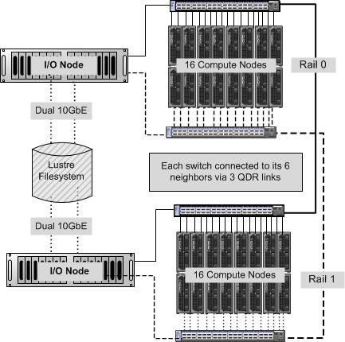
Subrack Level Architecture
16 compute nodes per subrack

Slide 9

3D Torus of Switches
Linearly expandable
Simple wiring pattern
Short Cables- Fiber Optic cables generally not required
Lower Cost :40% as many switches, 25% to 50% fewer cables
Works well for localized communication
Fault Tolerant within the mesh with 2QoS Alternate Routing
Fault Tolerant with Dual-Rails for all routing algorithms
3rd dimension wrap-around not shown for clarity

Slide 10
Gordon Network Architecture
XSEDE & R&E Networks
SDSC Network
Dual-rail IB
Dual 10GbE storage
GbE management
GbE public
Round robin login
Mirrored NFS
Redundant front-end
Data Movers
(4x)
Login
Nodes (4x)
Mgmt.
Nodes (2x)
Mgmt. Edge & Core Ethernet
Public Edge & Core Ethernet
NFS
Server (4x)
Data Oasis
Lustre PFS
4 PB
IO Nodes
Compute
Node
Compute
Node
Compute
Node
Compute
Node
1,024
IO Nodes
3D torus: rail 1
3D torus: rail 2
64
GbE
2x10GbE
10GbE
QDR 40 Gb/s

Slide 11
Primary Storage Option for Hadoop: One SSD per Compute Node (only 4 of 16 compute nodes shown)
Compute Node
SSD
The SSD drives on each I/O node are exported to the compute nodes via the iSCSI Extensions for RDMA (iSER).
One 300 GB flash drive exported to each compute node appears as a local file system
Lustre parallel file system is mounted identically on all nodes.
This exported SSD storage can serve as the local storage used by HDFS.
Lustre
Compute Node
SSD
Compute Node
SSD
Compute Node
SSD
Logical View
File system appears as:
/scratch/$USER/$PBS_JOBID

Slide 12
Hadoop Configuration Details

Slide 13
myHadoop – Integration with Gordon Scheduler
myHadoop* was developed at SDSC to help run Hadoop within the scope of the normal scheduler.
Scripts available to use the node list from the scheduler and dynamically change Hadoop configuration files.
mapred-site.xml
masters
slaves
core-site.xml
Users can make additional hadoop cluster changes if needed
Nodes are exclusive to the job [does not affect the rest of the cluster].
*myHadoop link: http://sourceforge.net/projects/myhadoop/

Slide 14
Hadoop on Gordon – Storage Options
Primary storage option is to use SSDs which are available via iSCSI Extensions for RDMA (iSER) on each compute node.
Prolog creates job specific SSD filesystem location which can be used for HDFS storage. myHadoop framework leveraged to do this dynamically.
Lustre storage is available for persistent option. DFS benchmark results show very good performance comparable to SSD storage.

Slide 15
Hadoop on Gordon – Network Options
All Gordon compute nodes are dual QDR Infiniband connected. Additionally, a 1GigE connection is available.
For a standard Apache Hadoop install IPoIB using one of the default QDR links is the best network option. myHadoop setup uses the ib0 addresses in dynamic configuration set up.
Mellanox's Unstructured Data Accelerator (UDA) is another option providing the middleware interface directly to high speed IB link. We are currently testing this on Gordon.

Slide 16
Hands On Examples : TestDFS and TeraSort Benchmarks

Slide 17
Hands On Examples
Copy over the following directory to your training account:
cp –r /home/diag/tutorials/hadoop ~/
Two examples
TestDFS_2.cmd – TestDFS example to benchmark HDFS performance.
TeraSort_2.cmd – Sorting performance benchmark.

Slide 18
TestDFS Example
PBS variables part:
#!/bin/bash
#PBS -q normal
#PBS -N hadoop_job
#PBS -l nodes=2:ppn=1
#PBS -o hadoop_dfstest_2.out
#PBS -e hadoop_dfstest_2.err
#PBS -V

Slide 19
TestDFS example
Set up Hadoop environment variables:
# Set this to location of myHadoop on gordon
export MY_HADOOP_HOME="/opt/hadoop/contrib/myHadoop"
# Set this to the location of Hadoop on gordon
export HADOOP_HOME="/opt/hadoop"
#### Set this to the directory where Hadoop configs should be generated
# Don't change the name of this variable (HADOOP_CONF_DIR) as it is
# required by Hadoop - all config files will be picked up from here
#
# Make sure that this is accessible to all nodes
export HADOOP_CONF_DIR="/home/$USER/config"

Slide 20
TestDFS Example
#### Set up the configuration
# Make sure number of nodes is the same as what you have requested from PBS
# usage: $MY_HADOOP_HOME/bin/configure.sh -h
echo "Set up the configurations for myHadoop"
### Create a hadoop hosts file, change to ibnet0 interfaces - DO NOT REMOVE -
sed 's/$/.ibnet0/' $PBS_NODEFILE > $PBS_O_WORKDIR/hadoophosts.txt
export PBS_NODEFILEZ=$PBS_O_WORKDIR/hadoophosts.txt
### Copy over configuration files
$MY_HADOOP_HOME/bin/configure.sh -n 2 -c $HADOOP_CONF_DIR
### Point hadoop temporary files to local scratch - DO NOT REMOVE -
sed -i 's@HADDTEMP@'$PBS_JOBID'@g' $HADOOP_CONF_DIR/hadoop-env.sh

Slide 21
TestDFS Example
#### Format HDFS, if this is the first time or not a persistent instance
echo "Format HDFS"
$HADOOP_HOME/bin/hadoop --config $HADOOP_CONF_DIR namenode -format
echo
sleep 1m
#### Start the Hadoop cluster
echo "Start all Hadoop daemons"
$HADOOP_HOME/bin/start-all.sh
#$HADOOP_HOME/bin/hadoop dfsadmin -safemode leave
echo

Slide 22
TestDFS Example
#### Run your jobs here
echo "Run some test Hadoop jobs"
$HADOOP_HOME/bin/hadoop jar $HADOOP_HOME/hadoop-test-1.0.3.jar TestDFSIO -write
-nrFiles 8 -fileSize 1024 -bufferSize 1048576
sleep 30s
$HADOOP_HOME/bin/hadoop jar $HADOOP_HOME/hadoop-test-1.0.3.jar TestDFSIO -read -
nrFiles 8 -fileSize 1024 -bufferSize 1048576
echo
#### Stop the Hadoop cluster
echo "Stop all Hadoop daemons"
$HADOOP_HOME/bin/stop-all.sh
echo

Slide 23
Running the TestDFS example
Submit the job:
qsub TestDFS_2.cmd
Check the job is running (qstat)
Once the job is running the hadoophosts.txt file is created. For example on a sample run:
$ more hadoophosts.txt
gcn-13-11.ibnet0
gcn-13-12.ibnet0

Slide 24
Configuration Files During the Run
Lets check the configuration details (files in ~/config) setup dynamically:
$ more masters
gcn-13-11.ibnet0
$ more slaves
gcn-13-11.ibnet0
gcn-13-12.ibnet0
$ grep scratch hadoop-env.sh
export HADOOP_PID_DIR=/scratch/$USER/538309.gordon-fe2.local
export TMPDIR=/scratch/$USER/538309.gordon-fe2.local
export HADOOP_LOG_DIR=/scratch/mahidhar/538309.gordon-fe2.local/hadoop-mahidhar/log
$ grep hdfs core-site.xml
<value>hdfs://gcn-13-11.ibnet0:54310</value>

Slide 25
Test Output
Check the PBS output and error files for the results.
Sample snippets:
13/01/30 18:56:00 INFO fs.TestDFSIO: Number of files: 8
13/01/30 18:56:00 INFO fs.TestDFSIO: Total MBytes processed: 8192
13/01/30 18:56:00 INFO fs.TestDFSIO: Throughput mb/sec: 41.651837012782316
13/01/30 18:56:00 INFO fs.TestDFSIO: Average IO rate mb/sec: 93.37788391113281
13/01/30 18:56:00 INFO fs.TestDFSIO: IO rate std deviation: 58.587153756958564
13/01/30 18:56:00 INFO fs.TestDFSIO: Test exec time sec: 99.554
13/01/30 18:56:00 INFO fs.TestDFSIO:
…
….
13/01/30 18:57:16 INFO fs.TestDFSIO: Number of files: 8
13/01/30 18:57:16 INFO fs.TestDFSIO: Total MBytes processed: 8192
13/01/30 18:57:16 INFO fs.TestDFSIO: Throughput mb/sec: 207.49746707193515
13/01/30 18:57:16 INFO fs.TestDFSIO: Average IO rate mb/sec: 207.5077362060547
13/01/30 18:57:16 INFO fs.TestDFSIO: IO rate std deviation: 1.4632078247537383
13/01/30 18:57:16 INFO fs.TestDFSIO: Test exec time sec: 41.365

Slide 26
TeraSort Test
Setup similar to TestDFS case
TeraSort part (Note: The size tested is only 100GB):
echo "Run some test Hadoop jobs"
$HADOOP_HOME/bin/hadoop --config $HADOOP_CONF_DIR dfs -mkdir output
$HADOOP_HOME/bin/hadoop --config $HADOOP_CONF_DIR dfs -mkdir input
$HADOOP_HOME/bin/hadoop jar $HADOOP_HOME/hadoop-examples-1.0.3.jar teragen 100000000 input/terasort-input
sleep 30s
$HADOOP_HOME/bin/hadoop jar $HADOOP_HOME/hadoop-examples-1.0.3.jar terasort input/terasort-input output/terasort-output
$HADOOP_HOME/bin/hadoop jar $HADOOP_HOME/hadoop-examples-1.0.3.jar teravalidate output/terasort-output input/terasort-validate
$HADOOP_HOME/bin/hadoop job -history all input/terasort-input

Slide 27
TeraSort Output
12/09/25 17:46:21 INFO terasort.TeraSort: starting
12/09/25 17:46:21 INFO mapred.FileInputFormat: Total input paths to process : 2
…
12/09/25 17:46:22 INFO compress.CodecPool: Got brand-new compressor
12/09/25 17:46:22 INFO mapred.FileInputFormat: Total input paths to process : 2
12/09/25 17:46:22 INFO mapred.JobClient: Running job: job_201209251744_0002
12/09/25 17:46:23 INFO mapred.JobClient: map 0% reduce 0%
12/09/25 17:46:39 INFO mapred.JobClient: map 1% reduce 0%
12/09/25 17:46:48 INFO mapred.JobClient: map 2% reduce 0%
…
12/09/25 18:01:02 INFO mapred.JobClient: map 100% reduce 99%
12/09/25 18:01:14 INFO mapred.JobClient: map 100% reduce 100%
12/09/25 18:01:19 INFO mapred.JobClient: Job complete: job_201209251744_0002
12/09/25 18:01:19 INFO mapred.JobClient: Counters: 30
…
12/09/25 18:01:19 INFO mapred.JobClient: FileSystemCounters
12/09/25 18:01:19 INFO mapred.JobClient: FILE_BYTES_READ=34637839494
12/09/25 18:01:19 INFO mapred.JobClient: HDFS_BYTES_READ=10000609172
12/09/25 18:01:19 INFO mapred.JobClient: FILE_BYTES_WRITTEN=44841252225
12/09/25 18:01:19 INFO mapred.JobClient: HDFS_BYTES_WRITTEN=10000000000
…
…

Slide 28
Hadoop on Gordon – TestDFSIO Results
Results from the TestDFSIO benchmark. Runs were conducted using 4 datanodes and 2 map tasks. Average write I/O rates are presented.

Slide 29
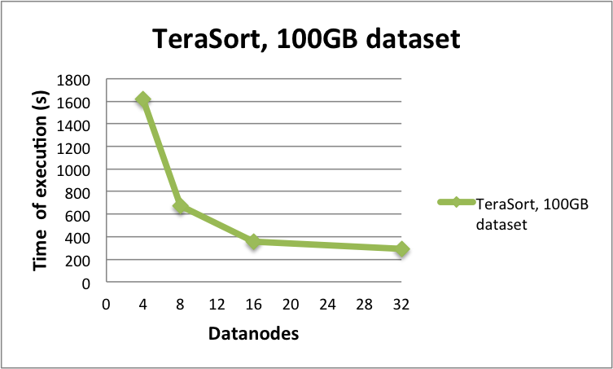
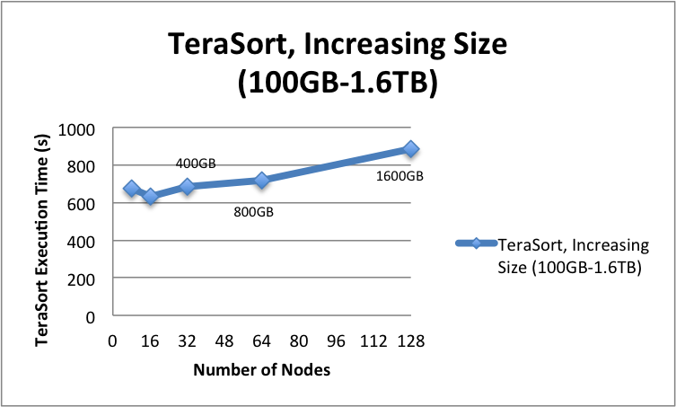
Hadoop on Gordon – TeraSort Results
(a)
(b)
Results from the TeraSort benchmark. Data generated using teragen and is then sorted. Two sets or runs were performed using IPoIB, SSD storage – (a) Fixed dataset size of 100GB, number of nodes varied from 4 to 32, (b) Increasing dataset size with number of nodes.

Slide 30
Hadoop Parameters
Several parameters can be tuned at the system level, in general configuration (namenode and jobtracker server threads), HDFS configuration (blocksize) , MapReduce configuration (number of tasks, input streams, buffer sizes etc).
Good summary in:
http://software.intel.com/sites/default/files/m/f/4/3/2/f/31124-Optimizing_Hadoop_2010_final.pdf

Slide 31
Tools/Applications w/ Hadoop
Several open source projects utilizing Hadoop infrastructure. Examples:
HIVE – A data warehouse infrastructure providing data summarization and querying.
Hbase – Scalable distributed database
PIG – High-level data-flow and execution framework
Elephantdb – Distributed database specializing in exporting key/value data from Hadoop.
Some these projects have been tried on Gordon by users.

Slide 32
Summary
Hadoop can be dynamically configured and run on Gordon using myHadoop framework.
High speed Infiniband network allows for significant gains in performance using SSDs.
TeraSort benchmark shows good performance and scaling on Gordon.
Future improvements/tests include using Mellanox UDA; use lustre filesystem for HDFS storage.

Slide 33
Data Oasis Heterogeneous Architecture Lustre-based Parallel File System
TRESTLES
IB cluster
GORDON
IB cluster
TRITON
Myrinet cluster
Mellanox 5020 Bridge
12 GB/s
64 Lustre LNET Routers
100 GB/s
Myrinet 10G Switch
25 GB/s
3 Distinct Network Architectures
MDS
Redundant Switches
for Reliability and Performance
MDS
Arista 7508
10G
Arista 7508
10G
MDS
64 OSS
(Object Storage Servers)
Provide 100GB/s Performance and >4PB Raw Capacity
Metadata Servers
OSS
72TB
OSS
72TB
OSS
72TB
OSS
72TB
JBOD
90TB
JBOD
90TB
JBOD
90TB
JBOD
90TB
JBODs
(Just a Bunch Of Disks)
Provide Capacity Scale-out to an Additional 5.8PB

