Slide 1
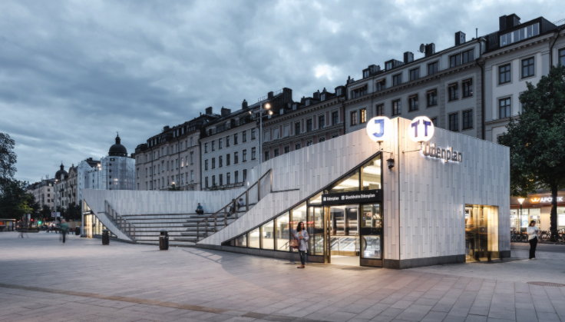
Simliar to Odenplan?
Gabriel Borg

Slide 2
Odenplan
Odenplan, a central city part of Vasaparken district in Stockholm
Nice venues; Café’s and Restaurants
At the heart of Stockholm city
Odenplan has Vasaparken which is one of the biggest parks in Stockholm.
The question is .. are there simlair places like Odenplan in Stockholm?

Slide 3
Different cities in the world have perfect venues that you cannot live without. In this project we will help people who are living in Odenplan, a central city part of Stockholm, to find a new home with similar features as Odenplan in Stockholm city. Despite of having dissimilarities of taste, we will look for city parts in Stockholm that looks like Odenplan.

Slide 4
Data gathering Stockholm stads website
Google maps geocoder API was used to obtain the latitude and longitude values
Foursquare API to collect the closest venues (supermarket, restaurant, park, etc.)

Slide 5
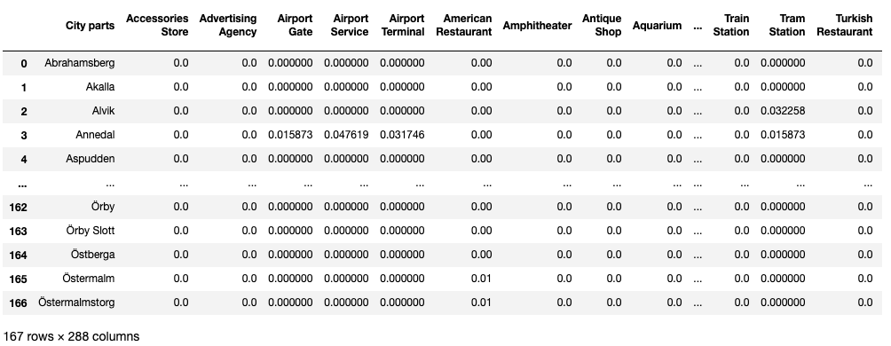

Slide 6
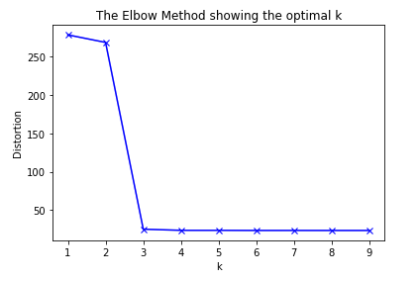
K-means
Cluster analysis
Optiaml k-value with elbow method
Cluster on the 10 most common venues!
Folium map to show the clustering of the city parts → red, blue & green (Odenplan is blue)

Slide 7
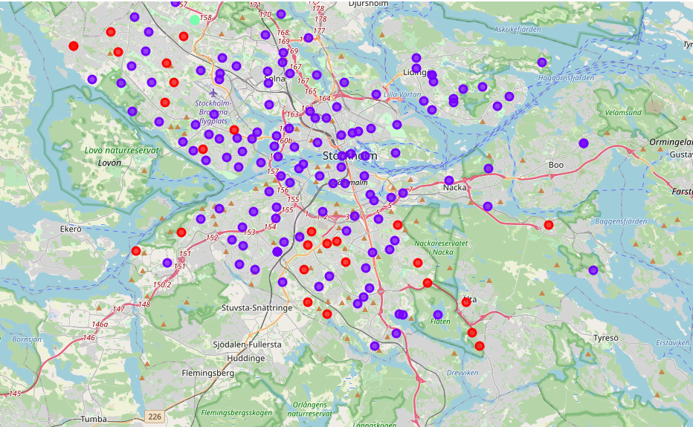
ODNEPLAN

Slide 8
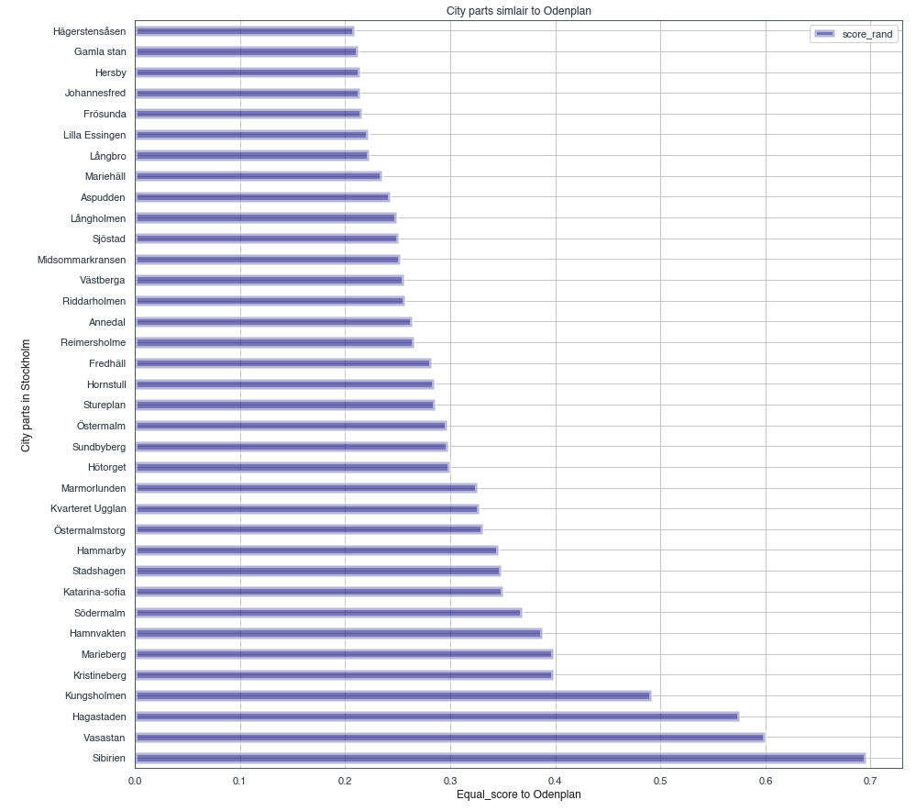

Slide 9
Conclusion
The results from previous graph are very promising and if you ask me who lives in Odenplan, the adjusted rand index is pretty accurate when it comes to similarity of city parts!

